Slide 1
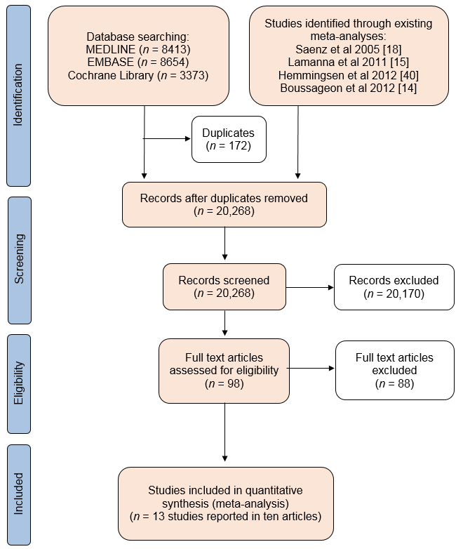
Preferred Reporting Items for Systematic Reviews and Meta-Analyses (PRISMA) flow diagram
Griffin et al (2017) Diabetologia DOI 10.1007/s00125-017-4337-9
© The Authors

Slide 2
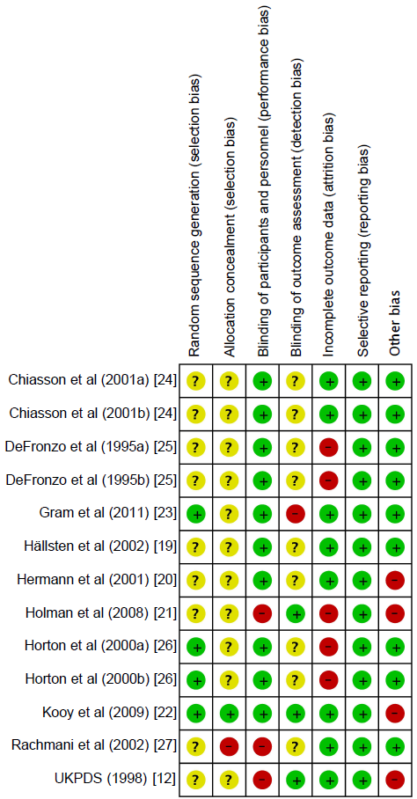



Risk of bias summary
Unclear risk of bias
High risk of bias
Low risk of bias
Griffin et al (2017) Diabetologia DOI 10.1007/s00125-017-4337-9
© The Authors

Slide 3
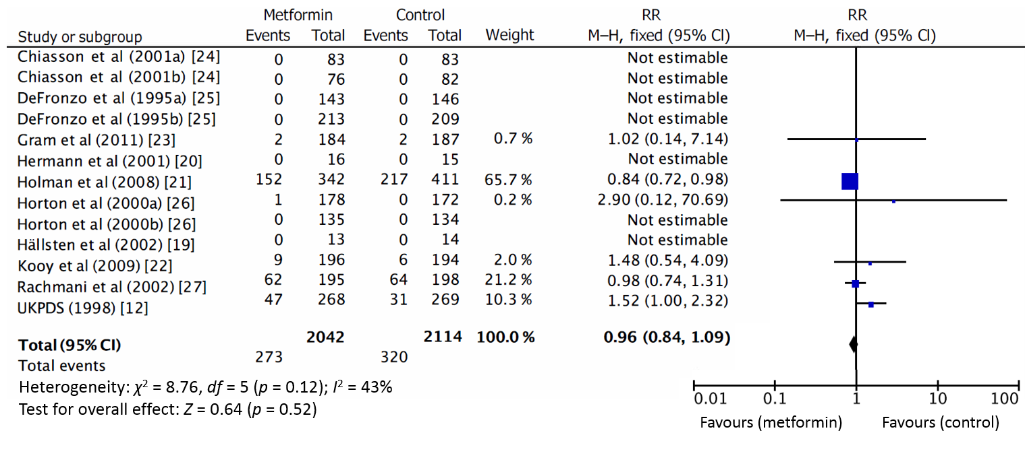
Forest plot showing the effect of metformin on risk of all-cause mortality
Griffin et al (2017) Diabetologia DOI 10.1007/s00125-017-4337-9
© The Authors

Slide 4
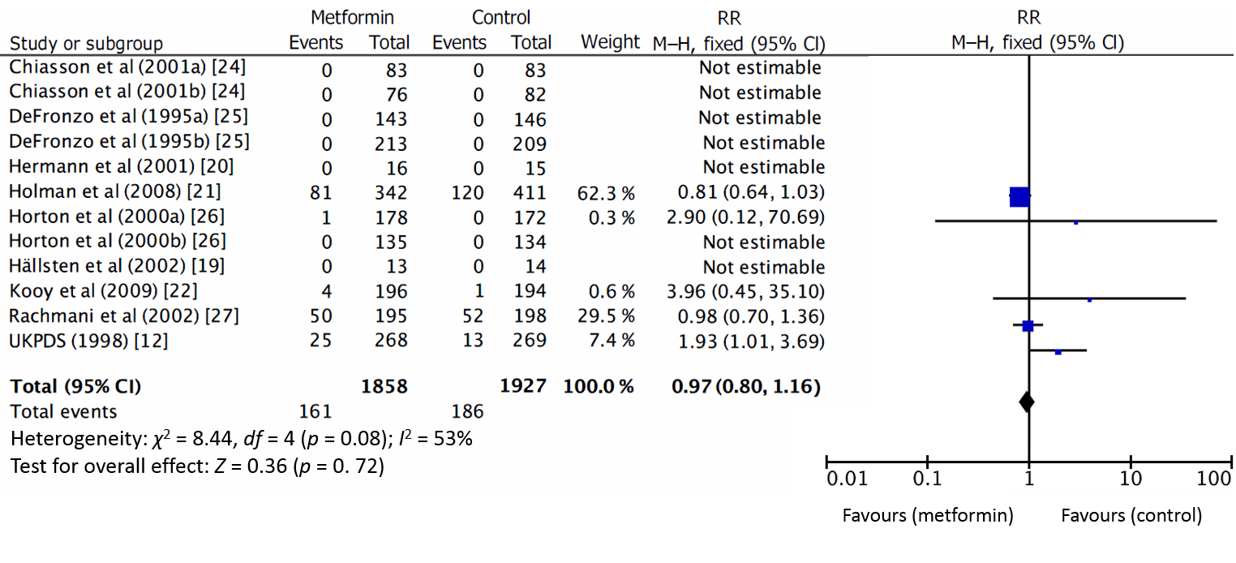
Forest plot showing the effect of metformin on risk of cardiovascular death
Griffin et al (2017) Diabetologia DOI 10.1007/s00125-017-4337-9
© The Authors

Slide 5
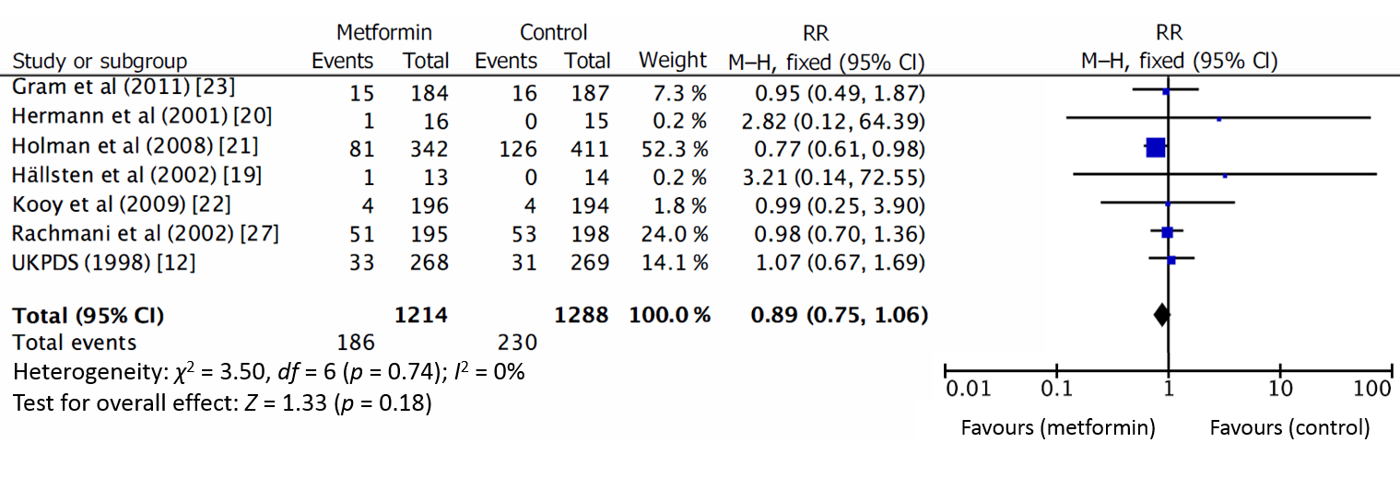
Forest plot showing the effect of metformin on risk of myocardial infarction
Griffin et al (2017) Diabetologia DOI 10.1007/s00125-017-4337-9
© The Authors

Slide 6
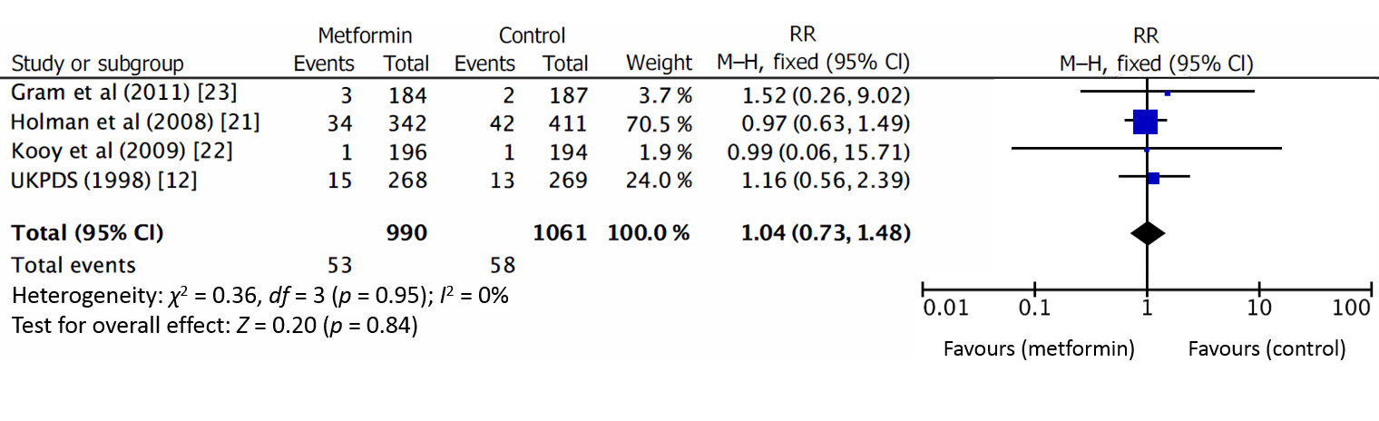
Forest plot showing the effect of metformin on risk of stroke
Griffin et al (2017) Diabetologia DOI 10.1007/s00125-017-4337-9
© The Authors

Slide 7
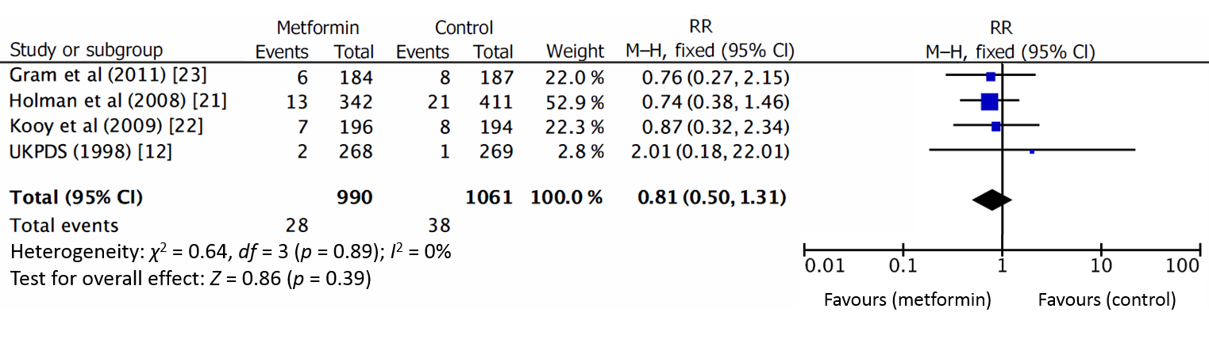
Forest plot showing the effect of metformin on risk of peripheral vascular disease
Griffin et al (2017) Diabetologia DOI 10.1007/s00125-017-4337-9
© The Authors

Slide 8
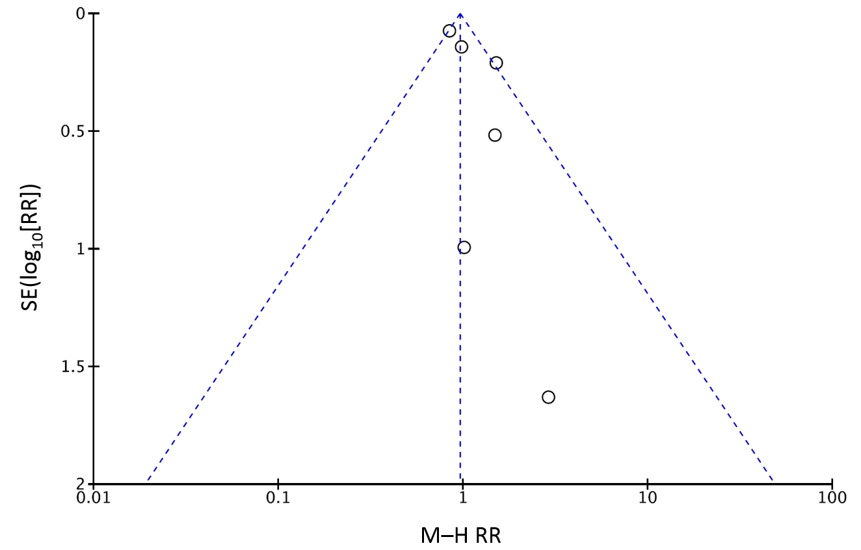
Funnel plot of effect size estimates for all-cause mortality to assess risk of publication bias
Griffin et al (2017) Diabetologia DOI 10.1007/s00125-017-4337-9
© The Authors

