Slide 1
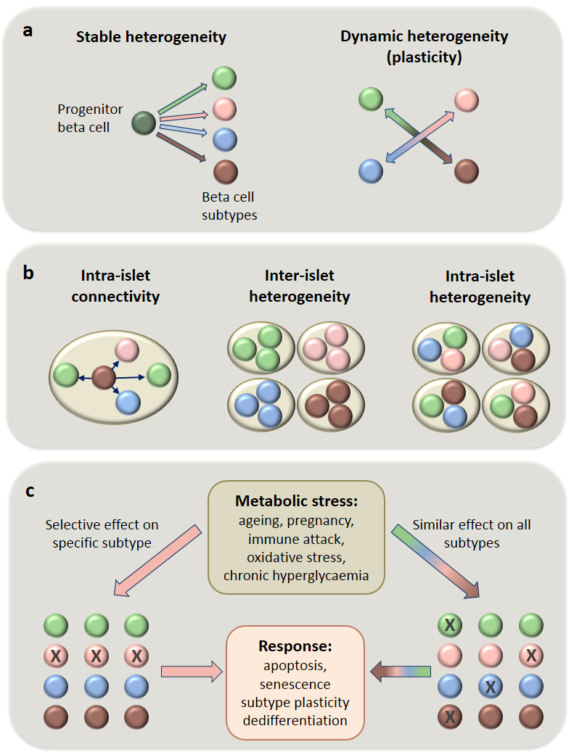
Open questions related to the origin (a), distribution (b) and stress-mediated fate (c) of beta cell subtypes
© Springer-Verlag Berlin Heidelberg 2017
Diabetologia DOI 10.1007/s00125-017-4326-z

