Slide 1
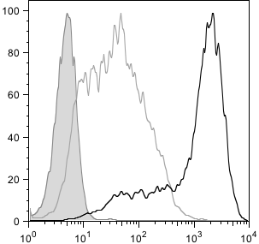

Domingues et al, Supplementary Figure 1
MFI
E6.1 Act 884
E6.1 Rest 35.5
% Max
Isotype control
CD69
Supplementary Figure 1. FACS profile for CD69 cell surface expression in resting and activated (with anti-CD3/CD28) Jurkat E6.1 cells.

Slide 2
Domingues et al, Supplementary Figure 2
3’RACE primer
CMV
Luciferase
hCD5 3’UTR constructs
SV40 pA
3´RACE
Luc-pA1
Luc-pA2
Luc-pA3
NTC
M
bp
2000
1000
500
Supplementary Figure 2. 3´RACE analysis using RNA extracted from Jurkat E6.1 cells transfected with Luc-pA1, Luc-pA2 and Luc-pA3 constructs. The primer used in the 3’RACE PCR (5’-GAGATCGTGGATTACGTCGCCAGTCAAG-3’) hybridizes with the luciferase gene and is indicated by an arrow in the schematic representation of the CD5 3´ UTR luciferase reporter constructs. The gel shows that each construct only originates one transcript corresponding to the 3’UTR of CD5 mRNA isoforms pA1, pA2 and pA3, respectively. NTC: PCR non‑template control; M: Molecular-weight size marker.

Slide 3
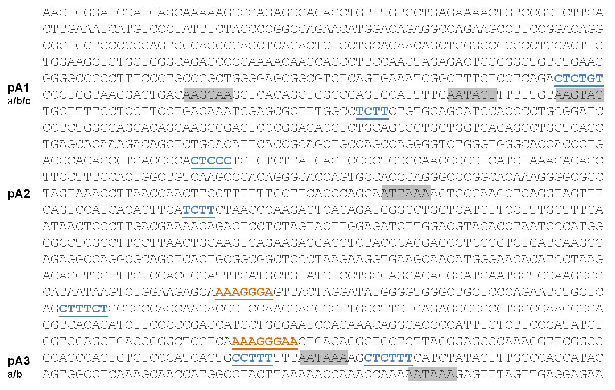
Domingues et al, Supplementary Figure 3
Supplementary Figure 3. In silico analysis of PTBP1 and miR-204/211 predicted binding sites. PTBP1 putative binding sites were predicted in the CD5 3´ UTR sequence using SFmap predictor and are shown in blue. miR-204/211 putative target sites were predicted on TargetScan using CD5 3´UTR and are indicated in orange. PAS are represented in grey boxes.

Slide 4
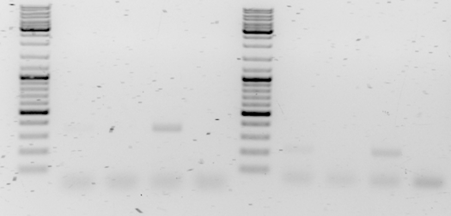
Domingues et al, Supplementary Figure 4
ARRDC2
DCAF4
M
IgG
M
IgG
PTB IP
PTB IP
bp
Input
NTC
Input
NTC
3000
1000
500
400
300
200
100
Supplementary Figure 4. RNA immunoprecipitation (RIP) experiment using an anti-PTBP1 antibody and Jurkat E6.1 extracts. The purified immunoprecipitated RNA was analyzed by RT-PCR (30 cycles) for the arrestin domain containing 2 (ARRDC2) mRNA using the primers ARRDC2-F (5’-ACGTGGACTACGCACTCAAG-3’) and ARRDC2-R (5’-TCCTCAGAGTACAGGGGTGG-3’) and for the DDB1 and CUL4 associated factor 4 (DCAF4) mRNA using the primers DCAF4-F (5’-CTCCCAGCATCACTGTTCGT-3’) and DCAF4-R (5’-CTGGGCCAAGACATCACTGT-3’). NTC: PCR non‑template control; M: Molecular-weight size marker.

Slide 5
Domingues et al, Supplementary Figure 5
Supplementary Figure 5. siRNA PTBP1 mRNA knock-down efficiency in Jurkat cells assessed by qRT-PCR. Error bars show SD and * a p value for Student’s t test lower than 0.05.

Slide 6
Domingues et al, Supplementary Figure 6
Supplementary Figure 6. miR-204 and miR-211 relative expression in resting and activated Jurkat cells quantified by qRT-PCR. Error bars show SD and * a p value for Student’s t test lower than 0.05. n=3 independent experiments.

Slide 7
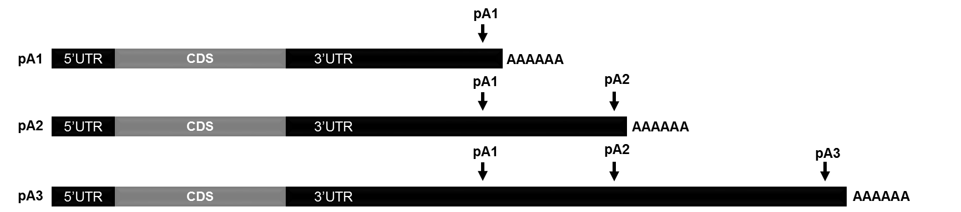
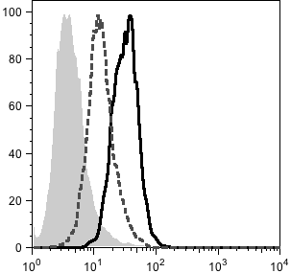

Domingues et al, Supplementary Figure 7
A
Total
pA3
siCD5_pA3
B
C
 | MFI
Isotype control | 4
Scramble | 31
siCD5_pA3 | 13
CD5
Supplementary Figure 7 : CD5 protein expression at the membrane decreases upon pA3 isoform knockdown. Jurkat E6.1 cells were transfected with an siCD5 that only targets the pA3 CD5 isoform (indicated in A) or with Scramble as control. 12 hours after transfection, cells were activated with 5 μg/mL mouse anti-human CD3 mAb (OKT3) and 2 μg/mL mouse anti-human CD28 mAb (CD28.2). B. 48h post-activation, knockdown efficiency of total CD5 mRNA and CD5 pA3 mRNA was quantified by RT-qPCR using specific primer pairs (indicated in A) relative to scramble. C. 48 hours post-activation, cells were stained with a PE-labeled mouse anti-human CD5 or the respective isotype controls and analyzed on a flow cytometer. CDS: coding sequence; MFI:mean fluorescence intensity.

Slide 8
Domingues et al, Supplementary Table S1
Supplementary Table S1 - Primer sequences used in this study
Primer name | Sequence (5´ – 3´)
Total pA Fw | CGGACAACTGGGCTCCTTCT
Total pA Rev | GCCTTGTCGTTGGAGGTGTT
pA2+3 Fw | CTCCCCAACCCCCTCATCTA
pA2+3 Rev | GGTTTACTAGGCGCCCCTTT
pA3 Fw | TCTGATCAAGGGAGAGGCCA
pA3 Rev | AGCATCAAATGGCGTGGAGA
18S Fw | GCAGAATCCACGCCAGTACAAGA
18S Rev | CCCTCTATGGGCCCGAATCTT
PTB Fw | GTTGGGTCGGTTCCTGCTAT
PTB Rev | CCGTCCATGGCACACAGAG
UV-XL pA1 Fw | GTAATACGACTCACTATAGGGGCGGCGTCTCAGTGAAATC
UV-XL pA1 Rev | GATCCGCAGGGGTGGATGCT
UV-XL pA2 Fw | GTAATACGACTCACTATAGGGCTGACCCACAGCGTCACCCC
UV-XL pA2 Rev | CTCTGACTCTTGGGTTAGAA
UV-XL pA3 Fw | GTAATACGACTCACTATAGGGCAGCCAGTGTCTCCCATCA
UV-XL pA3 Rev | TTTTAAGTAGGCCATGGTTGCT
RIP-CD5 Fw | AACTGGGATCCATGAGCAAA
RIP-CD5 Rev | CTGGCCGGGGTAGAAATAGG
RACE-Fw1 | CCCCAAAACAAGCAGCCTTCCAACTA
RACE-Fw2 | TTCTCCTCAGACTCTGTCCCTGGTAA

