Slide 1
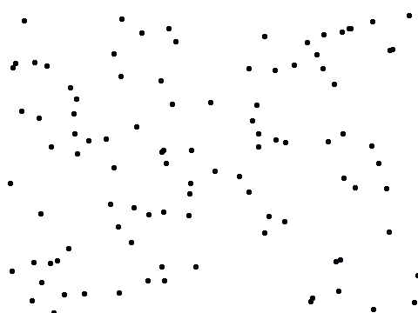
Welcome to the random dots experiment!
Next
Click to navigate through the presentation
presented by the Shadlen Lab

Slide 2
The experiment consists of many short games.
Here we will explain with short videos:
  How to start a game
  How to play the game
  How to understand the feedback
  Where to look
  Why you would lose a point
Next

Slide 3

In the experiment, you will use a tablet and pen
like these to give your responses.
Keep the pen tip in contact with the tablet surface at all time.
Hold the pen the same way you hold a regular pen,
that is, with the dominant hand.
Next

Slide 4
How to start a game
To start a game, move the green cursor to the ‘home position’
(the small gray dot at the bottom of the screen).
Drag the pen on the tablet to move the cursor.
Click here to watch how to start a game

Slide 5
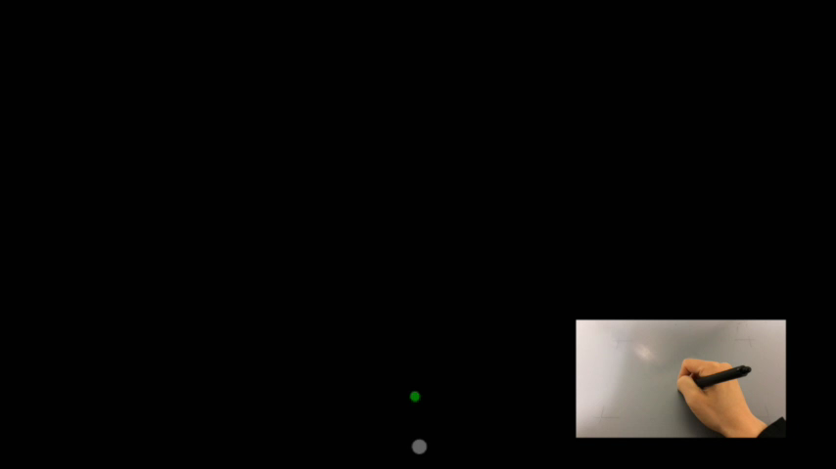
How to start a game
To start a game, move the green cursor to the ‘home position’
(the small gray dot at the bottom of the screen).
Drag the pen on the tablet to move the cursor.
Here is a demo video…

Slide 6
Do you know how to start each game?
Next
If YES, click Next
If NO, watch again by clicking here:

Slide 7
How to play the game
You will see a patch of flickering random dots.
  Think of it like grains of salt that appear and disappear.
  There is wind blowing.
Please decide whether the wind tends to blow the salt to the right or the left.
  Don’t try to track individual dots.
  Rather, try to figure out the average motion of the group.
  Try to make a decision on every trial. Even if you feel you are guessing, give your best guess.
Click here and decide whether the wind tends to blow the salt
to the right or the left

Slide 8
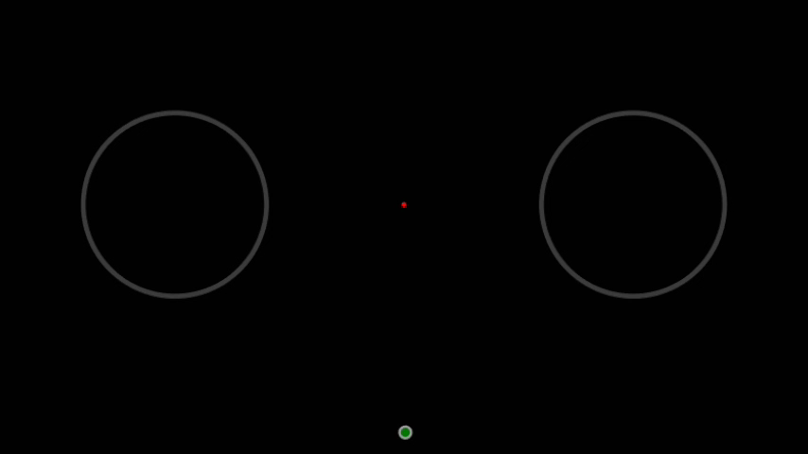
How to play the game
You will see a patch of flickering random dots.
  Think of it like grains of salt that appear and disappear.
  There is wind blowing.
Please decide whether the wind tends to blow the salt to the right or the left.
  Don’t try to track individual dots.
  Rather, try to figure out the average motion of the group.
  Try to make a decision on every trial. Even if you feel you are guessing, give your best guess.
Decide whether the wind tends to blow the salt to the right or the left.

Slide 9
What do you think?
Were the dots, on average, moving to the left or to the right?
Left
Right

Slide 10
This is incorrect!
Try again

Slide 11
This is correct!
Next

Slide 12
How to report your decision
To indicate your choice about the direction of the motion:
  Wait until you hear a beep.
  Move the cursor from the home position to the left or right circle.
    If the motion direction was to the left, choose the left circle, and vice versa.
    The circle you chose will brighten up when the cursor enters.
  Stay within the circle until it disappears.
Click here to watch how to report your decision

Slide 13
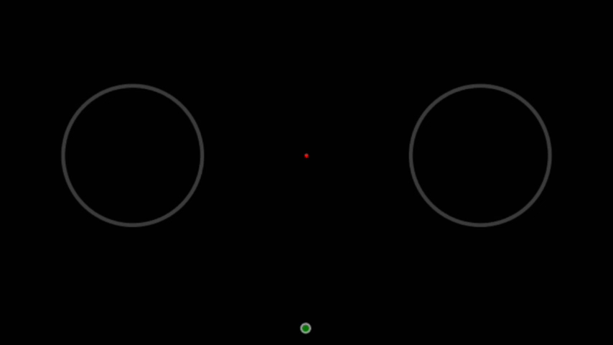
How to report your decision
To indicate your choice about the direction of the motion:
  Wait until you hear a beep.
  Move the cursor from the home position to the left or right circle.
    If the motion direction was to the left, choose the left circle, and vice versa.
    The circle you chose will brighten up when the cursor enters.
  Stay within the circle until it disappears.
Here is a demo video…

Slide 14
Do you know how to report the direction of motion?
Next
If YES, click Next
If NO, watch again by clicking here:

Slide 15
Feedback
You earn one point when your motion direction choice was correct.
You lose one point otherwise.
Your score starts from 50.
You will also receive audio feedback.
Click here for an example of a correct answer

Slide 16
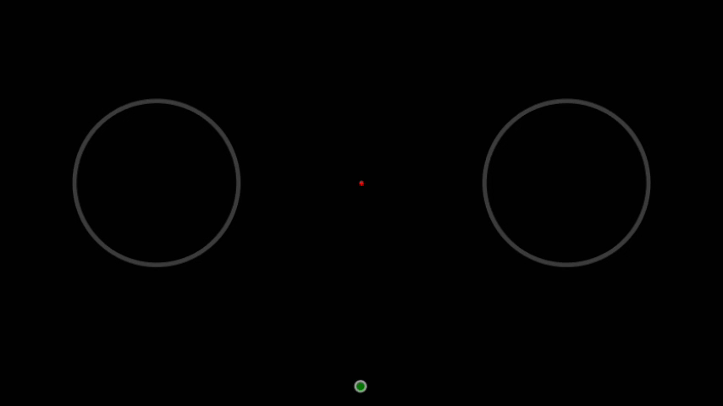
Feedback
You earn one point when your motion direction choice was correct.
You lose one point otherwise.
Your score starts from 50.
You will also receive audio feedback.
Here is a demo video…

Slide 17
Feedback
You earn one point when your motion direction choice was correct.
You lose one point otherwise.
Your score starts from 50.
You will also receive audio feedback.
Click here for an example of a wrong answer

Slide 18
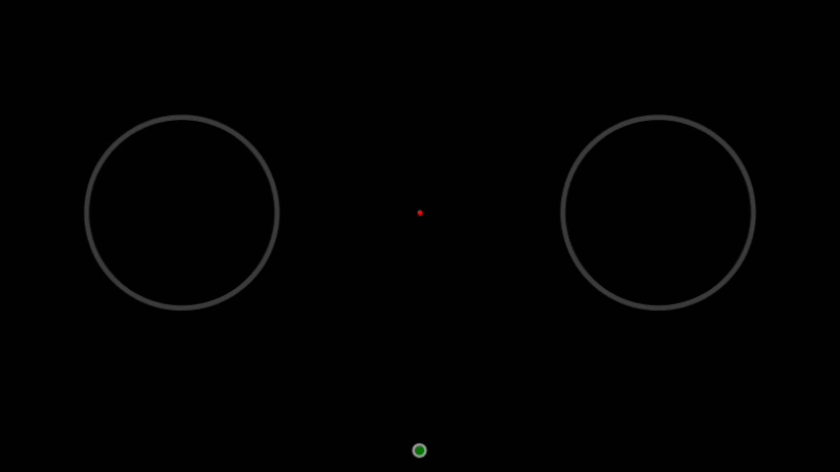
Feedback
You earn one point when your motion direction choice was correct.
You lose one point otherwise.
Your score starts from 50.
You will also receive audio feedback.
Here is a demo video…

Slide 19
Do you know what the feedback means?
Next
If YES, click Next
If NO, watch again by clicking here:

Slide 20
Where to look
We track the position of your eyes during the experiment.
When the pen enters the home position, a small red spot appears at the center of the screen.
Look directly at the red spot the whole time it is present.
The spot brightens slightly when you look at it.
Click here and try looking at the red spot
the whole time it is present

Slide 21

Where to look
We track the position of your eyes during the experiment.
When the pen enters the home position, a small red spot appears at the center of the screen.
Look directly at the red spot the whole time it is present.
The spot brightens slightly when you look at it.
Try looking at the red spot the whole time it is present.
Look here

Slide 22
Did you look at the red spot the whole time it was present?
Next
If YES, click Next
If NO, watch again by clicking here:

Slide 23
Why would you lose a point?
If you do not follow the instructions you lose one point and hear a warning sound.
Failures include:
  Leaving the home position before the beep
  Leaving the chosen circle before it disappears
  Entering the chosen circle too slowly
  Blinking or looking elsewhere while the red spot is present
Click here for an example of
leaving the home position before the beep

Slide 24
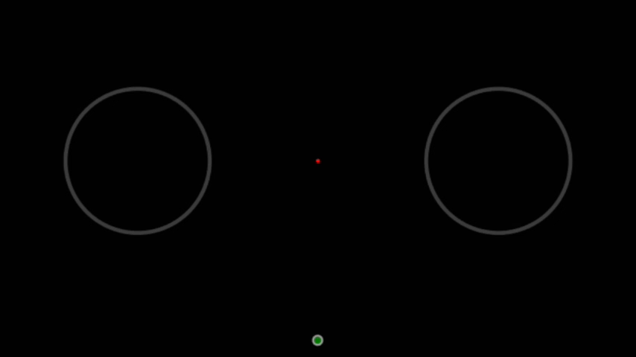
Why would you lose a point?
If you do not follow the instructions you lose one point and hear a warning sound.
Failures include:
  Leaving the home position before the beep
  Leaving the chosen circle before it disappears
  Entering the chosen circle too slowly
  Blinking or looking elsewhere while the red spot is present
Here is an example of leaving the home position before the beep…

Slide 25
Why would you lose a point?
If you do not follow the instructions you lose one point and hear a warning sound.
Failures include:
  Leaving the home position before the beep
  Leaving the chosen circle before it disappears
  Entering the chosen circle too slowly
  Blinking or looking elsewhere while the red spot is present
Click here for an example of
leaving the chosen circle before it disappears

Slide 26
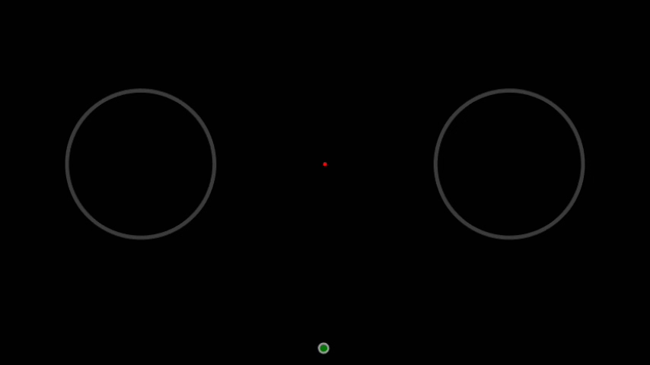
Why would you lose a point?
If you do not follow the instructions you lose one point and hear a warning sound.
Failures include:
  Leaving the home position before the beep
  Leaving the chosen circle before it disappears
  Entering the chosen circle too slowly
  Blinking or looking elsewhere while the red spot is present
Here is an example of leaving the chosen circle before it disappears…

Slide 27
Why would you lose a point?
If you do not follow the instructions you lose one point and hear a warning sound.
Failures include:
  Leaving the home position before the beep
  Leaving the chosen circle before it disappears
  Entering the chosen circle too slowly
  Blinking or looking elsewhere while the red spot is present
Click here for an example of
entering the chosen circle too slowly

Slide 28
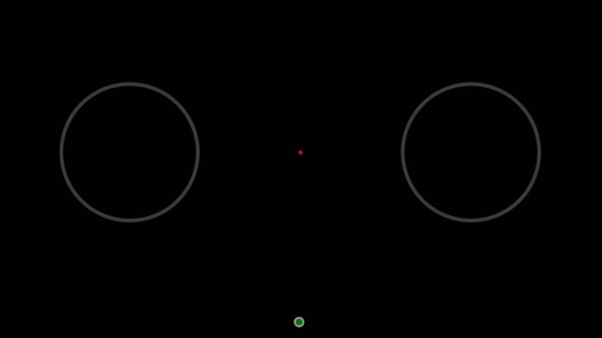
Why would you lose a point?
If you do not follow the instructions you lose one point and hear a warning sound.
Failures include:
  Leaving the home position before the beep
  Leaving the chosen circle before it disappears
  Entering the chosen circle too slowly
  Blinking or looking elsewhere while the red spot is present
Here is an example of entering the chosen circle too slowly…

Slide 29
That’s all for this experiment!
This was a lot of information. It is crucial that you understand the instructions. If something is not clear you can either …
watch a section again to review:
        How to start a game
        How to play the game
        How to understand the feedback
        Where to look
        Why you would lose a point
  or ask the assistant!
Only if everything is clear, press
Done

Slide 30
END
Thank you for your participation!

Slide 32
Welcome to the random dots experiment!
Next
Click to navigate through the presentation
presented by the Shadlen Lab

Slide 33
In this session, you will practice reporting time, using a “clock.”
  You will hear a high-pitched beep at a random time.
  You will be asked to report the time you heard the beep.
Next, we will explain:
  How to report the time you heard the beep.
  How to understand the feedback
  Where to look
  Why you would lose a point
Next

Slide 34
What time do you need to report?
The time you first saw the small dots
The time you left the home position
The time you heard the beep
The time you entered the circle
Any of the above

Slide 35
This is incorrect!
Try again

Slide 36
This is correct!
Next

Slide 37
Memorizing the time of the beep
A clock hand will revolve at the center of the moving dots.
You will hear a beep at a random time.
Please try to remember the exact position of the clock hand
at the moment you heard a beep.
To help you remember the time, there is a small tick mark on the clock that indicates the position when the clock first appeared.
Click here and try to remember
the exact position of the clock hand
at the moment you heard the beep

Slide 38
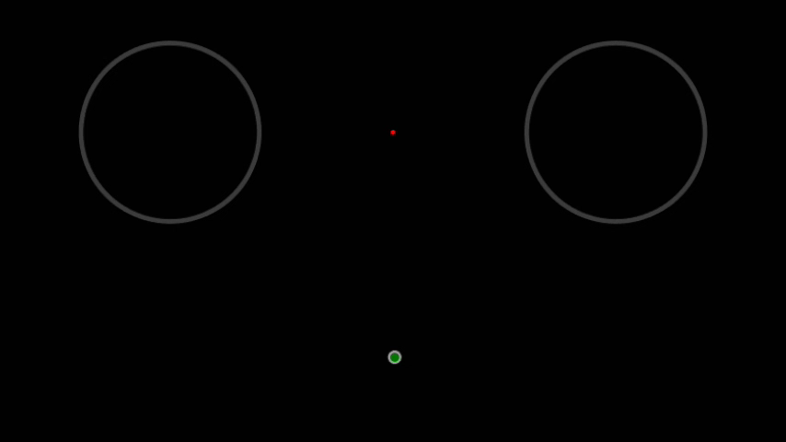
Memorizing the time of the beep
A clock hand will revolve at the center of the moving dots.
You will hear a beep at a random time.
Please try to remember the exact position of the clock hand
at the moment you heard a beep.
To help you remember the time, there is a small tick mark on the clock that indicates the position when the clock first appeared.
Try to remember the position of the clock hand when you heard the beep.
The clock first appeared here

Slide 39
Which is closest to the clock hand’s position at the moment you heard the beep?
The clock first appeared here
If you do not remember, replay by clicking here:

Slide 40
This is incorrect!
Try again

Slide 41
This is correct!
Next

Slide 42
Reporting the time of the beep
After the clock completes a full revolution, please drag the pen downward.
  This will move the clock hand around.
  Make sure the pen is in contact with the tablet surface at all time.
Move the pen until the clock hand marks the position it was in
when you heard the beep.
There will be a keypad with three buttons.
Press the center button to confirm the position.
Click here to watch how to report the time of the beep

Slide 43
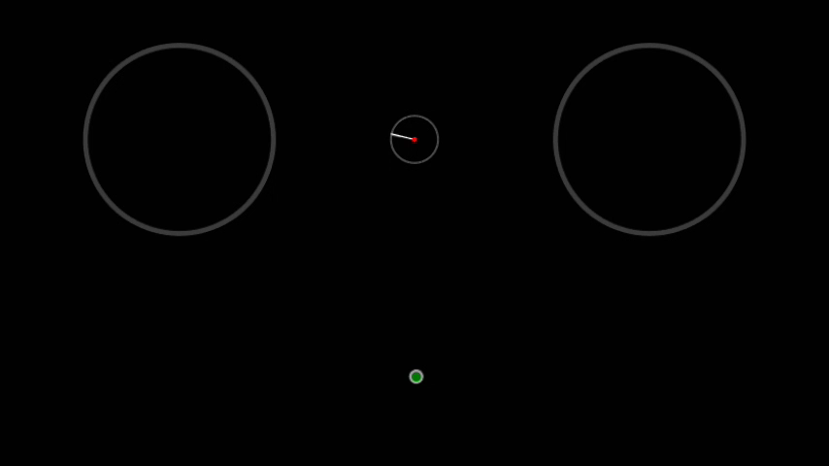
Reporting the time of the beep
After the clock completes a full revolution, please drag the pen downward.
  This will move the clock hand around.
  Make sure the pen is in contact with the tablet surface at all time.
Move the pen until the clock hand marks the position it was in
when you heard the beep.
There will be a keypad with three buttons.
Press the center button to confirm the position.
The clock first appeared here

Slide 44
Do you know how to report the time of the beep?
Next
If YES, click Next
If NO, watch again by clicking here:

Slide 45
Feedback
You will receive feedback about the accuracy of your time report.
Unlike the previous experiment…
  You earn one point when your time report is sufficiently accurate.
  You lose one point otherwise.
  You will see a red line that shows the actual time of the beep.
Click here for an example of a correct answer

Slide 46
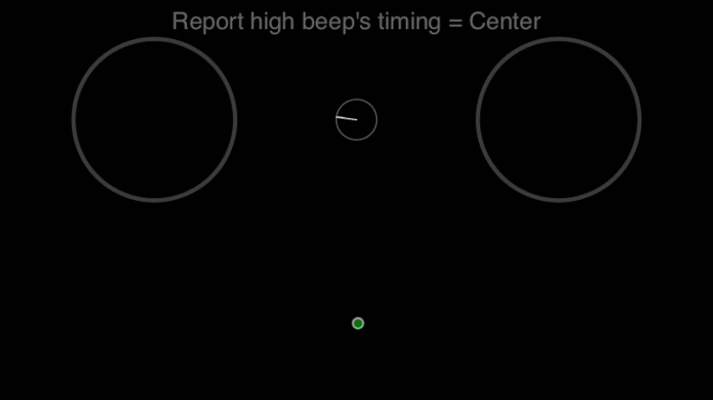
Feedback
You will receive feedback about the accuracy of your time report.
Unlike the previous experiment…
  You earn one point when your time report is sufficiently accurate.
  You lose one point otherwise.
  You will see a red line that shows the actual time of the beep.
Red line indicating correct time

Slide 47
Feedback
You will receive feedback about the accuracy of your time report.
Unlike the previous experiment…
  You earn one point when your time report is sufficiently accurate.
  You lose one point otherwise.
  You will see a red line that shows the actual time of the beep.
Click here for an example of a wrong answer

Slide 48
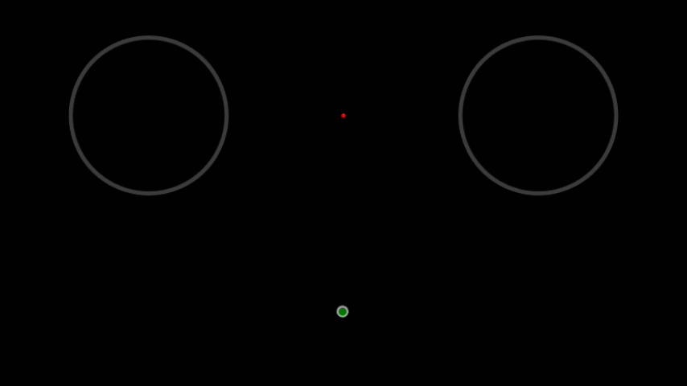
Feedback
You will receive feedback about the accuracy of your time report.
Unlike the previous experiment…
  You earn one point when your time report is sufficiently accurate.
  You lose one point otherwise.
  You will see a red line that shows the actual time of the beep.

Slide 49
Do you understand the feedback in the experiment?
Next
If YES, click Next
If NO, watch again by clicking here:

Slide 50
Where to look
As in the previous experiment, we track the position of your eyes.
When the pen enters the home position, a small red spot appears at the center of the screen.
Look directly at the red spot the whole time it is present.
The spot brightens slightly when you look at it.
Click here and try looking at the red spot
the whole time it is present

Slide 51

Where to look
As in the previous experiment, we track the position of your eyes.
When the pen enters the home position, a small red spot appears at the center of the screen.
Look directly at the red spot the whole time it is present.
The spot brightens slightly when you look at it.
Try looking at the red spot the whole time it is present.
Look here

Slide 52
Did you look at the red spot the whole time it was present?
Next
If YES, click Next
If NO, try again by clicking here:

Slide 53
Why would you lose a point?
If you do not follow the instructions you lose one point and hear a warning sound.
Failures include:
  Leaving the home position before the clock completes a full revolution
  Blinking or looking elsewhere while the red spot is present
Click here for an example of leaving the home position
before the clock has completed a full revolution

Slide 54

Why would you lose a point?
If you do not follow the instructions you lose one point and hear a warning sound.
Failures include:
  Leaving the home position before the clock completes a full revolution
  Blinking or looking elsewhere while the red spot is present
Here is an example of leaving the home position before the clock has completed a full revolution…

Slide 55
That’s all for this experiment!
This was a lot of information. It is crucial that you understand the instructions. If something is not clear you can either …
watch a section again to review:
        How to report the time of the beep
        How to understand the feedback
        Where to look
        Why you would lose a point
or ask the assistant!
Only if everything is clear, press
Done

Slide 56
END
Thank you for your participation!

Slide 58
Welcome to the random dots experiment!
Next
Click to navigate through the presentation
presented by the Shadlen Lab

Slide 59

This session is the same as the previous one except the following:
  You will see a set of flickering dots, but you should ignore it.
  You will then choose a circle.
    Pick one randomly, after the clock completes a full revolution.
    Then report the time of the beep.
Clock
(wait until one full revolution)
Dots
(should be ignored)
Beep
(remember time)
Choose
a circle
randomly
Report
the time
of the beep
Time
Next

Slide 60
Reporting the time of the beep
Flickering dots will appear, but ignore them in this session.
You will hear a high-pitched beep at a random time.
After the clock completes a full revolution, choose either circle.
Report the time you heard the beep by dragging the pen downward.
The feedback and score depends only on the accuracy of your time report.
Click here to watch an example trial

Slide 61

Reporting the time of the beep
Flickering dots will appear, but ignore them in this session.
You will hear a high-pitched beep at a random time.
After the clock completes a full revolution, choose either circle.
Report the time you heard the beep by dragging the pen downward.
The feedback and score depends only on the accuracy of your time report.

Slide 62
How should you choose a circle?
According to the direction of moving dots
Randomly, ignoring the moving dots

Slide 63
This is incorrect!
Try again

Slide 64
This is correct!
Next

Slide 65
What time do you need to report?
The time you left the home position
The time the small dots disappeared
The time you heard the beep
The time you entered the circle
Any of the above

Slide 66
This is incorrect!
Try again

Slide 67
This is correct!
Next

Slide 68
That’s all for this experiment!
This was a lot of information. It is crucial that you understand the instructions. If something is not clear you can either …
watch a section again to review:
        How to report the time of the beep
or ask the assistant!
Only if everything is clear, press
Done

Slide 69
END
Thank you for your participation!

Slide 71
Welcome to the random dots experiment!
Next
Click to navigate through the presentation
presented by the Shadlen Lab

Slide 72
This session is the same as the previous one except the following:
  You will hear a low-pitched beep, but you should ignore it.
  Please report the time of the high-pitched beep.
Clock
(wait until one full revolution)
Dots
(should be ignored)
Low-pitched
Beep
(should be ignored)
High-pitched
Beep
(remember time)
Report
the time
of the
high-pitched
beep
Choose
a circle
randomly
Time
Next

Slide 73
Reporting the time of the beep
Flickering dots will appear, but ignore them in this session.
You will hear a high-pitched beep and a low-pitched beep at random times.
After the clock completes a full revolution, choose either circle.
Report the time you heard the high-pitched beep by dragging the pen downward.
The feedback and score depends only on the accuracy of your time report.
Click here to watch an example trial

Slide 74

Reporting the time of the beep
Flickering dots will appear, but ignore them in this session.
You will hear a high-pitched beep and a low-pitched beep at random times.
After the clock completes a full revolution, choose either circle.
Report the time you heard the high-pitched beep by dragging the pen downward.
The feedback and score depends only on the accuracy of your time report.

Slide 75
How should you choose a circle?
According to flickering dots’ motion direction
Either one, ignoring the flickering dots

Slide 76
This is incorrect!
Try again

Slide 77
This is correct!
Next

Slide 78
What time do you need to report?
The time you left the home position
The time the small dots disappeared
The time you heard the low-pitched beep
The time you heard the high-pitched beep
Any of the above

Slide 79
This is incorrect!
Try again

Slide 80
This is correct!
Next

Slide 81
That’s all for this experiment!
This was a lot of information. It is crucial that you understand the instructions. If something is not clear you can either …
watch a section again to review:
        How to report the time of the beep
or ask the assistant!
Only if everything is clear, press
Done

Slide 82
END
Thank you for your participation!

Slide 84
Welcome to the random dots experiment!
Next
Click to navigate through the presentation
presented by the Shadlen Lab

Slide 85
In this experiment,
you are asked to judge the direction of random dot motion
AND report the time you made your decision.
  After a beep, but before the clock completes a full revolution, move the cursor into a circle to report the direction of motion.
  Then drag the pen downward to report the time you made your decision.
Clock
(stops when the cursor enters a circle)
Dots
(judge direction)
Beep
Move the cursor
into a circle
according to
the direction of motion
Report the time
you decided on
the direction of motion
in your mind
Time
Next

Slide 86
Next, we will explain:
  How to report the time you made your decision
  How to understand the feedback
  Where to look
  Why you would lose a point
Next

Slide 87
By the time you made your decision, we mean
the time you judged that the motion is to the left or right in your mind.
  This is not the time when the cursor left the home position.
  This is not the time when the cursor entered the left or right circle.
  This is not the time when you heard a beep.
Next

Slide 88
What time do you need to report?
The time you heard the beep
The time you left the home position
The time you entered the circle
The time you made the decision in your mind
Any of the above

Slide 89
This is incorrect!
Try again

Slide 90
This is correct!
Next

Slide 91
Memorizing the time of your decision
A clock hand will revolve at the center of the moving dots.
Please try to remember the exact position of the clock hand
at the moment you decided – in your mind – whether the motion is to the left or to the right.
To help you remember the decision time, there is a small tick mark on the clock that indicates the position of the clock hand when the dot pattern started.
Click here and try to remember
the exact position of the clock hand
at the moment you decided – in your mind – on the direction of motion

Slide 92
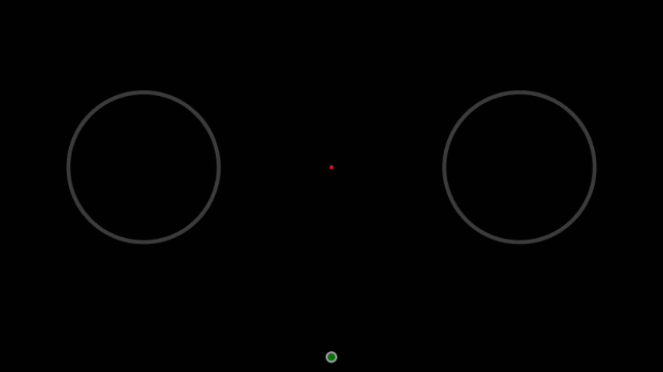
Memorizing the time of your decision
A clock hand will revolve at the center of the moving dots.
Please try to remember the exact position of the clock hand
at the moment you decided – in your mind – whether the motion is to the left or to the right.
To help you remember the decision time, there is a small tick mark on the clock that indicates the position of the clock hand when the dot pattern started.
Try to remember the position of the clock hand when you decided on the direction of motion.
The dot pattern started here

Slide 93
Which is closest to the clock hand’s position at the moment you decided on the direction of motion?
The dot pattern started here
If you do not remember, replay by clicking here:

Slide 94
Great. Now let’s learn how to report the decision time.
Next

Slide 95
Reporting the time of your decision
After making your motion direction choice, please drag the pen downwards.
  This will move the clock hand around.
  Make sure the pen is in contact with the tablet surface at all time.
Move the pen until the clock hand marks the position it was in
when you made the motion decision.
There will be a keypad with three buttons.
Press the center button to confirm the position.
Click here to watch how to report the time of your decision

Slide 96

Reporting the time of your decision
After making your motion direction choice, please drag the pen downwards.
  This will move the clock hand around.
  Make sure the pen is in contact with the tablet surface at all time.
Move the pen until the clock hand marks the position it was in
when you made the motion decision.
There will be a keypad with three buttons.
Press the center button to confirm the position.
Here is a demo video…
The dot pattern started here

Slide 97

You also have two other options:
If you don’t know your decision time
(for example, you forgot to notice the clock
hand position when you made the decision)
→ Press the top button.
2) If you didn’t make a decision
(for example, your choice about dot motion was
a random guess)
→ Press the bottom button.
  You don’t need to memorize the buttons. As you see in the example movies,
  instructions will appear on-screen during the experiment.
  Use the middle finger of your nondominant hand (the one not holding the pen)
  to press the button.
Next

Slide 98
Do you know how to report the time of your decision?
Next
If YES, click Next
If NO, watch again by clicking here:

Slide 99
Feedback
You will receive feedback about your left/right motion choice after you indicate your decision time.
You earn one point when your motion direction choice was correct.
You lose one point otherwise.
Your score starts from 50.
You will also receive audio feedback.
Click here for an example of a correct answer

Slide 100
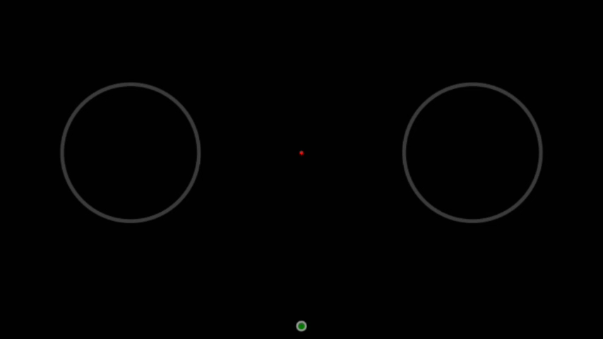
Feedback
You will receive feedback about your left/right motion choice after you indicate your decision time.
You earn one point when your motion direction choice was correct.
You lose one point otherwise.
Your score starts from 50.
You will also receive audio feedback.
Here is a demo video…

Slide 101
Feedback
You will receive feedback about your left/right motion choice after you indicate your decision time.
You earn one point when your motion direction choice was correct.
You lose one point otherwise.
Your score starts from 50.
You will also receive audio feedback.
Click here for an example of a wrong answer

Slide 102
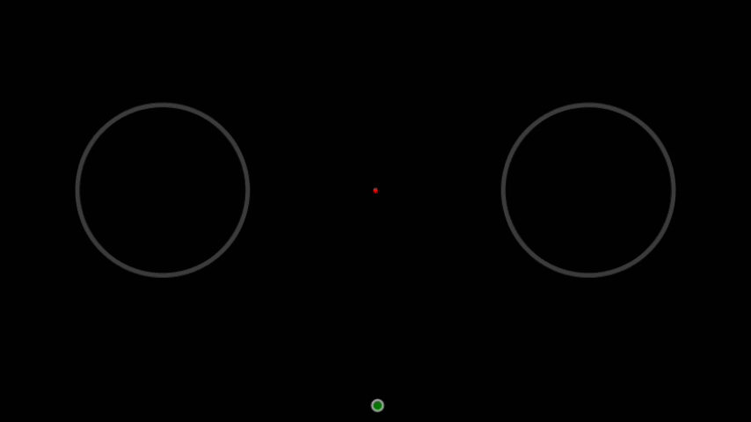
Feedback
You will receive feedback about your left/right motion choice after you indicate your decision time.
You earn one point when your motion direction choice was correct.
You lose one point otherwise.
Your score starts from 50.
You will also receive audio feedback.
Here is a demo video…

Slide 103
Again, the feedback is NOT about your reported decision time.
It is only about your left/right choice.
Next

Slide 104
Which button gives you the best score?
Top
“Don’t remember decision time”
Center
“Report decision time”
Bottom
“Didn’t decide”
None of them. The score is only about the left/right choice

Slide 105
This is incorrect!
Try again

Slide 106
This is correct!
Next

Slide 107
Do you understand the feedback in the experiment?
Next
If YES, click Next
If NO, watch again by clicking here:

Slide 108
Where to look
As in the previous experiment, we track the position of your eyes.
When the pen enters the home position, a small red spot appears at the center of the screen.
Look directly at the red spot the whole time it is present.
The spot brightens slightly when you look at it.
Click here and try looking at the red spot
the whole time it is present

Slide 109

Where to look
As in the previous experiment, we track the position of your eyes.
When the pen enters the home position, a small red spot appears at the center of the screen.
Look directly at the red spot the whole time it is present.
The spot brightens slightly when you look at it.
Try looking at the red spot the whole time it is present.
Look here

Slide 110
Did you look at the red spot the whole time it was present?
Next
If YES, click Next
If NO, try again by clicking here:

Slide 111
Why would you lose a point?
If you do not follow the instructions you lose one point and hear a warning sound.
Note that in this experiment, you should leave the home position
  After the beep,
  Before the clock completes a full revolution.
Failures include:
  Leaving the home position before the beep
  Leaving the chosen circle before it disappears
  Entering the chosen circle after the clock has completed a full revolution
  Blinking or looking elsewhere while the red spot is present
Click here for an example of entering the chosen circle
after the clock has completed a full revolution

Slide 112
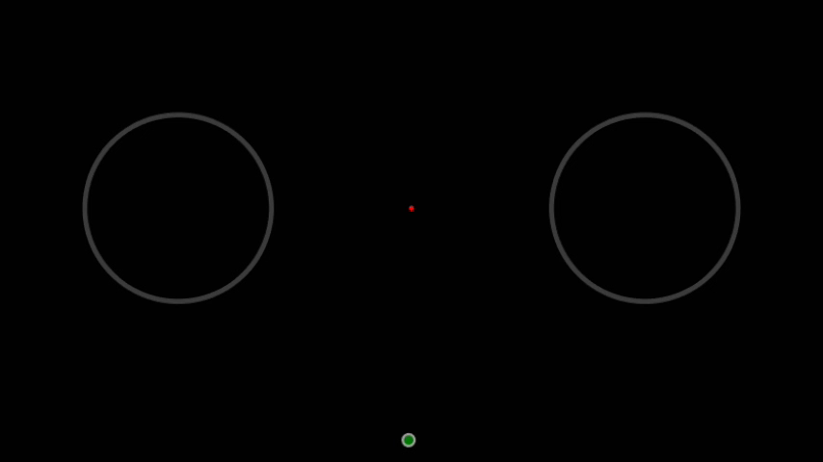
Why would you lose a point?
If you do not follow the instructions you lose one point and hear a warning sound.
Note that in this experiment, you should leave the home position
  After the beep,
  Before the clock completes a full revolution.
Failures include:
  Leaving the home position before the beep
  Leaving the chosen circle before it disappears
  Entering the chosen circle after the clock has completed a full revolution
  Blinking or looking elsewhere while the red spot is present
Here is an example of entering the chosen circle after the clock has completed a full revolution…

Slide 113
That’s all for this experiment!
This was a lot of information. It is crucial that you understand the instructions. If something is not clear you can either …
watch a section again to review:
        How to report the time you made the decision
        How to understand the feedback
        Where to look
        Why you would lose a point
or ask the assistant!
Only if everything is clear, press
Done

Slide 114
END
Thank you for your participation!

Slide 116
Welcome to the random dots experiment!
Next
Click to navigate through the presentation
presented by the Shadlen Lab

Slide 117
The experiment is different from the previous one in one aspect.
  Now you move the cursor to the left or right circle
  as soon as you are ready with an answer
  without waiting for the beep.
Next, we will explain:
  How to report your decision
  Why you would lose a point
Next

Slide 118
How to report your decision
Indicate your choice about the motion direction of the dots
as soon as you are ready with an answer without waiting for a beep (there will be no beep).
Try to respond as fast and correctly as possible.
The dot pattern will disappear as soon as you leave the home position.
Click here for an example response

Slide 119
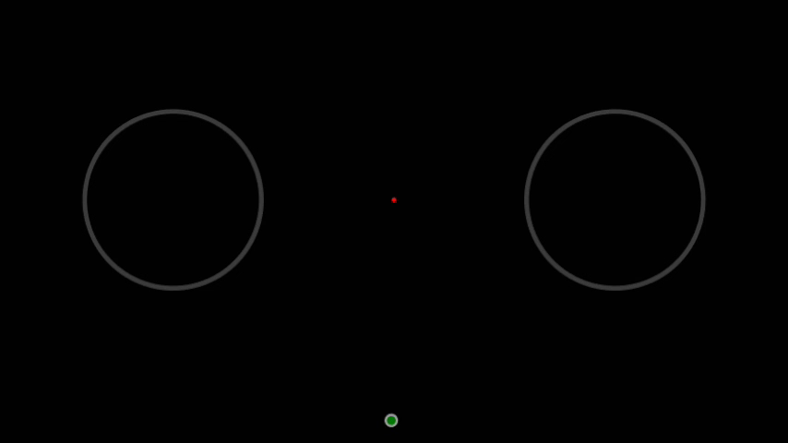
How to report your decision
Indicate your choice about the motion direction of the dots
as soon as you are ready with an answer without waiting for a beep (there will be no beep).
Try to respond as fast and correctly as possible.
The dot pattern will disappear as soon as you leave the home position.
Here is a demo video…

Slide 120
When do you move the cursor to the left or right circle?
After you hear a beep
As soon as you are ready with an answer

Slide 121
This is incorrect!
Try again

Slide 122
This is correct!
Next

Slide 123
Why would you lose a point?
If you do not follow the instructions you lose one point and hear a warning sound.
Failures include:
  Leaving the home position before the dot pattern appears
  Leaving the chosen circle before it disappears
  Entering the chosen circle after the clock has completed a full revolution
  Blinking or looking elsewhere while the red spot is present
Click here for an example of
leaving the home position before the dot pattern appears

Slide 124

Why would you lose a point?
If you do not follow the instructions you lose one point and hear a warning sound.
Failures include:
  Leaving the home position before the dot pattern appears
  Leaving the chosen circle before it disappears
  Entering the chosen circle after the clock has completed a full revolution
  Blinking or looking elsewhere while the red spot is present
Here is an example of leaving the home position before the dot pattern appears…

Slide 125
Why would you lose a point?
If you do not follow the instructions you lose one point and hear a warning sound.
Failures include:
  Leaving the home position before the dot pattern appears
  Leaving the chosen circle before it disappears
  Entering the chosen circle after the clock has completed a full revolution
  Blinking or looking elsewhere while the red spot is present
Click here for an example of entering the chosen circle
after the clock has completed a full revolution

Slide 126
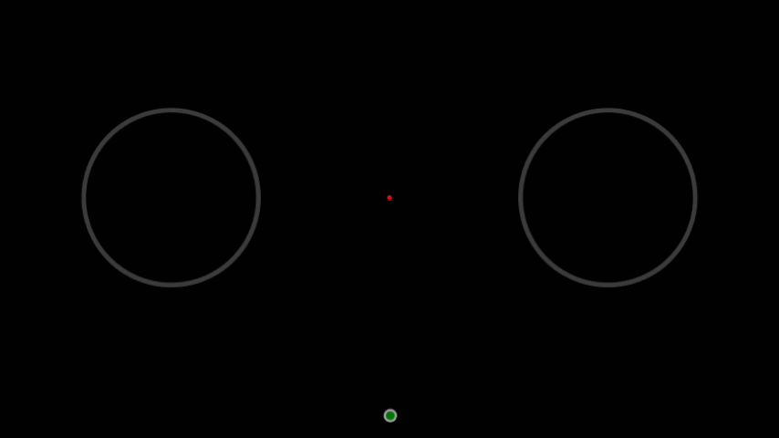
Why would you lose a point?
If you do not follow the instructions you lose one point and hear a warning sound.
Failures include:
  Leaving the home position before the dot pattern appears
  Leaving the chosen circle before it disappears
  Entering the chosen circle after the clock has completed a full revolution
  Blinking or looking elsewhere while the red spot is present
Here is an example of entering the chosen circle after the clock has completed a full revolution…

Slide 127
That’s all for this experiment!
This was a lot of information. It is crucial that you understand the instructions. If something is not clear you can either …
watch a section again to review:
        How to report your decision
        Why you would lose a point
or ask the assistant!
Only if everything is clear, press
Done

Slide 128
END
Thank you for your participation!

