Slide 1
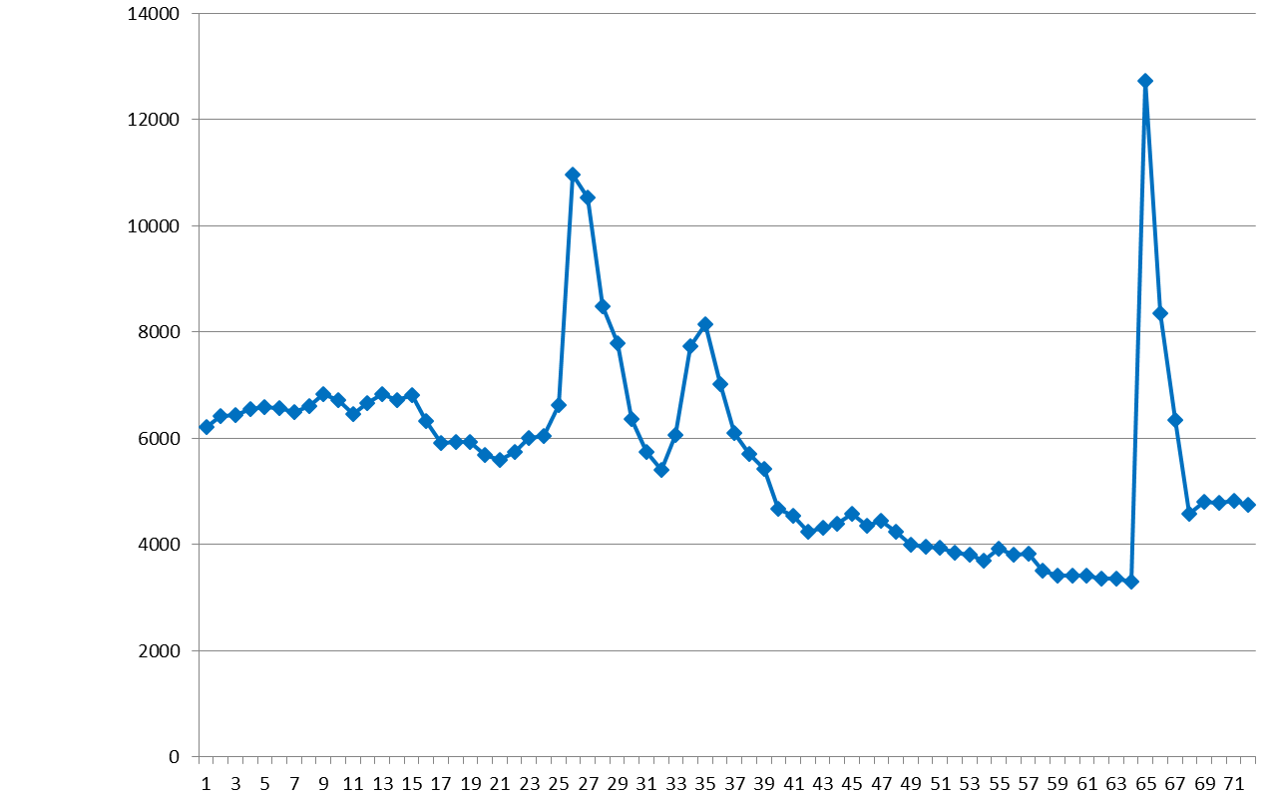
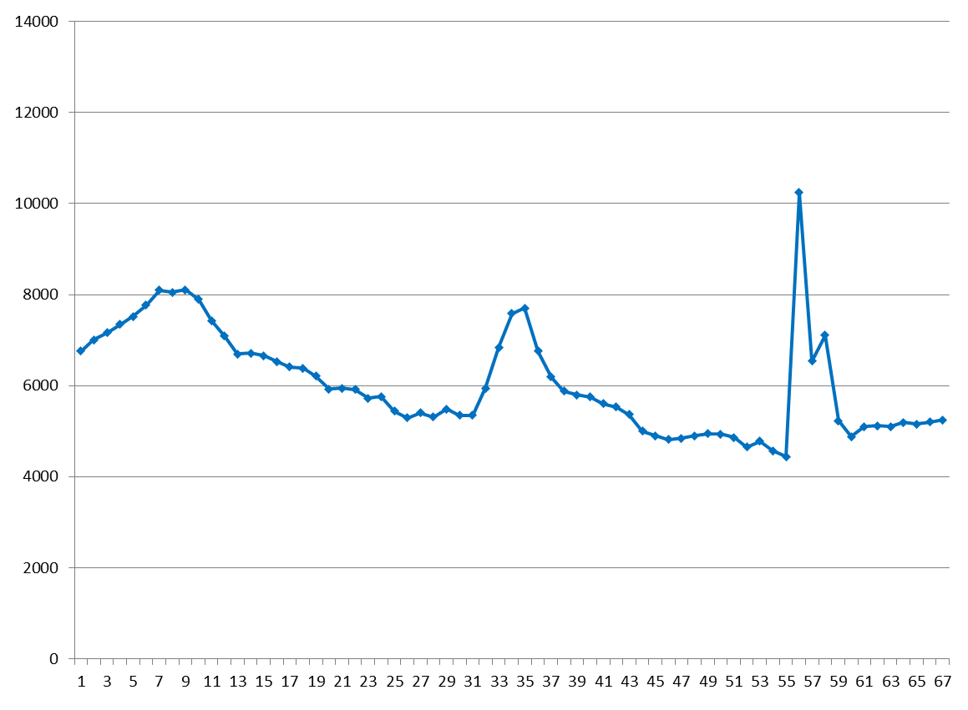
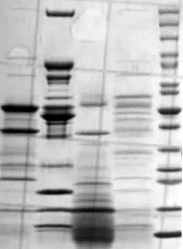
S1 Fig.
A
B
Input
I₄₆₀
Input
II₄₆₀
FT
I₄₈₀
II₄₈₀
Wash
Wash
FT
I₄₆₀
I₄₈₀
II₄₆₀
Input Ld kDa
II₄₈₀
Input Ld kDa
FT
200
200
150
150
120
100
120
100
85
85
70
70
60
50
40
60
50
40
30
25
30
25
20
20
15
15
10
10
C
Description
Locus Tag
BH460
peptides
BH480
peptides
Protease: CysP1 OS=B. anthracis GN=cysP1 GBAA_1995 69 0
Protease: VpR OS=B. anthracis GN=vpR GBAA_4584 36 0
Protease: NprC OS=B. anthracis GN=nprC GBAA_2183 6 12
Protease: S41 OS=B. anthracis GN=s41 GBAA_5414 30 12
S1 Fig. Identification of new proteases in the BH460 and BH480 secretomes.
Top panel (A and B) - Casein proteolytic activities of HTP-chromatographic fractions for BH460 (A) and BH480 (B) supernatants. Axis X – fraction numbers, axis Y – arbitrary units of the activities, FT – flow through the column. Bottom panel (A and B) - SDS-PAGE electrophoresis of proteins in the peaks revealed during HTP-chromatography. C – Heatmaps of proteases identified in BH460 and BH480 secretomes. Number of peptides found for proteases in BH460 and BH480 strains are shown.

