Slide 1
Supplemental Figure 1
Supplemental Figure 1: Treatment with TAK228 induces apoptosis in murine PKC cells: PKC cells were treated with vehicle or 25 nM TAK228 for 48 h and induction of apoptosis was analyzed by immunofluorescence staining for CC3 (red). DAPI counterstains nuclei (blue). Scale bar 20 mm
DAPI
CC3
MERGE
Vehicle
DAPI
CC3
MERGE
TAK228

Slide 2
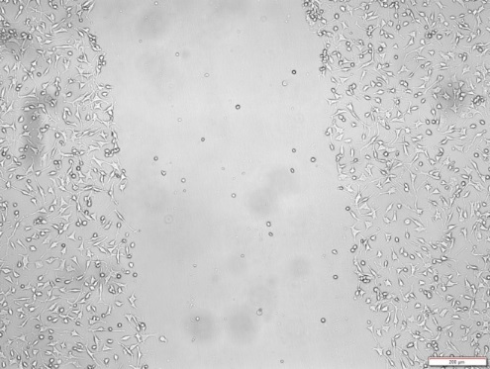
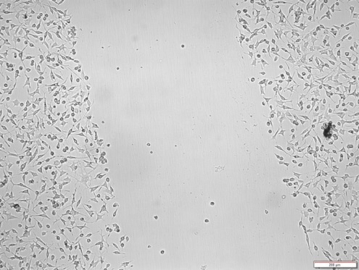
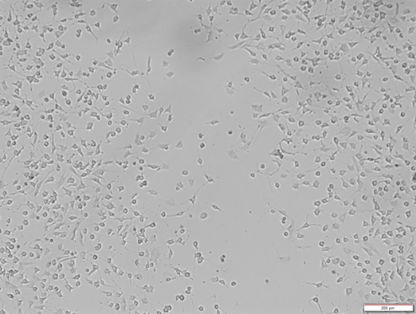
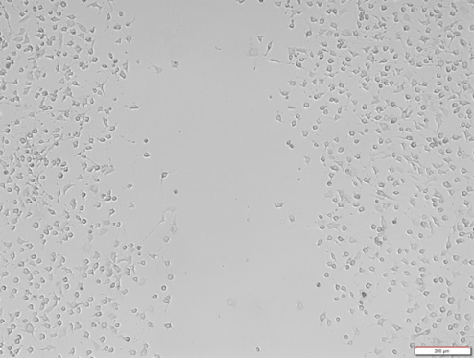
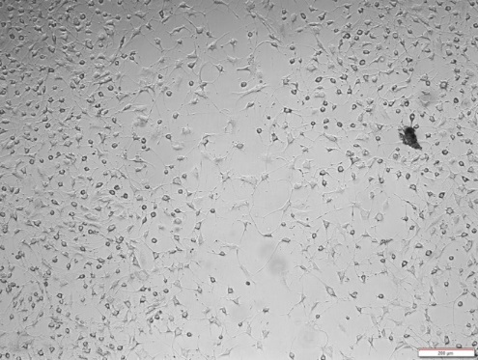
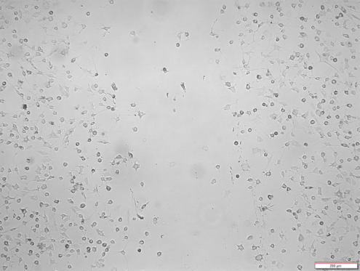
Supplemental Figure 2
Supplemental Figure 2: Treatment with TAK228 retards cellular migration in murine PKC cells. Mouse PKC cells were expanded in culture as monolayer and treated with vehicle or 25 nM TAK228. Scratch wound assay was performed and percent wound closure was calculated by imaging the wound area and measuring the area of the gap at 0 h, 48 h and 6 day time intervals. Scale bar = 200 mm.
Vehicle
TAK228
0 h
48 h
6 days

