Slide 1
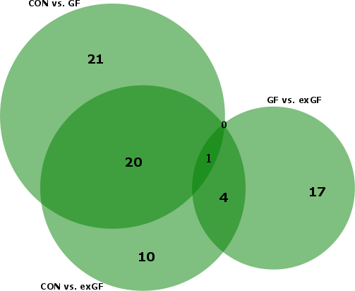
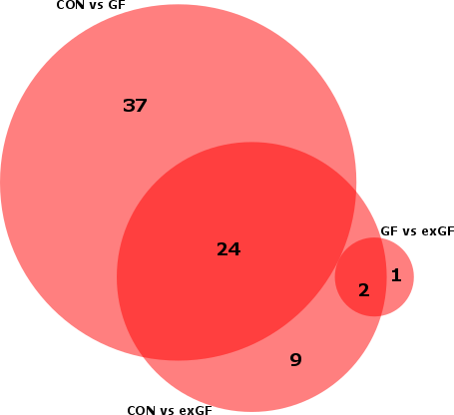
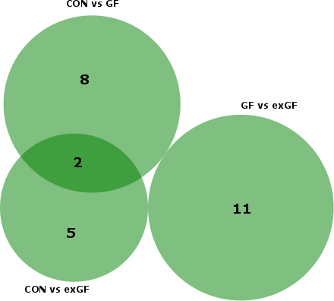
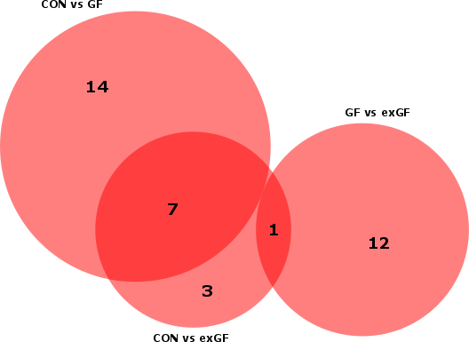
Supplemental Figure 1
a
b
Amygdala
Upregulated
Amygdala
Downregulated
miR-32-3p
Further increased by colonization
c
d
Prefrontal Cortex
Upregulated
Prefrontal Cortex
Downregulated

