Slide 1
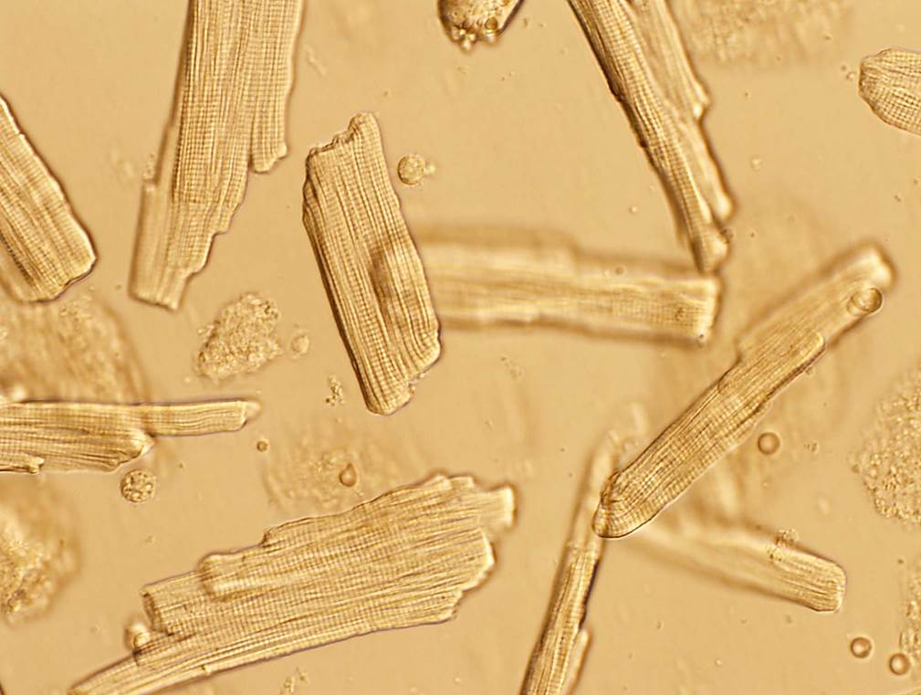
Supplemental Figure 1. Phase contrast microscopy of isolated unfixed rat cardiomyocytes (CMs).
The CMs are rectangular and clearly contain striations (60x).

Slide 2
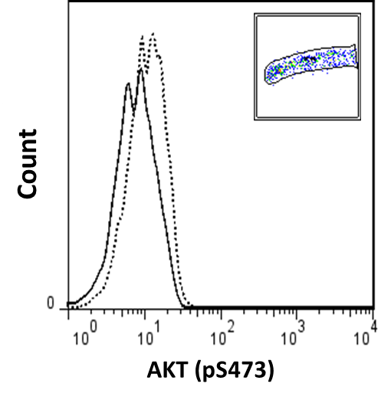
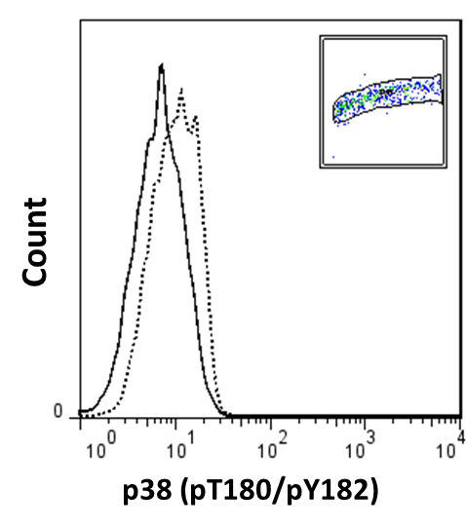
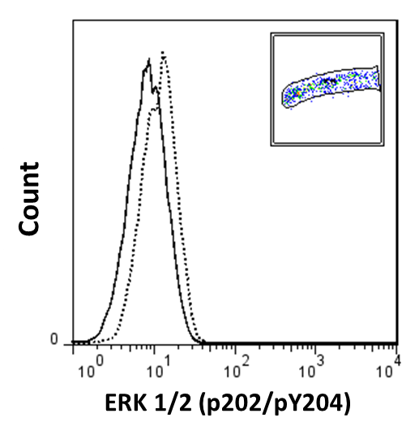
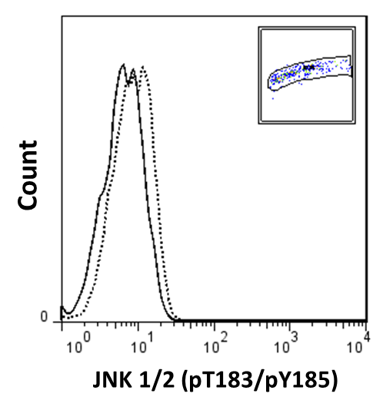
…..…
____
C5a 1 µg/ml
A
B
Control
C
D
Supplemental Figure 2. Examples of flow cytometry and FACS graphs using phospho-antibodies to assess expression of phosphorylated Akt (A) as well as phosphorylated MAPK proteins including p38 (B), ERK1/2 (C) and JNK 1/2 (D) on rat cardiomyocytes (CMs). In all frames solid line is control CMs and dashed line is CMs treated with C5a (1µg/ml) for 60 minutes.

