Slide 1
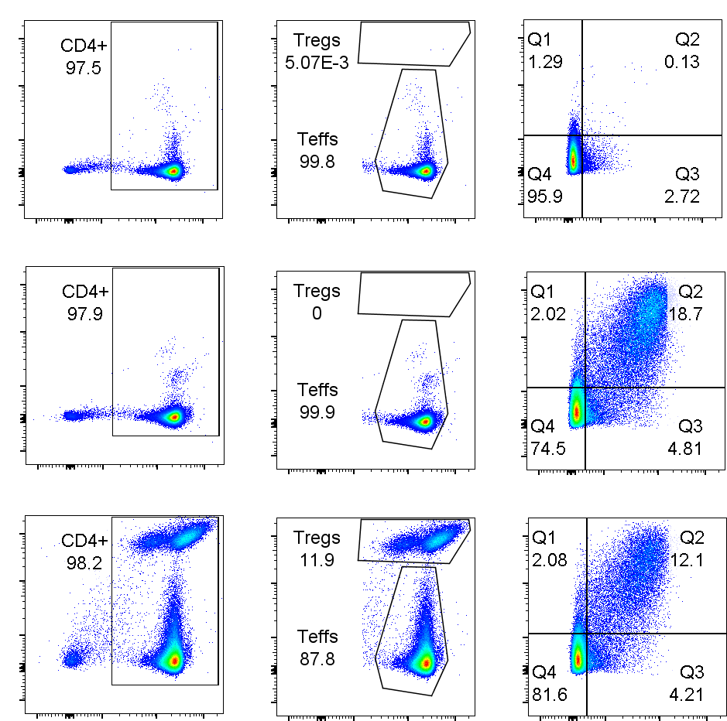
Teff + media
Teff + beads
1:4 Treg:Teff
EF670
EF670
CD154PE
CD4
APC Cy7
CD4
APC Cy7
CD69
FITC
Figure S1. Representative gating of 7-hr suppression assay from one subject Teff with media alone (top row), Teff with activation beads but not Tregs (middle), and 1:4 (Treg:Teff) ratio (bottom row). Analysis after 7hrs of incubation with 1:28 bead ratio (aCD3/aCD28 bead:Teff). The CD69+CD154+ gate was based on the best fit for the Teff+media across all the samples in a single (five subject) assay. CD69+CD154+ was analysed within EF670- Teffs, within the CD4+ cells. EF670+ Tregs were quantified but not further analysed.

Slide 2
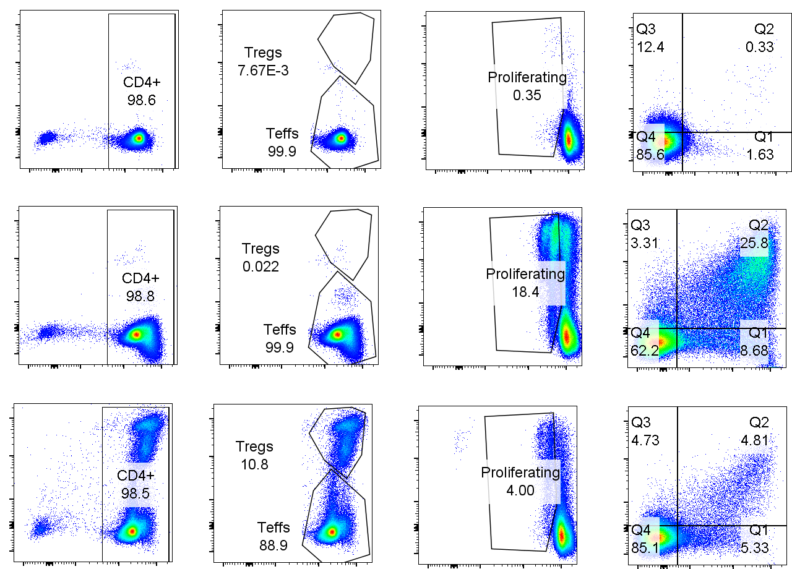
Teff + media
Teff + beads
1:4 Treg:Teff
EF670
EF670
CD134PE
CD134PE
CD4
APC Cy7
CD4
APC Cy7
CD25
FITC
CD25
FITC
Figure S2. Representative gating of 2-day suppression assay from single subject Teff with media alone (top row), Teff with activation beads but not Tregs (middle), and 1:4 (Treg:Teff) ratio (bottom row). Analysis after 2 days of incubation with 1:28 bead ratio (aCD3/aCD28 bead:Teff). The proliferation gate was based on the Teff+media condition for each sample because the level of CFSE staining varied slightly between samples. The CD25+CD134+ gate was based on the best fit for the Teff+media across all the samples in a single (five subject) assay. Proliferation and CD25+CD134+ were analysed within EF670- Teffs, within the CD4+ cells. EF670+ Tregs were quantified but not further analysed. The subject was the same as the one in Supplementary Figure 4.

Slide 3
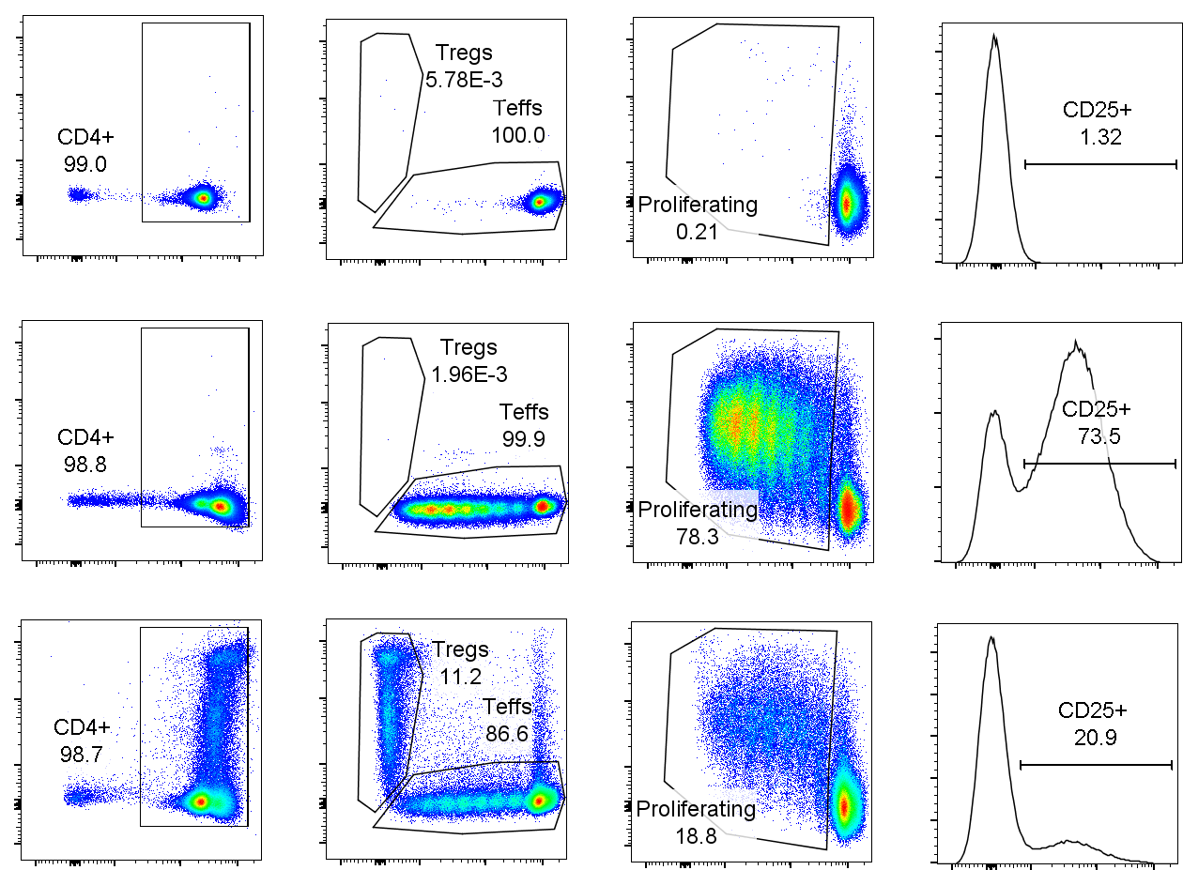
Teff + media
Teff + beads
1:4 Treg:Teff
EF670
EF670
CD25
PE Cy7
CD4
APC Cy7
CFSE
CFSE
CD25
PE Cy7
Figure S3. Representative gating of 4-day suppression assay from single subject. Teff with media alone (top row), Teff with activation beads but not Tregs (middle), and 1:4 (Treg:Teff) ratio (bottom row). Analysis after 4 days of incubation with 1:28 bead ratio (aCD3/aCD28 bead:Teff). The proliferation gate was based on the Teff+media condition for each sample because the level of CFSE staining varied slightly between samples. The CD25 gate was based on the best fit for the Teff+media across all the samples in a single (five subject) assay. Proliferation and CD25+ were analysed within CFSE+EF670- Teffs, within the CD4+ cells. CFSE-EF670+ Tregs were quantified but not further analysed. The subject was the same as the one in Supplementary Figure 4.

Slide 4
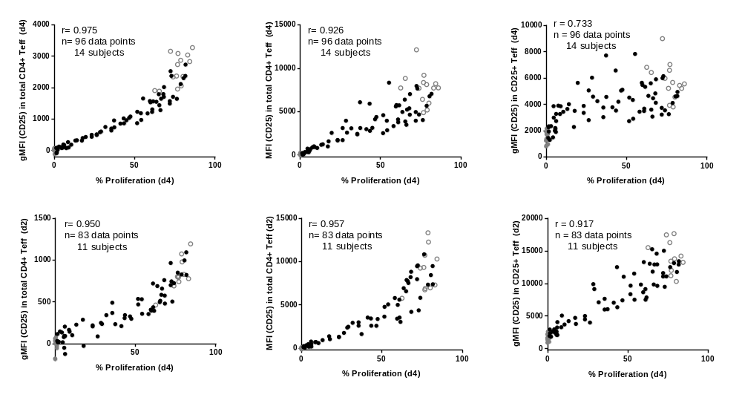
a
b
c
d
e
f
Figure S4. Correlation of CD25 expression level in CD4+ Teff, as measured by mean fluorescent intensity (MFI), with CFSE-based proliferation. (a) Correlation of CD25 geometric MFI in total Teff at day 4 with percentage proliferation at day 4. (b) Correlation of CD25 MFI in total Teff at day 4 with percentage proliferation at day 4. (c) Correlation of CD25 geometric MFI in CD25+Teff at day 4 with percentage proliferation at day 4. (d) Correlation of CD25 geometric MFI in total Teff at day 2 with percentage proliferation at day 4. (e) Correlation of CD25 MFI in total Teff at day 2 with percentage proliferation at day 4. (f) Correlation of CD25 geometric MFI in CD25+Teff at day 2 with percentage proliferation at day 4.

Slide 5
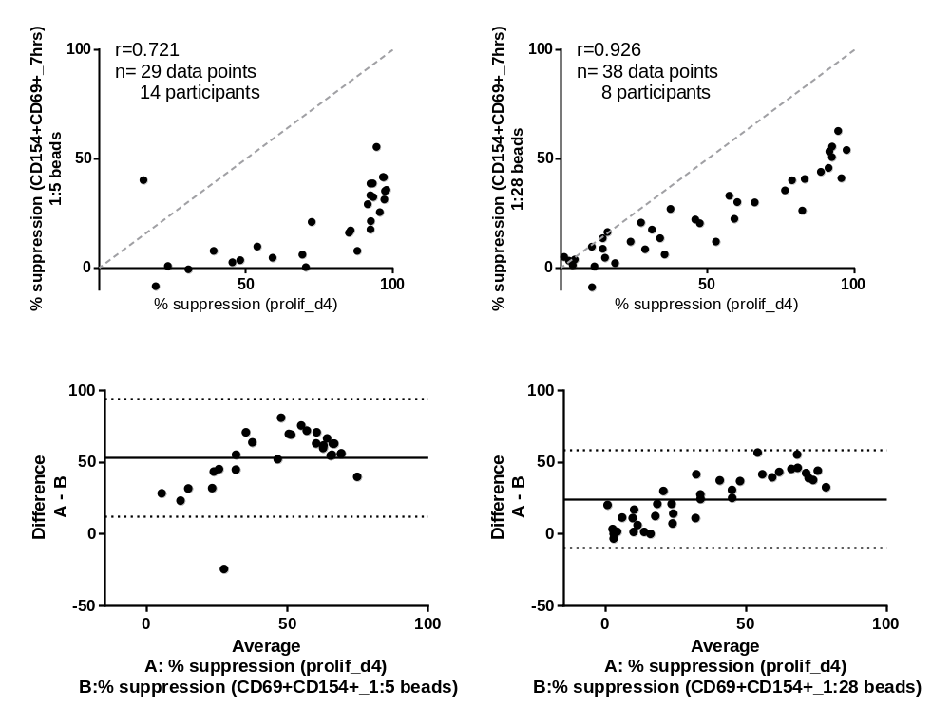
a
b
c
d
Figure S5. Comparison of CD154+CD69+ surface expression based suppression assay and CFSE-based suppression assay at 7 hours. (a) Correlation of percentage suppression of CD154+CD69+ Teff at 7 hours and percentage suppression of proliferation at day 4 at 1:5 (Teff:Bead) ratio. (b) Correlation of percentage suppression of CD154+CD69+ Teff at 7 hours and percentage suppression of proliferation at day 4 at 1:28 (Teff:Bead) ratio. (c) Bland-Altman plot of percentage suppression of CD154+CD69+ Teff at 7 hours and percentage suppression of proliferation at day 4 at 1:5 (Teff:Bead) ratio. (d) Bland-Altman plot of percentage suppression of CD154+CD69+ Teff at 7 hours and percentage suppression of proliferation at day 4 at 1:28 (Teff:Bead) ratio. Dashed line shows y=x, solid line shows average bias, dotted lines 95% CI for agreement. Experiments show suppression by expanded Tregs, of CD4+CD25- (Teffs, 50000 per well) cells MACs sorted from frozen PBMC, activated with aCD3/aCD28 beads. Depending on the number of cells available ratios of 1:2-1:64 Treg:Teff were included for each sample and compared to a Teff with aCD3/aCD28 beads. Fluorescence flow cytometry was used to measure dilution of CFSE or CD69+CD154+ cells on day 4 and 7 hrs of culture, respectively.

Slide 6
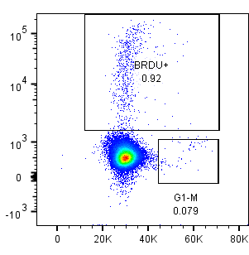
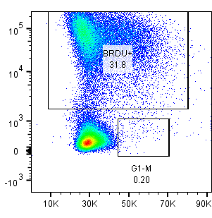
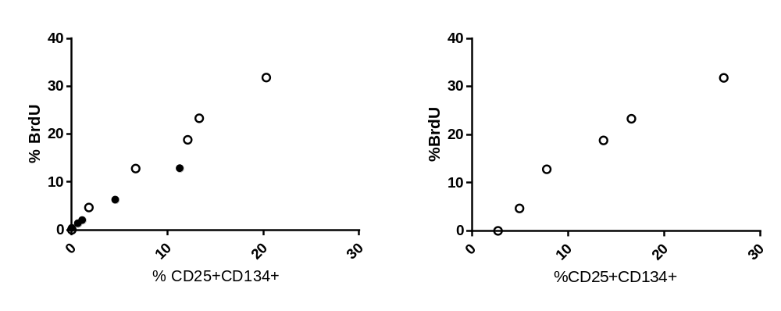
a
b
c
d
Figure S6. CD25 cell surface expression correlates with BrdU-based proliferation. BrdU was added to assays at start and on d1, staining for BrdU, 7-AAD, CD25 and CD134 was performed on d1 and d2 respectively. In concurrent assays, cells were stained with CFSE and proliferation was analysed. BrdU staining on d1 (a) and d2 (b) in effector T-cells stimulated with aCD3/aCD28 beads. Correlation on d2 of BrdU and CD25/CD134 staining in effector T-cell from two different sources (c), and proliferation in single effector T-cell cultured with different ratios of eTreg (d).

