Slide 1
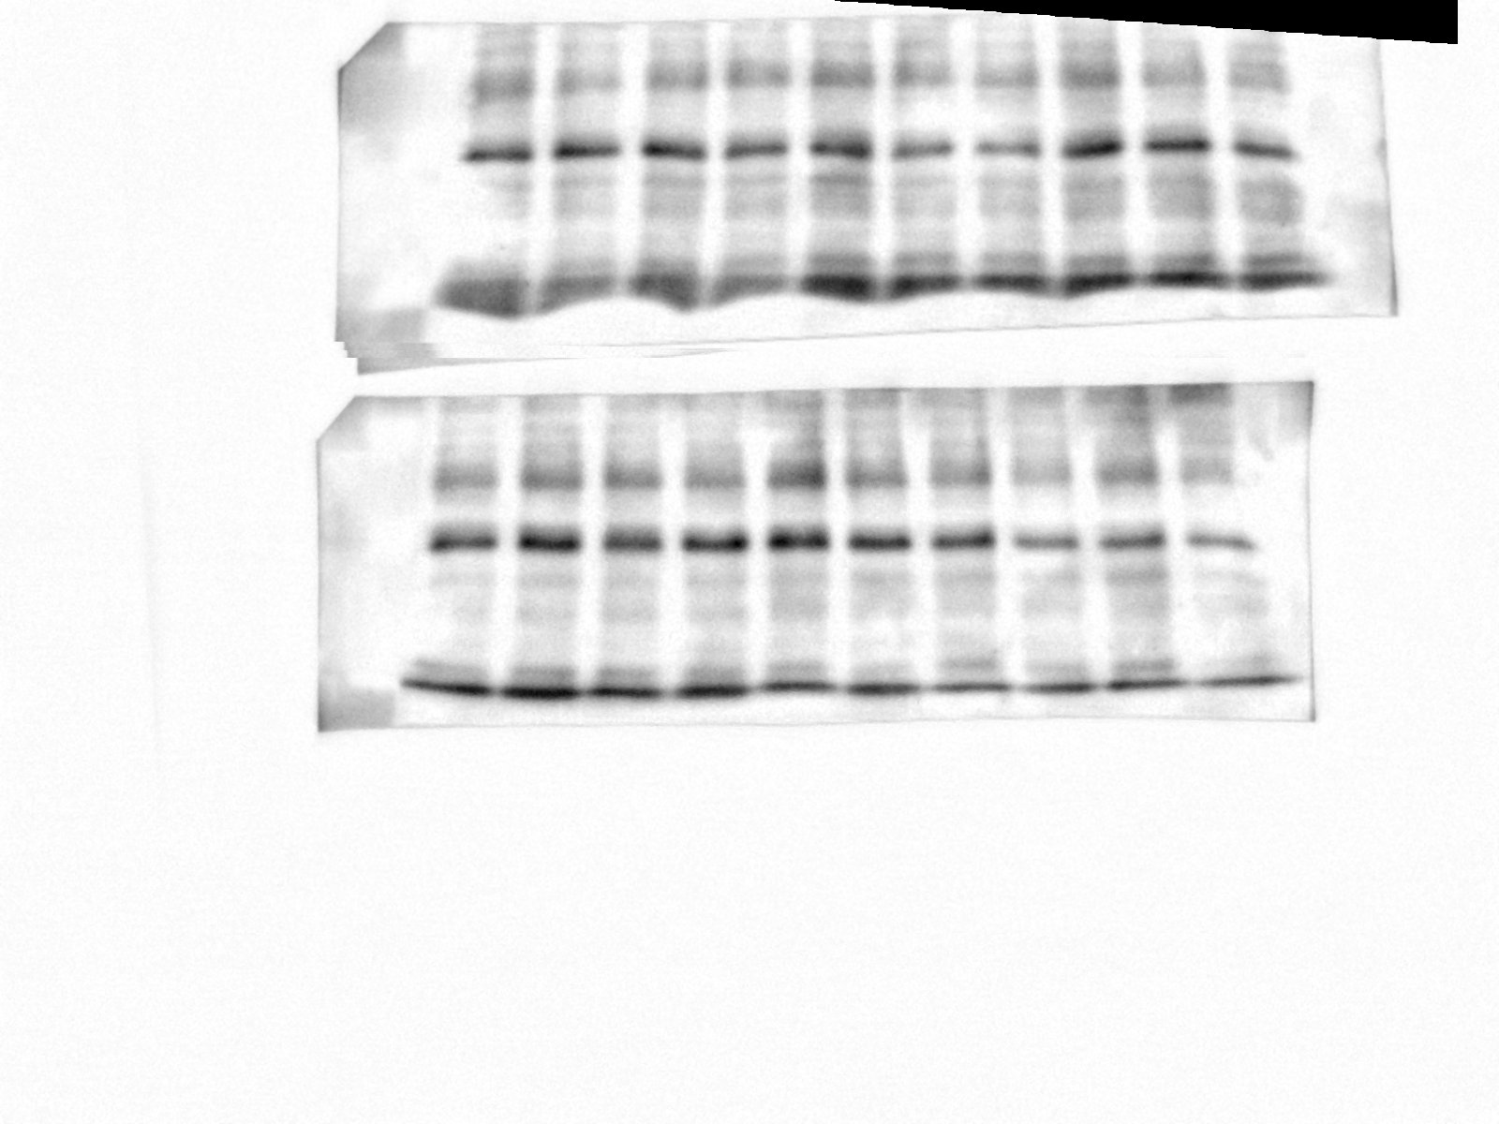
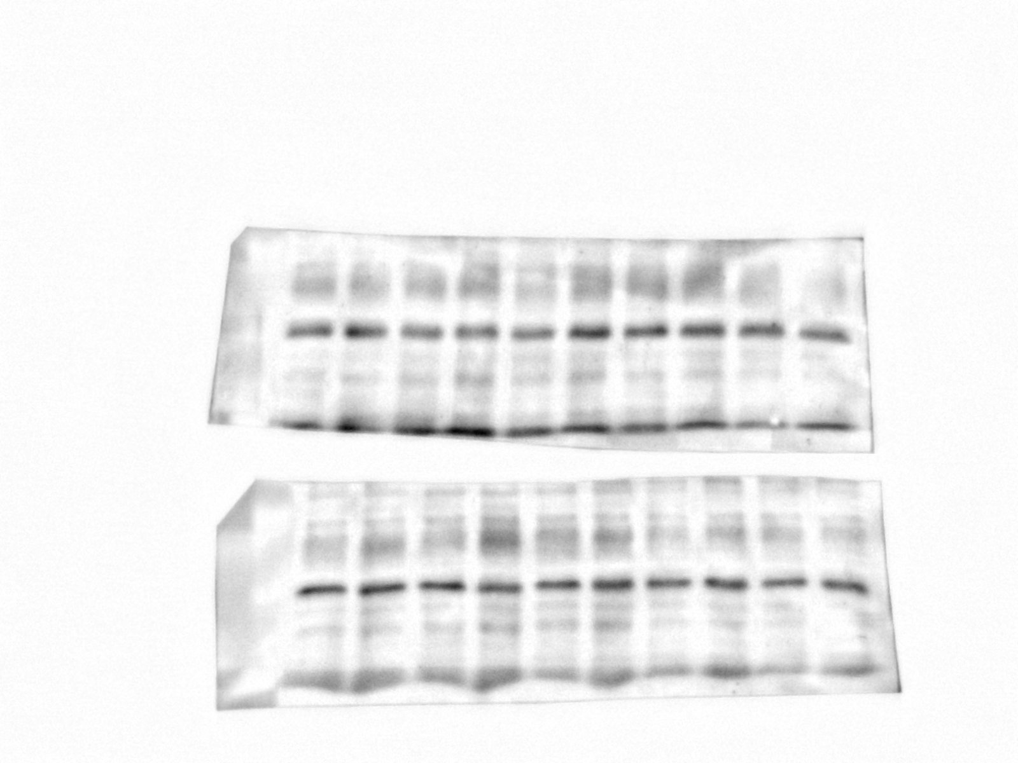
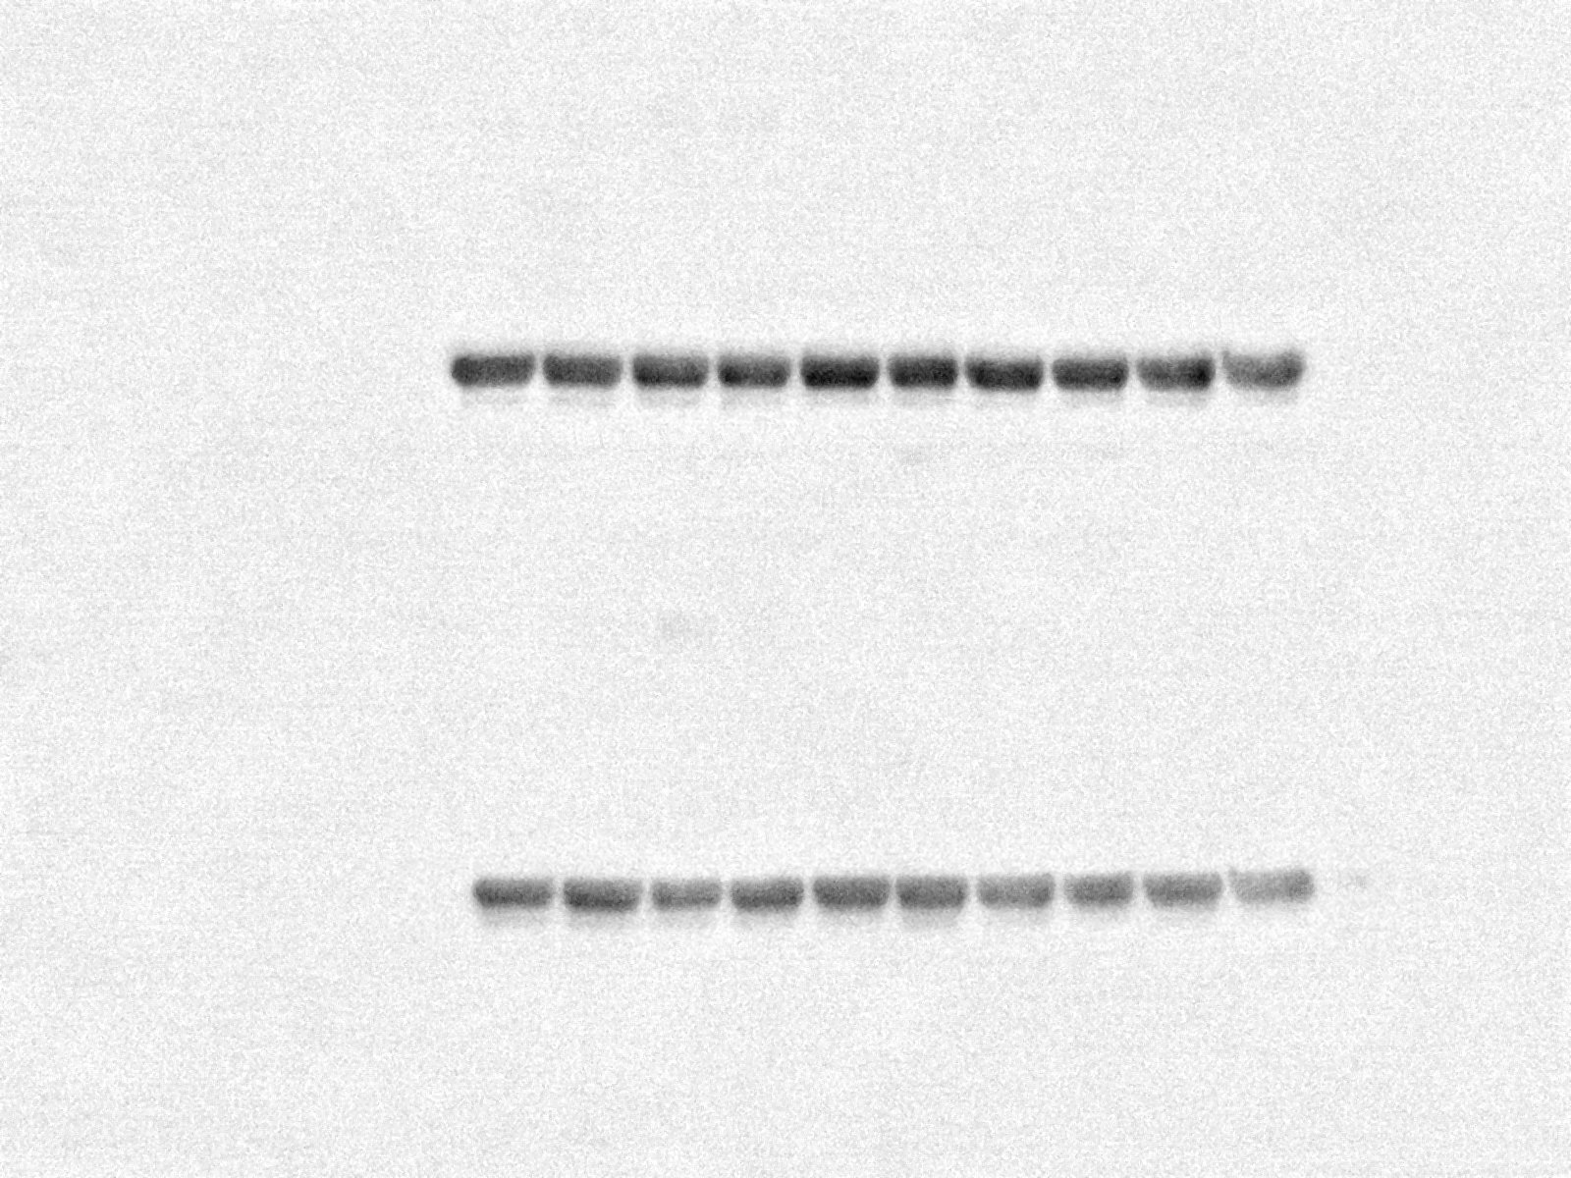
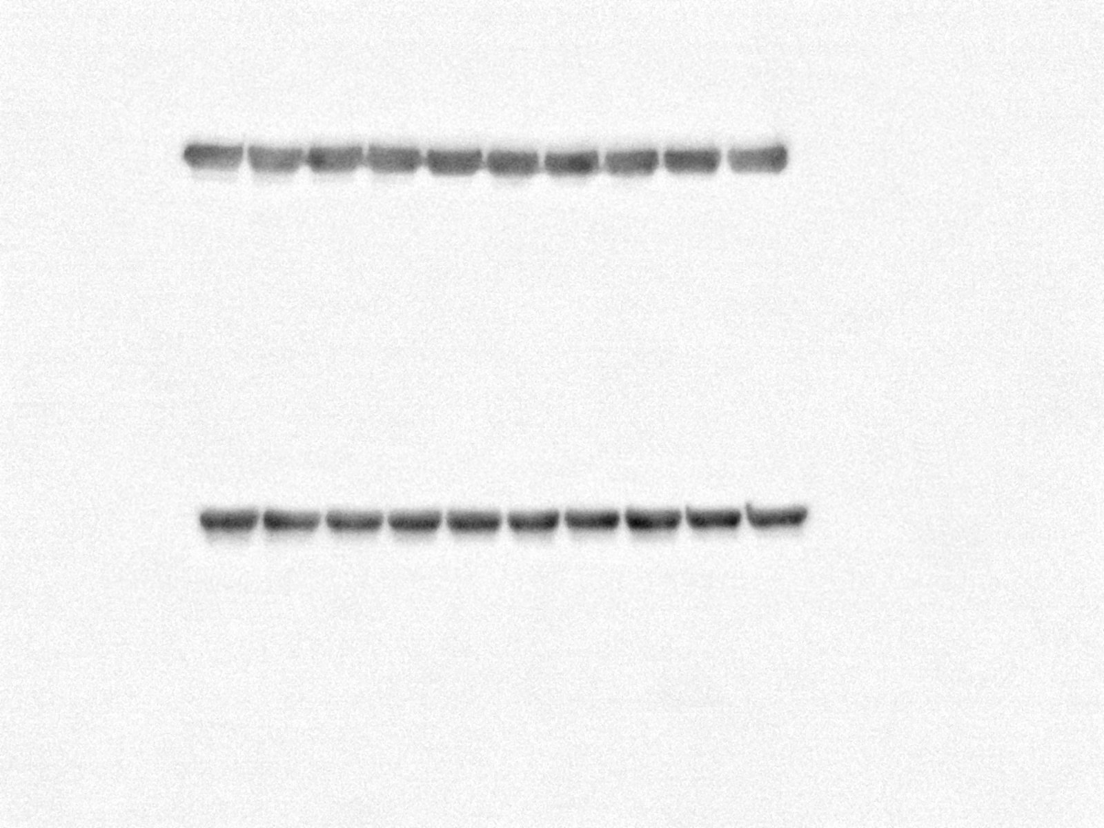
Additional File 8, Thomas MH et al., revised version
A
OLE diet
ARA diet
B
OLE diet
ARA diet
NaCl
Aβ₄₂
NaCl
Aβ₄₂
NaCl
Aβ₄₂
NaCl
Aβ₄₂
TREM-2
◄28 kDa►
TREM-2
β-tubulin
◄50►
kDa
β-tubulin
NaCl
Aβ₄₂
NaCl
Aβ₄₂
NaCl
Aβ₄₂
NaCl
Aβ₄₂
OLE diet
ARA diet
OLE diet
ARA diet

