Slide 1
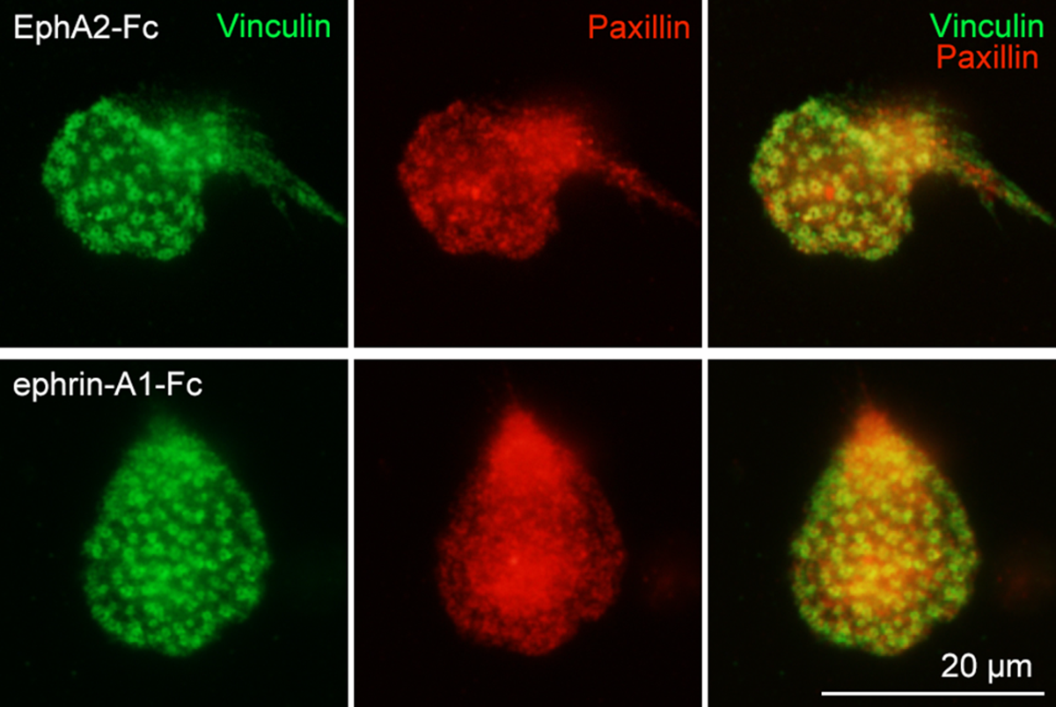
Supple. Fig. 1

