Slide 1
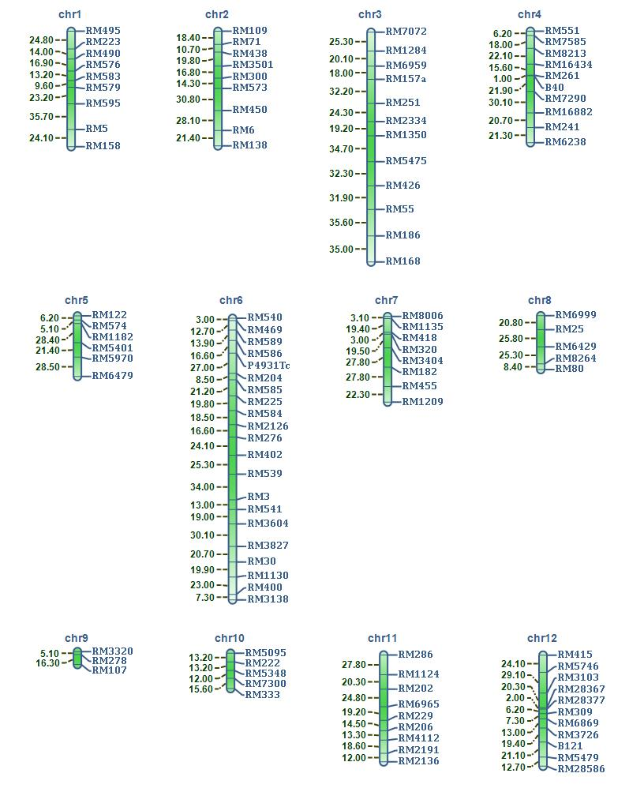
Additional file 3: Figure S3

