Slide 1
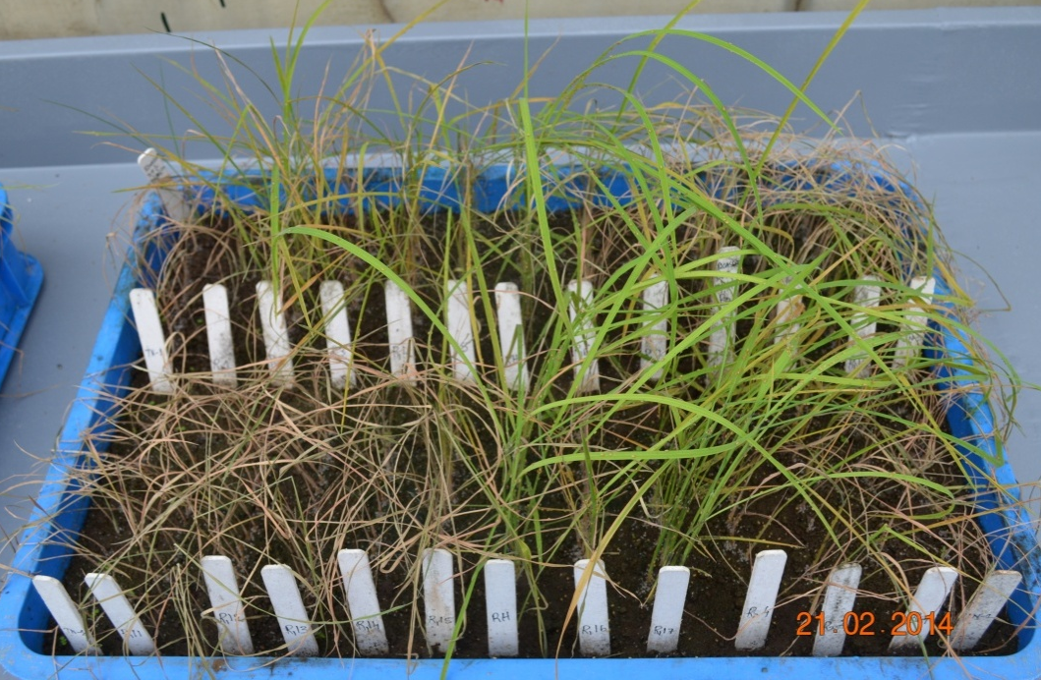
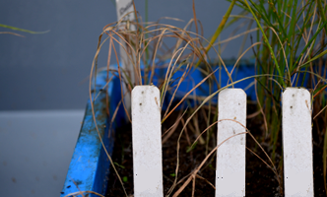
CR2711-76
Jaya
TN-1
CR2711-76
TN-1
Rathu Heenati
CR2711-76
a
Jaya
CR2711-76
b
Jaya
Jaya
Additional file: Fig. S8

