Slide 1
Supplementary Figure S1
A
B
7 Non Responders
4 Responders
Figure S1: Extraction of paraffin-embedded PD-L1+ RCC tissues for RNA isolation. Brown staining indicates PD-L1 protein expression (IHC) in tumor foci. In (A), blue circles outline macroscopic tumor areas that were excised by manual scraping with a scalpel. In (B), focal areas of PD-L1+ tissue outlined with blue lines were excised by laser capture microdissection (LCM). Scale bars are equal to 500 um.

Slide 2
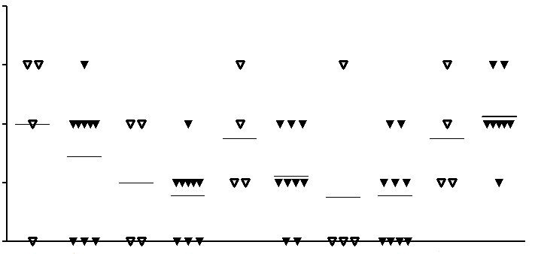
Supplementary Figure S2
4
p=0.36
p=0.81
p=0.32
p=0.67
p=0.46
3
Relative Score
2
1
0
R
NR
R
NR
R
NR
R
NR
R
NR
PD-1
PD-L2
LAG-3
TIM-3
Immune cell infiltrates

Slide 3
Figure S2 legend: Molecules previously found to be up-regulated in PD-L1+ vs. PD-L1(-) melanomas are not differentially expressed in PD-L1+ RCCs from patients with divergent clinical outcomes after anti-PD-1 therapy. Expression of molecules previously found to be associated with PD-L1 expression in melanoma (Taube et al., Clin Cancer Res 2015), and other candidate markers, were assessed by IHC in 13 PD-L1+ RCC specimens, derived from 4 patients who responded to anti-PD-1 and 9 who did not. Specimens were scored for protein expression on the following scale: 0, absent expression; 1, focal expression, <5% of cells positive; 2, moderate expression, 5-50% of cells positive; 3, severe expression, >50% of cells positive. Horizontal bars indicate mean values. No significant differences were observed between responders (R) and non-responders (NR), using a two-sided Wilcoxon rank sum test. In data not shown, there were also no significant differences in FoxP3 expression or in CD4:CD8 ratios between the two groups.

Slide 4
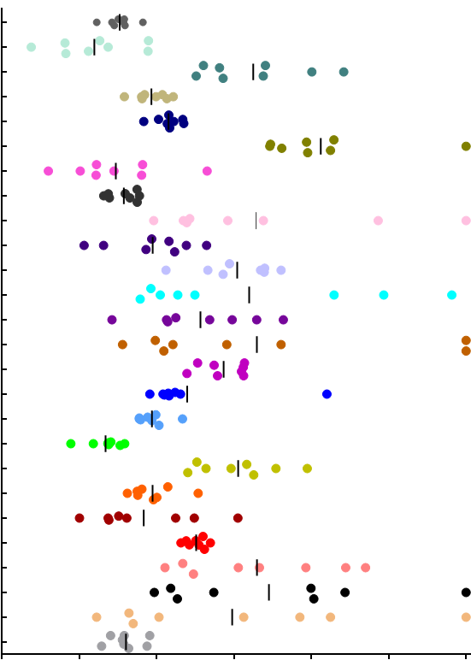
GUSB
AKR1C3
BACH2
BMP1
CACNB1
CCL3
CD24
E2F8
ENPP5
F2RL1
IL11RA
KCNJ16
LTBP1
MAL
MYLK2
NFATC1
PITX2
PLEC
SLC23A1
SLC37A4
TNFRSF19
UCP3
UGT1A1
UGT1A3
UGT1A6
WHSC1
Supplementary Figure S3
Gene target
0 15 20 25 30 35 40
Cycle threshold

Slide 5
Figure S3 legend: Gene expression in RCC cell lines. The expression of 25 genes found to be differentially expressed in RCCs from anti-PD-1 responders vs. non-responders was assessed by qRT-PCR in 8 established RCC cell lines (786-0, A498, ACHN, Caki-1, RXF-393, TK-10, SN12C, and U0-31). The expression of each gene target in an individual cell line is shown as the average cycle threshold (Ct) value from triplicate reactions. Lower Ct values indicate higher gene expression. In cases of undetectable gene amplification, a Ct value of 40 was assigned (the maximum number of PCR cycles used). Vertical black bars indicate mean Ct values. The GUSB transcript was used as the internal reference. Results were visualized using GraphPad software (La Jolla, CA).

Slide 6
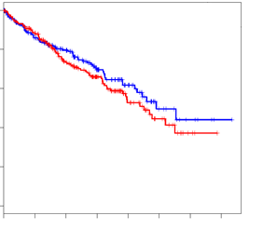
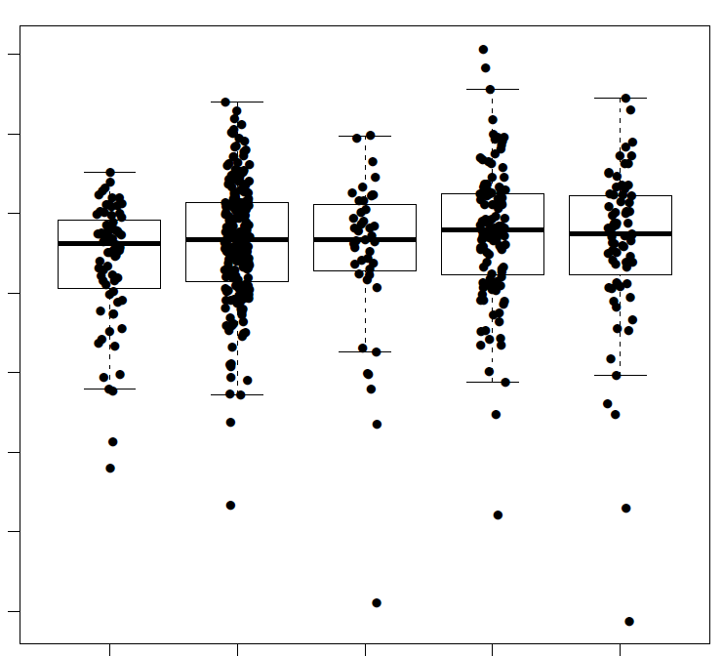
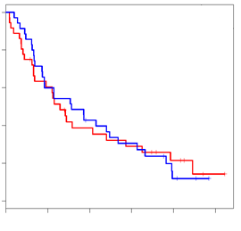
A
RCC all stages (n=444)
Supplementary Figure S4
1.0
FDR=0.78
0.8
0.6
High
Low
0.4
0.2
B
0.0
16
FDR =0.78
0
500
2000
1000
2500
3500
14
1500
3000
Proportion surviving
12
RCC stage IV (n=71)
10
Relative expression
1.0
8
FDR=0.28
6
0.8
4
0.6
2
0.4
0.2
Normal (n=72)
Stage II (n=43)
Stage I (n=214)
Stage III (n=116)
0.0
Stage IV (n=71)
0
500
1500
1000
2000
2500
Days after diagnosis

Slide 7
Figure S4 legend: In silico analyses of TCGA RCC data do not demonstrate significant associations between UGT1A6 gene expression and overall survival or clinical stage. (A) Association of UGT1A6 expression with overall survival was assayed in silico in The Cancer Genome Atlas RCC database. A Cox regression model was used with continuous expression values of UGT1A6 in the whole patient dataset (N=444, upper panel), or only in patients with stage IV disease (n=71, lower panel). All p-values were adjusted by the Benjamini-Hochberg procedure (FDR, false discovery rate). Kaplan-Meier curves were generated using the median expression level to segregate samples into two groups, high and low UGT1A6 expressers.(B) The potential association of UGT1A6 mRNA expression levels in primary kidney specimens with clinical tumor stage was evaluated by fitting in a linear model using continuous expression levels of UGT1A6, and tumor stage (normal, or tumor stage I-IV) as a numeric value. The p-value adjusted by the Benjamini-Hochberg procedure (FDR, false discovery rate) is shown.

