Slide 1
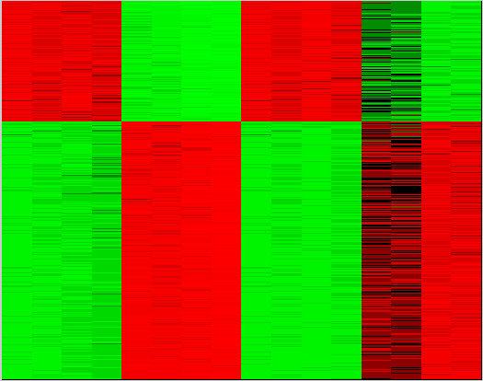
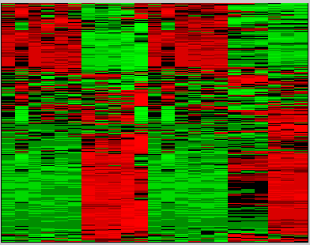

MDM
A549
#1125 #1067
#1125 #1067
68
68
68
68
68
68
67
67
67
67
67
67
Time (hours)
S1 |Fig

