Slide 1
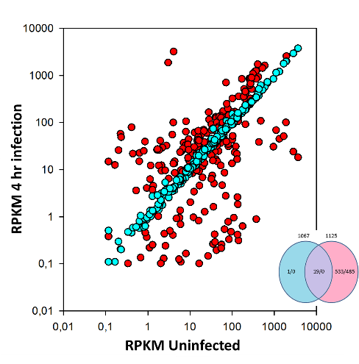
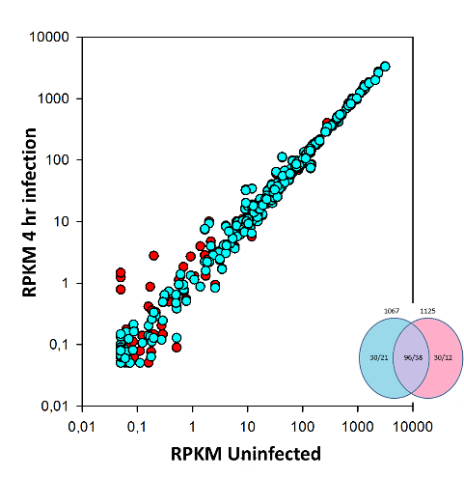
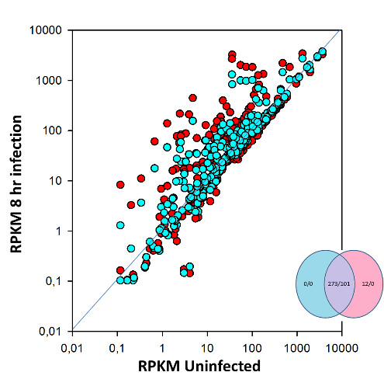
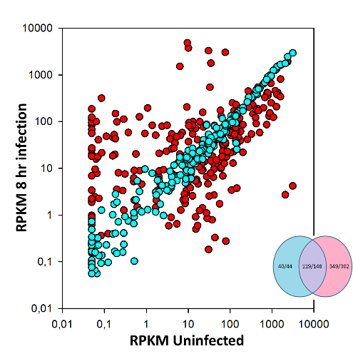
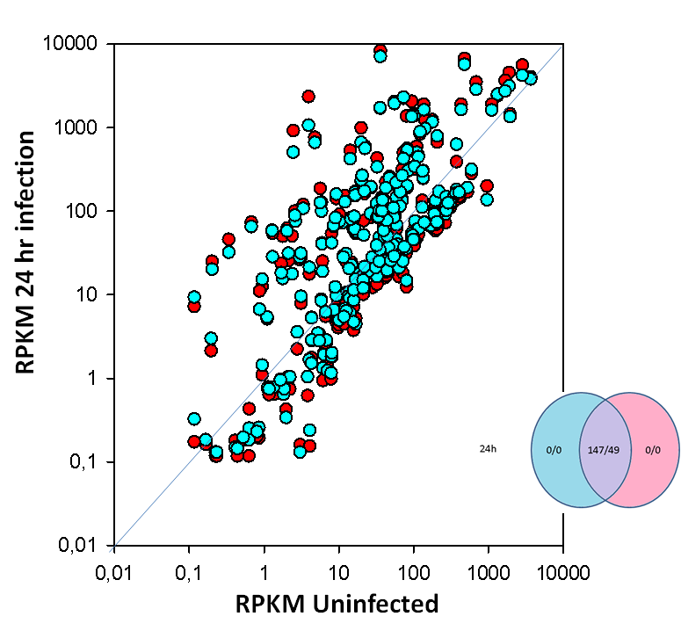
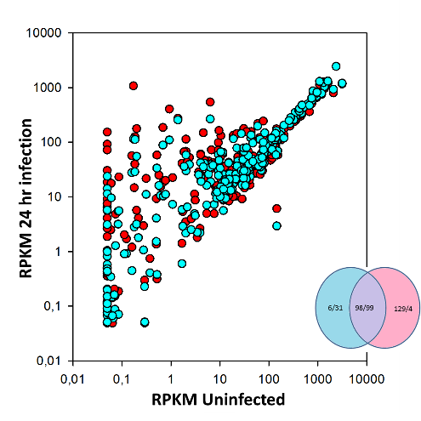
MDM
A549
KRT8
KRT18
Mitochondrial
function
EIF2 pway
Cell cycle
control
Cholesterol
synthesis
HLA-A-F
IL8
CD40
IL1B
CCLs
TLRs
TNF
IFI30
CH25H
CH25H
IFIH1 IFIT2 ISG15 CCL2
IL6
IL27
HLA-I
ISG15
IL8
chemokines
IL1B IRF7 MYD88
CASP1
mitochondrial
USP18 EIF2 signaling
DDX58 MAVS
KRT8,18
ISD15 IFIT1,3 IL1R
TNFSF10 IL1RN
DDX58 TNF
CXCL11
STAT1
MX1
PYCARD
CH25H
IL29 KRT8,18
cholesterol
synthesis
Cell cycle control
CH25H
ISG15 CCL2
CXCL11 IFIH1 IFIT1 HLA-I
DDX58
STAT2 IL8
IL27
SOcS1
IFIT3 ISG15
chemokines
IL27A,B
DDX58
MX1
DHX58
IRF1
PYCARD
CH25H
MYC
IL29 KRT8,18
CH25H
S4 Fig

