Slide 1
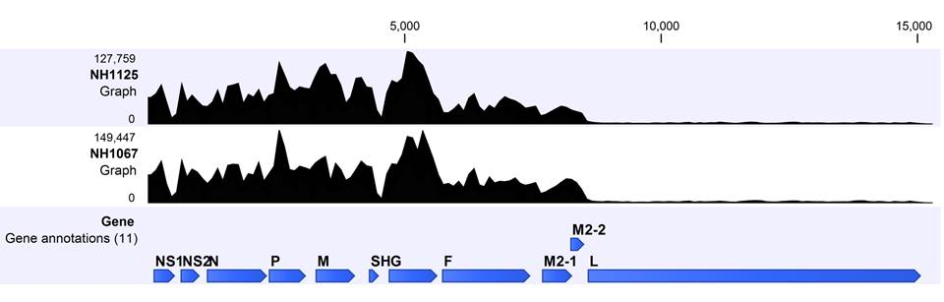

A
B
C
D
*
*
*
S6 Fig

