Slide 1
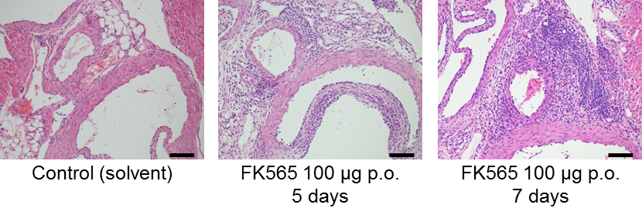
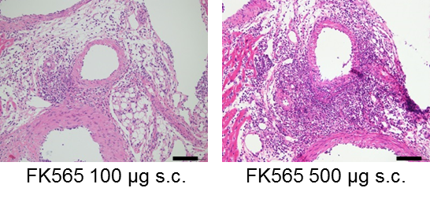
A
B
Figure S1. FK565-induced coronary arteritis after oral or subcutaneous administration
A, Histological evaluation of coronary artery on the following day after oral administration of 100 μg of FK565 or distilled H₂O (solvent of FK565) for 5 or 7 days (scale bar, 100 μm).
B, Histological evaluation of coronary artery on the following day after subcutaneous administration of 100 or 500 μg of FK565 twice (days 0 and 3) (scale bar, 100 μm).

