Slide 1
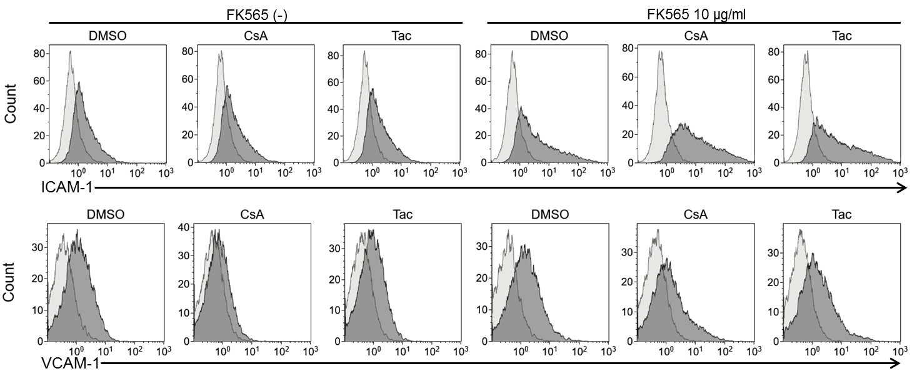
Figure S3. Histogram of ICAM-1 and VCAM-1 expression in HCAEC
Histograms show flow cytometric analysis of ICAM-1 and VCAM-1 expression in HCAEC after stimulation of FK565 with CsA or Tac. Respective isotype controls are shown as light gray area.

