Slide 1
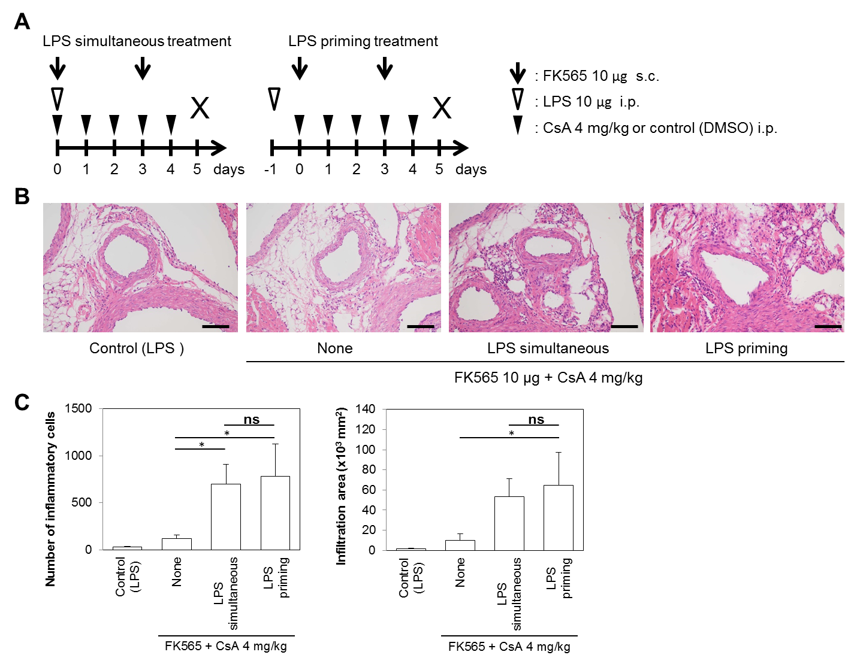
Figure S5. Comparison of coronary arteritis exacerbation between simultaneous administration and priming of LPS
A, The experimental protocol. We set the treatment protocol as 10 μg of FK565 for 2 days and 4 mg/kg of CsA for 5 consecutive days with or without single dose of LPS (10 μg). LPS was administrated simultaneously with CNI/FK565 or primed one day prior to CNI/FK565.
B-D, The histological evaluation of coronary arteritis (B) induced by CsA and FK565 with LPS (simultaneous or priming treatment) in WT mice (scale bar, 100 μm). The numbers (C) and infiltration areas (D) of inflammatory cells are shown. The data are presented as the mean ± SD (n = 3). *: p < 0.05, ns: not significant (Tukey-Kramer test).

