Slide 1
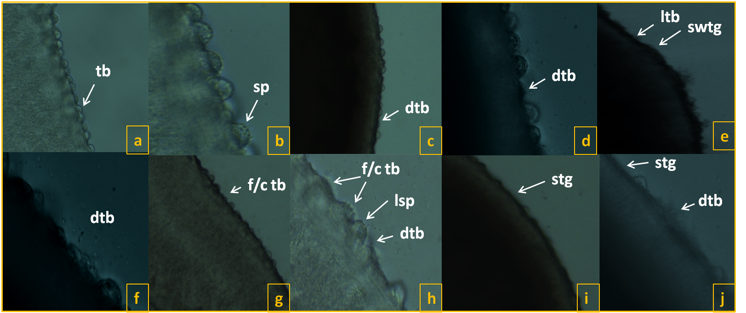
S1 Figure. Tegumental changes in PFA-fixed S. mansoni adult male worms following in vitro praziquantel and miltefosine treatments. a, b: control untreated; c-f: praziquantel-treated (6 µg/ml for 24 hours); g-j: miltefosine-treated (40 µg/ml for 48 hours ). Slight changes are seen in: c, d, g , h. Extensive changes are seen in: e, f, i, j. tb, tubercle, sp, spines; dtb, destruction of tubercle; stg, swollen tegument; ltb, loss of tubercles; f/ctb, flattened/collapsed tubercle, lsp, loss of spines; stg, smooth tegument; dtg: disrupted tegument. a, c, e, g: 10x magnification & b, d, f, h: 40x magnification.

