Slide 1
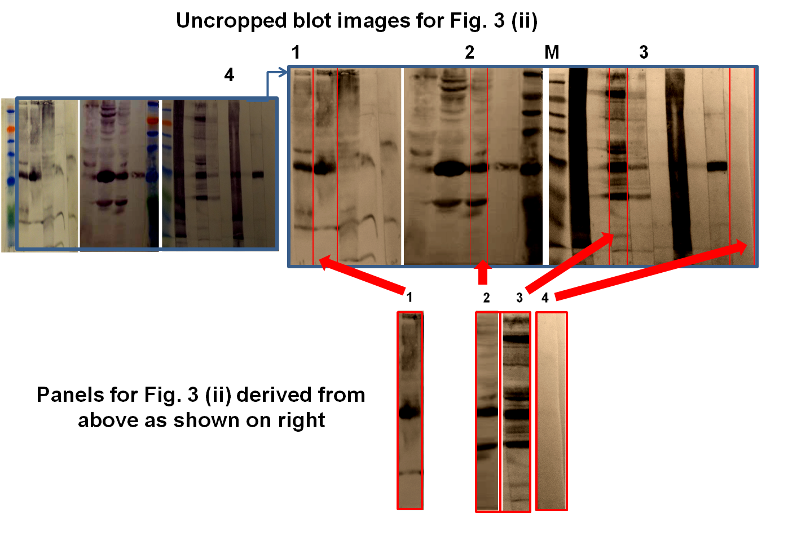
S2 Figure. Uncropped blot images for Fig. 3 (ii).

