Slide 1
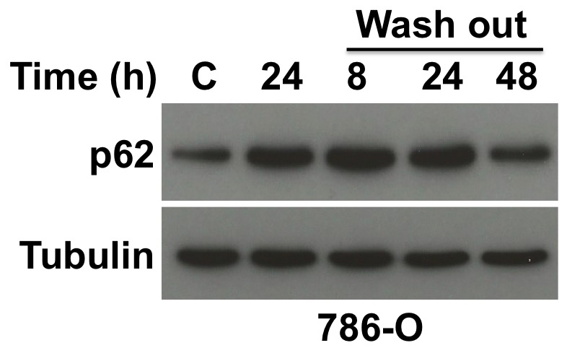
Supplemental Figure 5. Wash out experiment with ROC-325. 786-O cells were untreated (C) or treated with 5 μM ROC-325 for 24 h. ROC-325 was then washed out and fresh media was added to the cells for 8, 24, and 48 h. Cell pellets were harvested, lysed, and p62 levels were determined by immunoblotting.

