Slide 1
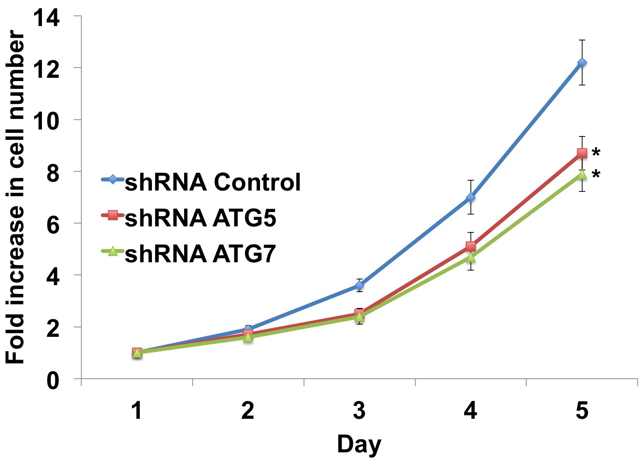
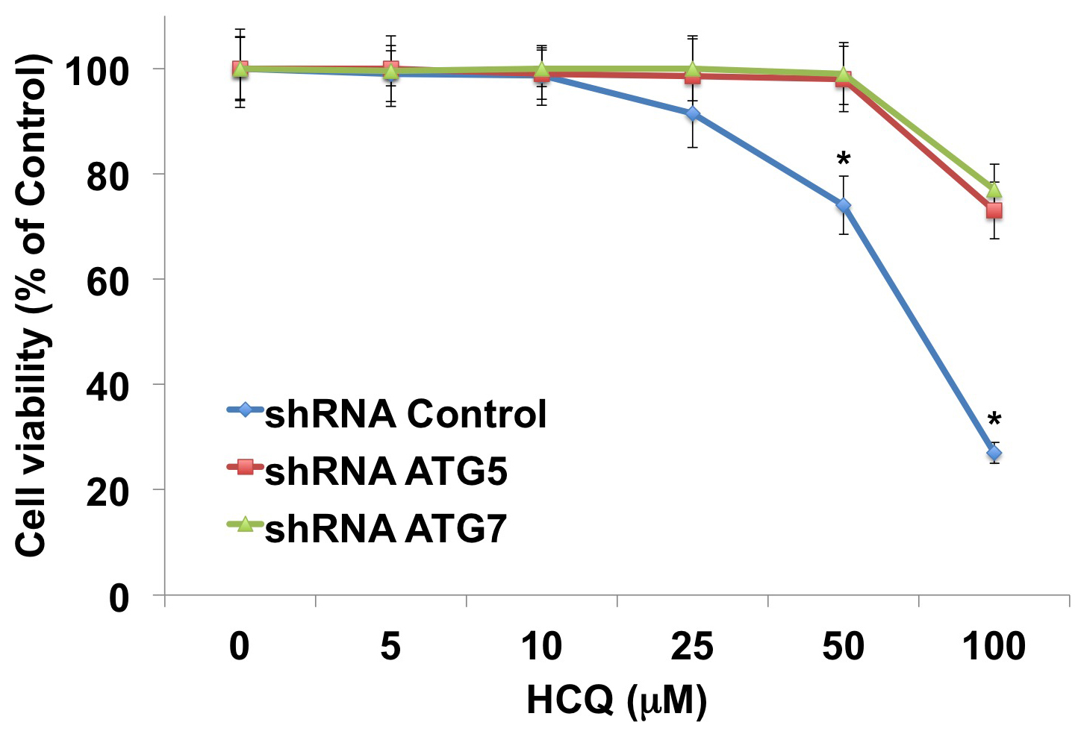
A
B
Supplemental Figure 6. Growth characteristics and sensitivity to HCQ of 786-O cells infected with control, ATG5, and ATG7 lentiviral shRNA. (A) Cell proliferation of 786-O cells infected with control, ATG5, and ATG7 shRNA was determined by trypan blue exclusion assay using a Vi-Cell automated cell counter for a period of 5 days. * Indicates a significant difference compared to shRNA control infected cells. Mean ± SD, n = 3. p < 0.05. (B) Effects of HCQ on 786-O cells infected with control, ATG5, and ATG7 shRNA. Cells were treated with the indicated concentrations of HCQ for 72 h and cell viability was determined by MTT assay. Mean ± SD, n = 3. * Indicates a significant difference from either ATG5 or ATG7 shRNA infected cells. P < 0.05.

