Slide 1
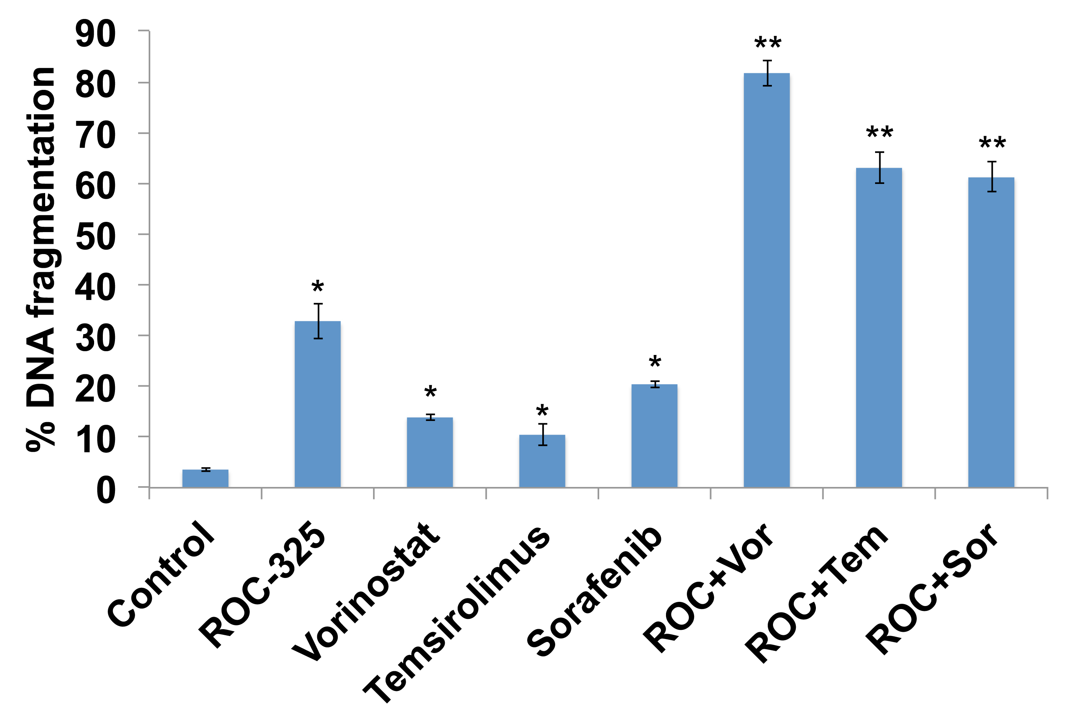
Supplemental Figure 7. ROC-325 significantly enhances the pro-apoptotic effects of FDA-approved anticancer agents. 786-0 RCC cells were treated with 5 µM ROC-325 alone or in combination with 2 µM vorinostat, 50 nM temsirolimus, and 5 µM sorafenib for 48 h. Drug-induced apoptosis was quantified by PI/FACS analysis of cells with fragmented DNA. N = 3 ± SD, *Indicates significant difference vs. control, **indicates significant difference between single agent and combination treatments, P<0.05.

