Slide 1
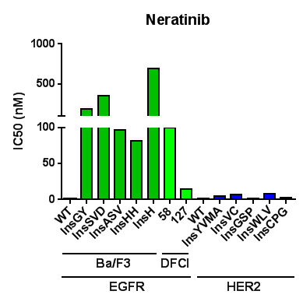
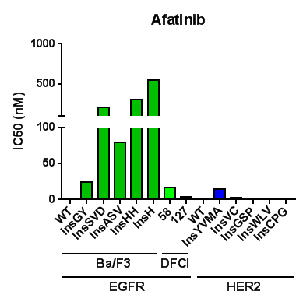
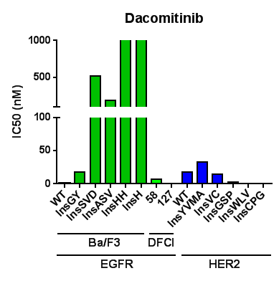
Figure S1

Slide 2
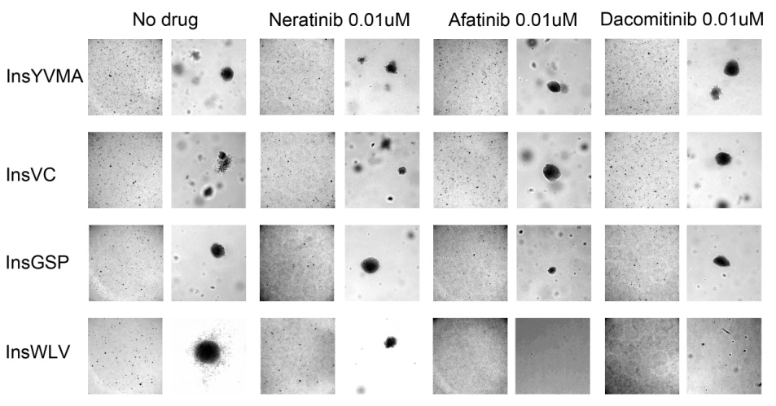
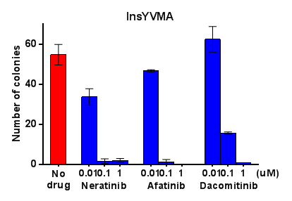
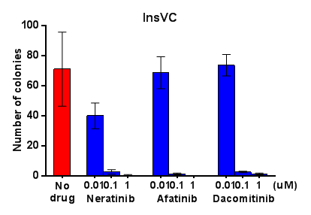
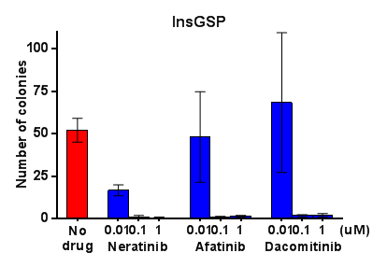
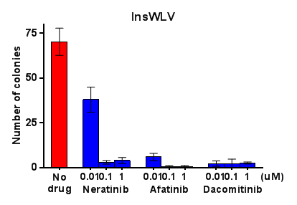
A.
B.
Figure S2

Slide 3
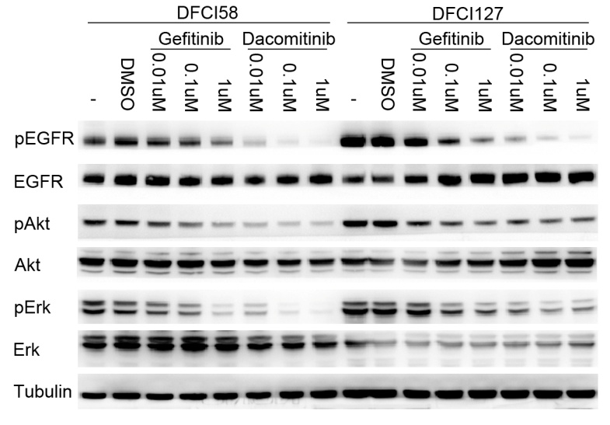
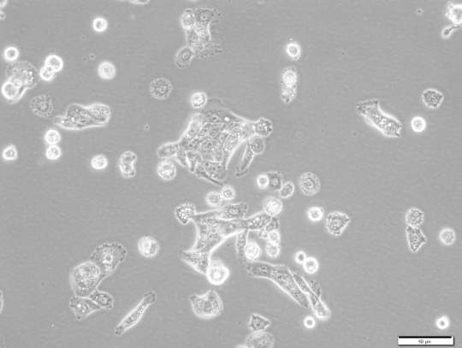
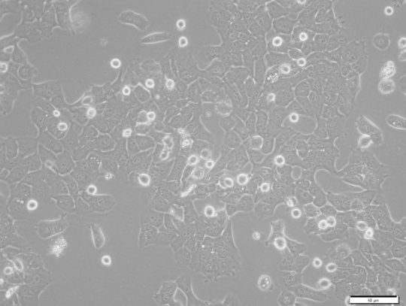
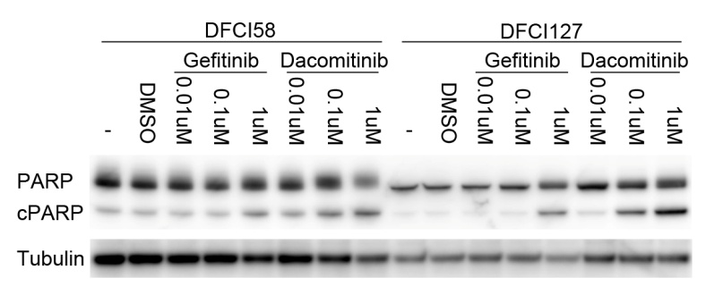
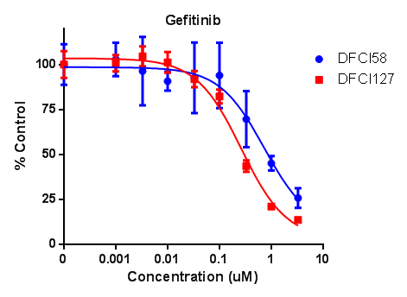
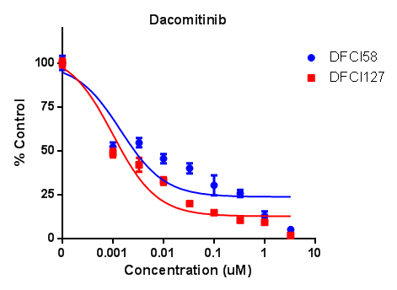
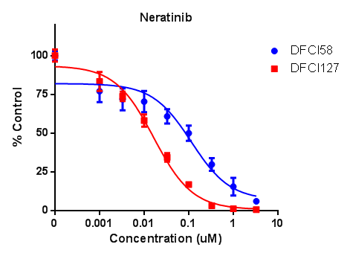
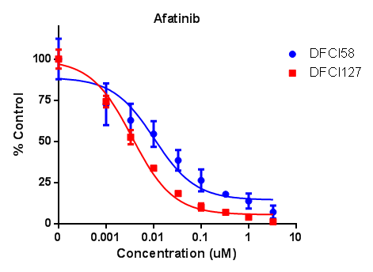
A.
C.
DFCI58
DFCI127
100um
100um
B.
Figure S3

Slide 4
EGFR 762 EAYVMASVDNPHVCRLLGICLTSTVQLITQLMP 794
EAYVMA V +P+V RLLGICLTSTVQL+TQLMP
HER2 770 EAYVMAGVGSPYVSRLLGICLTSTVQLVTQLMP 802
EGFR 795 FGCLLDYVREHKDNIGSQYLLNWCVQIAK 823
+GCLLD+VRE++ +GSQ LLNWC+QIAK
HER2 803 YGCLLDHVRENRGRLGSQDLLNWCMQIAK 831
Figure S4

