Slide 1
454 GS FLX
Ion Torrent PGM
Illumina MiSeq
DNA Input
50 ng
12.5 ng
Amplicon Generation
1 Round Fusion PCR
(2 PCR rxns/sample)
2 Round Tailed PCRs
(1 PCR rxn/sample)
Qiagen Hot Star HiFidelity Polymerase (1U)
Kapa HiFidelity Hot Start
Polymerase (0.5 U)
Primer F: Adapter A + Barcode + 8F
Primer R: 338R + Barcode + Adapter B
Primer F: Adapter A + Barcode + 8F
Primer R: 338R + Adapter trP1
1 Round PCR
Primer F: Overhang + 8F
Primer R: 338R + Overhang
2 Round PCR
Primer F: Nextera Index 1
Primer R: Nextera Index 2
Thermocycler
Conditions
35 Cycles,
Annealing T°C: 50°C
35 Cycles,
Annealing
T°C: 50°C
25 Cycles,
Annealing T°C: 50°C
35 Cycles,
Annealing T°C: 55°C
25 Cycles,
Annealing T°C: 55°C
Amplicon
Purification
2% Agarose E-Gel
2% Agarose E-Gel
Magnetic Beads
454 GS FLX
PGM1
PGM2
PGM3
MiSeq1 = MiSeq2

Slide 2
GS FLX
PGM
MiSeq
Raw sequences
Quality control
Performed for each platform
separately
Initial Processing
Trimmed and filtered reads
Combined fna files
QIIME
UPARSE
DADA2
(Illumina only)
QIIME1
QIIME2
QIIME3
QIIME4
UPARSE1
UPARSE2
Error Suppression/ Dereplication
De novo OTU picking
Open reference
OTU picking
OTU picking
Chimera
detection
Chimera
detection
Chimera
detection
Taxonomy
assignment
Taxonomy
assignment
Taxonomy assignment
Alpha and
beta diversity analyses
Alpha and
beta diversity analyses
Alpha and beta diversity analyses

Slide 3
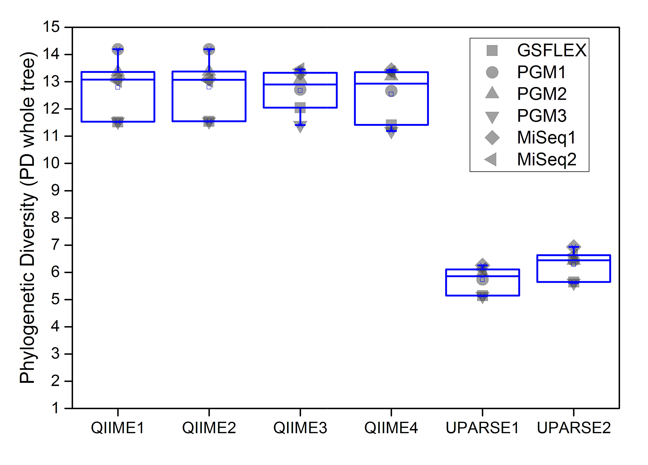
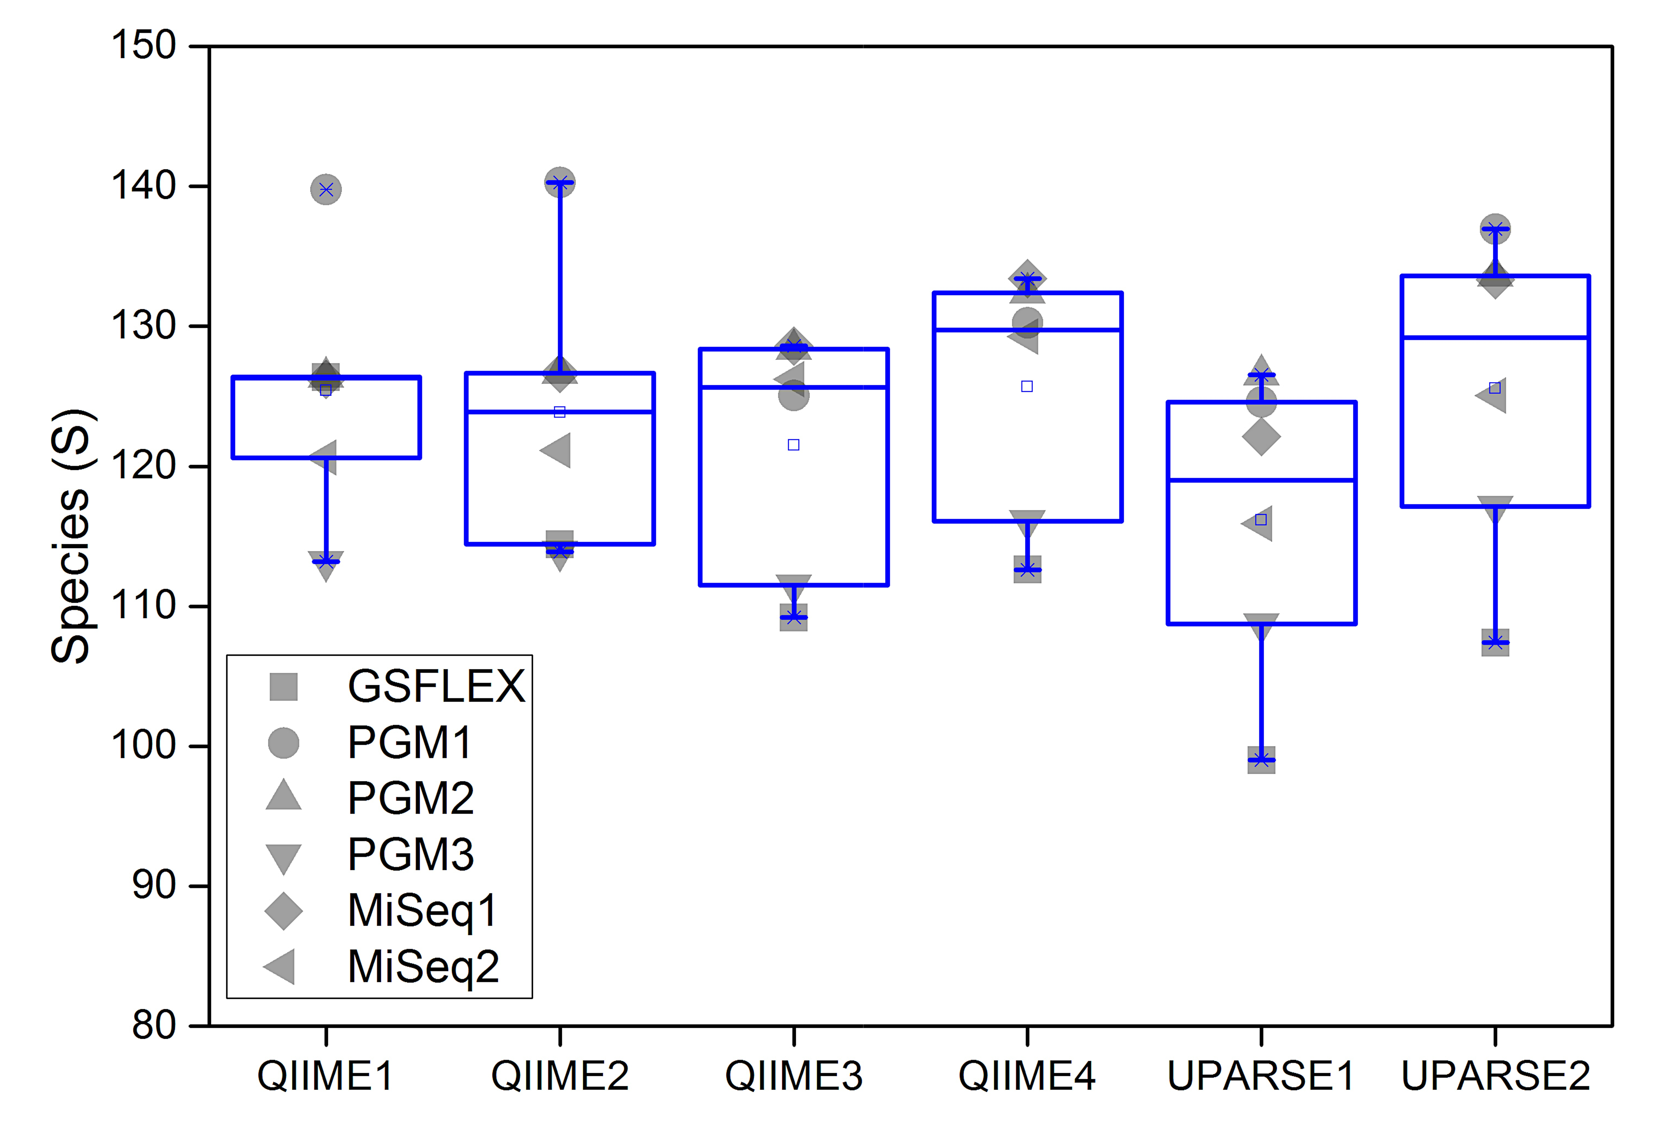
Phylogenetic Diversity
ANALYSIS PIPELINE
QIIME1
QIIME2
QIIME3
QIIME4
UPARSE1
UPARSE2
(A)
GSFLEX | MiSeq1 | 0.015 | 0.06 | 0.18 | 0.015 | 0.015 | 0.015
GSFLEX | MiSeq2 | 0.03 | 0.075 | 0.075 | 0.03 | 0.015 | 0.03
MiSeq1 | MiSeq2 | 1 | 1 | 1 | 1 | 1 | 1
PGM1 | MiSeq2 | 0.135 | 0.06 | 0.69 | 1 | 0.555 | 1
PGM1 | MiSeq1 | 0.06 | 0.12 | 1 | 0.645 | 0.045 | 0.105
PGM1 | GSFLEX | 0.015 | 0.015 | 1 | 0.225 | 0.195 | 0.015
PGM2 | PGM3 | 0.015 | 0.03 | 0.015 |  | 0.015 | 0.015
PGM2 | MiSeq2 | 1 | 1 | 1 | 1 | 1 | 1
PGM2 | MiSeq1 | 1 | 1 | 1 | 1 | 1 | 0.15
PGM2 | GSFLEX | 0.015 | 0.015 | 0.33 | 0.03 | 0.015 | 0.015
PGM2 | PGM1 | 0.36 | 0.435 | 1 | 1 | 1 | 1
PGM3 | PGM1 | 0.015 | 0.015 | 0.075 | 0.015 | 0.105 | 0.015
PGM3 | GSFLEX | 1 | 1 | 1 | 1 | 1 | 1
PGM3 | MiSeq1 | 0.015 | 0.015 | 0.015 | 0.015 | 0.015 | 0.015
PGM3 | MiSeq2 | 0.045 | 0.03 | 0.015 | 0.015 | 0.015 | 0.015
PLATFORM
Species Richness
(B)
GSFLEX | MiSeq1 | 0.075 | 0.195 | 0.09 | 0.105 | 0.03 | 0.03
GSFLEX | MiSeq2 | 1 | 1 | 1 | 1 | 0.36 | 0.93
MiSeq1 | MiSeq2 | 0.015 | 0.015 | 0.105 | 0.225 | 0.075 | 0.015
PGM1 | MiSeq2 | 1 | 1 | 1 | 1 | 1 | 1
PGM1 | MiSeq1 | 0.015 | 0.015 | 1 | 1 | 0.705 | 0.195
PGM1 | GSFLEX | 1 | 1 | 1 | 1 | 1 | 1
PGM2 | PGM3 | 0.18 | 0.165 | 0.03 | 0.03 | 0.105 | 0.06
PGM2 | MiSeq2 | 1 | 1 | 1 | 1 | 1 | 1
PGM2 | MiSeq1 | 0.255 | 0.255 | 0.015 | 0.015 | 0.015 | 0.015
PGM2 | GSFLEX | 1 | 1 | 0.09 | 0.285 | 1 | 1
PGM2 | PGM1 | 0.015 | 0.03 | 1 | 1 | 1 | 1
PGM3 | PGM1 | 0.015 | 0.03 | 1 | 1 | 1 | 1
PGM3 | GSFLEX | 0.3 | 0.225 | 0.015 | 0.015 | 0.015 | 0.015
PGM3 | MiSeq1 | 1 | 1 | 0.06 | 0.03 | 0.075 | 0.09
PGM3 | MiSeq2 | 0.015 | 0.015 | 0.015 | 0.03 | 0.015 | 0.015
PLATFORM
Significantly different (p<0.05)
Figure 3
Not significantly different (p>0.05)

Slide 4
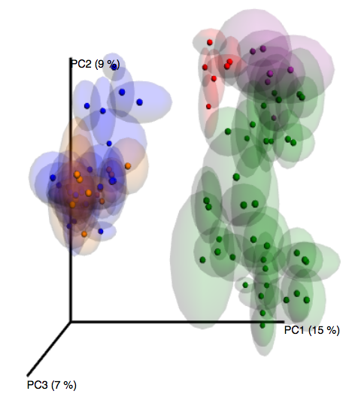
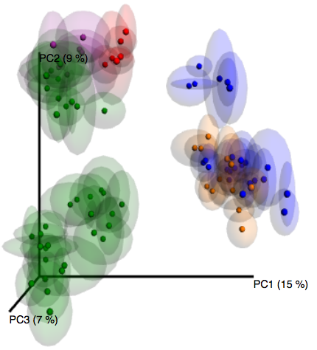
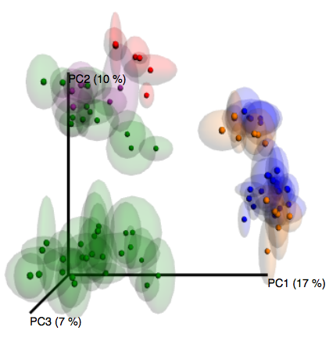
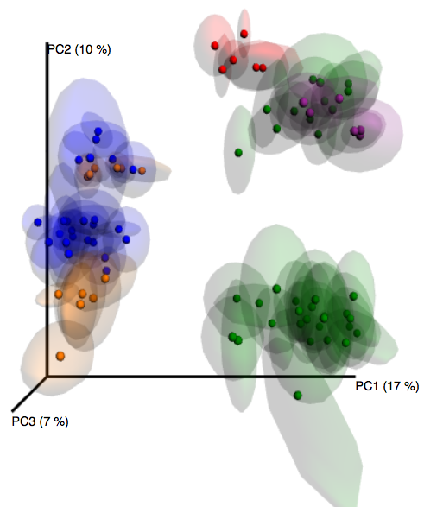
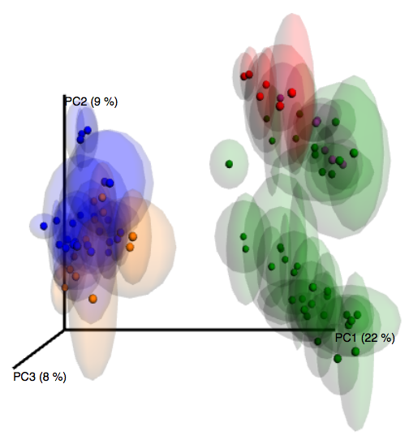
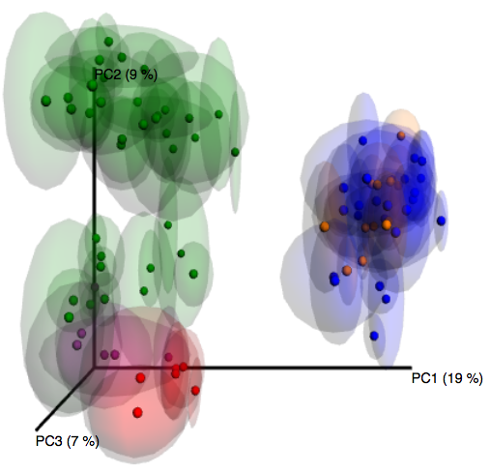

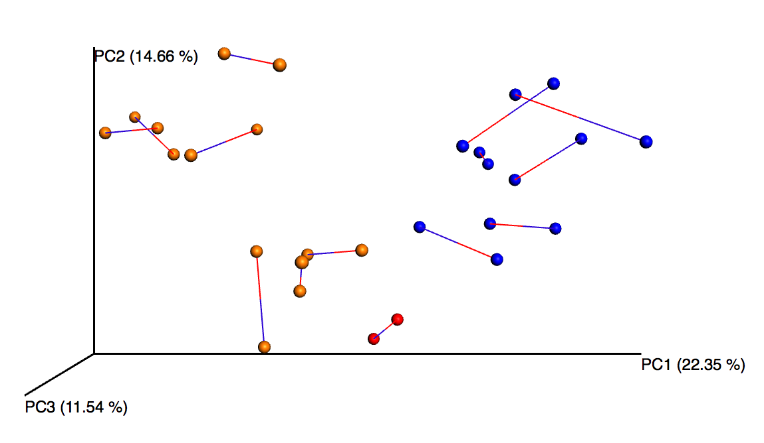
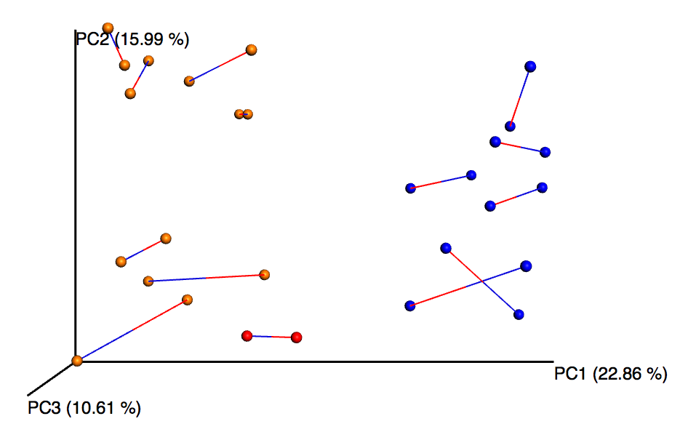
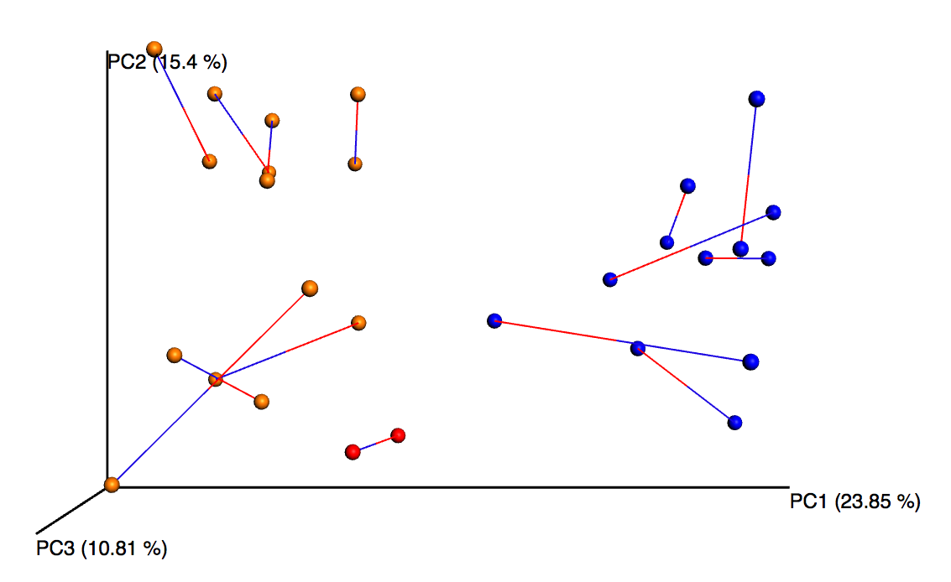
(A)
QIIME1
QIIME2
QIIME3
ANOSIM R=0.4946, P=0.001,
PERMANOVA F=7.2165, P=0.001,
ANOSIM p=0.001, R=0.4998
PERMANOVA p=0.001, F=7.3045
ANOSIM p=0.001, R=0.5015
PERMANOVA p=0.001, F=8.4217
QIIME4
UPARSE1
UPARSE2
ANOSIM p=0.001, R=0.5052
PERMANOVA p=0.001, F=8.6540
ANOSIM p=0.001, R=0.5768
PERMANOVA p=0.001, F=10.1628
ANOSIM p=0.001, R=0.5554
PERMANOVA p=0.001, F=9.4836
Control-Challenged
Vaccinated
Vaccinated - Challenged
Prebiotics
Prebiotics-Challenged
(B)
GS FLEX – MiSeq1
GS FLEX – PGM1
MiSeq– PGM1
Monte Carlo p < 0.01
M²= 0.387
Monte Carlo p < 0.01
M²= 0.345
Monte Carlo p < 0.01
M²= 0.482

Slide 5
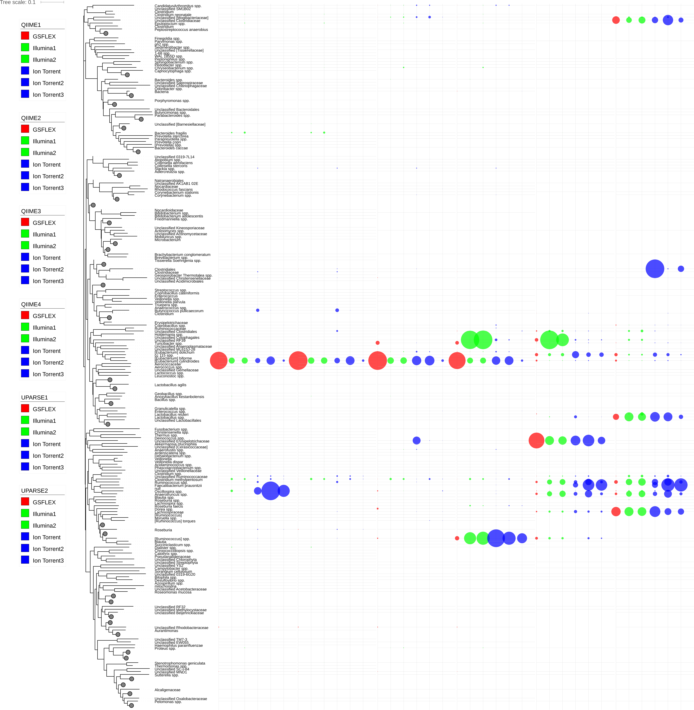
QIIME1
QIIME2
QIIME3
QIIME4
UPARSE1
UPARSE2
GS FLEX
Illumina1
Illumina2
PGM1
PGM2
PGM3

Slide 6

Cyanobacteria
Fusobacteria
Verrucomicrobia
Chloroflexi
Chlorobi
Other
Tenericutes
Thermi
TM7
Actinobacteria
Bacteroidetes
Firmicutes
Proteobacteria
De novo
*
QIIME
Open ref
*
*
UPARSE
Bifidobacterium adolescentis
Bifidobacterium spp.
Lactobacillus
Lactobacillus_agilis
Lactobacillus_iners
Lactobacillus_reuteri
Lactobacillus_spp.
Lactobacillus_zeae
Tepidimicrobium_spp.
Thermacetogenium_spp.
Tindallia_Anoxynatronum_spp.
Tissierella_Soehngenia_spp.

Slide 7
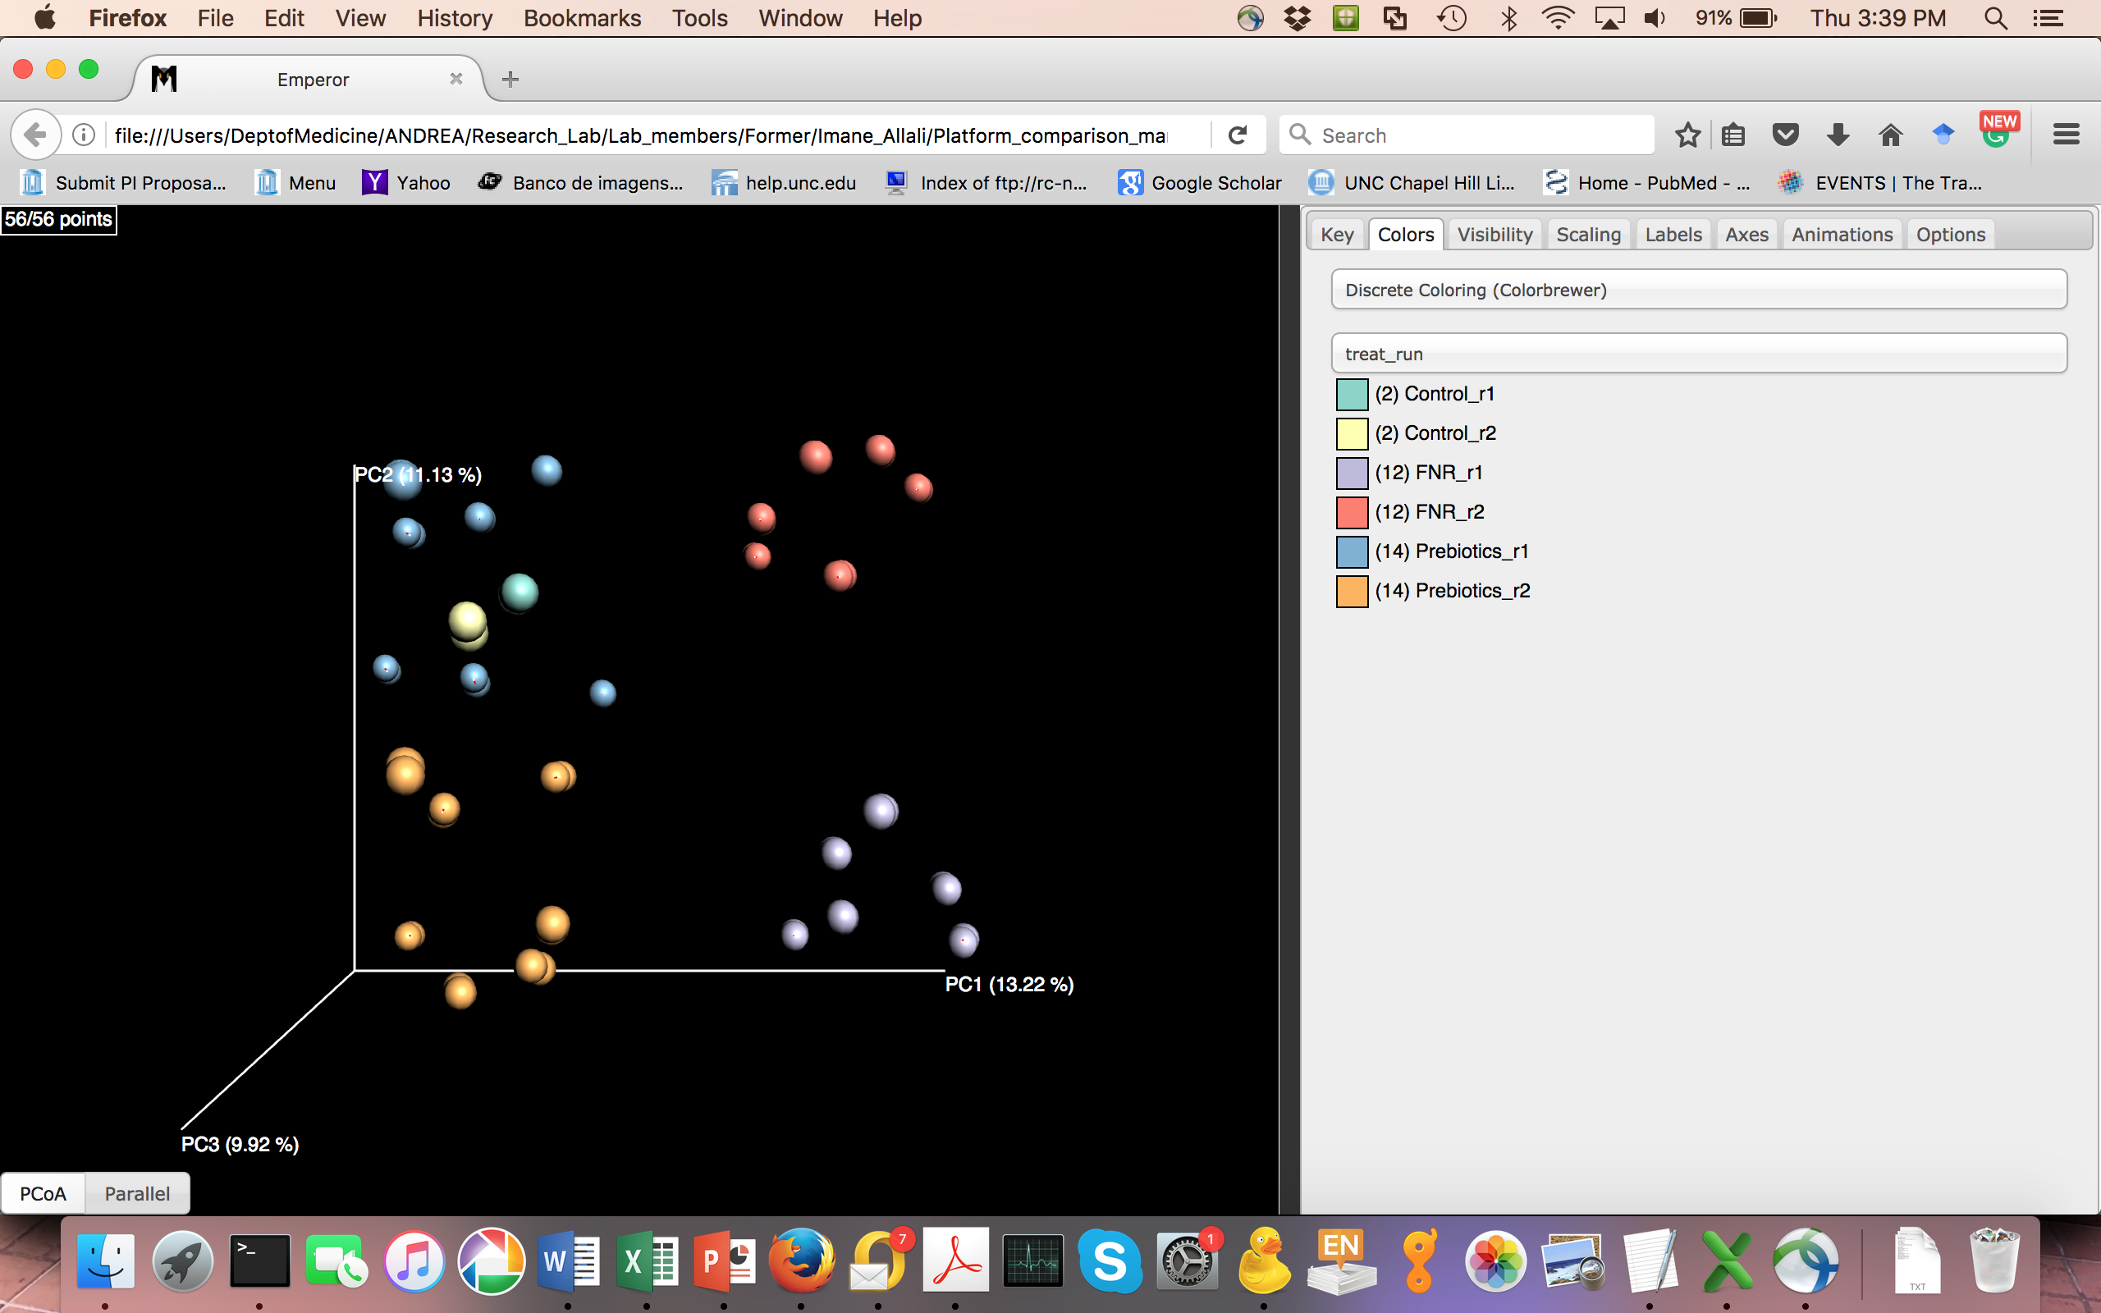
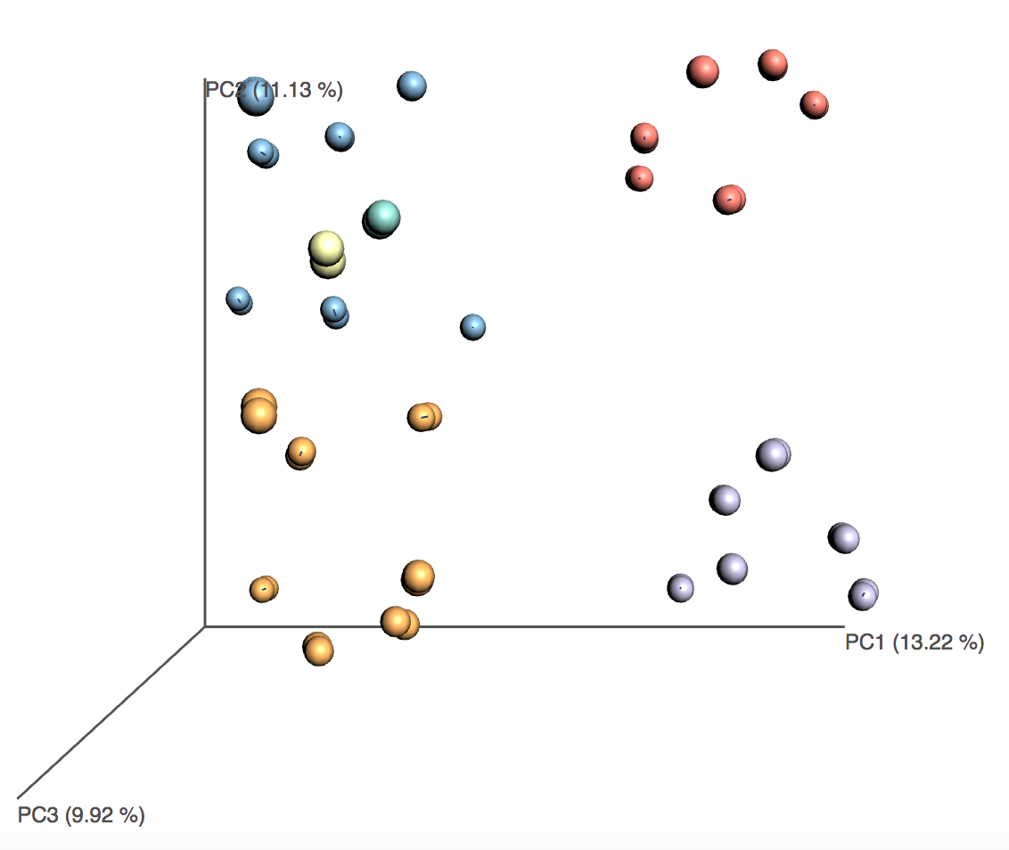
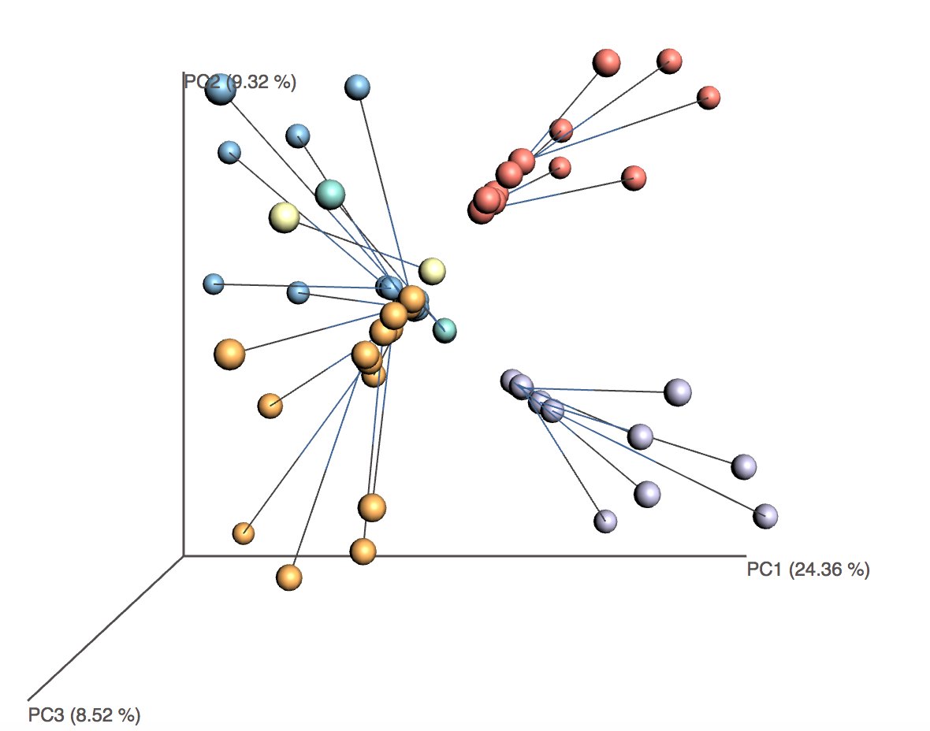
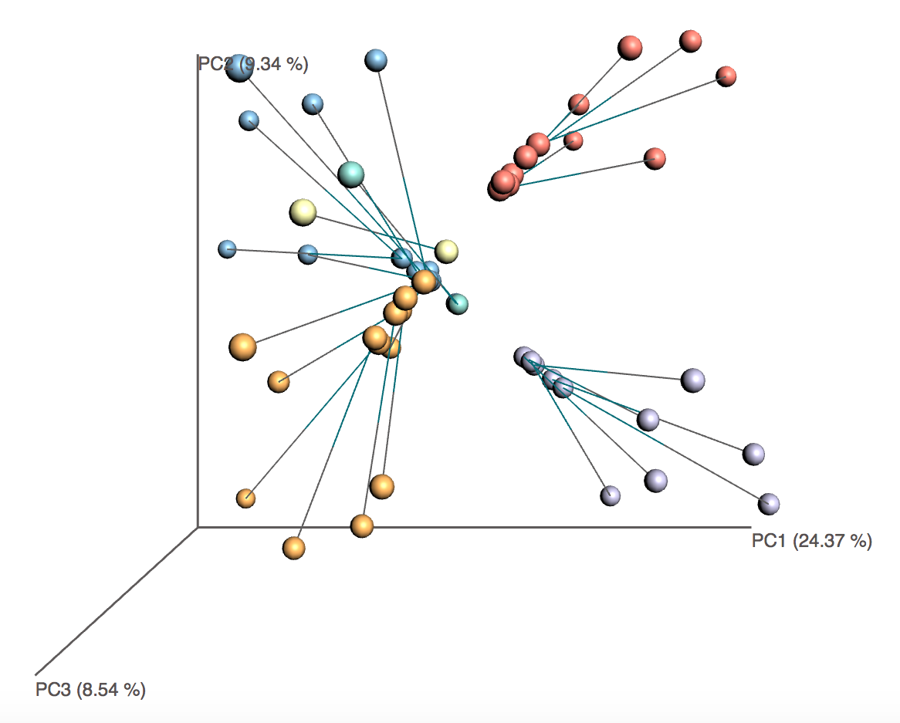
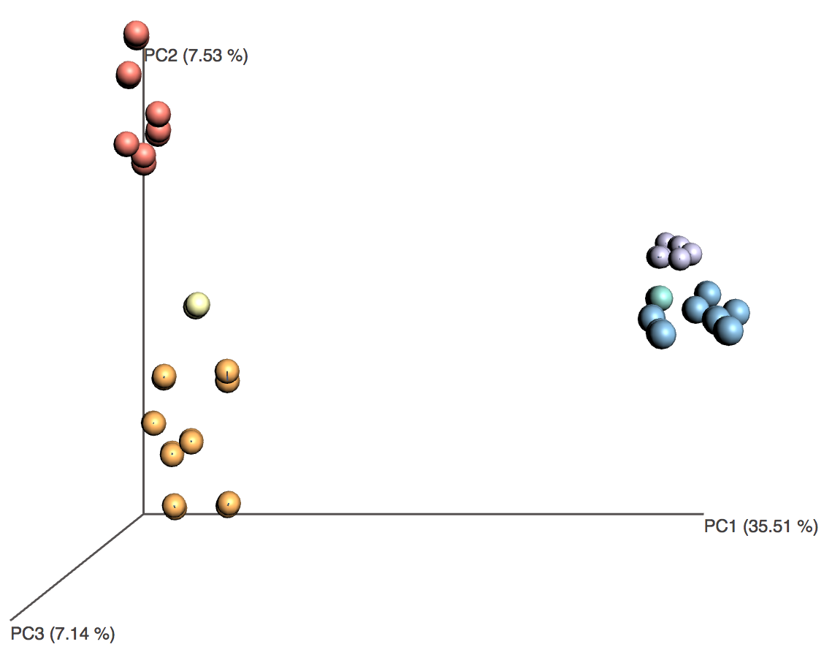
(A)
Control_run1
Vaccinated_run1
Prebiotics_run1
Control_run2
Vaccinated_run2
Prebiotics_run2
DADA2.DADA2/DADA2.QIIME
DADA2.QIIME/ QIIME.DADA2
DADA2.DADA2/QIIME.QIIME
QIIME.QIIME/ QIIME.DADA2
(B)
(C)
(D)
Vaccinated
Control
Vaccinated
Prebiotics

