Slide 1
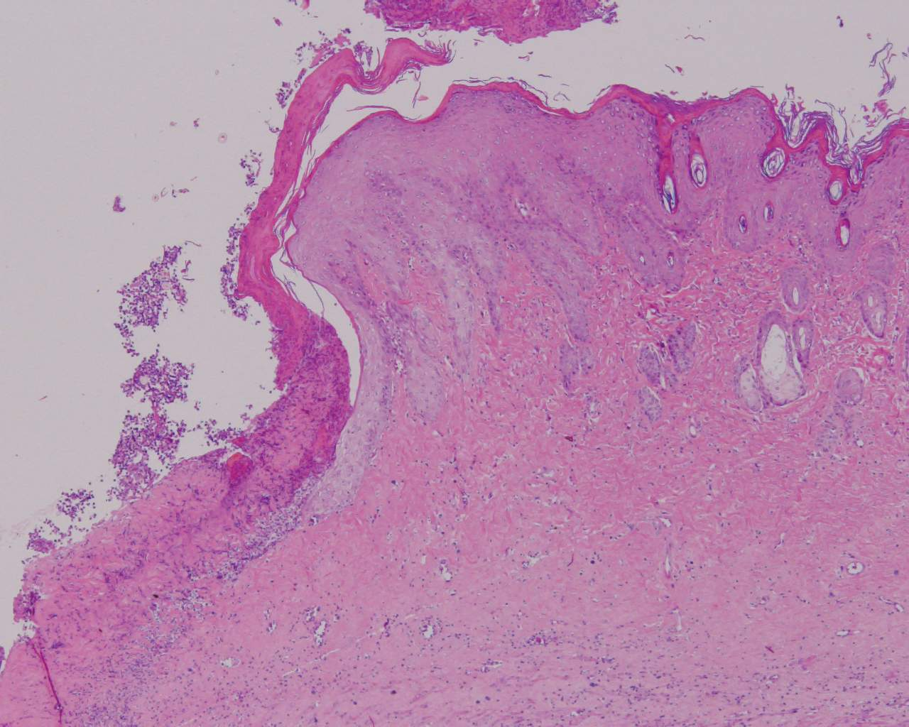
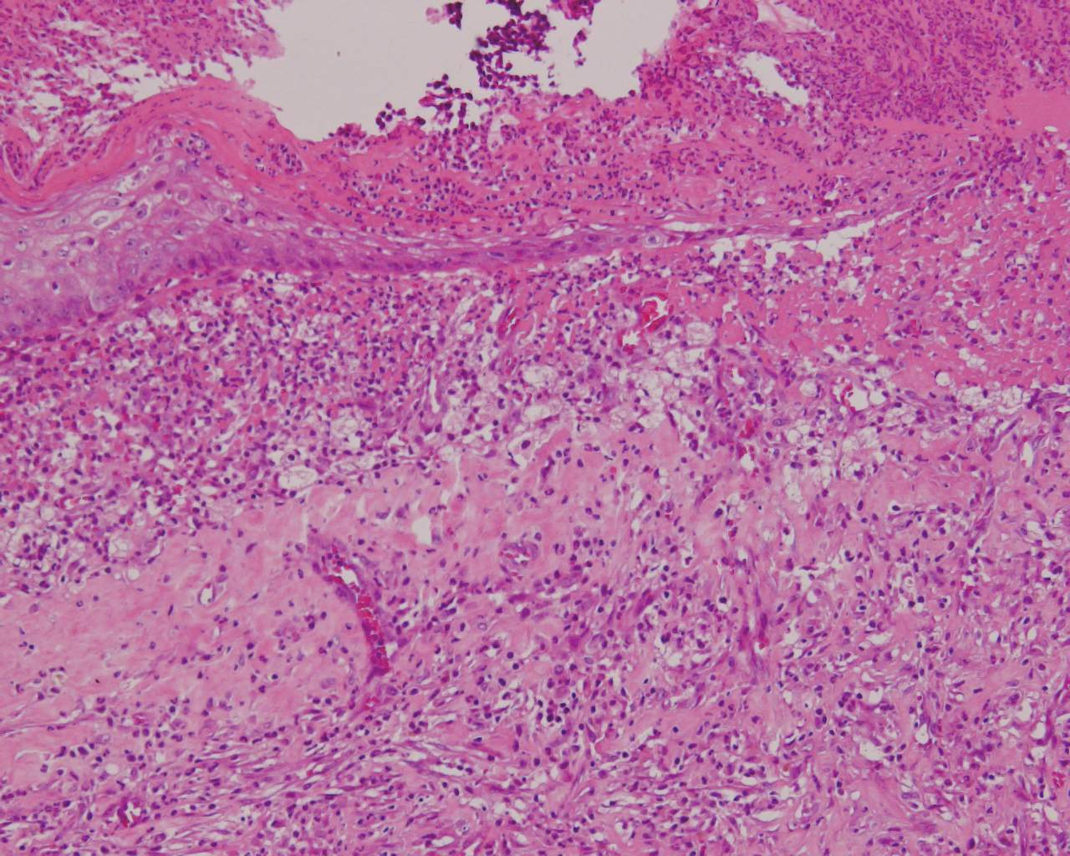
Supplementary Fig. 1
A
B
Polymorphonuclear leukocytes
Macrophages
200 μM
100 μM
Notes:
IMG_4945No3 Na欠 No7 AA処理 (2012/7/24) TRskin AA8-02 TRskin AA8-04

