Slide 1
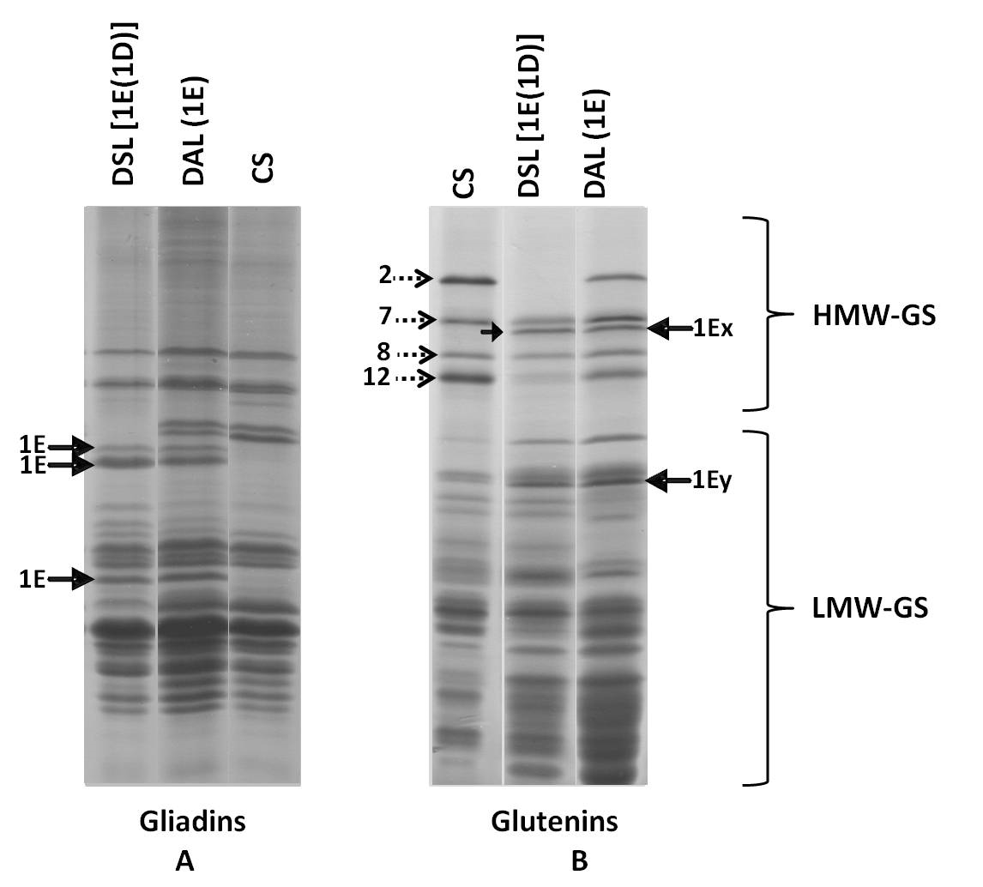
Supplementary Figure 1
Notes:
Supplementary Figure 1: Seed storage protein electrophoretic profiles for identification of Th. elongatum specific protein markers.
Gliadins profile: Three bands specific to Th. elongatum (1E, shown by arrow) were identified in disomic substitution line DSL1E(1D) and disomic addition line DAL(1E) in case of the gliadins profile. These bands were used as markers for screening Th. elongatum specific gliadins (Chromosome 1ES) in further crosses.
Glutenins profile: Two bands specific to Th. elongatum (1Ex and 1Ey; shown by arrow) were identified. 1Ex was marked below 1B7x and 1Ey was located in LMW Glutenin region. These bands were used as markers for screening Th. elongatum specific glutenins (Chromosome 1EL) in further crosses.

Slide 2
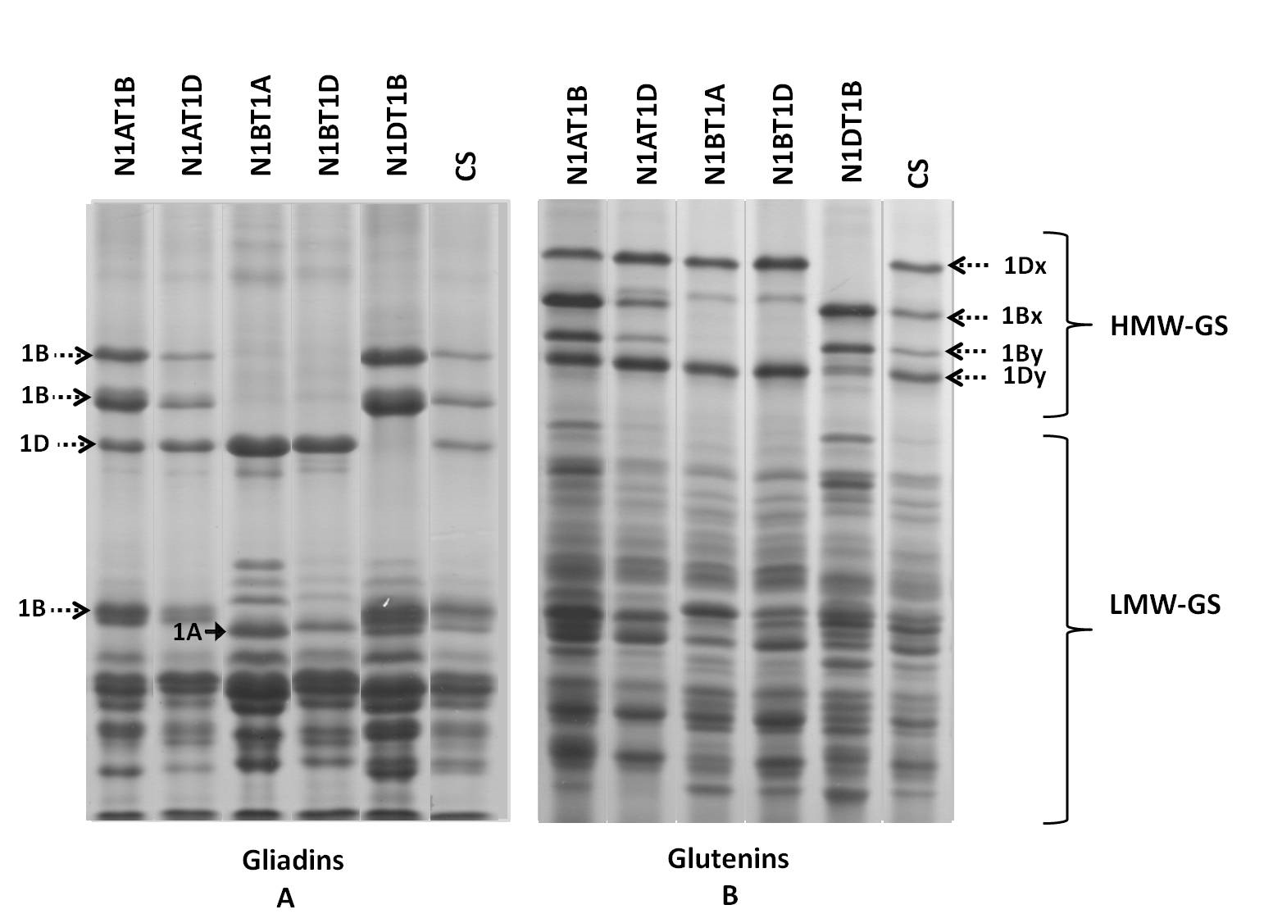
Supplementary Figure 2
Notes:
Supplementary Figure 2: Seed storage protein electrophoretic profiles for identification of Chinese spring specific protein markers.
A) Gliadins profile: Nulli tetra genetic stocks in Chinese spring background were used to identify chromosome 1A specific gliadins (1A shown by arrow). These were used as markers for screening of Chromosome 1AS specific gliadins.
B) Glutenins profile: Nulli tetra genetic stocks in Chinese spring background were used to identify chromosome 1A specific glutenins. As Chromosome 1A specific glutenins are not expressed in Chinese spring, we could not find marker for chromosome 1AL

Slide 3
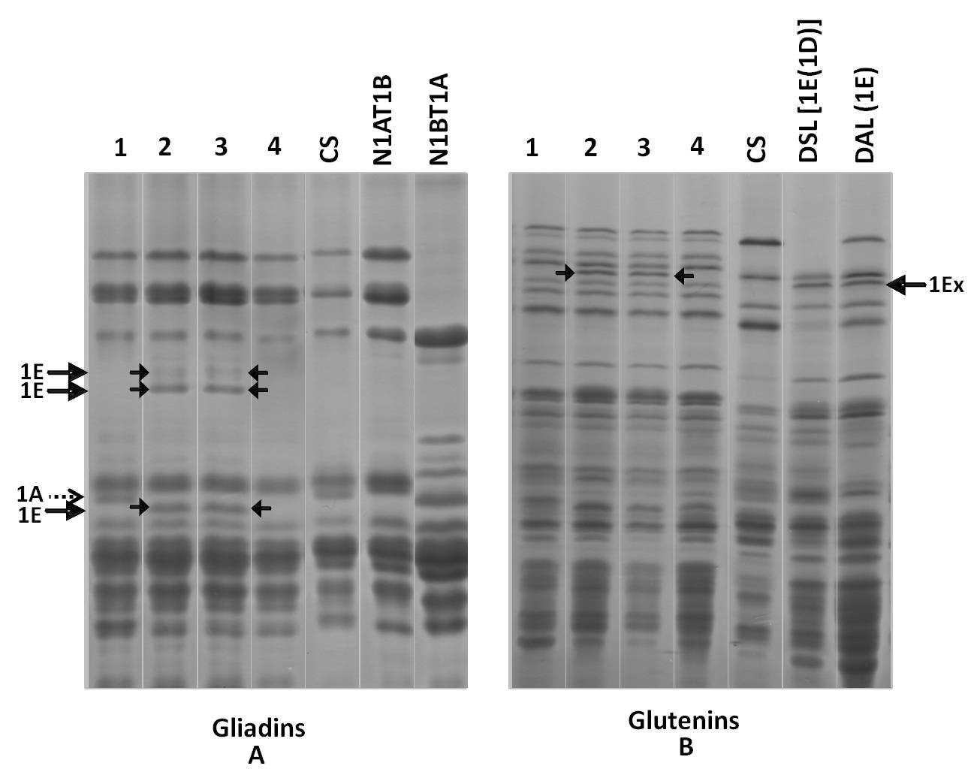
Supplementary Figure 3
Notes:
Supplementary Figure 3: Screening of seeds of different crosses on the basis of Th. elongatum specific protein markers.
Gliadin profile: Seeds 2 and 3 showing presence of Th. elongatum specific gliadins (Chromosome 1ES) and absence of 1AS Chinese spring specific band
Glutenin profile: Seeds 2 and 3 showing presence of Th. elongatum specific glutenins (Chromosome 1EL)
By screening both gliadin and glutenin profile it was revealed that seeds 2 and 3 contained Th. elongatum chromosomes. these seeds were selected for final screening by GISH and FISH.

Slide 4
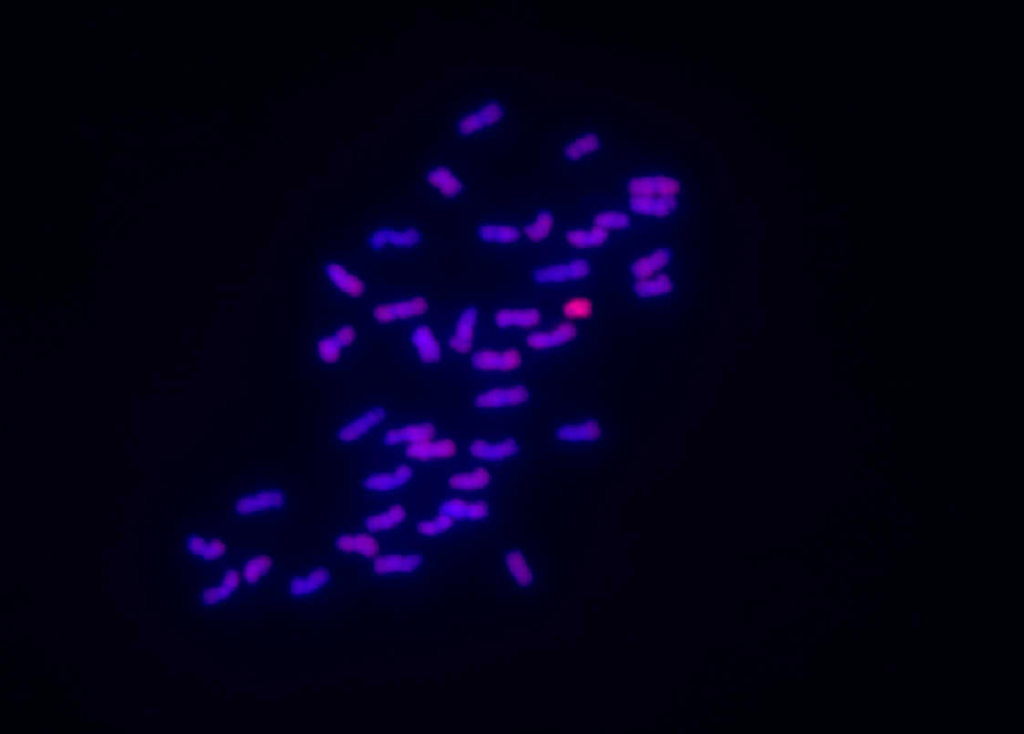
Supplementary Figure 4
Notes:
Genomic in situ Hybridization for the screening of Thinopyrum elongatum specific translocation in Triticum aestivum;
Red signal (marked with arrow) showing Th.elongatum broken chromosome. Total genomic DNA of Th. elongatum was labelled with tetramethyl-rhodamine-5-dUTP(Red) by random primer labelling method and was used as a probe. The other wheat chromosomes were counterstained with DAPI(6-diamidino-2-phenylindole ) blue.

Slide 5
Supplementary Table 1. SSR marker based screening of translocation line. Good background recovery indicated development of almost NIL of translocation line
Chromosome no. | SSR Primers | Polymorphic Markers | N61 Pattern | CS Pattern
1A | 41 | 19 | 9 | 0
1B | 28 | 7 | 7 | 0
1D | 33 | 8 | 8 | 0
2A | 27 | 6 | 6 | 0
2B | 25 | 6 | 6 | 0
2D | 26 | 10 | 10 | 0
3A | 22 | 1 | 0 | 1
3B | 24 | 6 | 5 | 1
3D | 24 | 1 | 1 | 0
4A | 21 | 4 | 4 | 0
4B | 20 | 3 | 3 | 0
4D | 20 | 2 | 2 | 0
5A | 26 | 3 | 3 | 0
5B | 19 | 1 | 1 | 0
5D | 25 | 3 | 3 | 0
6A | 30 | 6 | 6 | 0
6B | 27 | 4 | 4 | 0
6D | 25 | 5 | 0 | 0
7A | 22 | 6 | 6 | 0
7B | 26 | 9 | 9 | 1
7D | 25 | 9 | 9 | 0

