Slide 1
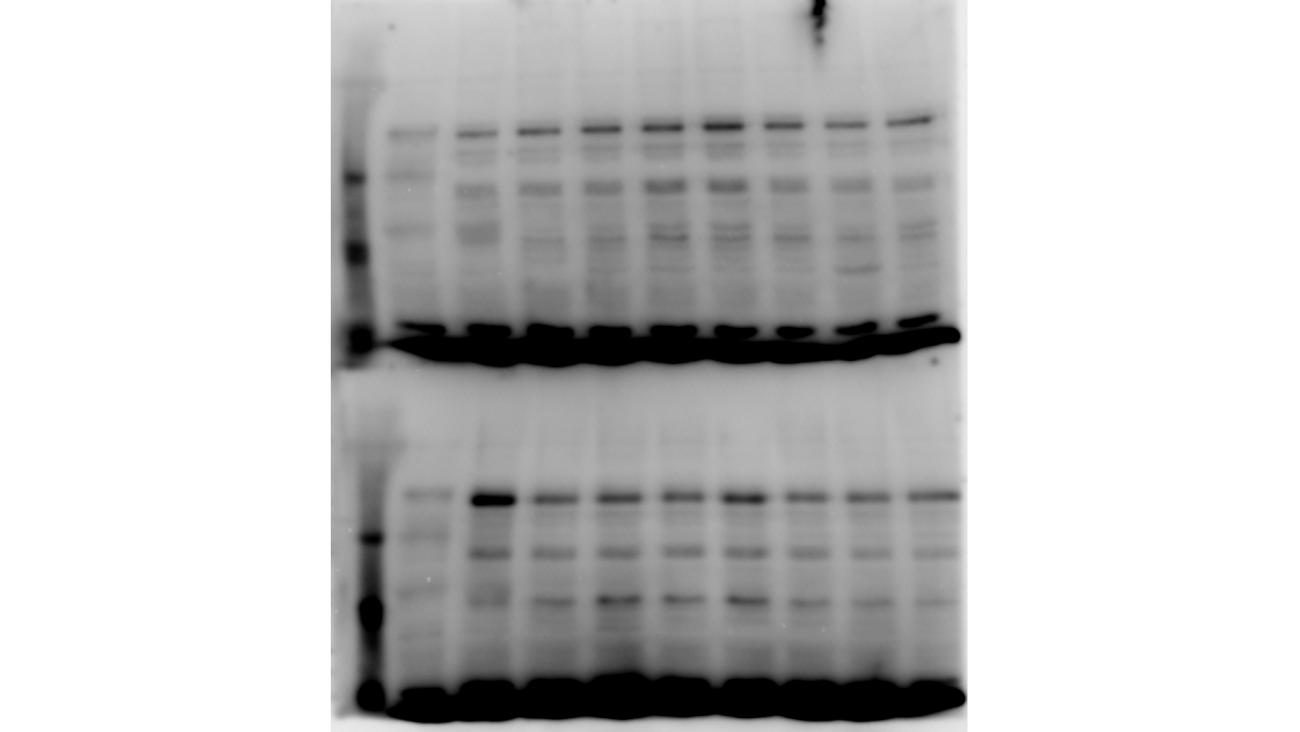
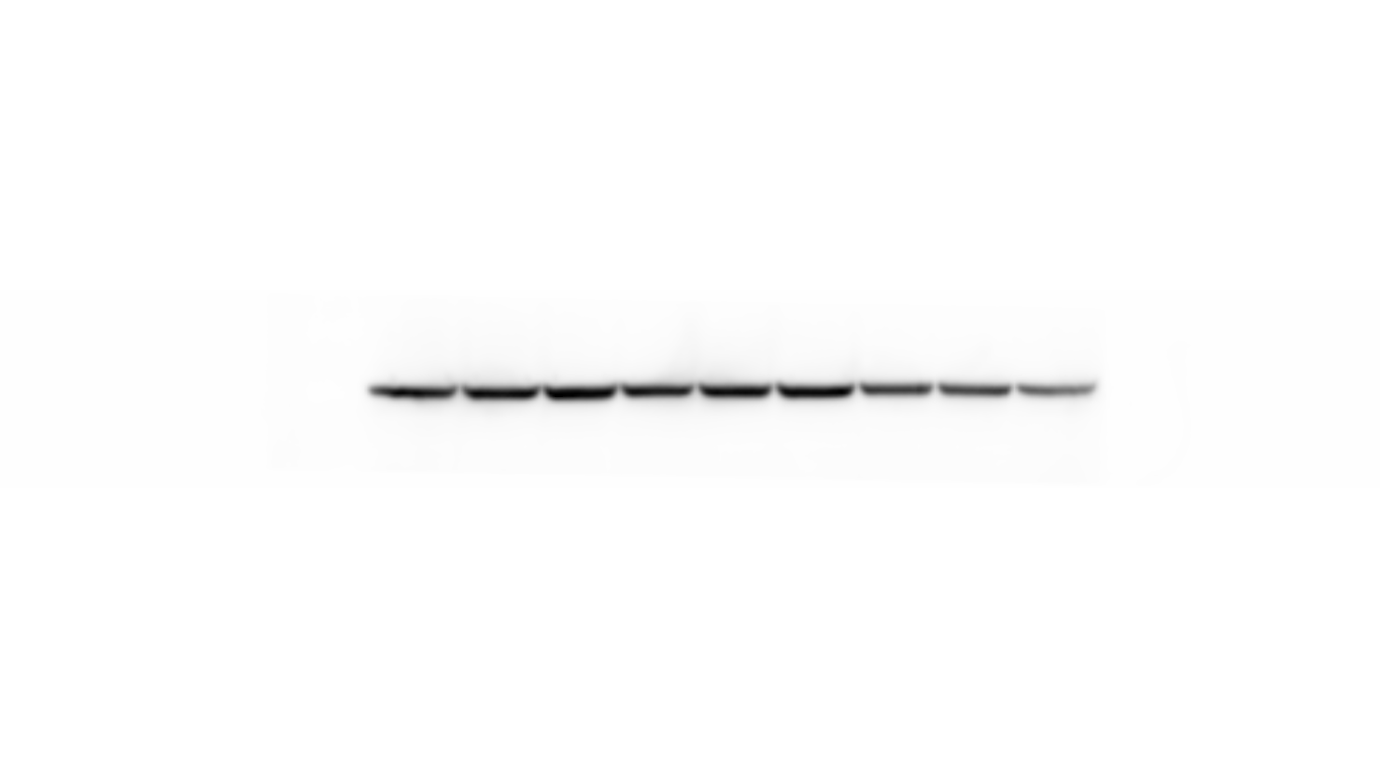
FIGURE S1.
Youssef and Han.
Role of IGFs and Low PO₂ in Osteogenic Differentiation
Room air
Low oxygen
Diff
Non-Diff
Diff
A
Non-Diff
HIF-1α
β-ACTIN
B

Slide 2





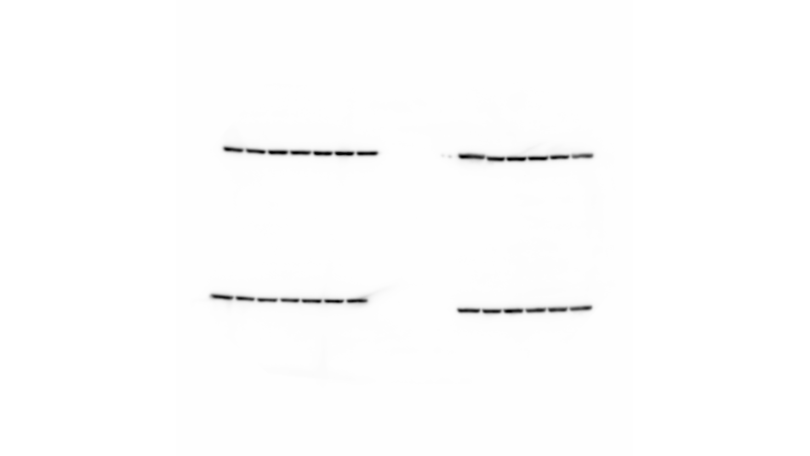
FIGURE S2.
Youssef and Han.
Role of IGFs and Low PO₂ in Osteogenic Differentiation
Related to figure 2
Room-air
Low- oxygen
Low/Room
ND
Diff
ND
Diff
ND
Diff
-
I
II
-
I
II
-
I
II
-
I
II
-
I
II
-
I
II
OCT4
SOX2
RUNX2
β-ACTIN
Notes:
SOX2 is required for osteoblasts self-renewal and inhibits their differentiation. Therefore, loss of SOX2 inhibits proliferation and maybe required for maintaining colony differentiation.
RUNX2 level is increased by low oxygen tension more so than in room air conditions.
PMSC preconditioning in low oxygen tension improves osteogenic differentiation but is opposed by IGF signaling

Slide 3
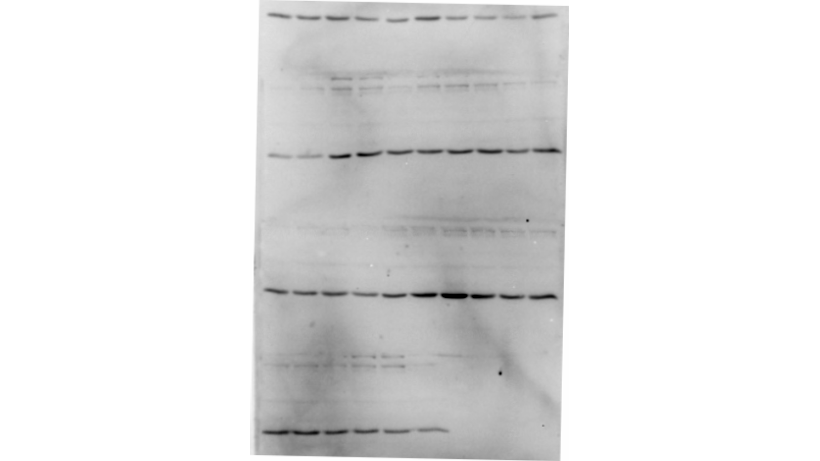
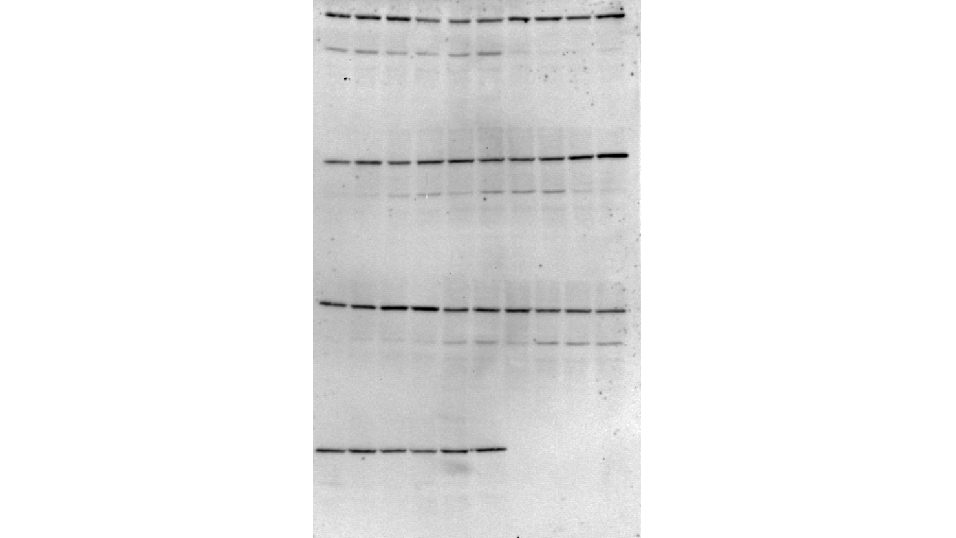
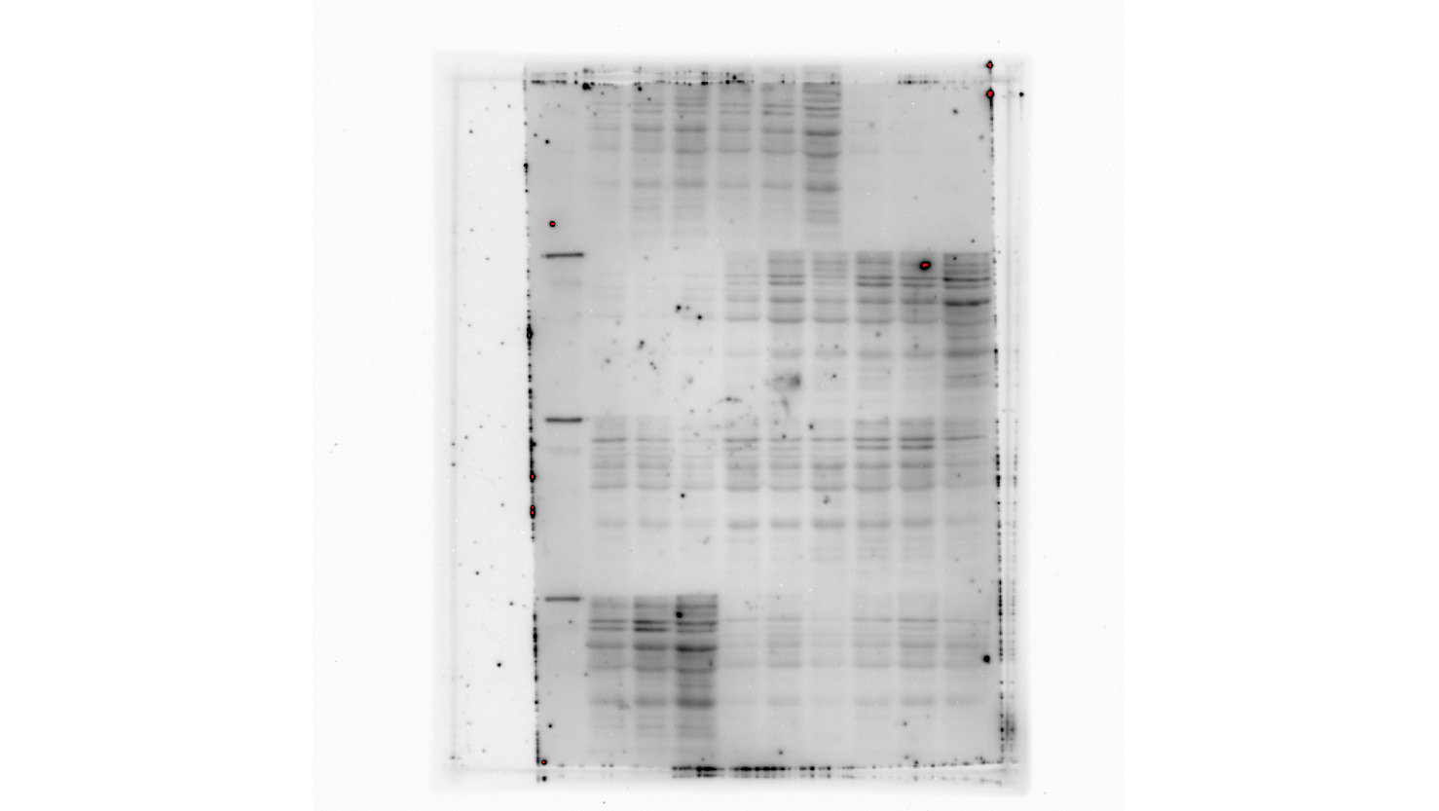
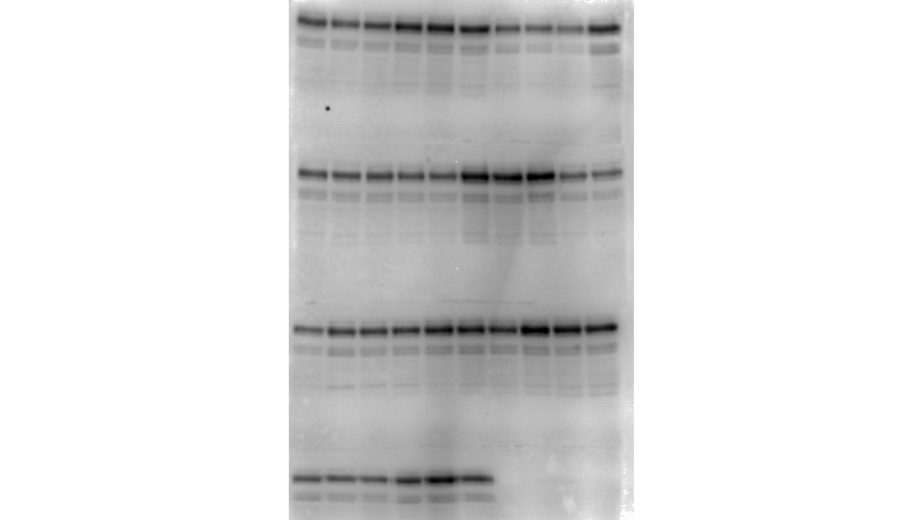
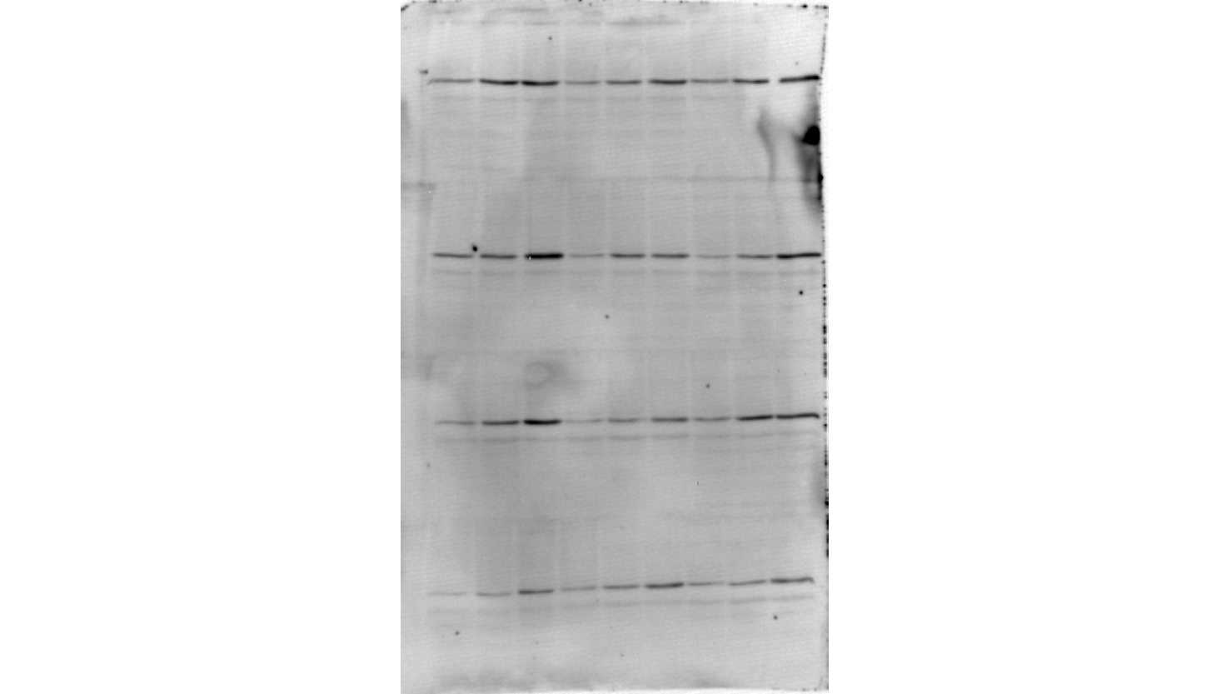
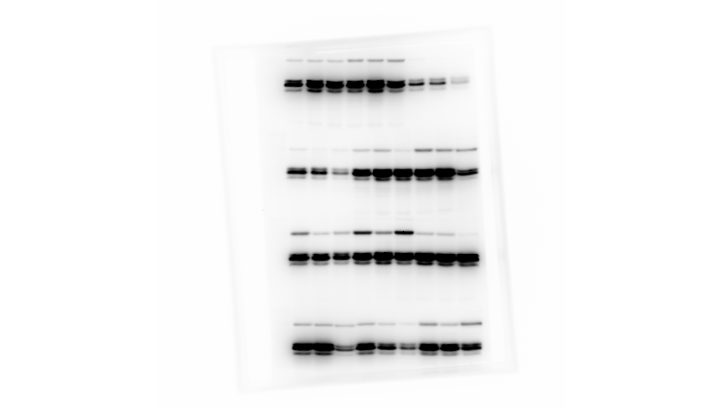
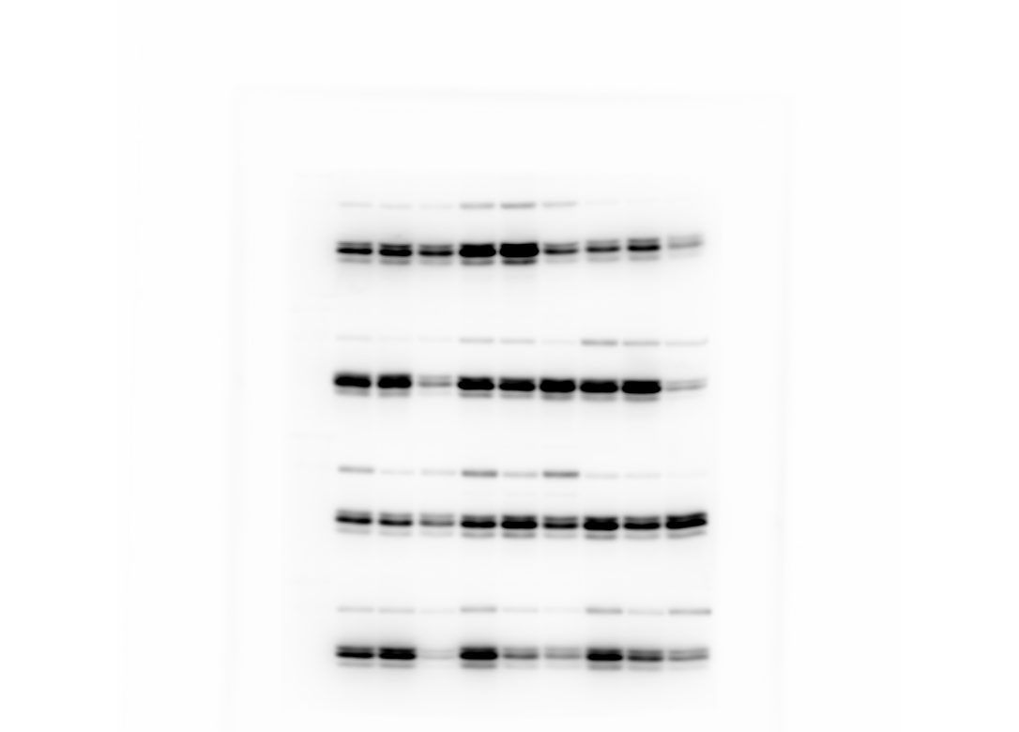
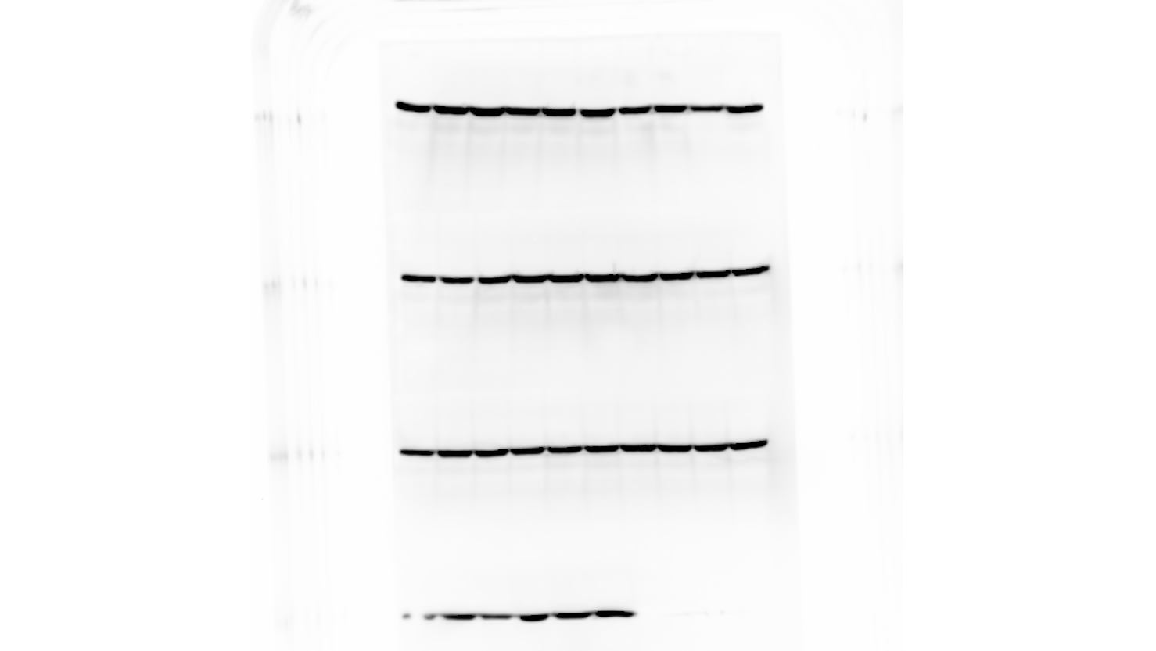
FIGURE S3.
Youssef and Han.
Role of IGFs and Low PO₂ in Osteogenic Differentiation
Related to figure 4
Room-air
Room-air
Room-air
Low-oxygen
Low-oxygen
Low-oxygen
Diff -
Diff +IGF-1
Diff +IGF-2
Diff -
Diff +IGF-1
Diff +IGF-2
3
7
14
3
7
14
3
7
14
3
7
14
3
7
14
3
7
14
Days
OCT4
SOX2
p-RUNX2
RUNX2
OPN
p-AKT
p-ERK1/2
β-ACTIN

Slide 4
FIGURE S4.
Youssef and Han.
Role of IGFs and Low PO₂ in Osteogenic Differentiation

Slide 5
FIGURE S5.
Youssef and Han.
Role of IGFs and Low PO₂ in Osteogenic Differentiation

Slide 6
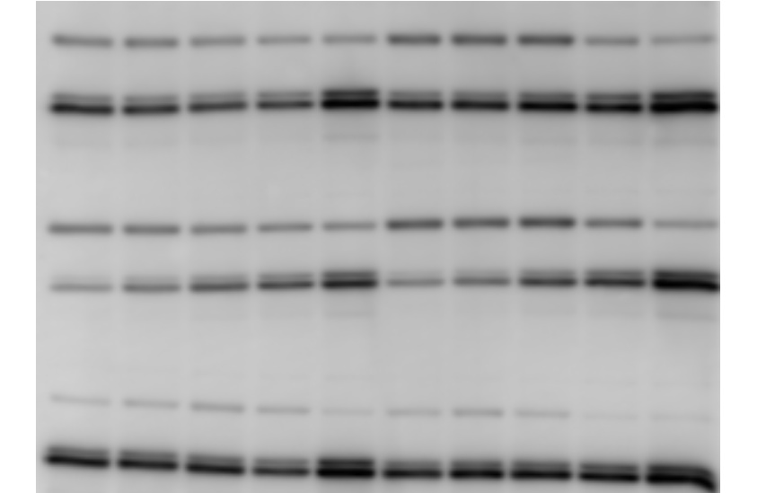
FIGURE S6.
Youssef and Han.
Role of IGFs and Low PO₂ in Osteogenic Differentiation
Room-air
-hrs
3
6
12
24
48
p-AKT
DMSO
p-ERK1/2
p-AKT
U0126
p-ERK1/2
p-AKT
p-ERK1/2
LY294002

Slide 7
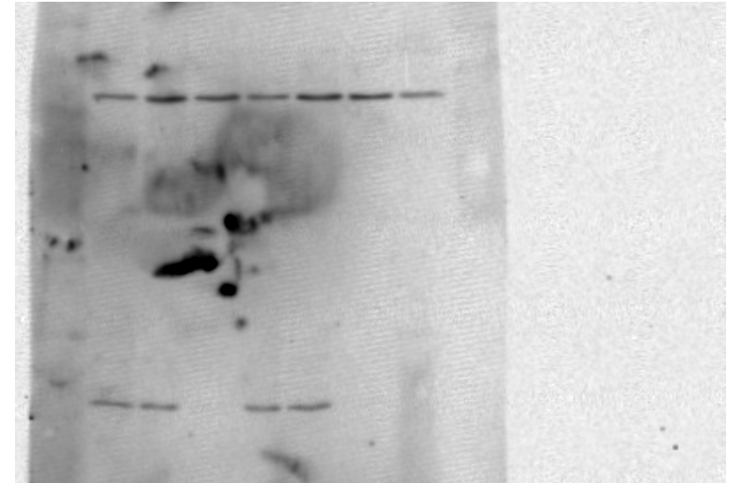
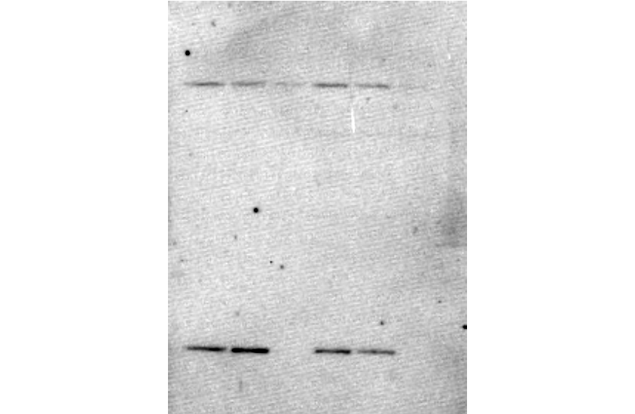
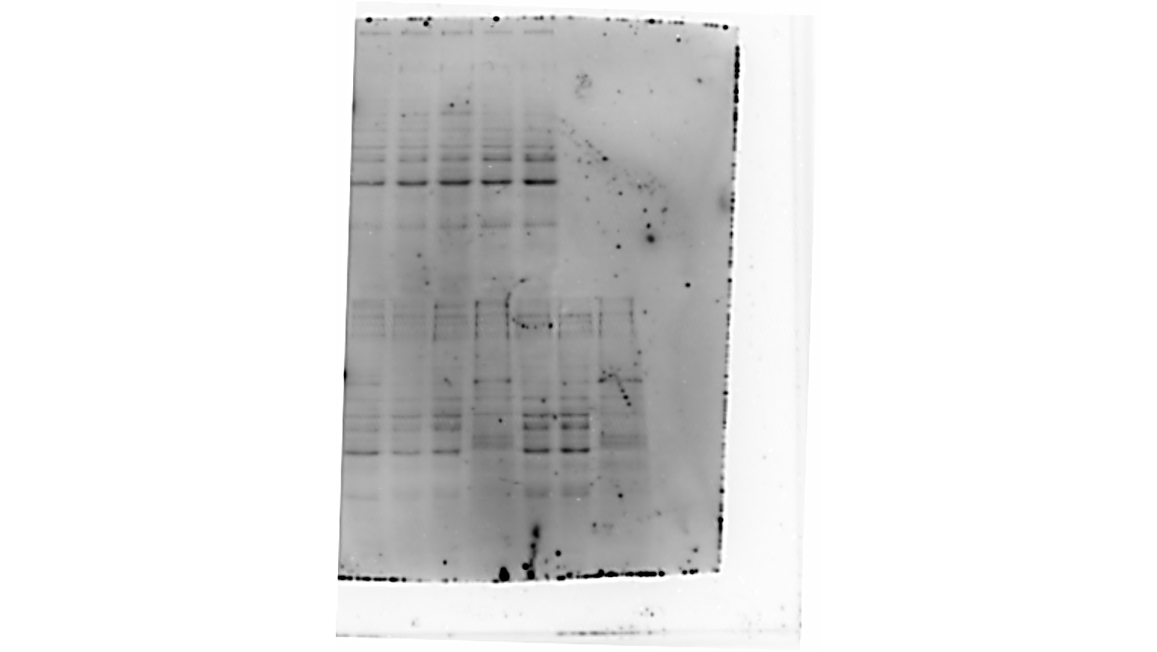
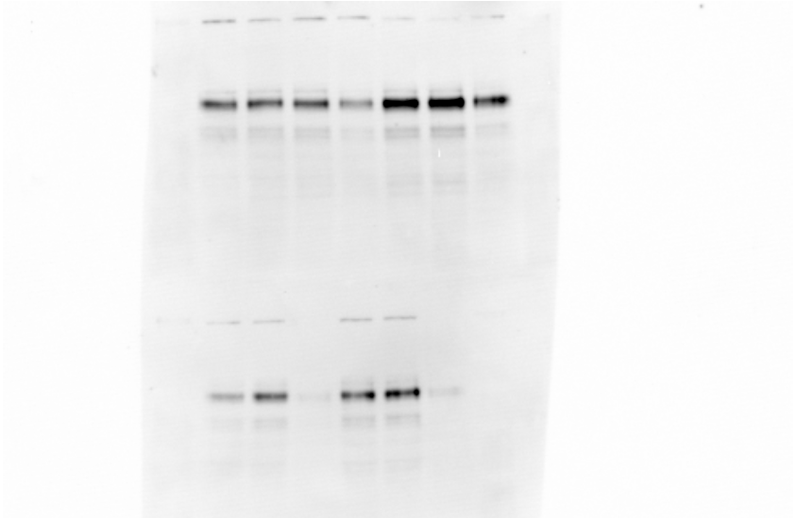
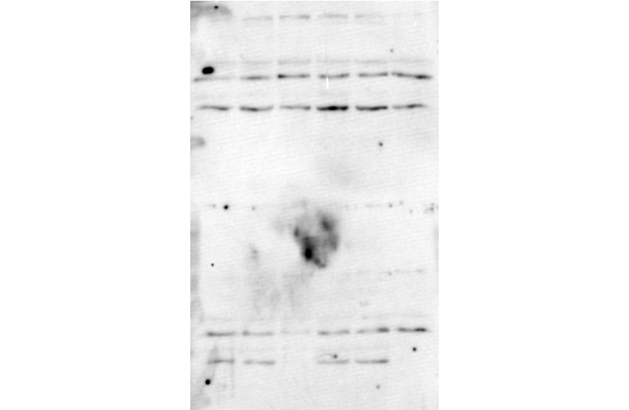
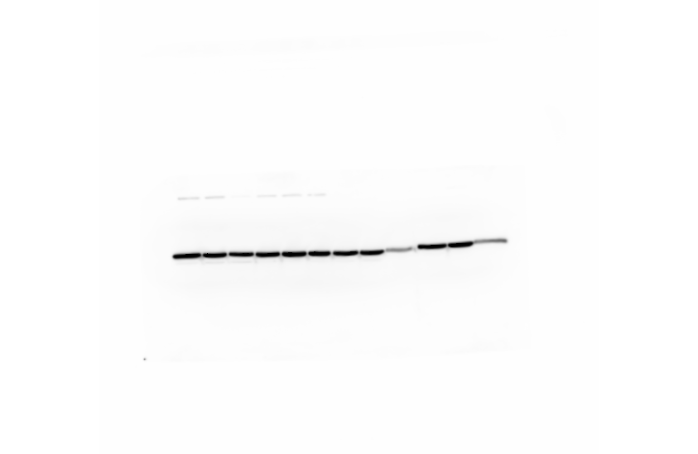
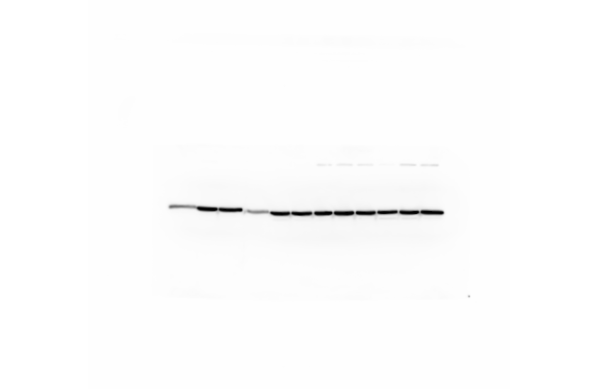
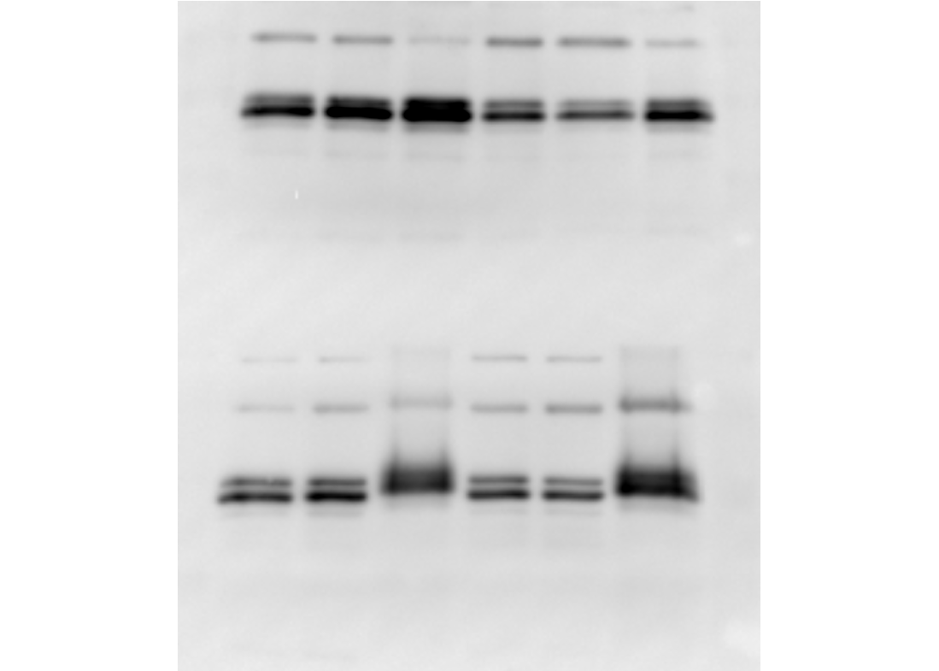
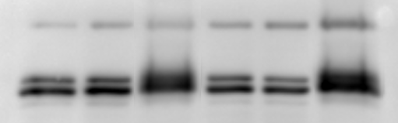
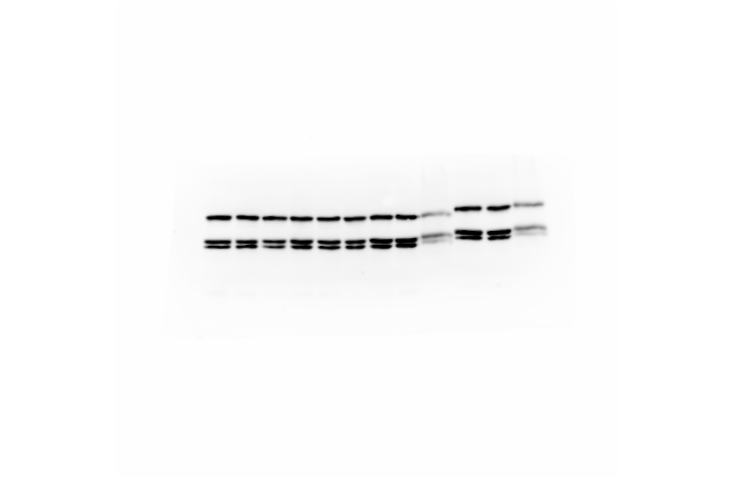
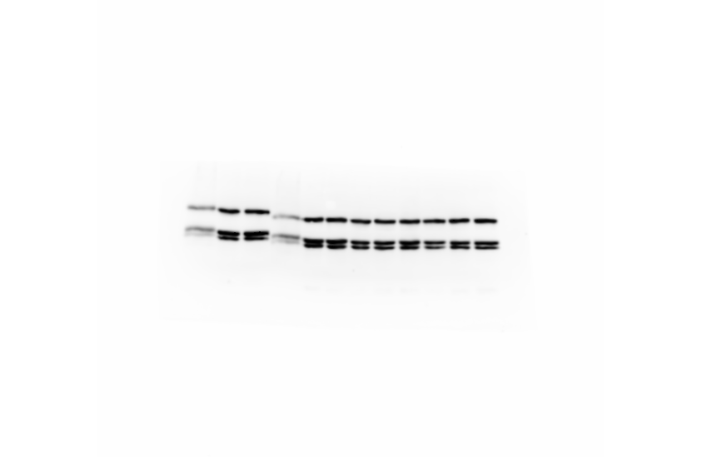
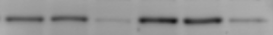
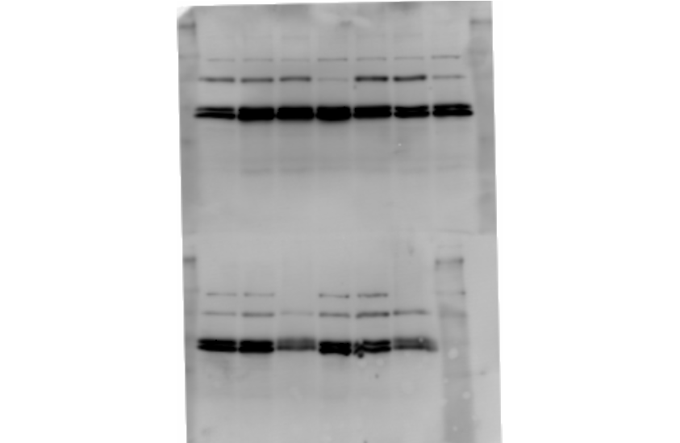
FIGURE S7.
Youssef and Han.
Role of IGFs and Low PO₂ in Osteogenic Differentiation
Related to figure 7
Room-air
Low-oxygen
ND
Diff.
ND
Diff.
(-)
U0
LY
(-)
U0
LY
(-)
U0
LY
(-)
U0
LY
OCT4
SOX2
p-RUNX2
RUNX2
OPN
β-ACTIN
p-ERK1/2
ERK1/2
p-AKT
AKT

