Slide 1
Supplementary Table S1. Anti-TNP IgE-producing hybridomas used in this study.
clone | Parental myeloma | Spleen from | Gifted by
IGEL b4 | P3X63AG8.653 | C57BL/6 | Dr. H. Karasuyama (Tokyo Medical and Dental University, Tokyo, Japan)
IGEL a2 | NS-1 | BALB/c | Dr. M. Hikida (Akita University, Akita, Japan)
H1 DNP-ε-26※ | SP2/0 | (BALB/c×A/J) F₁ | Dr. S. Taki (Shinshu University, Nagano, Japan) with the permission of Dr. S. Yamasaki (Kyushu University, Fukuoka, Japan)
※ H1 DNP-ε-26 cells were produced by immunization of 2, 4-dinitrophenyl antigens, and we confirmed that the Ab bound TNP residues by ELISPOT assay.

Slide 2
Supplementary Table S2. Reagents used in this study.
Reagents | Usage (Final concentration) | Source
Ovalbumin (OVA) | For making TNP-conjugated carrier | Sigma-Aldrich Co. LLC., St Louis, MO
LPS (from Escherichia coli 055:B5) | Aggregation assay (10 μg/ml) ELISPOT assay (of aggregated cells) (10 μg/ml) | Sigma-Aldrich
Rabbit gamma-globulin (RGG) | For making TNP-conjugated carrier | Sigma-Aldrich
Bovine serum albumin (BSA) | For making TNP-conjugated carrier | Sigma-Aldrich
TNP_{4.5}-conjugated OVA | Aggregation assay (1 μg/ml) | Our laboratory
TNP₁₈-OVA | Immunization (100 μg/mouse), Aggregation assay (1 μg/ml) | Our laboratory
TNP_{23.3}-OVA | Aggregation assay (1 μg/ml) | Our laboratory
TNP₄₁-OVA | Aggregation assay (1 μg/ml), ELISPOT assay (of aggregated cells) (1 μg/ml) | Our laboratory
TNP₄₆-RGG | Aggregation assay (1 μg/ml) | Our laboratory
TNP₂₆-BSA | Aggregation assay (1 μg/ml) | Our laboratory
TNP-LPS | Aggregation assay (10 μg/ml), Fig.1C (1 μg/ml), ELISPOT assay (of aggregated cells) (10 μg/ml) | gifted by Dr. S. Ono (Osaka Ohtani University, Osaka, Japan)
TNP₅₁-Ficoll | Aggregation assay (1 μg/ml) | gifted by Dr. S. Ono

Slide 3
Supplementary Table S3. Detection antibodies used in this study.
Target molecules | Clone |  | Isotype |  | Label | Usage (Final concentration) | Source
IgE | 23G3 |  | Rat IgG1/k |  | Biotin | Immunohistochemistry (5.0 μg/ml), ELISA (for coating) (2.0 μg/ml), Flow cytometric analysis | eBioscience, San Diego, CA
FcεRI | MAR-1 |  | Armenian Hamster IgG |  | No label or Biotin | Aggregation assay (10 μg/ml), Flow cytometric analysis | eBioscience
FcεRII | B3B4 |  | Rat IgG2a/k |  | Biotin | Aggregation assay (100 μg/ml), Flow cytometric analysis | eBioscience
FcγRII/FcγRIII | 2.4G2 |  | Rat IgG2b/k |  | No label | Administration (200 μg/mouse), Aggregation assay (5.0 μg/ml), Flow cytometric analysis (for blocking) | Tonbo Biosciences, San Diego, CA
FcγRII/FcγRIII | 93 |  | Rat IgG2a/k |  | Phycoerythrin (PE) | Flow cytometric analysis | Beckman Coulter Inc., Brea, CA
IgE | Poly-clonal |  | Goat |  | Alkaline phospatase (AP) | ELISPOT, ELISA | Southern Biotech, Birmingham, AL
IgG1 | Poly-clonal |  | Goat |  | AP | ELISPOT | Southern Biotech, gifted from Dr. K. Ishihara (Kawasaki Medical School, Okayama, Japan)
α4-integrin | PS/2 |  | Rat IgG2b/k |  | Biotin | Flow cytometric analysis | gifted from Dr. K. Miyake (The University of Tokyo, Tokyo, Japan)
α5-integrin | HMa5-1 |  | Armenian Hamster IgG |  | Biotin | Flow cytometric analysis | gifted from Dr. K. Miyake
β1-integrin | KMI6 |  | Rat IgG2a/k |  | Biotin | Flow cytometric analysis | gifted from Dr. K. Miyake
β2-integrin | Cat# 01662D |  | Rat IgG2a/k |  | Biotin | Flow cytometric analysis | Becton, Dickinson and Company, Franklin Lakes, NJ
Vascular cell adhesion molecule-1 (VCAM-1) | M/K-1 |  | Rat IgG1/k |  | Biotin | Flow cytometric analysis | gifted from Dr. K. Miyake
Intercellular adhesion molecule-1 (ICAM-1) | YN1/1.7.4 |  | Rat IgG2b/k |  | PE | Flow cytometric analysis | eBioscience
P-selectin | RB40.34 |  | Rat IgG1/k |  | Biotin | Flow cytometric analysis | Becton, Dickinson and Company
E-selectin | 10E9.6 |  | Rat IgG2a/k |  | Biotin | Flow cytometric analysis | Becton, Dickinson and Company
Isotype-control matched mAb
Isotype |  | Clone |  | Label |  | Usage | Source
Rat IgG1/k |  | eBRG1 |  | Biotin |  | Flow cytometric analysis | eBioscience
Rat IgG2a/k |  | eBR2a |  | Biotin |  | Aggregation assay , Flow cytometric analysis | eBioscience
Rat IgG2a/k |  | 11-26 |  | PE |  | Flow cytometric analysis | Beckman Coulter
Rat IgG2b/k |  | eB149/10HS |  | No label |  | Aggregation assay | eBioscience
Armenian hamster IgG |  | eBio299Arm |  | No label or Biotin |  | Aggregation assay , Flow cytometric analysis | eBioscience

Slide 4
Supplementary Table S4.
IgE concentration in SN within short-term culture.
Hours | Exp #1 (ng/ml) | Exp #2 (ng/ml)
2H | 6.59±3.18 | 15.14±9.95
4H | 23.99±8.74 | 30.71±19.09
6H | 45.26±9.14 | 54.28±24.79
After culturing IGEL b4 cells (4×10⁴/well) in 96-well plates for 2, 4 and 6 hours, the IgE levels in culture supernatant (SN) were measured by ELISA. Data represent the mean ±S.D. of triplicate cultures.

Slide 5
Supplementary Table S5. Primer pairs for detecting mRNA expression by RT-PCR.
Receptor | Forward primer | Reverse primer | Positive control
Ighe (secreted IgE) | AGCACCACCATAACGCCACA | CATCCACCTTCCCCACCACAGC | Splenocytes from immunized mice^{※1}
Ighe (membrane-bound IgE) | GGCAAACTGATCTCAAACAGC | TGTTGGCATAGTCTTGGAAGG | Splenocytes from immunized mice^{※1}
Fcer1a | GAGTGCCACCGTTCAAGACA | TGGAGACGGGGCTCTCATAA | Mast cells^{※2}
Fcer2a | AACAGCTGGGAGACACTGCAA | AGCCCTTGCCAAAATAGTAGCAC | Splenocytes from BALB/c
Fcgr2b | AAGTCTAGGAAGGACACTGC | TGCTTTTCCCAATGCCAAGG | Mast cells^{※2}
Fcgr3 | CAAGCCTGTCACCATCACTG | TTGCCATACGATGGATGGGG | Mast cells^{※2}
Fcgr4 | ATCTTCAGCATCCTTTCGTATA | TGCTGTATCACTGTTGGTCC | Peritoneal cells from C57BL/6
※1: BALB/c mice were immunized with TNP₁₈-OVA in alum twice, and spleens were collected on the 7th day after immunization.
※2: Mast cells were generated as described [S1].
Reference
[S1] Murata A, Okuyama K, Sakano S, Kajiki M, Hirata T, Yagita H, et al. A Notch ligand, Delta-like 1 functions as an adhesion molecule for mast cells. J Immunol. 2010;185: 3905-3912.

Slide 7
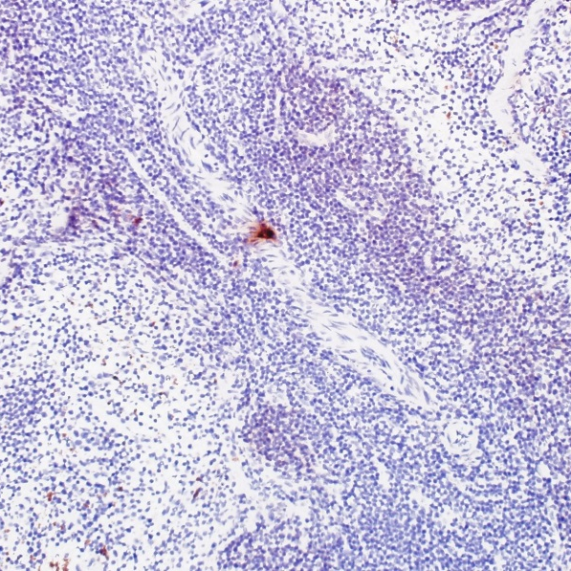
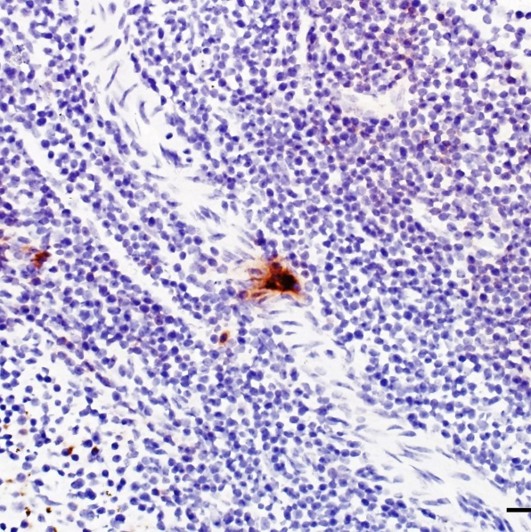
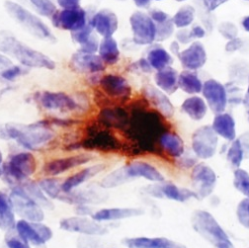
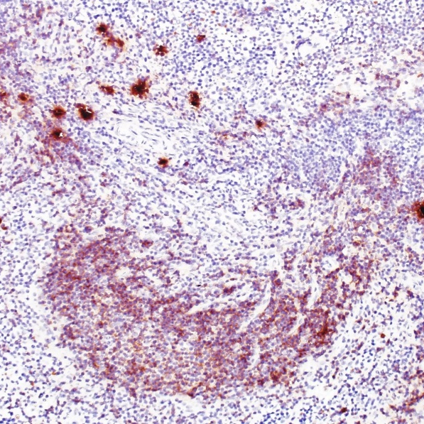
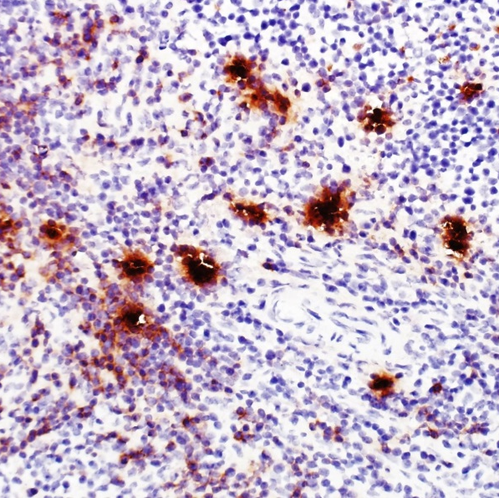
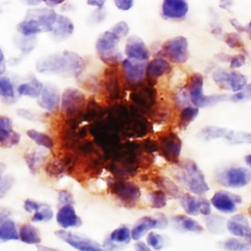
A
B
Spleen of immunized mice
Mean cell number in aggregation | 3.12±0.09
Mean aggregate number | 7.67±4.71
Total IgE-PC number out of aggregation | 71.33±21.01
Total IgE-PC number involved in aggregation | 24.33±15.08
Total IgE-PCs | 95.67±6.02
% of aggregated cells in total IgE-PCs | 26.47±16.68
PBS
TNP-OVA
in alum
100 μm
50 μm
20 μm
Supplementary Fig. S1. IgE-PCs formed cell aggregates in the spleens of immunized mice.
BALB/c mice were immunized intraperitoneally twice with TNP₁₈-OVA (100 μg) in aluminum hydroxide gel (2.0 mg) or PBS (control) as described in Materials and methods section. Seven days after the last immunization, transaxial spleen tissue sections were stained with an anti-IgE mAb (brown). (A) Representative photomicrographs of spleen sections of control (PBS) and immunized (TNP-OVA in alum) mice. (B) The number of IgE-PC aggregation and IgE-PC number in transaxial spleen sections (0.47±0.03 cm²) of three immunized mice were counted. IgE-PCs were defined as the strongly IgE⁺ cells. An aggregation of IgE-PCs was defined as a cluster consisting of more than three IgE-PCs.

Slide 8
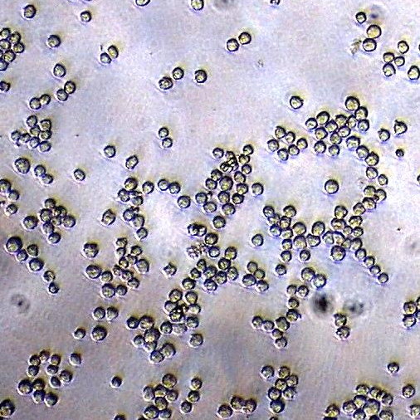
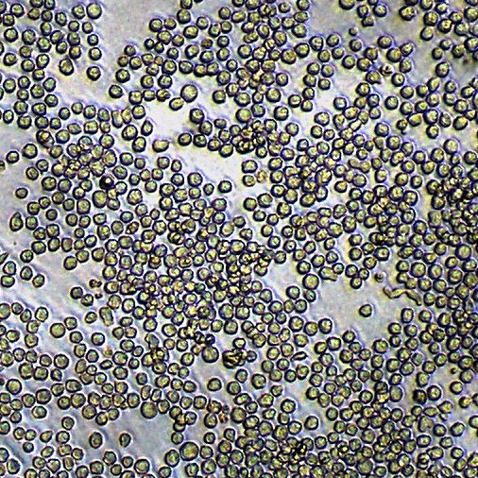
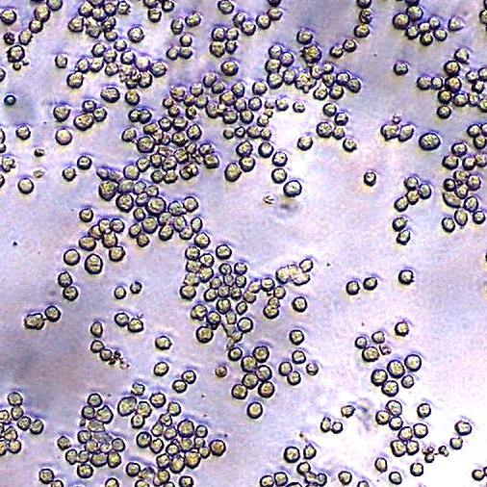
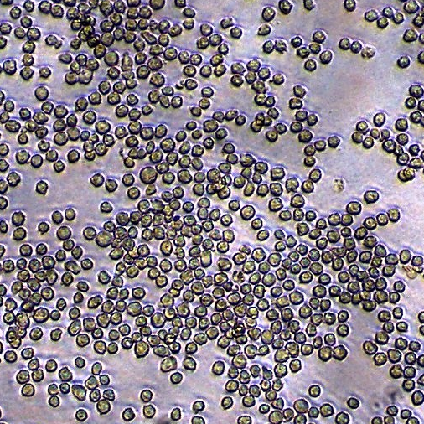
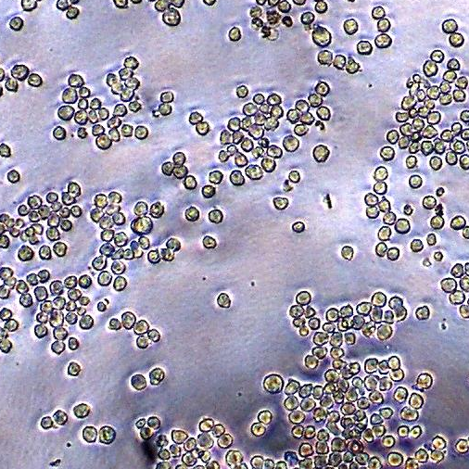
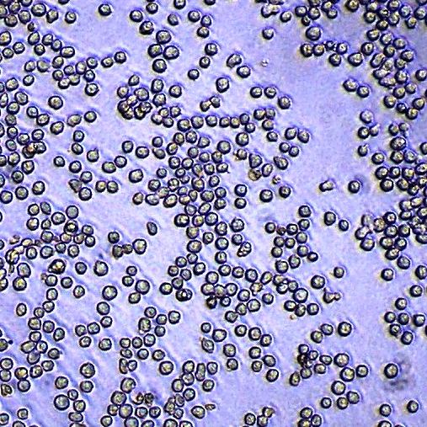
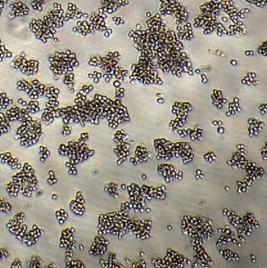
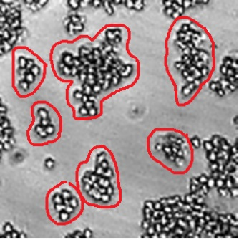
A
IGEL a2
H1 DNP-ε-26
C
D
100
∗
30
∗
PBS
20
LPS
PBS
Number of clusters
/region
Number of cells
per aggregate/region
TNP-LPS
50
10
0
IGEL b4
IGEL a2
H1 DNP-
ε-26
0
IGEL b4
IGEL a2
H1 DNP-
ε-26
LPS
E
F
10
1.0
5
0.5
Cell number (×10⁴)
Viability
TNP-
LPS
0
0
100 μm
IGEL b4
IGEL a2
H1 DNP-
ε-26
IGEL b4
IGEL a2
H1 DNP-
ε-26
B
Fig. S2C
: Number of clusters
10
30
20
Fig. S2D
: Number of cells/cluster
10
10
10
→ Total cells involved
in the cell aggregation (=Number of cluster × Number of cells/cluster)
10
= Aggregation Index (AI)
Supplementary Fig. S2. The calculation of AI values, and cell numbers and viability after the aggregation assay.
Three anti-TNP IgE-producing hybridoma cell lines were cultured with TNP-LPS (10 μg/ml), LPS (10 μg/ml) or PBS for 2 days. (A) Representative photomicrographs of IGEL a2 and H1 DNP-ε-26 cultured with indicated reagents are shown. (B) A representative photomicrograph of IGEL b4 cells cultured with TNP-LPS. Based on the photomicrographs, we counted (C) the number of clusters and (D) the number of cells in a cluster in a unit area. The ‘‘aggregation index (AI)’’ values were computed by multiplying these values. (E) The cell numbers and (F) the cell viabilities of each hybridoma after the aggregation assay with indicated reagents were shown. (E) The dotted line indicated the initial cell number (0.5×10⁴) on day 0.
Notes:
写真切り取り方(Fig.A)
3:4→4:3→3:4→1:1

Slide 9
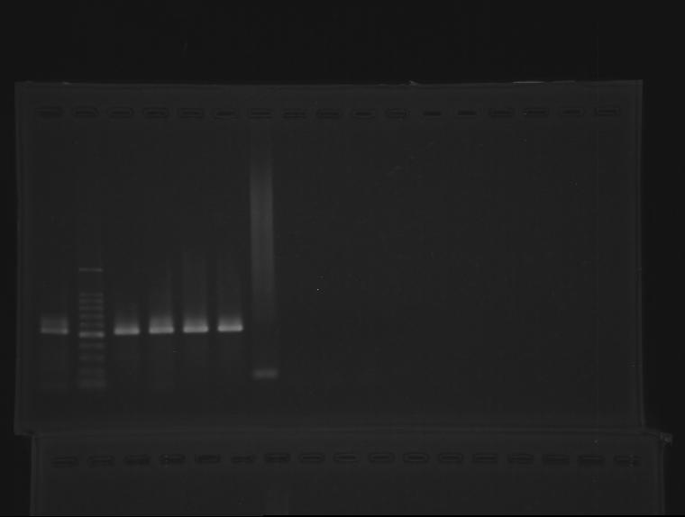
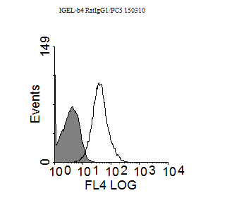
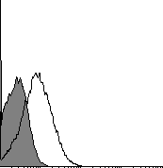
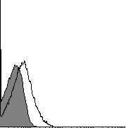
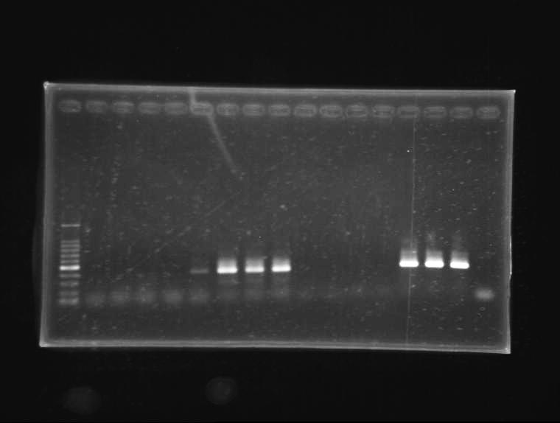
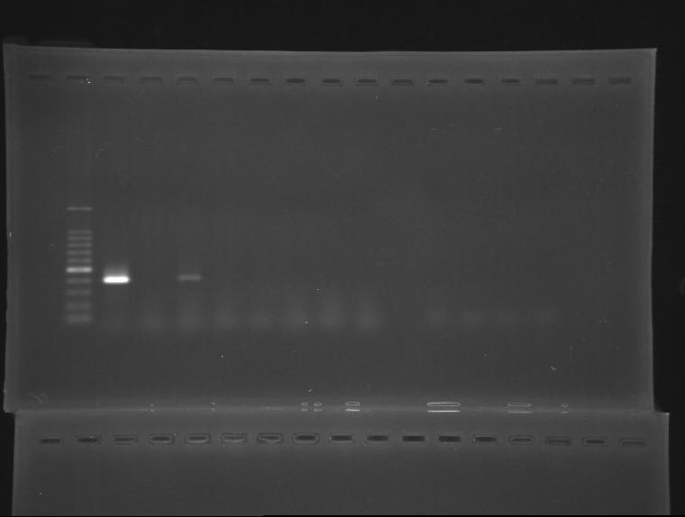
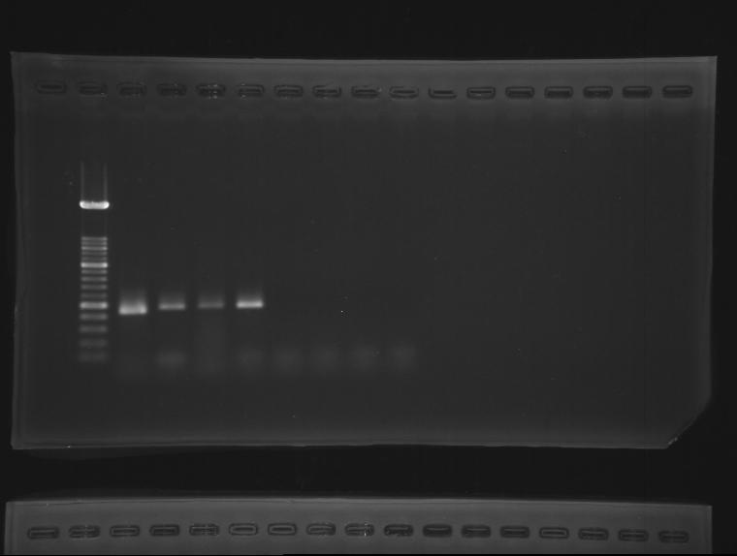
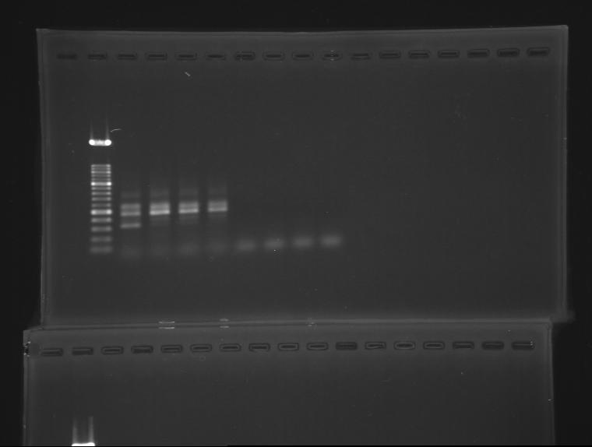
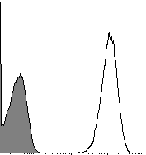
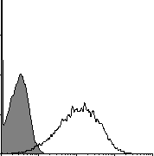
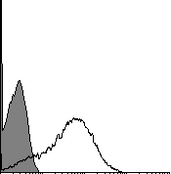
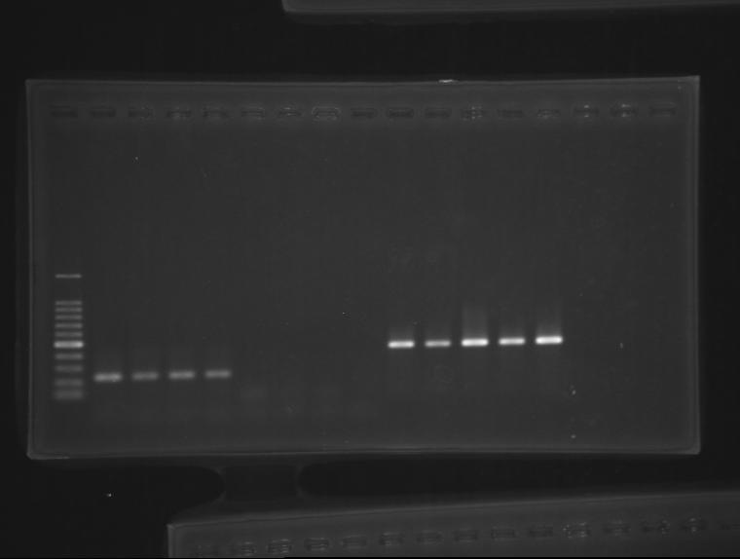
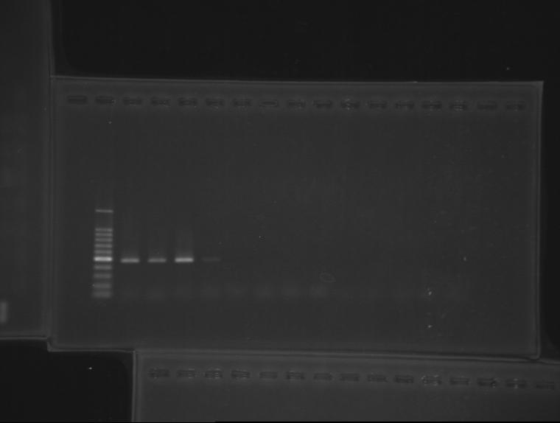
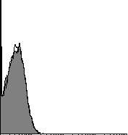
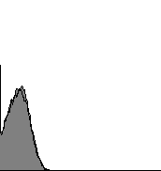
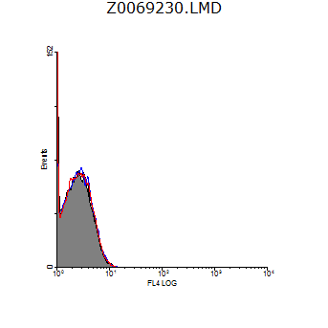
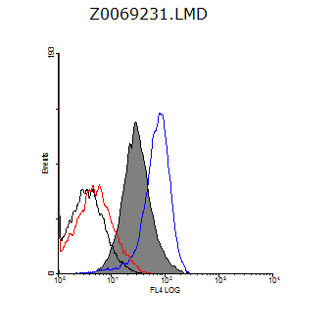
A
Positive-
Control
IGEL
b4
IGEL
a2
H1 DNP-
ε-26
B
Ighe (secreted IgE)
Relative
cell number
IGEL b4
IGEL a2
H1 DNP-ε-26
Ighe (membrance-bound IgE)
Fcer1a
10⁰
10⁴
10⁴
10⁴
10¹
10²
10³
10⁰
10¹
10²
10³
10⁰
IgE
10¹
10²
10³
Fcer2a
D
Fcgr2b
IGEL b4
IGEL a2
H1 DNP-ε-26
Fcgr3
Relative
cell number
Fcgr4
10⁰
10¹
10²
10³
10⁴
10⁰
10¹
10²
10³
10⁴
10⁰
FcγRII/FcγRIII
10¹
10²
10³
10⁴
C
E
Relative
cell number
IGEL b4
IGEL b4
Relative
cell number
IGEL b4
IGEL b4
10⁰
10¹
10²
10³
10⁴
10⁰
10⁰
10¹
10²
10³
10⁴
10¹
10²
10³
10⁴
10⁰
FcεRI
10¹
10²
10³
10⁴
Iso-Ctrl
IgE
FcεRII
Supplementary Fig. S3. Expression of FcRs in/on three IgE-hybridomas.
(A) Total RNAs of each IgE-hybridoma and of cells for positive control (see supplemental Table S5) were analyzed for the expression of indicated genes by RT-PCR. The three bands of Fcgr2b PCR products were correspond to non-specific product (upper band), Fcgr2b isoform 1 (middle band) and Fcgr2b isoform 2 (lower band). (B-D) Flow cytometric analyses of indicated IgE-hybridomas for the surface expression of (B) IgE (open histograms), (C) FcεRI or FcεRII (open histograms), (D) FcγRII/FcγRIII (mAb clone: 93). Stainings of each Isotype-matched control mAb were shown as filled histograms. (E, right panel) IGEL b4 cells were incubated with (red line) or without (blue line) anti-FcγRII/FcγRIII mAb (clone: 2.4G2) and then incubated with Ag-secreted IgE complexes (formed by TNP₄₁-OVA and b4-SN (80% v/v)). Total IgE on the cell surfaces were detected by the flow cytometry with an anti-IgE mAb. Black line (blocked with 2.4G2) and filled histogram (not blocked with 2.4G2) showed the expression of surface IgE on Ag-IgE complex-untreated IGEL b4 cells. (E, left panel) Staining of each treated cells with isotype-matched control mAb (Iso-Ctrl) for the anti-IgE mAb.
Notes:
写真切り取り方(Fig.A)
3:4→4:3→3:4→4:3→1:1

Slide 10
15
∗
10
AI (×10)
5
0
0.4
PBS
TNP-OVA
TNP-
OVA
+ purified
anti-TNP IgE
Supplementary Fig. S4. Purified anti-TNP IgE induced IGEL b4 cell aggregation.
The AI values of IGEL b4 cells after the short-term aggregation assay with PBS (5% v/v) or TNP₄₁-OVA (1.0 μg/ml) in addition to purified anti-TNP IgE (10 μg/ml). A representative data of three independent experiments was shown. *p < 0.05.

Slide 11
A
Inhibition of cell metabolism
B
ATP_{ase} inhibitor
C
Actin polymerization
inhibitor
D
Protein synthesis
inhibitor
12
6
12
15
8
4
8
∗
10
AI (×10²)
4
5
4
∗
2
∗
0
N.D.
0
0
0
DMSO
DMSO
Cycloheximide
37 ºC
4 ºC
PBS
NaN₃
Cytochalasin D
Supplementary Fig. S5. Cell aggregation involved signal transduction leading to the actin polymerization.
Short-term aggregation assays with TNP-LPS and b4-SN for IGEL b4 cells were conducted with various conditions. (A) The assay was conducted at 37°C or 4°C, and (B) with NaN₃ (50 mM). (C and D) IGEL b4 cells were pre-incubated with (C) cytochalasin D (100 μM) or PBS (control), or (D) cycloheximide (20 μg/ml) or DMSO (control) for 30 min. Then, cell suspensions were diluted with medium and the short-term aggregation assay were conducted with (C) cytochalasin D (50 μM) or (D) cycloheximide (10 μg/ml).

Slide 12
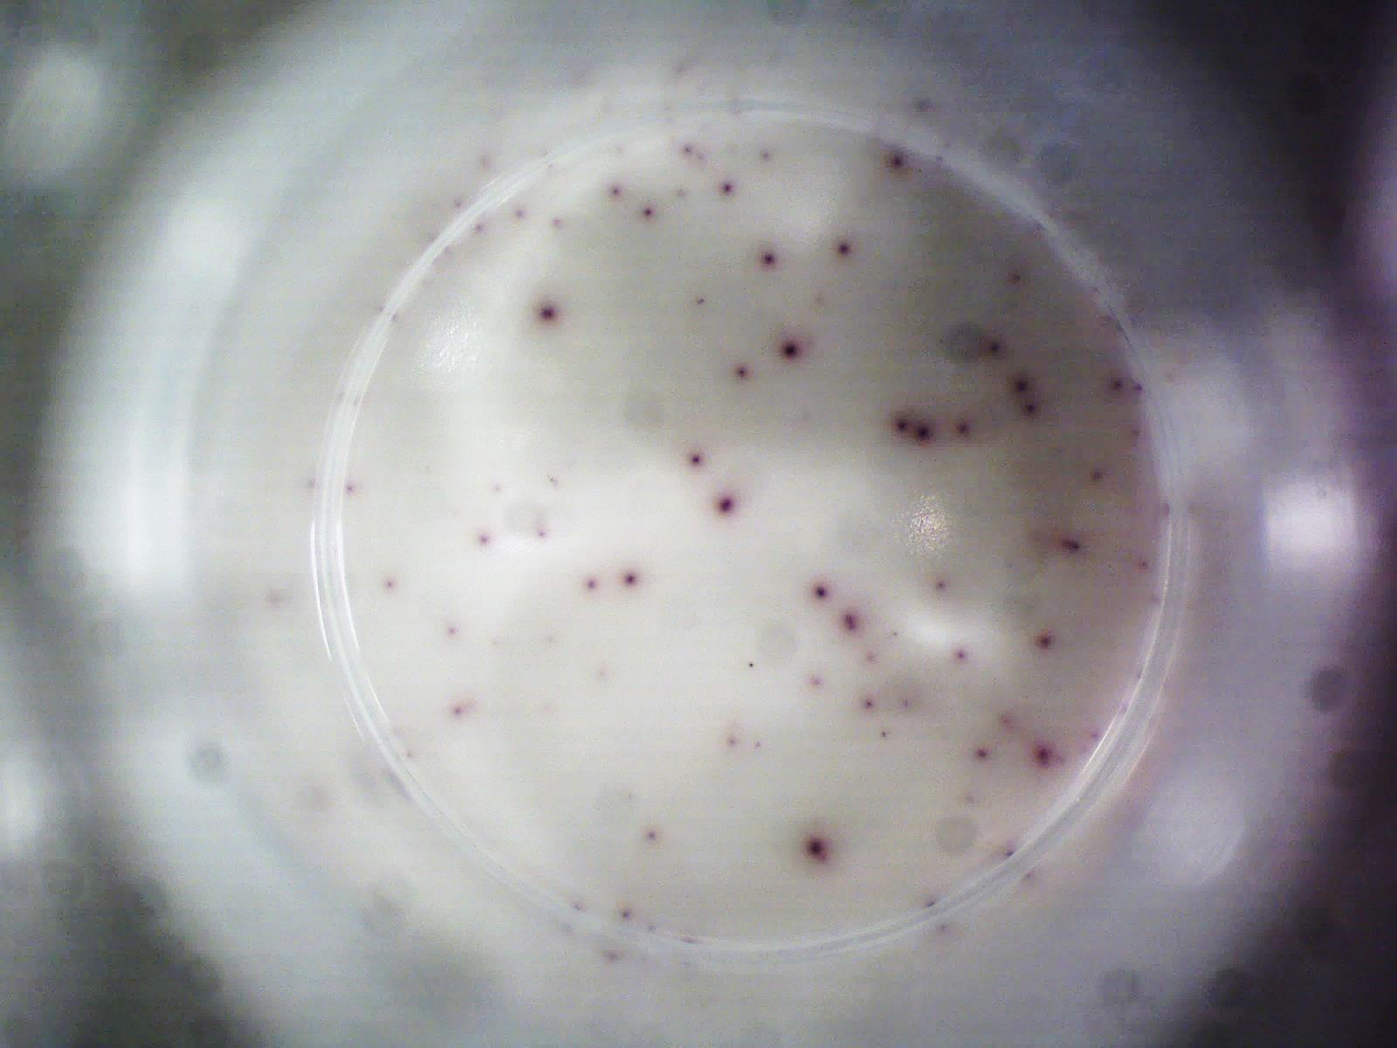
Whole cell
A
B
1.
2.
3.
TNP-LPS, TNP-OVA or LPS
100
Exp #1
300
Exp #2
2days
Collect whole cells
or enriched
aggregated cells
Seed 100 cell/well
of ELISPOT
(triplicate wells)
IGEL b4
200
50
IgE production/cell (pixel)
100
4.
228
5.
∗
Detect
spot area
by ELISPOT
Calculate the median of spot area per about 300 spots
0
0
112
(pixel)
PBS
LPS
PBS
LPS
Supplementary Fig. S6. Evaluation of IgE production by ELISPOT assay and the effect of LPS stimulation on the IgE production of IGEL b4 cells.
(A) Experimental design of evaluation of IgE production was shown. After culturing IGEL b4 cells with Ags for 2 days, the cell aggregations were dispersed by vigorous pipetting. The IgE production from a single IGEL b4 cell were measured by ELISPOT assays. Note that dispersed IGEL b4 cells (100 cells/well) did not form cell aggregate by further culturing in wells of 96-well plates, suggesting that each spot made by EPISPOT assay was formed by a single IGEL b4 cell. (B) The effect of LPS (10 μg/ml) stimulation on the IgE production of IGEL b4 cells was evaluated by ELISPOT assay. Significant differences compared with the response of IGEL b4 cells cultured with PBS were indicated by an asterisk (p < 0.05, Mann-Whitney U-test).
Notes:
写真切り方→3:4→4:3→3:4→1:1

Slide 13
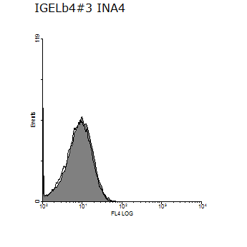
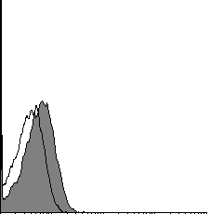
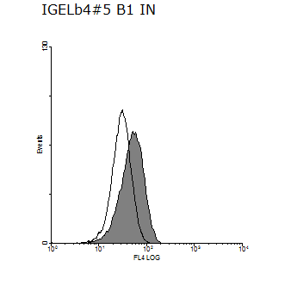
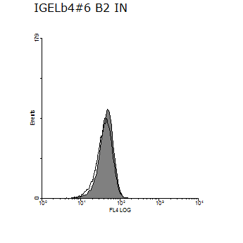
Integrin α4
Integrin α5
Integrin β1
Integrin β2
Relative cell number
10⁰
10¹
10²
10³
10⁴
10⁰
10¹
10²
10³
10⁴
10⁰
10¹
10²
10³
10⁴
10⁰
10¹
10²
10³
10⁴
VCAM-1
ICAM-1
P-selectin
E-selectin
Relative cell number
10⁰
10¹
10²
10³
10⁴
10⁰
10¹
10²
10³
10⁴
10⁰
10¹
10²
10³
10⁴
10⁰
10¹
10²
10³
10⁴
Supplementary Fig. S7. Expression of adhesion molecules on aggregated IGEL b4 cells.
IGEL b4 cells were cultured with TNP₄₁-OVA (1.0 μg/ml) (open histograms) or PBS (filled histograms) for 2 days. Flow cytometric analysis for the expression of indicated adhesion molecules was performed.

Slide 14
15
∗
PBS
10
∗
TNP-LPS
AI (×10²)
5
0
0.74
2.59
b4-SN
IgG1-SN
Supplementary Fig. S8. Cell aggregation of IGEL b4 cells was also induced by IgG1-SN.
IGEL b4 cells were subjected to the short-term aggregation assay with b4-SN or IgG1-SN (80 % v/v, each) in addition to TNP-LPS (10 μg/ml) or PBS. Anti-TNP IgG1-SN was collected in the same way as b4-SN. AI values were shown.

