Slide 1
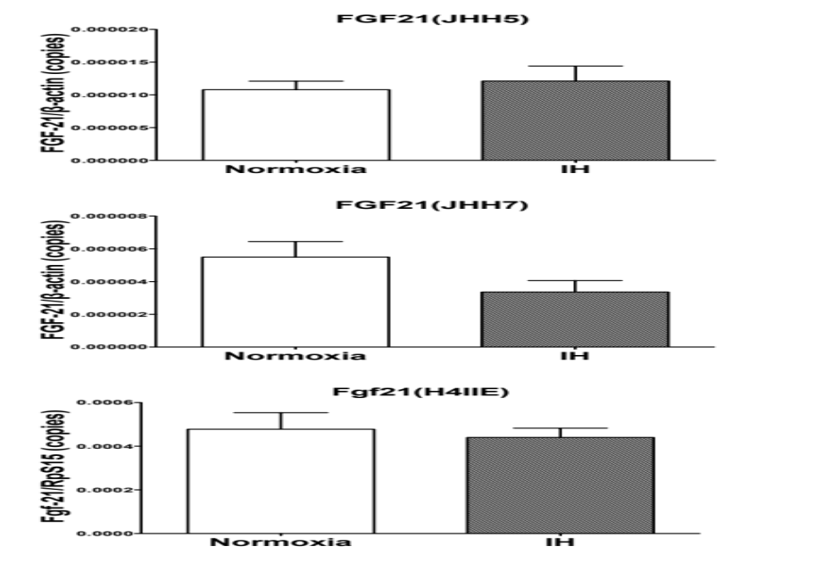
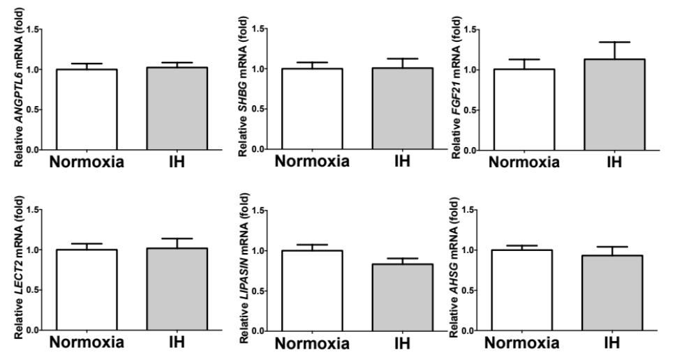
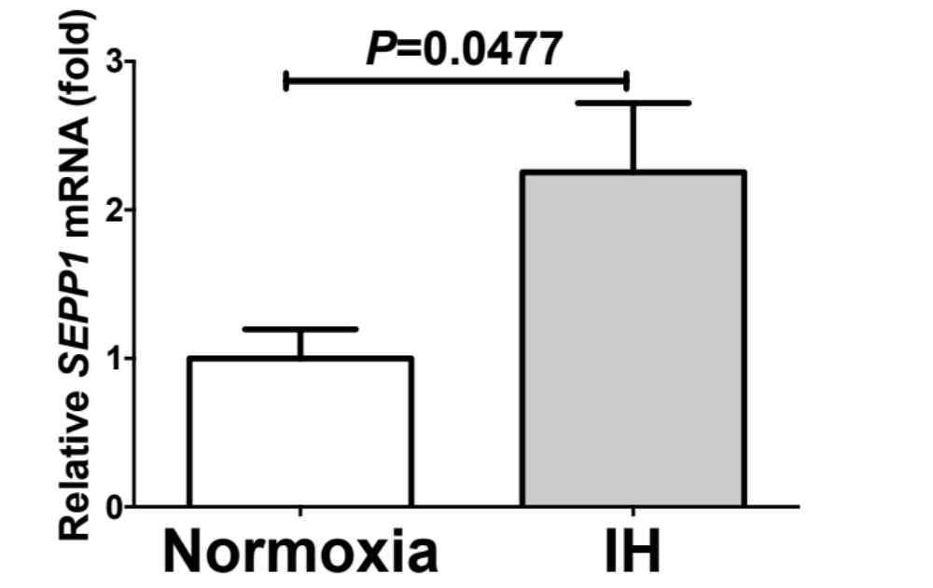
Supplemental Fig. 1
A
B
C
D
E
F
G

Slide 2
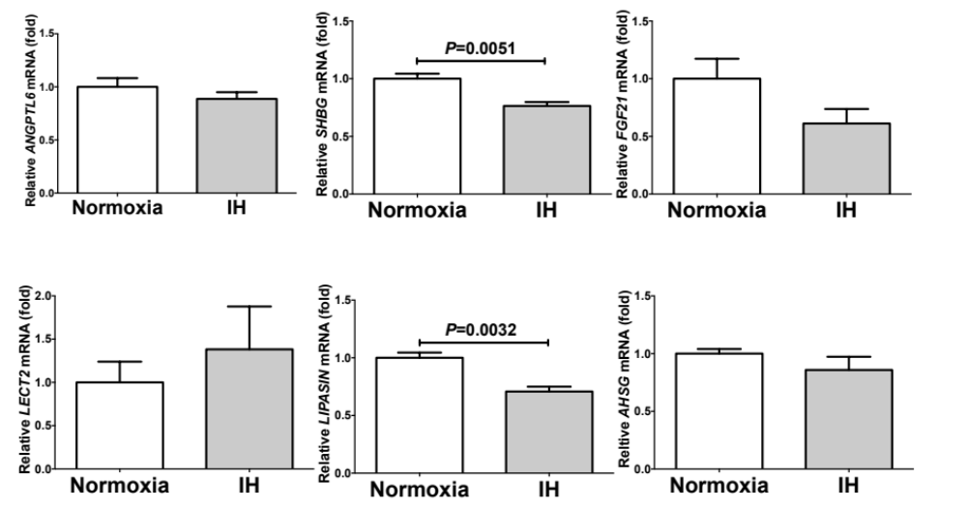
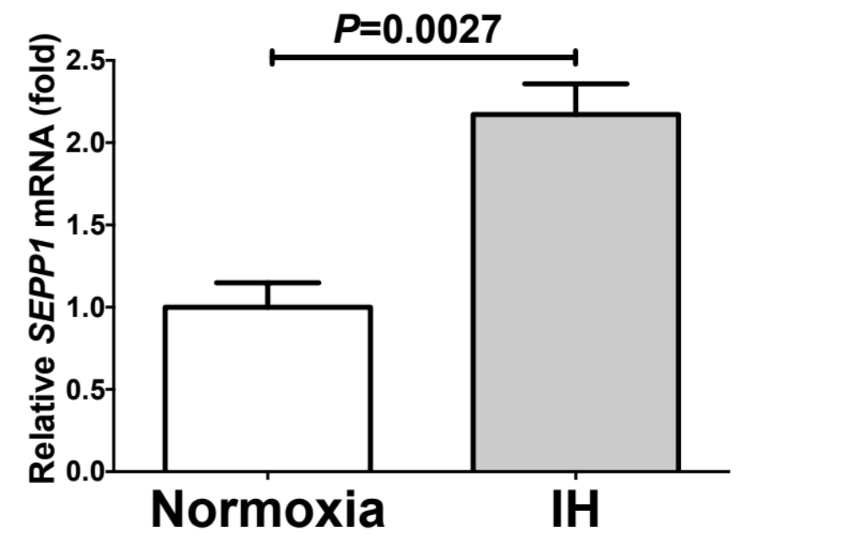
Supplemental Fig. 2
B
C
D
A
E
F
G

Slide 3
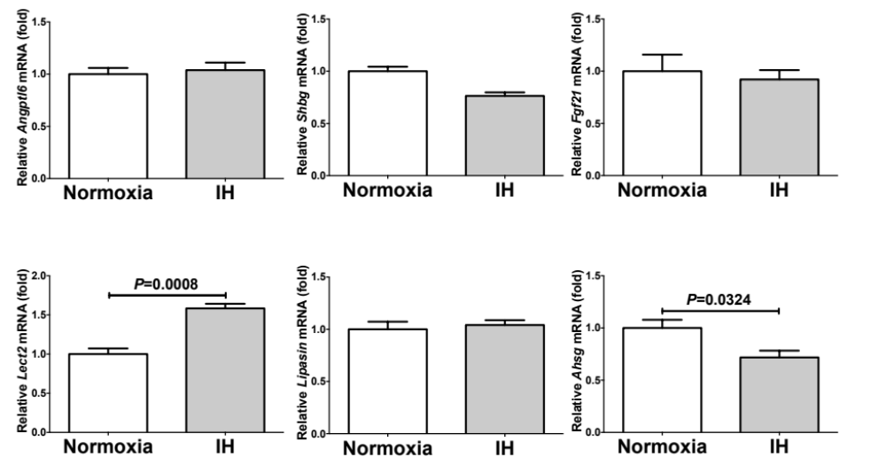
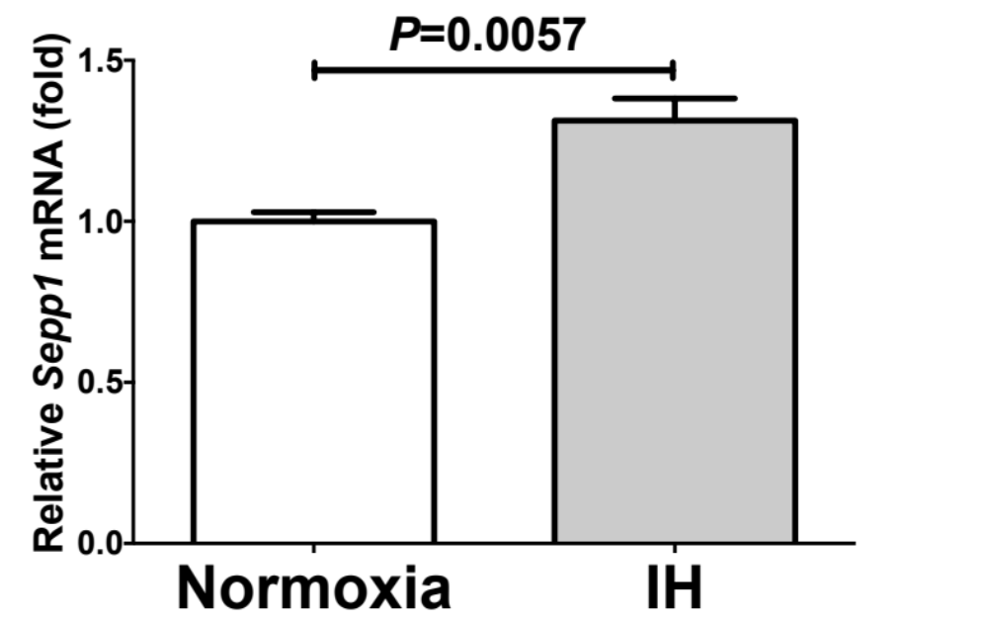
Supplemental Fig. 3
B
C
D
A
E
F
G

Slide 4
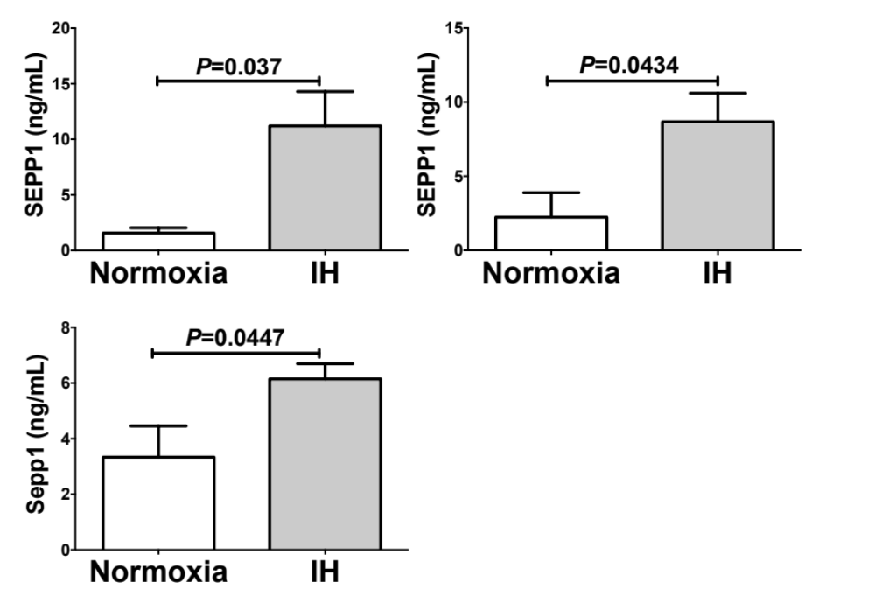
A
B
C
Supplemental Fig. 4

Slide 5
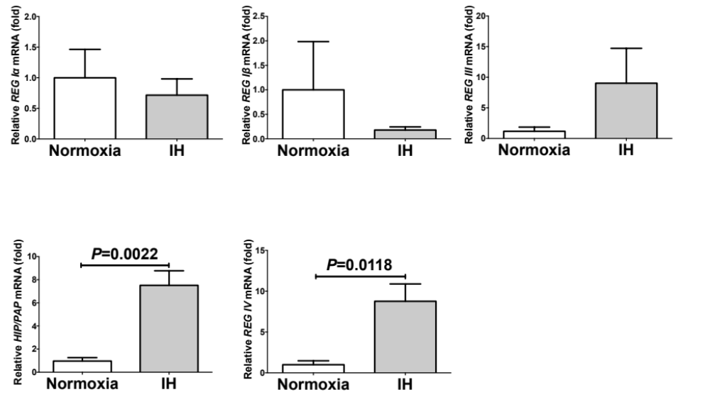
Supplemental Fig. 5
A
B
C
D
E

Slide 6
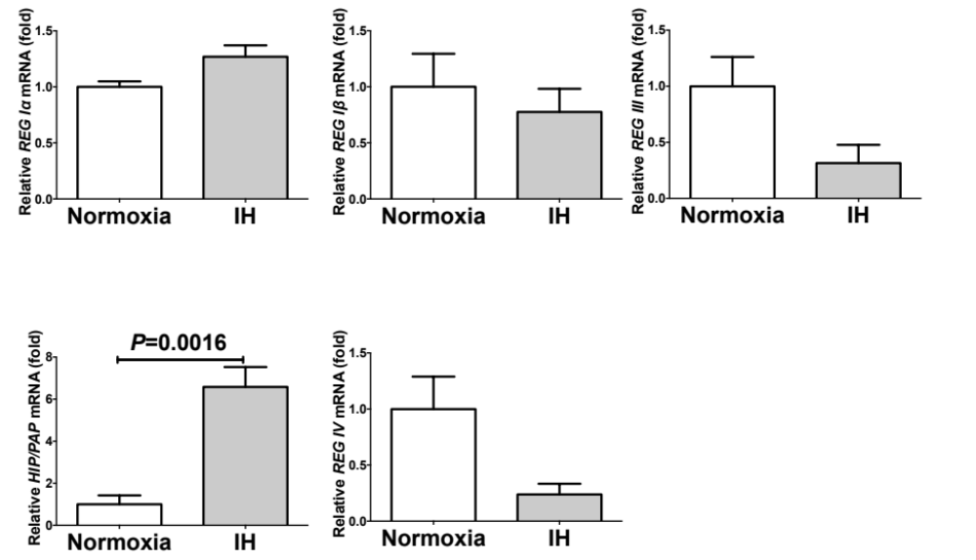
Supplemental Fig. 6
A
B
C
D
E

Slide 7
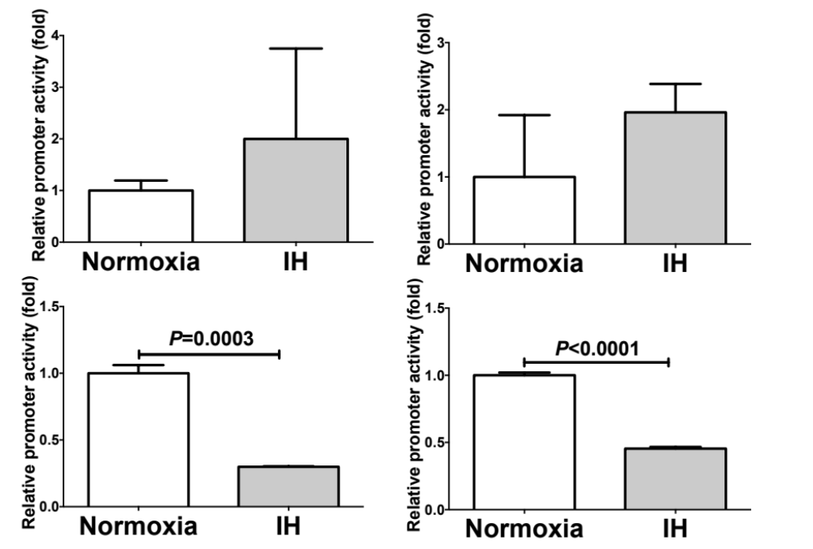
Supplemental Fig. 7
A
B
C
D

