Slide 1
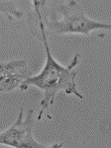
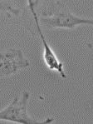
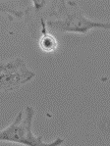
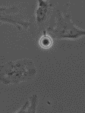
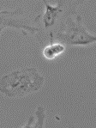
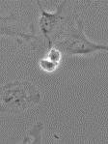
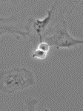
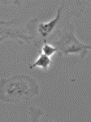
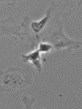
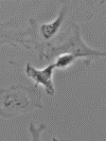
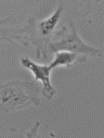
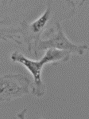
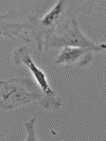
































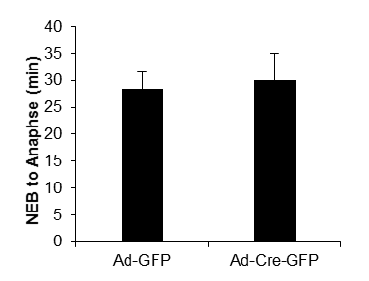
6’
Ad-GFP infected MEFs
A
12’
18’
24’
30’
36’
42’
48’
54’
60’
66’
72’
78’
6’
Ad-Cre-GFP infected MEFs
30’
B
12’
18’
24’
36’
42’
48’
54’
60’
66’
72’
78’
84’
90’
96’
102’
108’
114’
120’
126’
132’
138’
144’
150’
156’
162’
168’
174’
180’
186’
192’
198’
C
Supplementary Fig. 3. Depletion of Hnf1b did not affect time from NEB to anaphase. After Hnf1b^{flox/flox} primary P3 MEFs were infected with Ad-GFP (A) or Ad-Cre-GFP (B) for 24 h, live cell images were obtained every 6 min for 16 h. Mitotic cells were selected and time of NEB to anaphase was measured (C). Data are expressed as mean±SD, N=5, *P<0.05; **P<0.01; ***P<0.001.
Supplementary Figure 3

