Slide 1
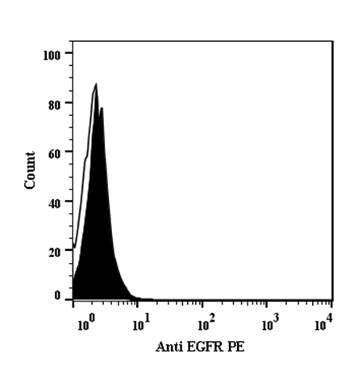
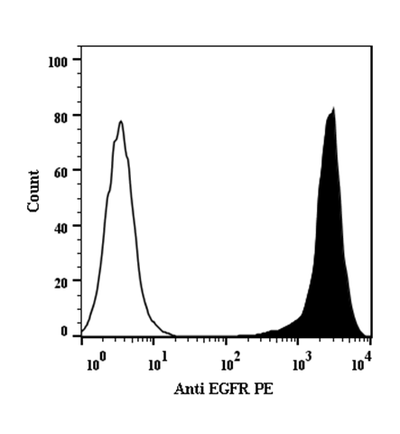
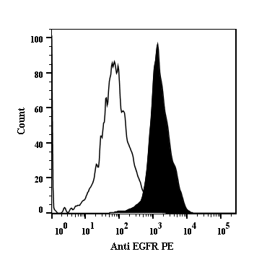
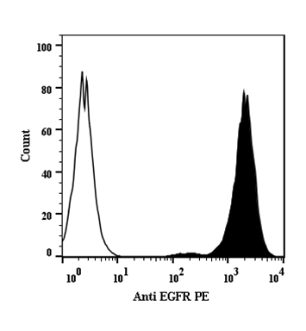
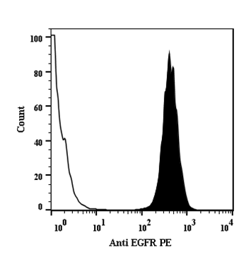
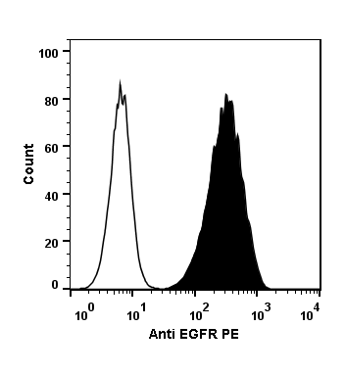
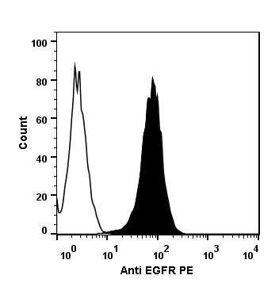
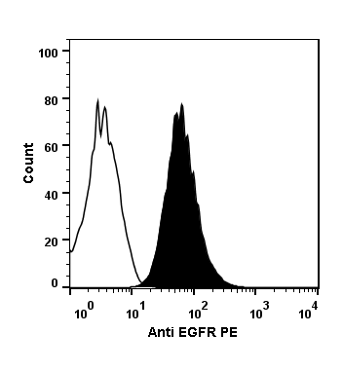
Supplemental Figure 1
A.
B.
C.
D.
E.
F.
G.
H.

Slide 2
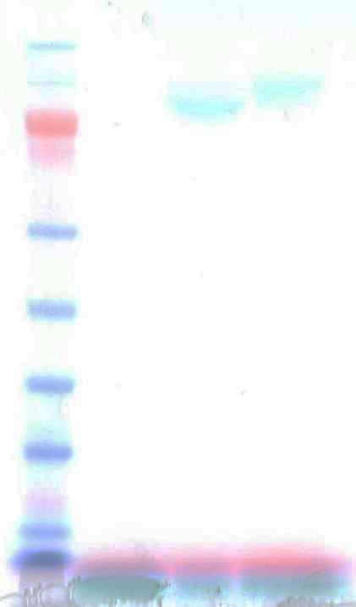

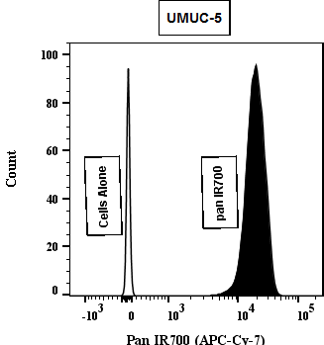
Supplemental Figure 2
A.
Pan-IRDye700
Panitumumab
Panitumumab
Marker
IRDye700
Pan-IRDye700
IRDye700
250
148
98
64
50
36
22
SDS-PAGE
Infrared
B.

Slide 3
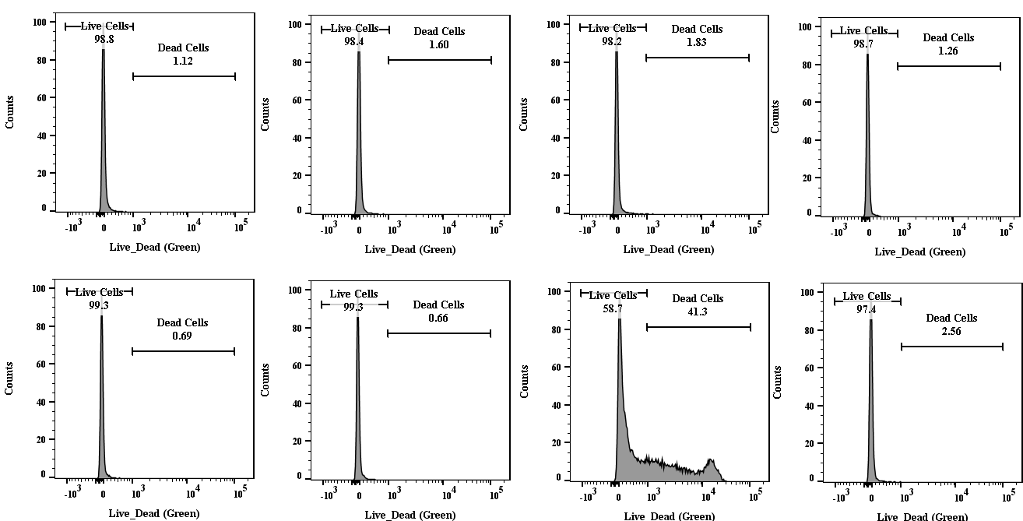
Supplemental Figure 4
No Treatment
pan
pan IR700
pan + pan IR700
NIR 0 J/cm²
NIR 32 J/cm²

Slide 4
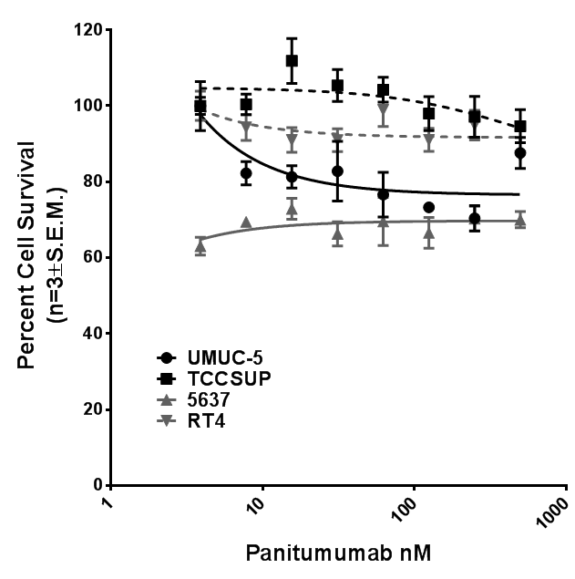
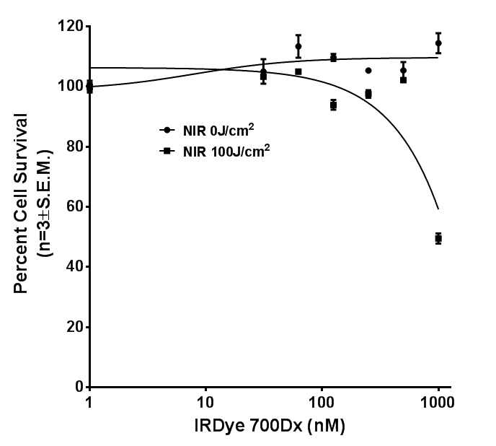
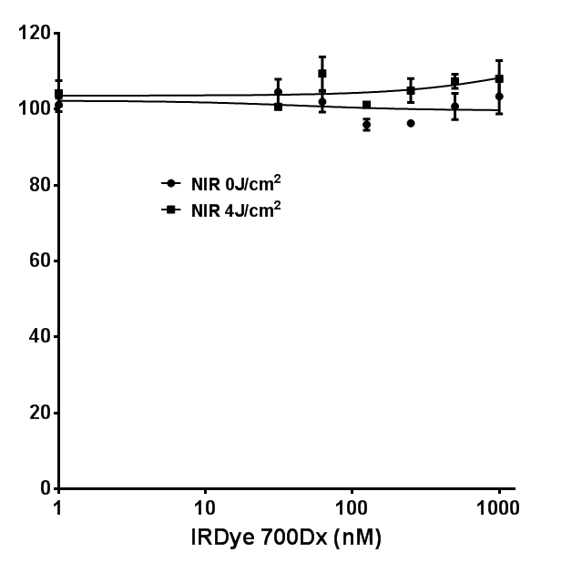
Supplemental Figure 5
A.
B.

Slide 5
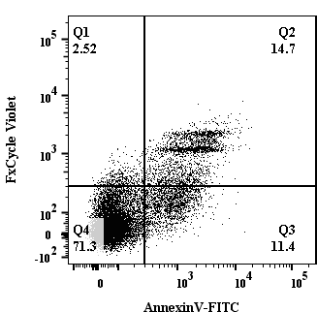
Supplemental Figure 7

Slide 6
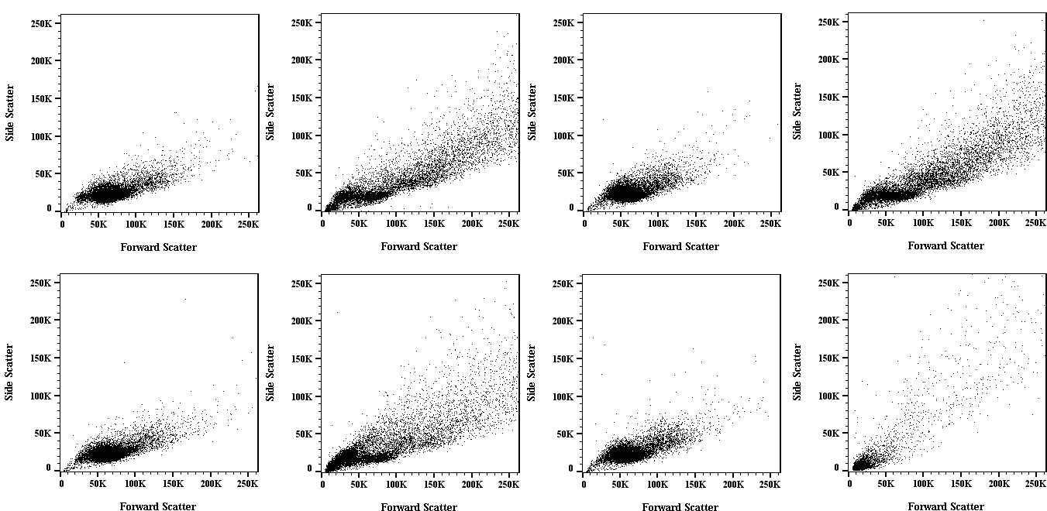
Supplemental Figure 8
No Treatment
pan
IR700
pan IR700
NIR 0 J/cm²
NIR 4 J/cm²

Slide 7
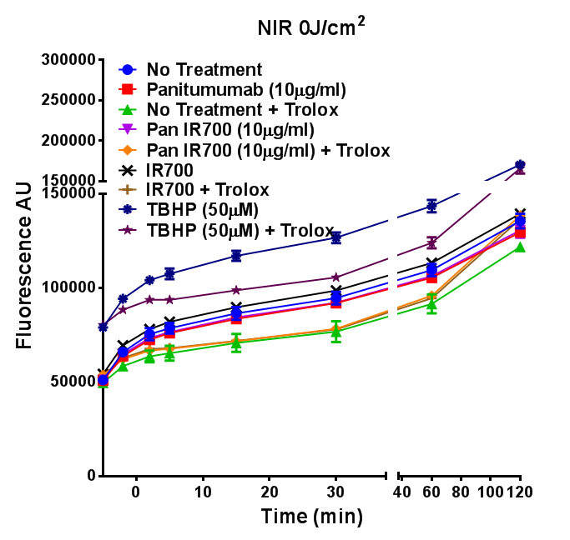
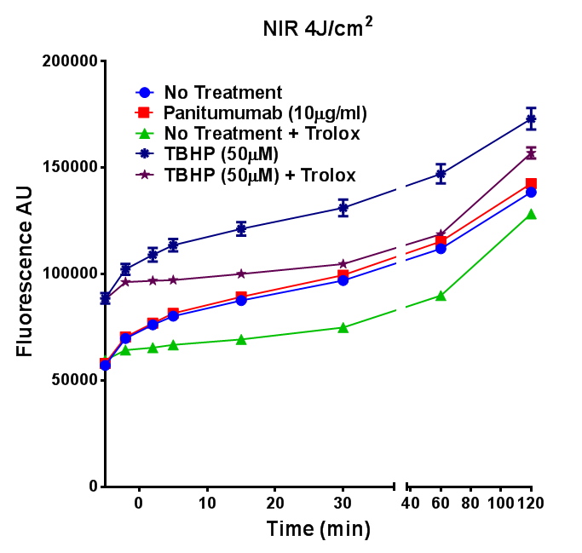
Supplemental Figure 9
A.
B.

Slide 8
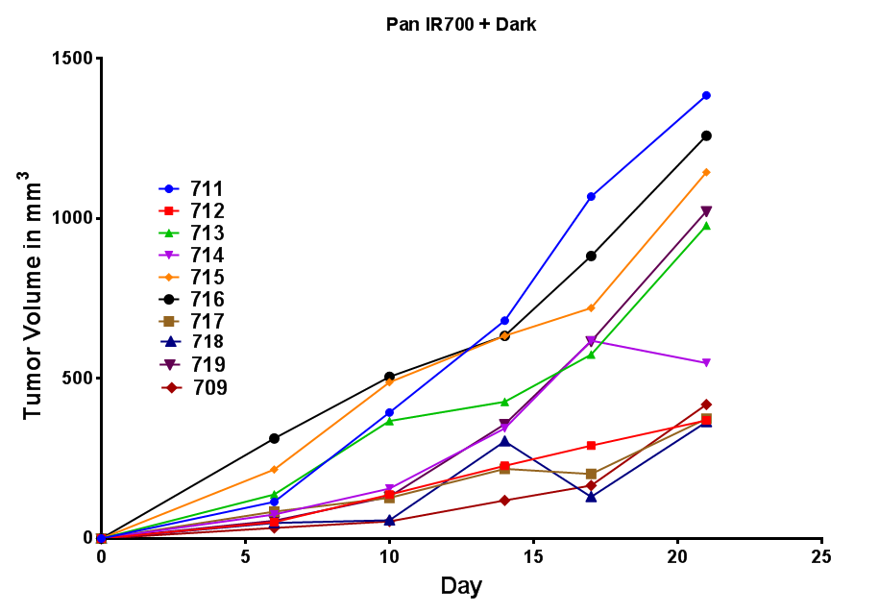
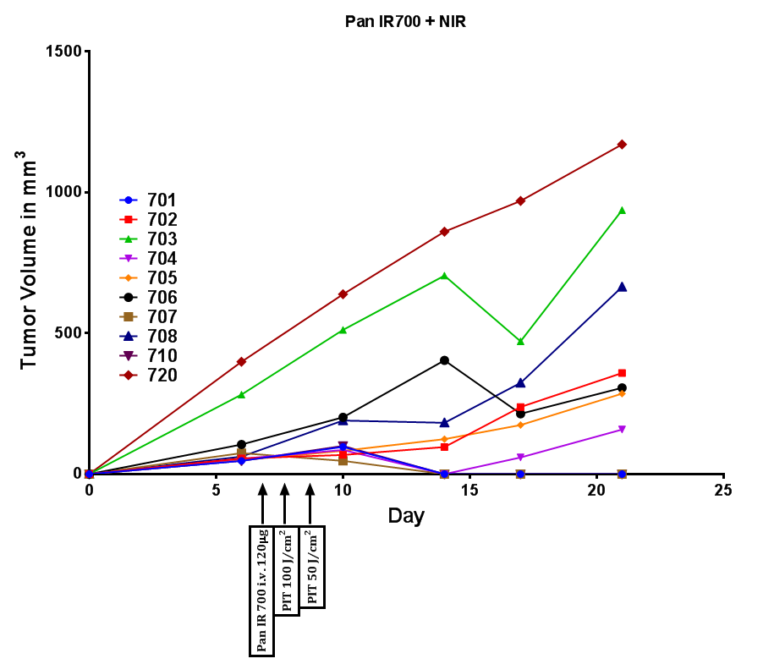
Supplemental Figure 10
A.
B.

Slide 9
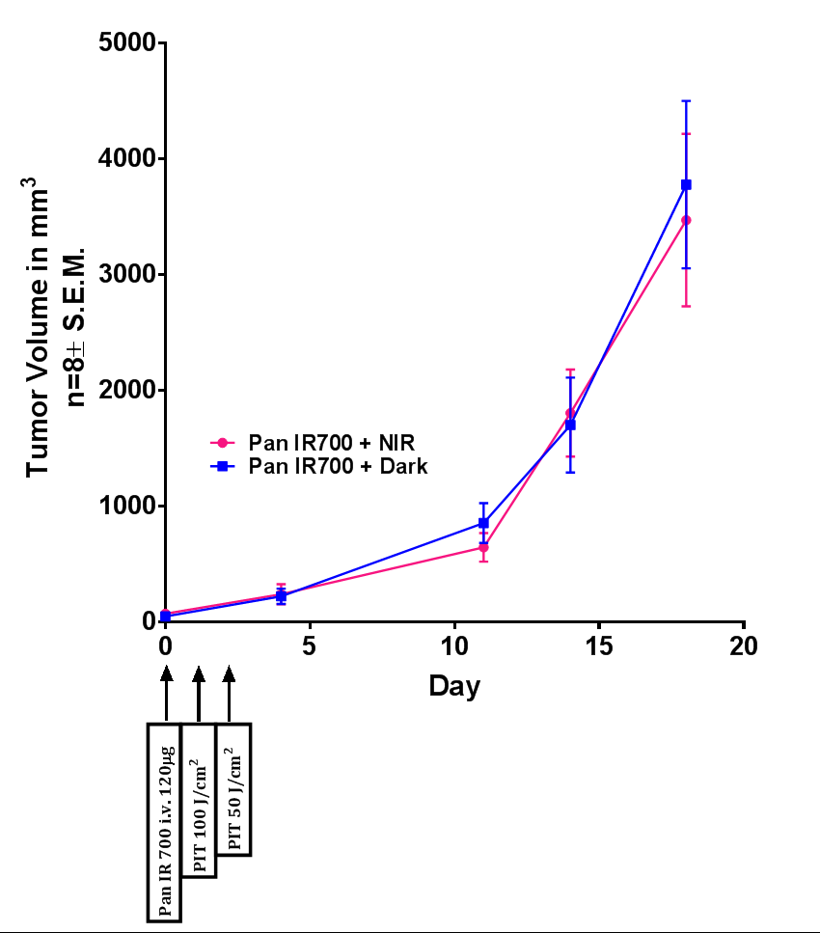
Supplemental Figure 11

