Slide 1
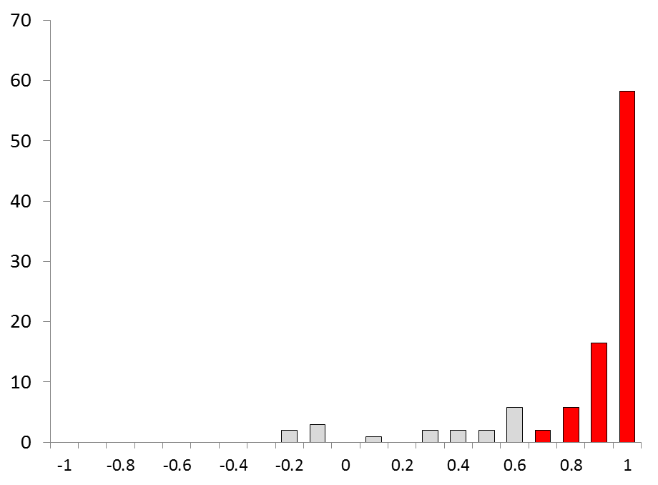
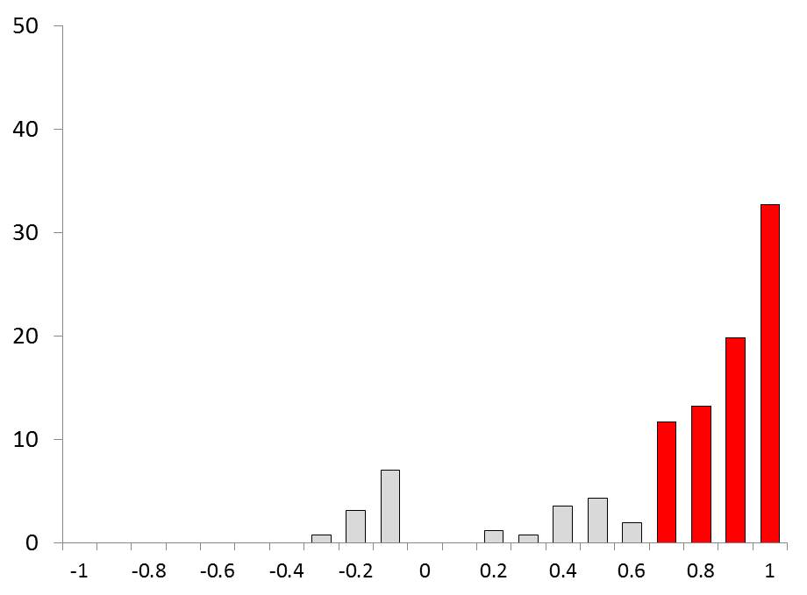
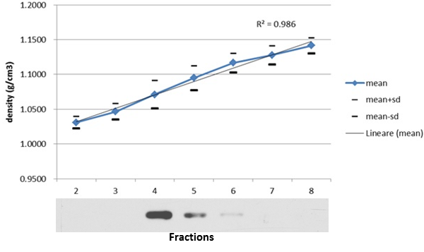
Assessment of experimental reproducibility
%
82.5%
A)
C)
trophozoites
G T G T
Quantitative assessment of parasite protein extracts from mature gametocyte sample MG-A and trophozoite sample T-A. Equal volumes of protein extracts from gametocytes (G) and trophozoites (T) prepared for sucrose gradient separation of DRMs, were blotted and probed with 14-3-3 and Hsp70. Relative intensity of the specific signals confirms that parasite extracts loaded into sucrose gradients are comparable.
B)
%
gametocytes
77.4%
Linearity of sucrose gradients were evaluated determining the density of the collected gradient fractions based on their refractive index. In our experimental conditions the raft-resident protein Flotillin floats mainly to fraction 4.
Distribution of the best correlation values between PAP pairs. To evaluate PAP reproducibility between replicates, the Pearson’s correlation coefficients were calculated for each PAP pair and the best values considered. Around 80% of the identified proteins display conserved PAPs (R ≥ 0.7; P < 0.05) in at least two replicates.

