Slide 1
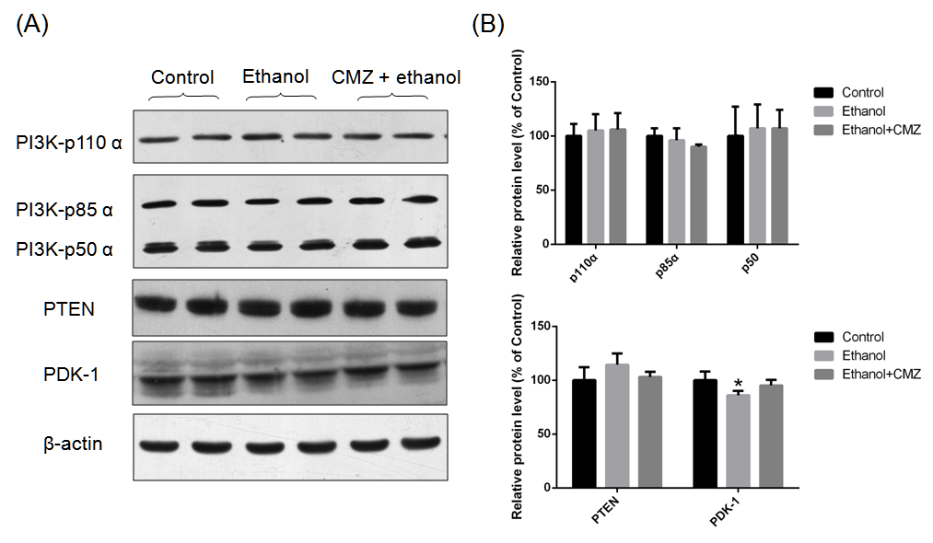
Suppl. Fig. 1
Supplementary Fig. 1. Effects of chronic ethanol exposure and CMZ on the protein levels of PI3K, PTEN, and PDK-1. (A) Representative western blotting bands of PI3K catalytic subunit p110, PI3K regulatory subunit p85 and p50, PTEN, and PDK-1. (B) Quantitative data analyses of PI3K-p110, PI3K-p85, PI3K-p50, PTEN, and PDK-1. Data were presented as mean ± SD (n=5), and expressed as the percentage of the control. *P<0.05, compared with the control group mice.

Slide 2
Suppl. Fig. 2
Supplementary Fig. 2. Effects of 4-HNE on the cell viability of HepG2 cells. CCK-8 was used for the analysis of the 4-HNE cytotoxicity, which was performed according to the manufacturer's protocol (Dojindo Molecular Technologies, Japan). In brief, the cells seeded in 96-well plates were incubated with various doses of 4-HNE in 5% CO2 at 37 °C for 24 h. Then, 10 μL of CCK-8 was added to the cultures and incubation was continued for an additional 1.5 h. The reaction was stopped by adding 50 μL of 1% (w/v) sodium dodecyl sulfate solution, and then absorbance was measured at 450 nm using the multifunctional microplate reader (Tecan Infinite 200 PRO, Switzerland). **P<0.01, compared with the control value.

Slide 3
Suppl. Fig. 3
Supplementary Fig. 3. Effects of IGF-1 on chronic ethanol-induced increase of CP2E1 protein level, 4-HNE adducts level, and MDA levels. (A) Representative western blot bands of hepatic CYP2E1 and quantitative analysis; (B) Representative western blotting bands and the quantitative data of 4-HNE-protein adducts; (C) Hepatic MDA levels determined by using a commercial assay kits (Beyotime, China). *P<0.05, **P<0.01, compared with the control group mice; #P<0.01, compared with the Ethanol gorup mice.

Slide 4
Suppl. Fig. 4
Supplementary Fig. 4. Effects of ethanol and IGF-1 on the protein levels of PPAR-α, ACOX, LFABP, SREBP-1c, ACC, p-ACC, FAS, and PPAR-γ. (A) Representative western blot bands and the quantitative data of PPAR-α, LFABP and ACOX; (B) Representative western blot bands and the quantitative data of SREBP-1c, ACC, p-ACC, and FAS; (C) Representative western blot bands and the quantitative data of PPAR-γ. *P<0.05, **P<0.01, compared with the Control; #P<0.05, ##P<0.01, compared with the ethanol group mice.

