Slide 1
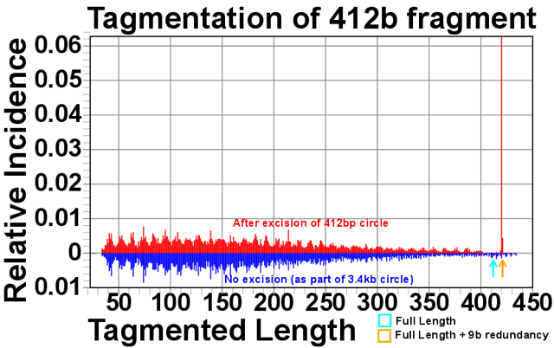
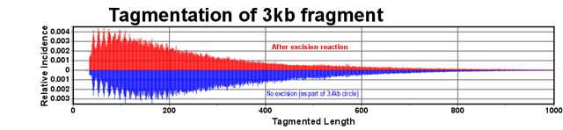

Slide 3
Figure S2. Testing tagmentation efficiency on circular DNA substrates of different length.
A 3-kbp plasmid DNA (derived from pGEM5Zf+) and 412-bp circular DNA molecules were fragmented using
Nextera-XT tagmentase. This graph provides a position-by-position summary of aligned reads. The orange arrow
indicates a read length of a singly-tagmented circle, 421 bp (412 bp + 9 bp duplication)

