Slide 1
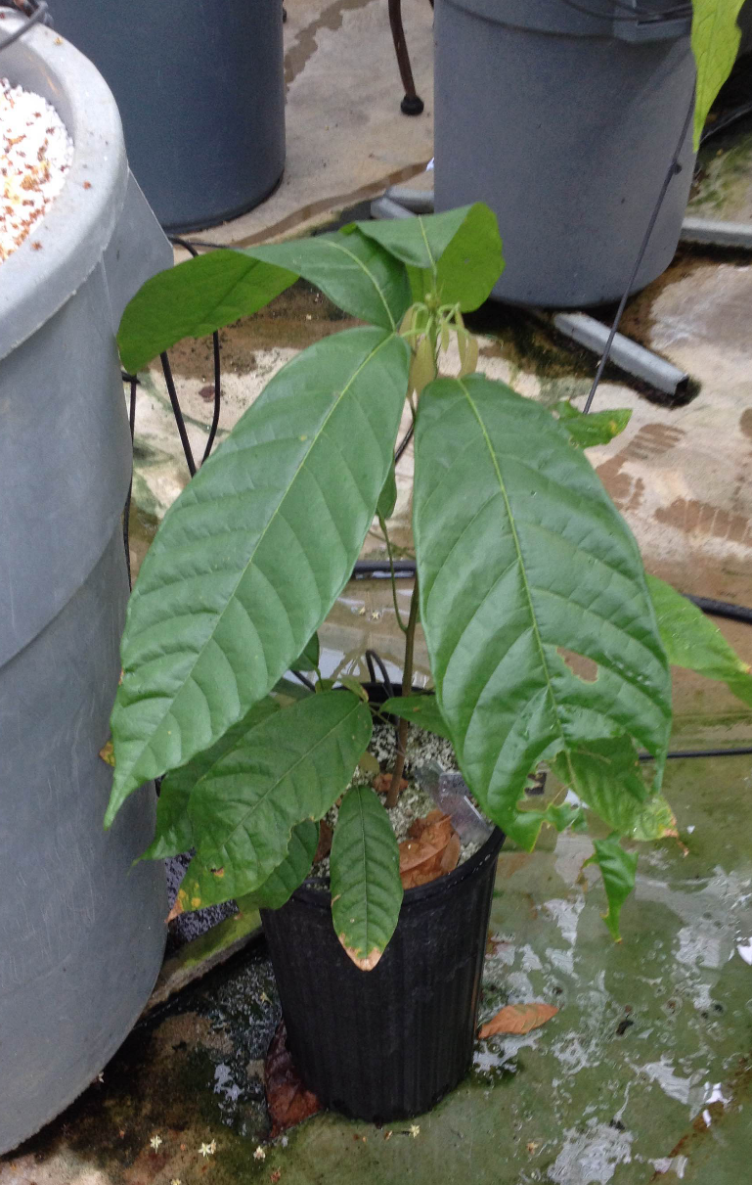

Slide 2
Supplementary Figure 1: Transgenic Theobroma cacao plant containing the homologous TcLec2 gene fusion with the glucocorticoid receptor (TcLEC2-GR) under the control of the constitutive 35S CaMV promoter.

Slide 3
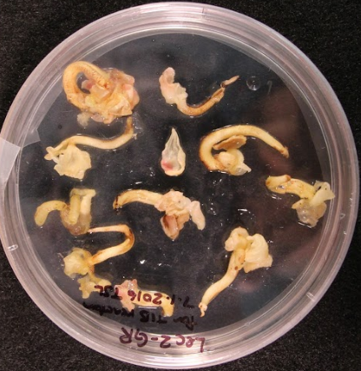
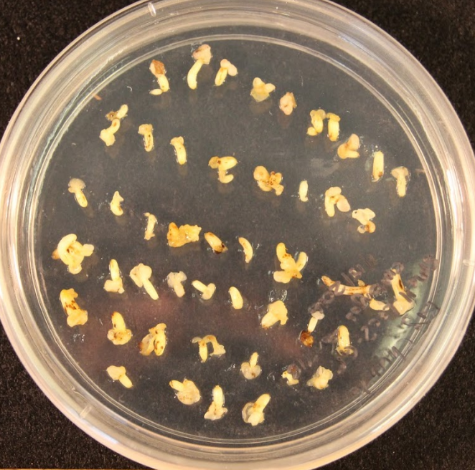

Slide 4
Supplementary Figure 2: T. cacao transgenic LEC2-GR secondary embryos generated from the initial transformant (left), as compared to embryos derived from the leaf of the regenerated transgenic LEC2-GR plant (right) illustrating the smaller size at which embryos would tend to develop on the same embryo development media.

