Slide 1
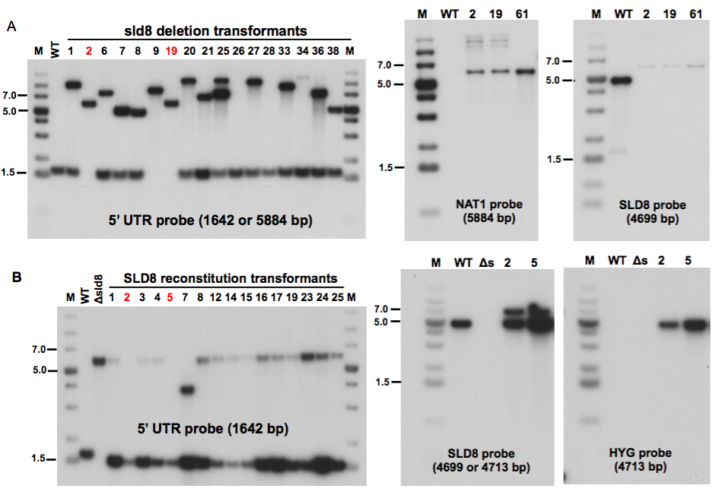
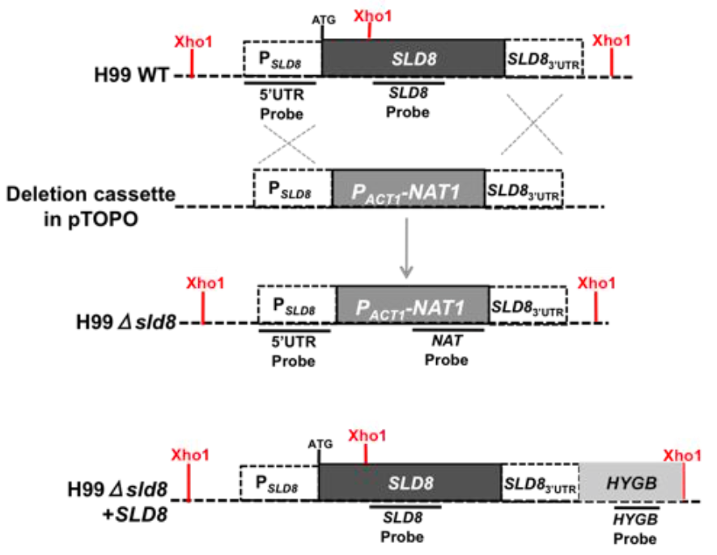
A
B
C
Concentration (pmoles per nmoles
^{of inorganic phosphate)}

