Slide 1
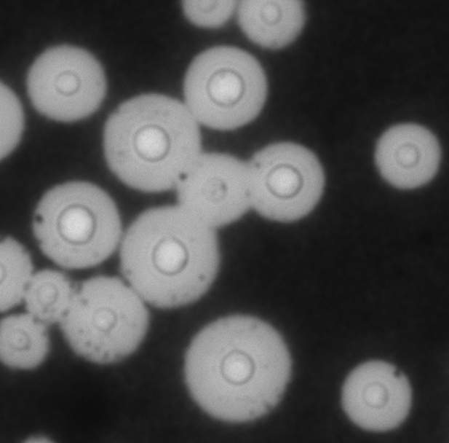
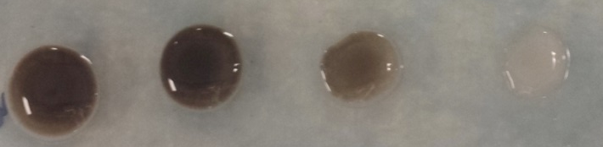
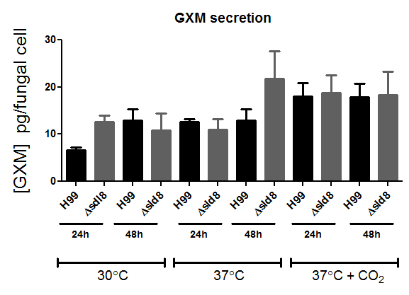
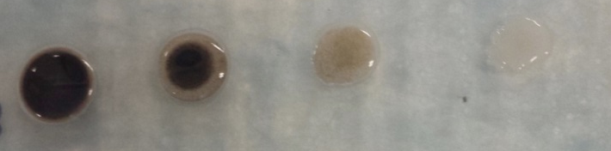
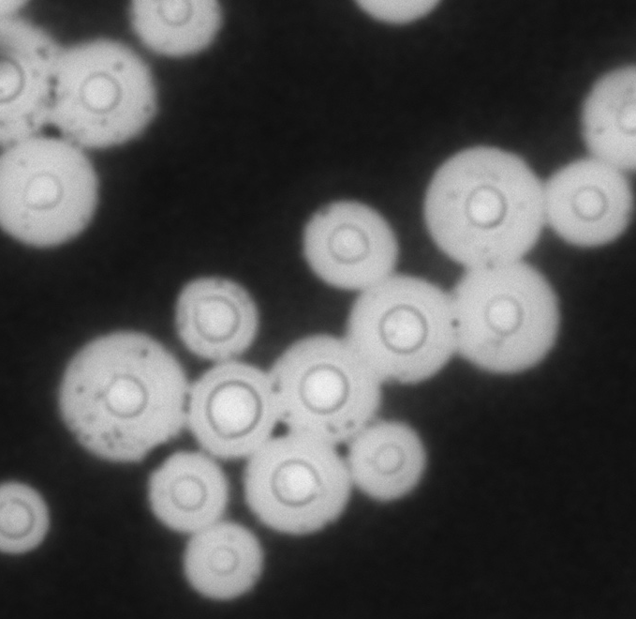
A
B
C
D
Wild-type
Wild-type
10⁷ 10⁶ 10⁵ 10⁴
Wild-type
∆sld8
20 μm
Δsld8
Δsld8
F
G
20 μm
E
Laccase Activity
Urease Activity
Cn H99
Cn Δsld8

