Slide 1
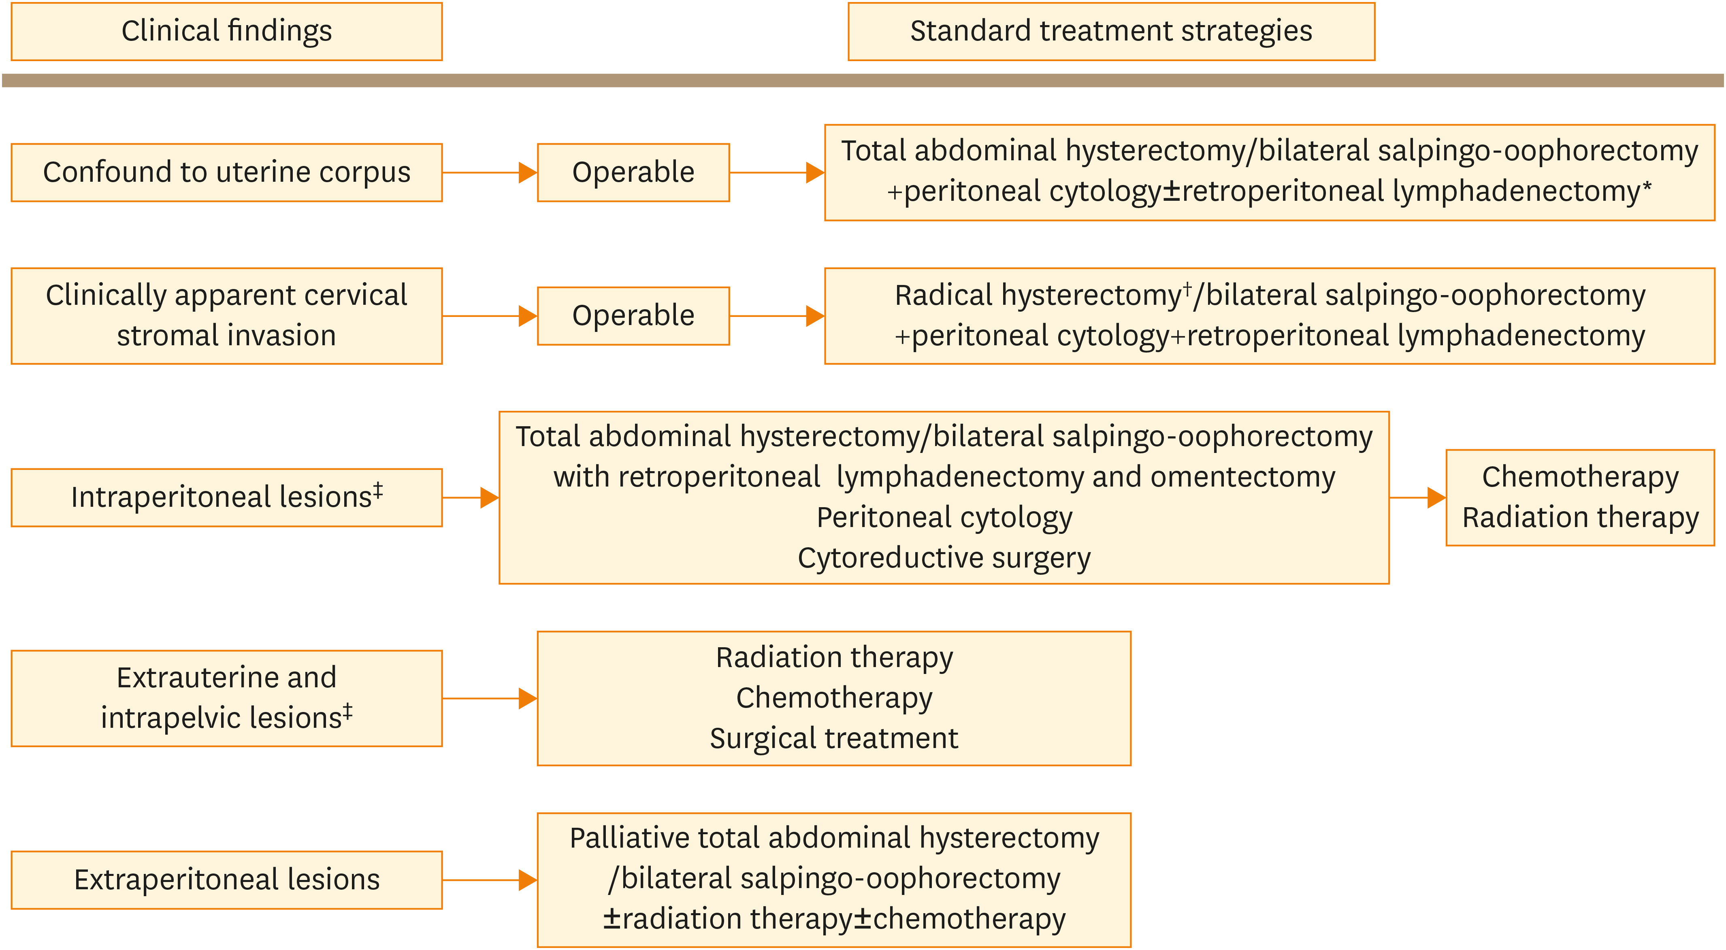
Supplementary Fig. 2. A summary of treatment strategies presented in the guideline published in 2006. To be advised that the revised editions were published in 2009 and 2013, which have some minor changes from this flowchart. Several differences are summarized in the annotation. More information for treatment options or detailed strategies in each…
J Gynecol Oncol. 2017 Jan;28:e76.
https://doi.org/10.3802/jgo.2017.28.e76
Notes:
Fig. 2. A summary of treatment strategies presented in the guideline published in 2006. To be advised that the revised editions were published in 2009 and 2013, which have some minor changes from this flowchart. Several differences are summarized in the annotation. More information for treatment options or detailed strategies in each edition is available in the references published elsewhere [3, 4].
*Lymphadenectomy is optional in endometrioid G1/G2 with no myometrium invasion (in the 2006 and 2009 editions), or <1/2 myometrium invasion (in the 2013 edition). †Modified radical hysterectomy is also listed as well as radical hysterectomy in the 2009 and 2013 editions. ‡Surgical treatment with subsequent chemotherapy/radiation therapy is suggested if operable in the 2013 edition.
This figure cited from [3].

