Slide 1
Supplemental Figure 1
(PKA inhibitor)
(PKA activator)
^{T39A}

Slide 2
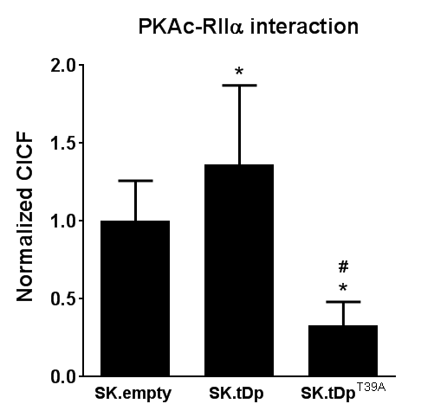
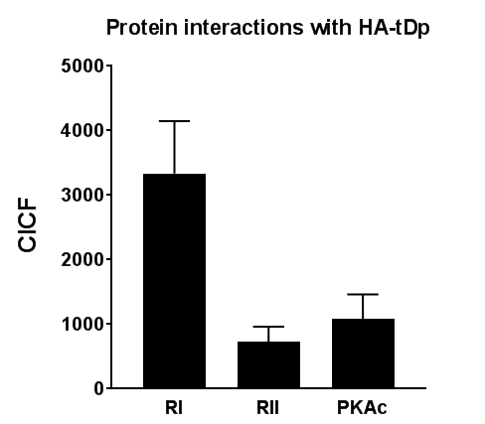
Supplemental Figure 2
A
B

Slide 3
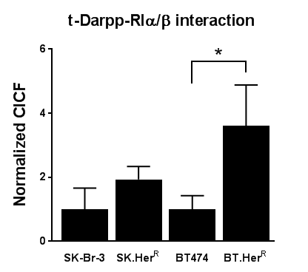



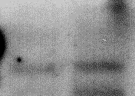





Supplemental Figure 3
A
B
SK-Br-3
SK.Her^{R}
BT474
BT.Her^{R}
C
MDA-MB-468
SK-Br-3
SK.Her^{R}
BT.Her^{R}
HCC1143
MDA-MB-468
HCC1143
BT474
PKA-RIα
t-Darpp
α-tubulin

Slide 4
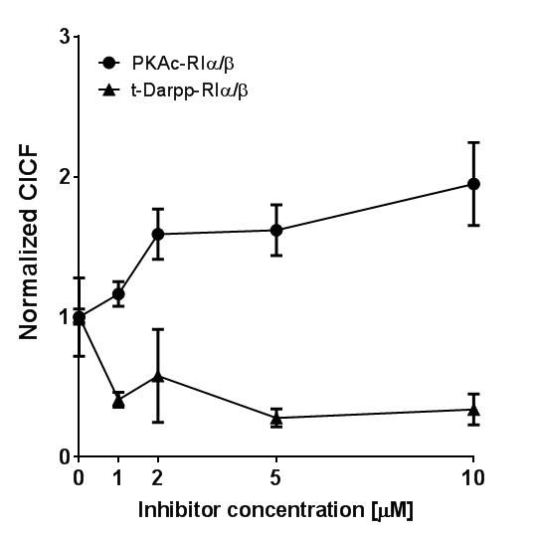
Supplemental Figure 4

