Slide 1
Supplementary Figure 1
A
B
C

Slide 2
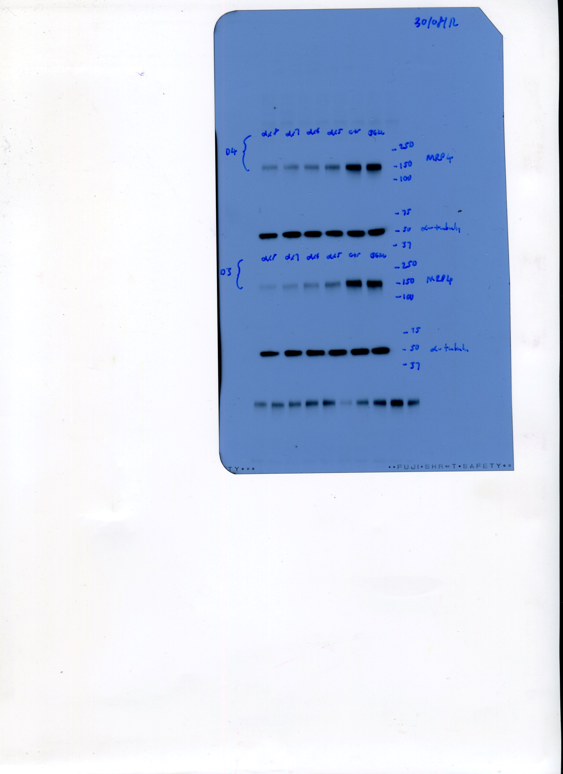
Supplementary Figure 2
A
B
ABCC4.5
ABCC4.6
siRNA
control
ABCC4.7
Mock
250kDa
150kDa
ABCC4
100kDa
75kDa
50kDa
α-tubulin
37kDa
C

Slide 3
Supplementary Figure 3
A
B
C
D

