Slide 1
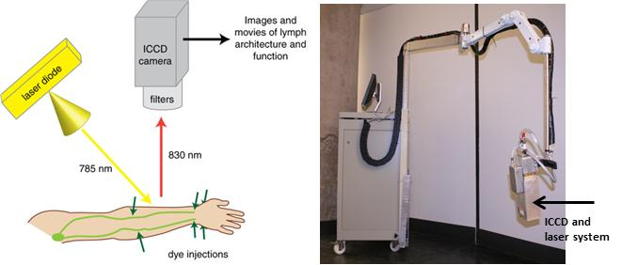
Schematic of NIRFLI operations
images and movies of lymph anatomy and function
ICCD camera
laser diode
filters
830 nm
785 nm
dye injections
Supplementary Fig. 1

