Slide 1
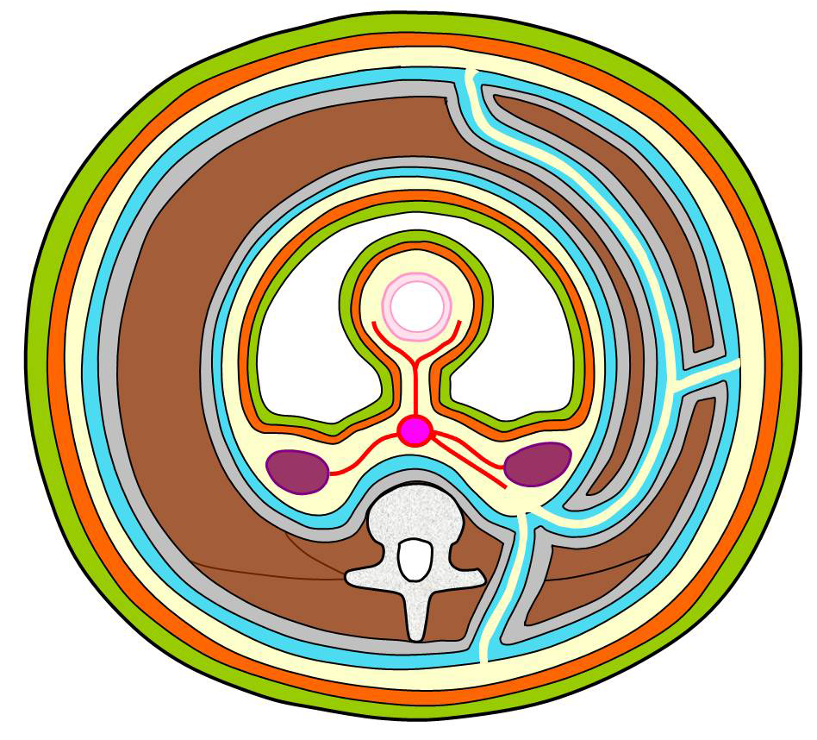
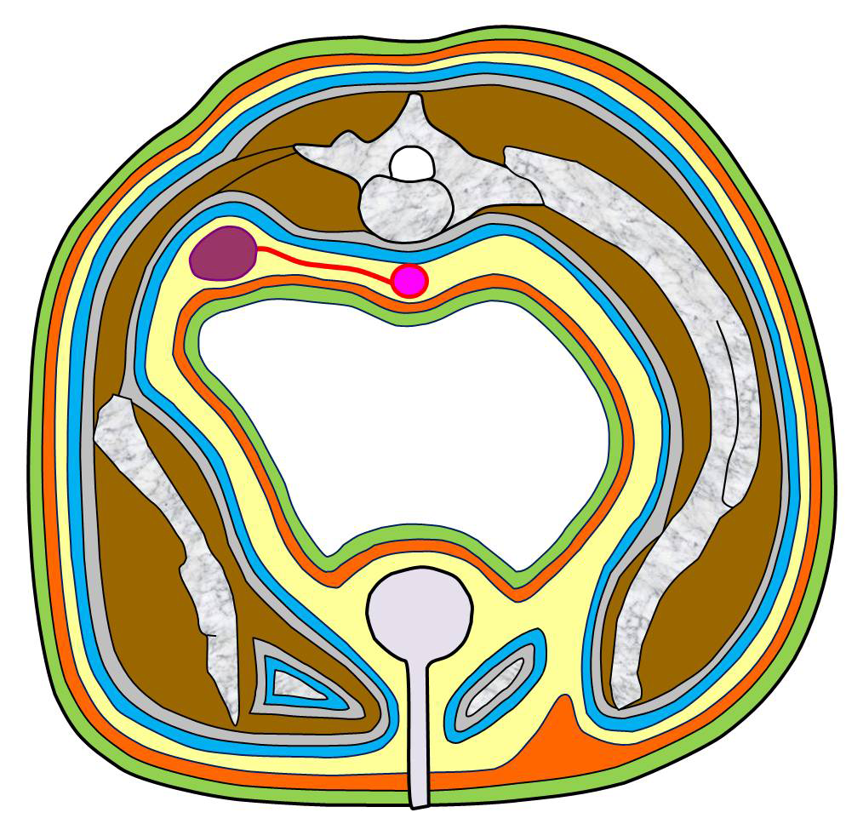
#1. “Interfascial spaces” advocated by Sato
A: Laminated structure of the fasciae in the abdominal trunk
Inner layer
Basic layers
Schema depicted with the
arteries of the abdominal wall
1. Peritoneum
Abdominal
muscles
2. Deep layer of the subperitoneal fascia
Yellow area
3. Superficial layer of the subperitoneal fascia
EA
4. Transversalis fascia
I
Outer layer
MA
Ao: Aorta
EA: Epigastric
artery
I: Intestine
K: Kidney
LA: Lumbar
artery
MA: Mesenteric
artery
RA: Renal artery
1’. Skin
K
RA
Ao
2’. Superficial layer of the subcutaneous fascia
Yellow area
3’. Deep layer the subcutaneous fascia
4’. Investing layer of the abdominalis fascia
Yellow area: interfascial spaces (neurovascular corridor)
LA
The body wall is formed with laminated layers. The structure, consisting of four layers, can be symmetrically
arranged between the external and internal sides of the abdominal trunk, like the rings on the cut surface of an onion.
Each area between layer #2 (2’) and #3 (3’) is the “interfascial space”, alias the “neurovascular corridor”, because
the interfascial spaces give passage to the main vessels and nerves.²⁶ The external interfascial space is the
superficial abdominal fascia as pointed out by Ishikawa. (Presented at the 35th annual meeting of JAAM in 2007.)
This figure was slightly revised by us.
B: Diagram showing the continuation of the fascial strata between the
abdomen and the pelvis
Upper right
Horizontal
section
Upper left
Horizontal
section
According to Sato, layer #2, the
deep layer of the subperitoneal
fascia, corresponds to the anterior
renal fascia, and layer #3, the
superficial layer of the subperitoneal
fascia, corresponds to the posterior
renal fascia.
Sato advocated that the kidney,
ureter, gonadal vessels, and iliac
vessels run within the interfascial
spaces sandwiched by the above
two layers and that the spaces in the
abdomen continue into the pelvis.
K
Ao
Ilium
Ureter
Gonadal artery,
iliac arteries
Urinary bladder
Acetabulum
Lower right
Coronal
section
Lower left
Coronal
section
Pubis
Clik!
Both panels A and B are cited from “Sato T. Fundamental plane of the fascial strata of the body wall. Igakunoayumi.
1980;114:C168-75. (in Japanese)” and reference #26 in the main text with permission from the copyright owner
(Tokyo Medical and Dental University, Tokyo, Japan). To our knowledge, it was Tobin who first advocated the
fascial continuation into the pelvis, corresponding to the combined interfascial plane, and denied the disappearance
of the renal fasciae halfway through the pelvis. (Tobin CE, Benjamin JA, Wells JC. Continuity of the fasciae lining
the abdomen, pelvis, and spermatic cord. Surg. Gynecol. Obstet.1946;83:575–96.)

