Slide 1
Caveolae-Mediated Endocytosis is Critical for Tumor Cell Albumin Endocytosis and Response to Albumin-Bound Chemotherapy
Moumita Chatterjee et al.
Supplementary Data

Slide 2
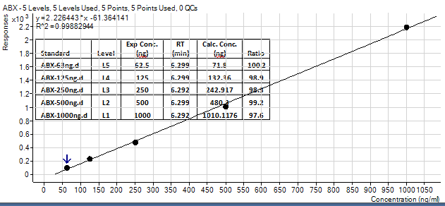
A
B
Supplementary Figure S1. A. Mass spectrometry signature of nab-paclitaxel, qualifier and quantifier ions selected. B. Standard curve which was used for quantifying the intracellular concentration of paclitaxel in nab-paclitaxel or paclitaxel-treated cells for mass spectrometry cytotoxicity assay experiments.

Slide 3
Cell Line | Cav-1 expression (F.I.U/µg) | nab-paclitaxel IC50(ng/ml)
MIAPaCa-2 | 53.24909 | 32.09
BxPC3 | 199.6836 | 40.35
Capan2 | 27.72773 | 71.96
AsPC-1 | 17.86797 | 136.1
HPAFII | 4.266862 | 1000
H23 | 48.35235 | 33.33
A549 | 82.7098 | 9.659
H1299 | 44.30801 | 51.11
H792 | 22.95091 | 148.1
H520 | 7.921807 | 57.79
F.I.U = Fluorescence Intensity Units
Supplementary Figure S2. Table of ten PC and NSCLC cell lines with relative Cav-1 expression in Fluorescence Intensity Units (F.I.U.) per microgram of protein and their corresponding IC₅₀ value for nab-paclitaxel (ng/ml).

Slide 4
Control MIAPaCa-2 cells
shCav-1 MIAPaCa-2 cells
Supplementary Figure S3. Transmission electron micrograph images showing near absence of caveolae along the plasma membrane in Cav-1 depleted (shCav-1) MIAPaCa-2 cells (bottompanel) compared to control (scrambled shRNA) MIAPaCa-2 cells (top panel). Images taken at 49000X. Arrows show caveolae along the plasma membrane in control cells.

Slide 5
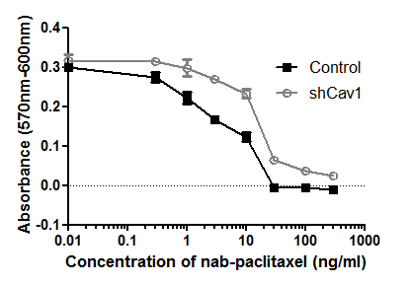
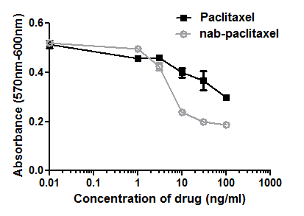
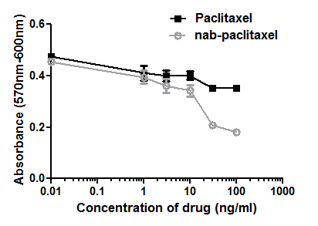
A.
BxPC3
B.
A549
*
*
*
*
*
*
*
*
*
*
C.
D.
MIAPaCa-2
H23
*
*
*
*
*
*
Supplementary Figure S4. A,B. Cytotoxicity assays with BxPC3 (A) and A549 (B) control (scramble) shRNA and Cav-1 shRNA stably transduced cells demonstrating that loss of Cav-1 sensitizes cells to nab-paclitaxel. C,D. Cytotoxicity assays comparing sensitivity of MIAPaCa-2 (C) and H23 (D) cells to nab-paclitaxel and free paclitaxel demonstrating that cells are more sensitive to nab-paclitaxel.

Slide 6
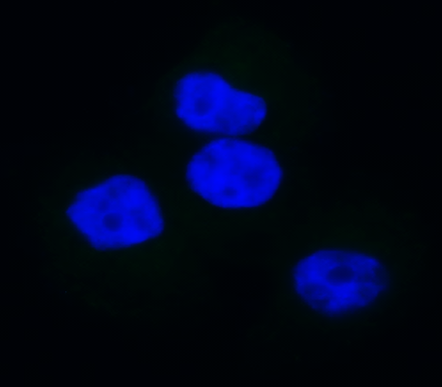
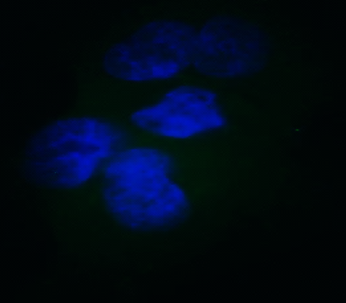
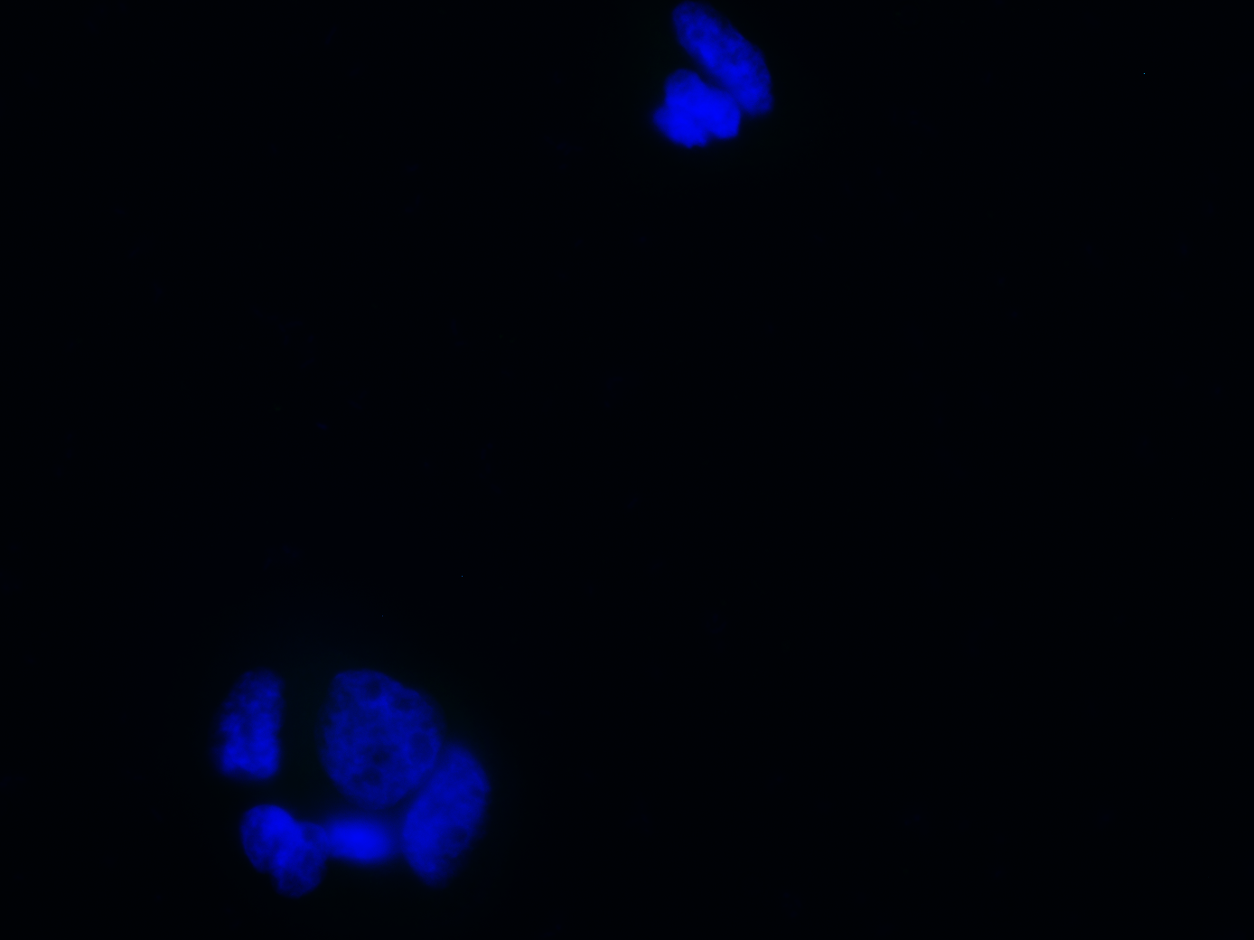
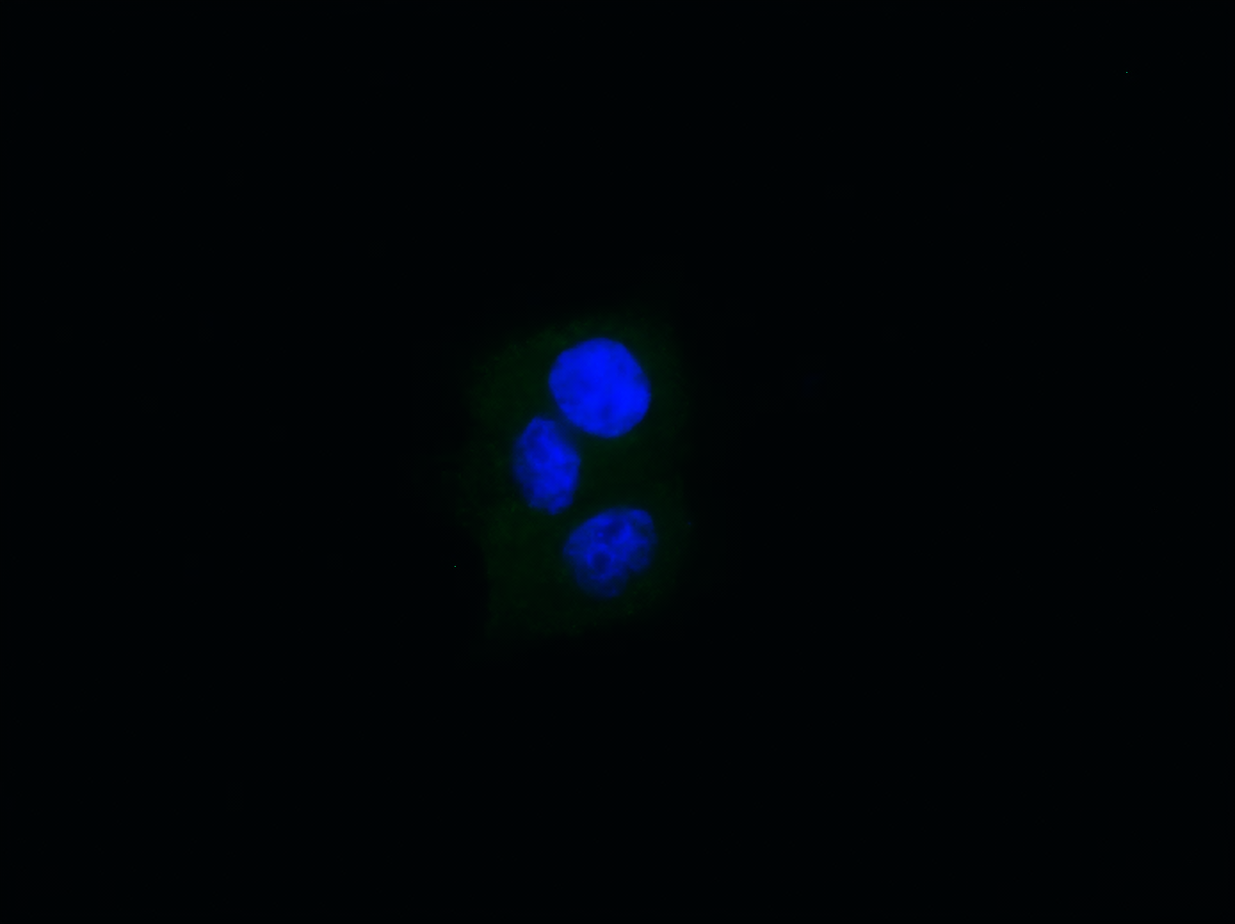
A.
Control HPAFII
Control HPAFII + Albumin
DAPI
Albumin
DAPI
Albumin
B.
Control AsPC1
Control AsPC1 + Albumin
DAPI
Albumin
DAPI
Albumin
Supplementary Figure S5. A,B. Confocal immunofluorescence images showing minimal uptake of 0.5% (w/v) human serum albumin in control HPAFII (A) and AsPC1 (B) cells.

