Slide 1
Supplementary data
Therapy response testing on 3D Breast cancer in a perfused microfluidic platform
Table S1. Culture conditions for the breast cancer cell lines used.

Slide 2
Table S2. Statistical analysis of culture condition studies in Figure 2 using Tukey’s multiple comparisons test from GraphPad version 6. Abbreviations: mg – Matrigel®, col I – collagen I, 10e6 and 20e6 – seeding densities at 10x10⁶ and 20x10⁶ cells/ml respectively, flow - perfusion.
Tukey's multiple comparisons test
MDA-MB-453 static vs flow | Significant? | Summary | Adjusted P Value
Seeding density (10e6 vs 20e6, same ECM, same culture condition)
mg static:10e6 vs. mg static:20e6 | No | ns | > 0.9999
bme2rgf static:10e6 vs. bme2rgf static:20e6 | No | ns | 0.7309
col I static:10e6 vs. col I static:20e6 | No | ns | 0.9994
mg flow:10e6 vs. mg flow:20e6 | No | ns | 0.8441
bme2rgf flow:10e6 vs. bme2rgf flow:20e6 | Yes | ** | 0.0031
col I flow:10e6 vs. col I flow:20e6 | No | ns | > 0.9999
Culture condition (Static vs Flow, same ECM, same seeding density)
mg static:10e6 vs. mg flow:10e6 | Yes | *** | 0.0001
bme2rgf static:10e6 vs. bme2rgf flow:10e6 | Yes | **** | < 0.0001
col I static:10e6 vs. col I flow:10e6 | No | ns | 0.9968
mg static:20e6 vs. mg flow:20e6 | Yes | *** | 0.0006
bme2rgf static:20e6 vs. bme2rgf flow:20e6 | Yes | *** | 0.0003
col I static:20e6 vs. col I flow:20e6 | No | ns | 0.7093
ECM (same culture condition, same seeding density)
mg static:10e6 vs. bme2rgf static:10e6 | No | ns | 0.9998
mg static:10e6 vs. col I static:10e6 | No | ns | 0.9574
bme2rgf static:10e6 vs. col I static:10e6 | No | ns | 0.9998
mg static:20e6 vs. bme2rgf static:20e6 | No | ns | 0.781
mg static:20e6 vs. col I static:20e6 | No | ns | 0.9084
bme2rgf static:20e6 vs. col I static:20e6 | No | ns | > 0.9999
mg flow:10e6 vs. bme2rgf flow:10e6 | No | ns | > 0.9999
mg flow:10e6 vs. col I flow:10e6 | Yes | **** | < 0.0001
bme2rgf flow:10e6 vs. col I flow:10e6 | Yes | **** | < 0.0001
mg flow:20e6 vs. bme2rgf flow:20e6 | No | ns | 0.6741
mg flow:20e6 vs. col I flow:20e6 | Yes | **** | < 0.0001
bme2rgf flow:20e6 vs. col I flow:20e6 | No | ns | 0.2008

Slide 3
Table S3. Statistical analysis of compound screening studies in Figure 3 using Tukey’s multiple comparisons test generated from GraphPad version 6. Abbreviations: mg – Matrigel®, col I – collagen I, 10e6 and 20e6 – seeding densities at 10x10⁶ and 20x10⁶ cells/ml respectively, flow - perfusion.
Tukey's multiple comparisons test | Significant? | Summary | Adjusted P Value
HCC1937 vs MDA-MB-231 vs MDA-MB-453
Seeding density (10e6 vs 20e6, same ECM, same cell type)
mg HCC1937:10e6 vs. mg HCC1937:20e6 | Yes | **** | < 0.0001
bme2rgf HCC1937:10e6 vs. bme2rgf HCC1937:20e6 | Yes | *** | 0.0004
col I HCC1937:10e6 vs. col I HCC1937:20e6 | No | ns | > 0.9999
mg MDA-MB-231:10e6 vs. mg MDA-MB-231:20e6 | No | ns | > 0.9999
bme2rgf MDA-MB-231:10e6 vs. bme2rgf MDA-MB-231:20e6 | Yes | **** | < 0.0001
col I MDA-MB-231:10e6 vs. col I MDA-MB-231:20e6 | No | ns | > 0.9999
mg MDA-MB-453:10e6 vs. mg MDA-MB-453:20e6 | No | ns | 0.9995
bme2rgf MDA-MB-453:10e6 vs. bme2rgf MDA-MB-453:20e6 | No | ns | 0.3193
col I MDA-MB-453:10e6 vs. col I MDA-MB-453:20e6 | No | ns | > 0.9999
ECM (same cell type, same seeding density)
mg HCC1937:10e6 vs. bme2rgf HCC1937:10e6 | No | ns | 0.7068
mg HCC1937:10e6 vs. col I HCC1937:10e6 | Yes | ** | 0.0053
bme2rgf HCC1937:10e6 vs. col I HCC1937:10e6 | No | ns | 0.8212
mg HCC1937:20e6 vs. bme2rgf HCC1937:20e6 | No | ns | > 0.9999
mg HCC1937:20e6 vs. col I HCC1937:20e6 | No | ns | 0.6537
bme2rgf HCC1937:20e6 vs. col I HCC1937:20e6 | No | ns | 0.88
mg MDA-MB-231:10e6 vs. bme2rgf MDA-MB-231:10e6 | No | ns | > 0.9999
mg MDA-MB-231:10e6 vs. col I MDA-MB-231:10e6 | No | ns | > 0.9999
bme2rgf MDA-MB-231:10e6 vs. col I MDA-MB-231:10e6 | No | ns | > 0.9999
mg MDA-MB-231:20e6 vs. bme2rgf MDA-MB-231:20e6 | Yes | **** | < 0.0001
mg MDA-MB-231:20e6 vs. col I MDA-MB-231:20e6 | No | ns | > 0.9999
bme2rgf MDA-MB-231:20e6 vs. col I MDA-MB-231:20e6 | Yes | *** | 0.0001
mg MDA-MB-453:10e6 vs. bme2rgf MDA-MB-453:10e6 | No | ns | > 0.9999
mg MDA-MB-453:10e6 vs. col I MDA-MB-453:10e6 | Yes | ** | 0.0015
bme2rgf MDA-MB-453:10e6 vs. col I MDA-MB-453:10e6 | Yes | *** | 0.0002
mg MDA-MB-453:20e6 vs. bme2rgf MDA-MB-453:20e6 | No | ns | 0.9969
mg MDA-MB-453:20e6 vs. col I MDA-MB-453:20e6 | No | ns | 0.0739
bme2rgf MDA-MB-453:20e6 vs. col I MDA-MB-453:20e6 | No | ns | 0.9238
Cell Type (same ECM, same seeding density)
mg HCC1937:10e6 vs. mg MDA-MB-231:10e6 | No | ns | 0.9045
mg HCC1937:10e6 vs. mg MDA-MB-453:10e6 | No | ns | 0.6039
mg MDA-MB-231:10e6 vs. mg MDA-MB-453:10e6 | No | ns | > 0.9999
mg HCC1937:20e6 vs. mg MDA-MB-231:20e6 | Yes | **** | < 0.0001
mg HCC1937:20e6 vs. mg MDA-MB-453:20e6 | Yes | **** | < 0.0001
mg MDA-MB-231:20e6 vs. mg MDA-MB-453:20e6 | No | ns | > 0.9999
bme2rgf HCC1937:10e6 vs. bme2rgf MDA-MB-231:10e6 | Yes | *** | 0.0006
bme2rgf HCC1937:10e6 vs. bme2rgf MDA-MB-453:10e6 | Yes | **** | < 0.0001
bme2rgf MDA-MB-231:10e6 vs. bme2rgf MDA-MB-453:10e6 | No | ns | > 0.9999
bme2rgf HCC1937:20e6 vs. bme2rgf MDA-MB-231:20e6 | No | ns | 0.0717
bme2rgf HCC1937:20e6 vs. bme2rgf MDA-MB-453:20e6 | Yes | **** | < 0.0001
bme2rgf MDA-MB-231:20e6 vs. bme2rgf MDA-MB-453:20e6 | No | ns | 0.1378
col I HCC1937:10e6 vs. col I MDA-MB-231:10e6 | Yes | **** | < 0.0001
col I HCC1937:10e6 vs. col I MDA-MB-453:10e6 | No | ns | 0.436
col I MDA-MB-231:10e6 vs. col I MDA-MB-453:10e6 | Yes | *** | 0.0005
col I HCC1937:20e6 vs. col I MDA-MB-231:20e6 | Yes | **** | < 0.0001
col I HCC1937:20e6 vs. col I MDA-MB-453:20e6 | No | ns | 0.1283
col I MDA-MB-231:20e6 vs. col I MDA-MB-453:20e6 | Yes | * | 0.0116

Slide 4
Figure S1. Raw data: Array of phase contrast, fluorescent live/dead images of the breast cancer subgroups MDA-MB-453, MDA-MB-231 and HCC 1937 cultured in 3D perfusion culture. (NucBlue® and microfluidic autofluorescence – blue, calcein AM – green, NucRed® – red) Chips marked with an asterix were excluded from analysis due to a pipetting error.
MDA-MB-453
Matrigel BME2rgf Collagen I
Matrigel BME2rgf Collagen I
*
*
MDA-MB-231
HCC 1937
Matrigel BME2rgf Collagen I
Matrigel BME2rgf Collagen I
Matrigel BME2rgf Collagen I
Matrigel BME2rgf Collagen I
*
Notes:
032-003

Slide 5
Figure S2. RealTime-GloTM (RTG) assay optimization for (A) HCC1937 and (B) MDA-MB-231 in the OrganoPlate® for day 0 and day 7 culture . For day 7, chips that were used on day 0 were also compared with unused chips (no RTG).
HCC1937 or MDA-MB-231 in matrigel, 5%CO2
Day 0 seeding, RTG
Day 7, RTG
Rocker: 8min, 7°
Continuous, bidirectional flow
A
B
  The goal of this optimization study is to check seeding density range for the linearity of the RealTime-GloTM (RTG, Promega) assay at day 0 and after 7 days of culture. For HCC1937, during the linear phase of the RTG signal (10-30min after addition RTG reagent), a linear signal dependent on seeding density is detected. Best linearity is 15 min after reagent addition. High seeding densities deplete the substrate early after addition. Best linearity is 10 min after addition. For MDA-MB-231, During the linear phase of the RTG signal (top graph, 10-35min after addition RTG reagent), a linear signal dependent on seeding density is detected. Best linearity is 30 min after reagent addition.

Slide 6
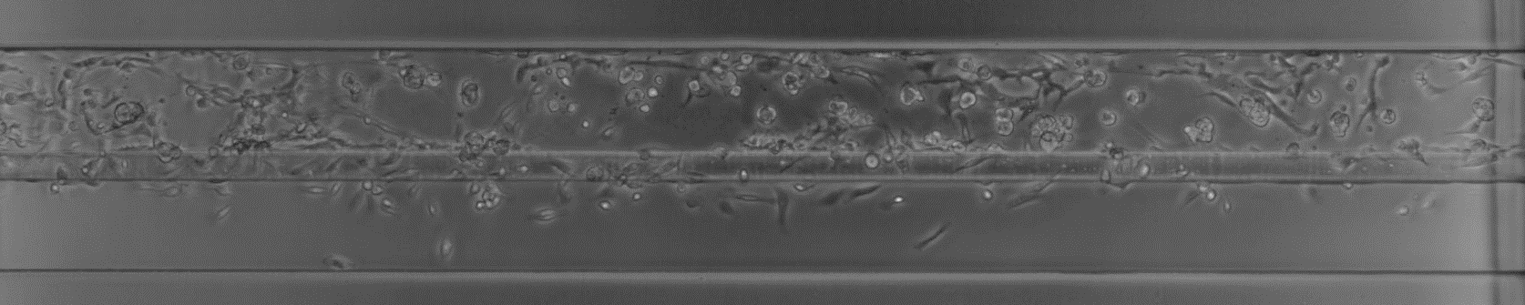
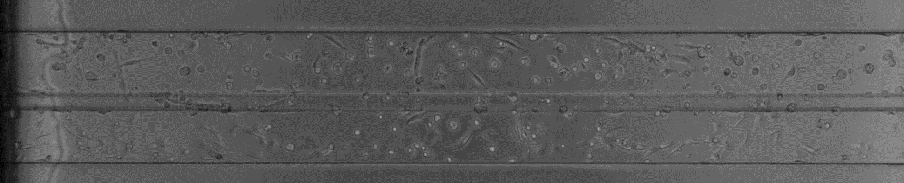
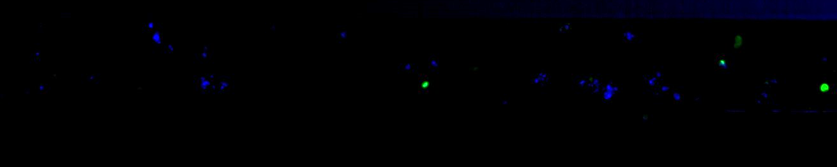
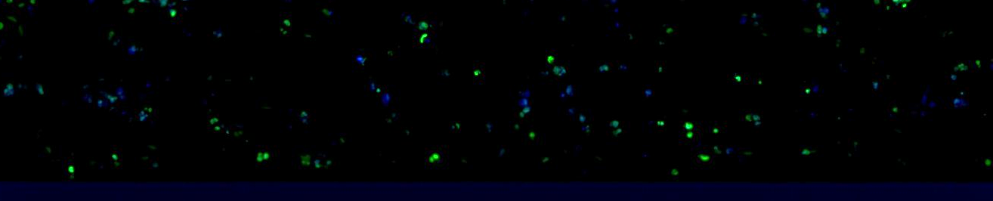
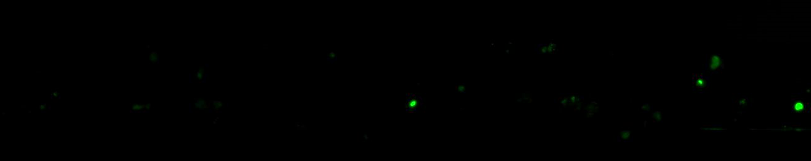
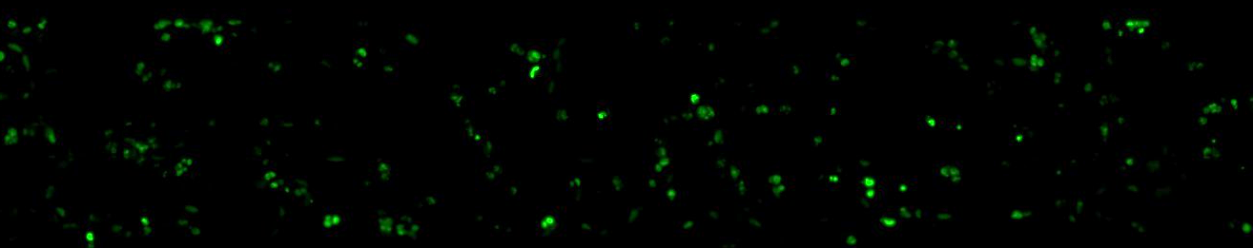

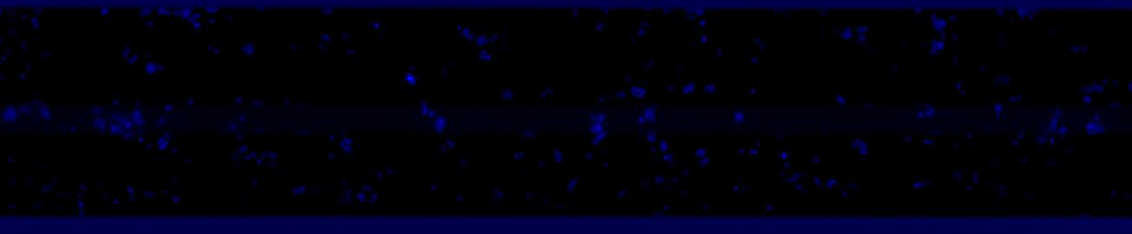
Figure S3. MDA-MB-231 were cultured for 1 day in matrigel prior to 48h 100µM cisplatin exposure in the OrganoPlate®. Cells were fixed and DNA damage was visualized by staining for phosphorylated H2A.X (green). DNA was visualised by Hoechst staining (blue). Cancer cells exposed to cisplatin showed an increase in DNA damage marker expression.
0 µM cisplatin
100 µM cisplatin
DNA phospho-H2A.X
phospho-H2A.X
DNA

