Slide 1
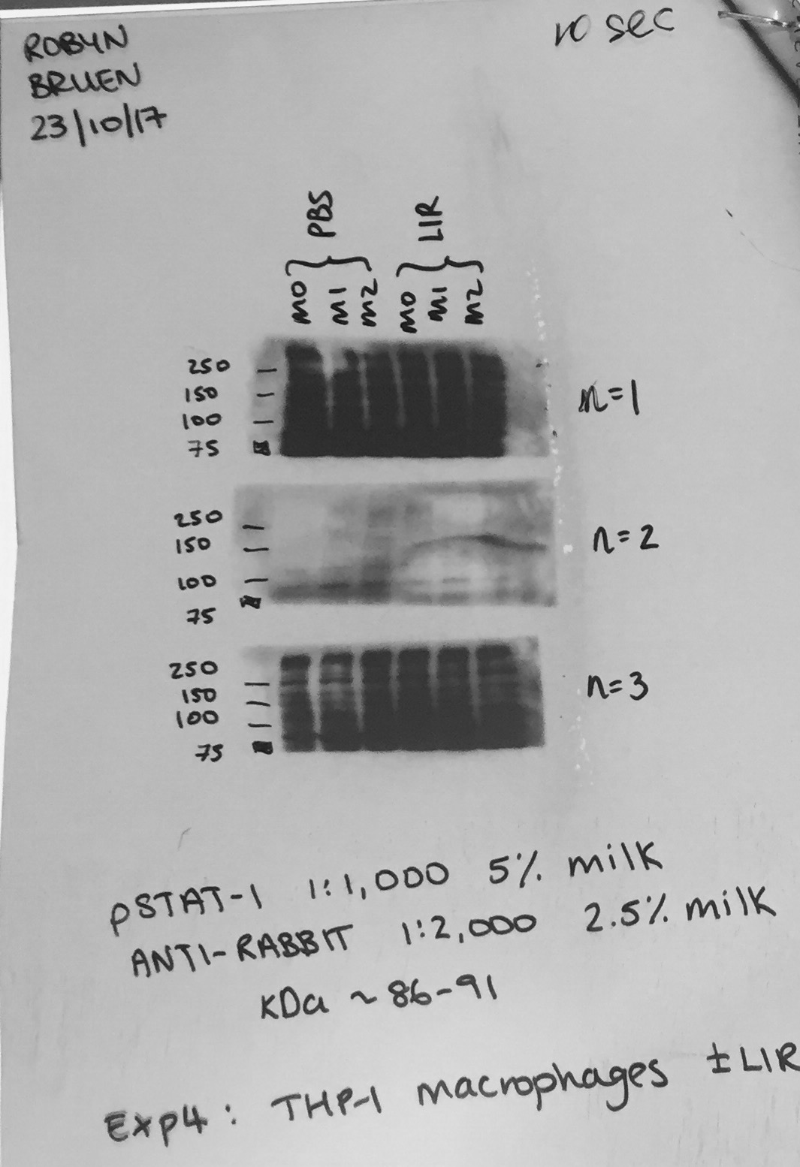
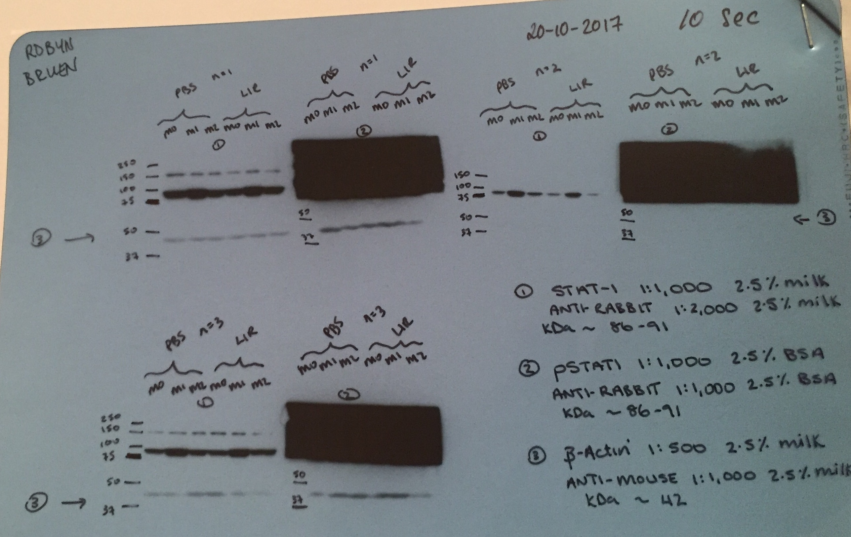
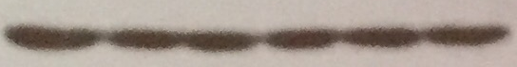
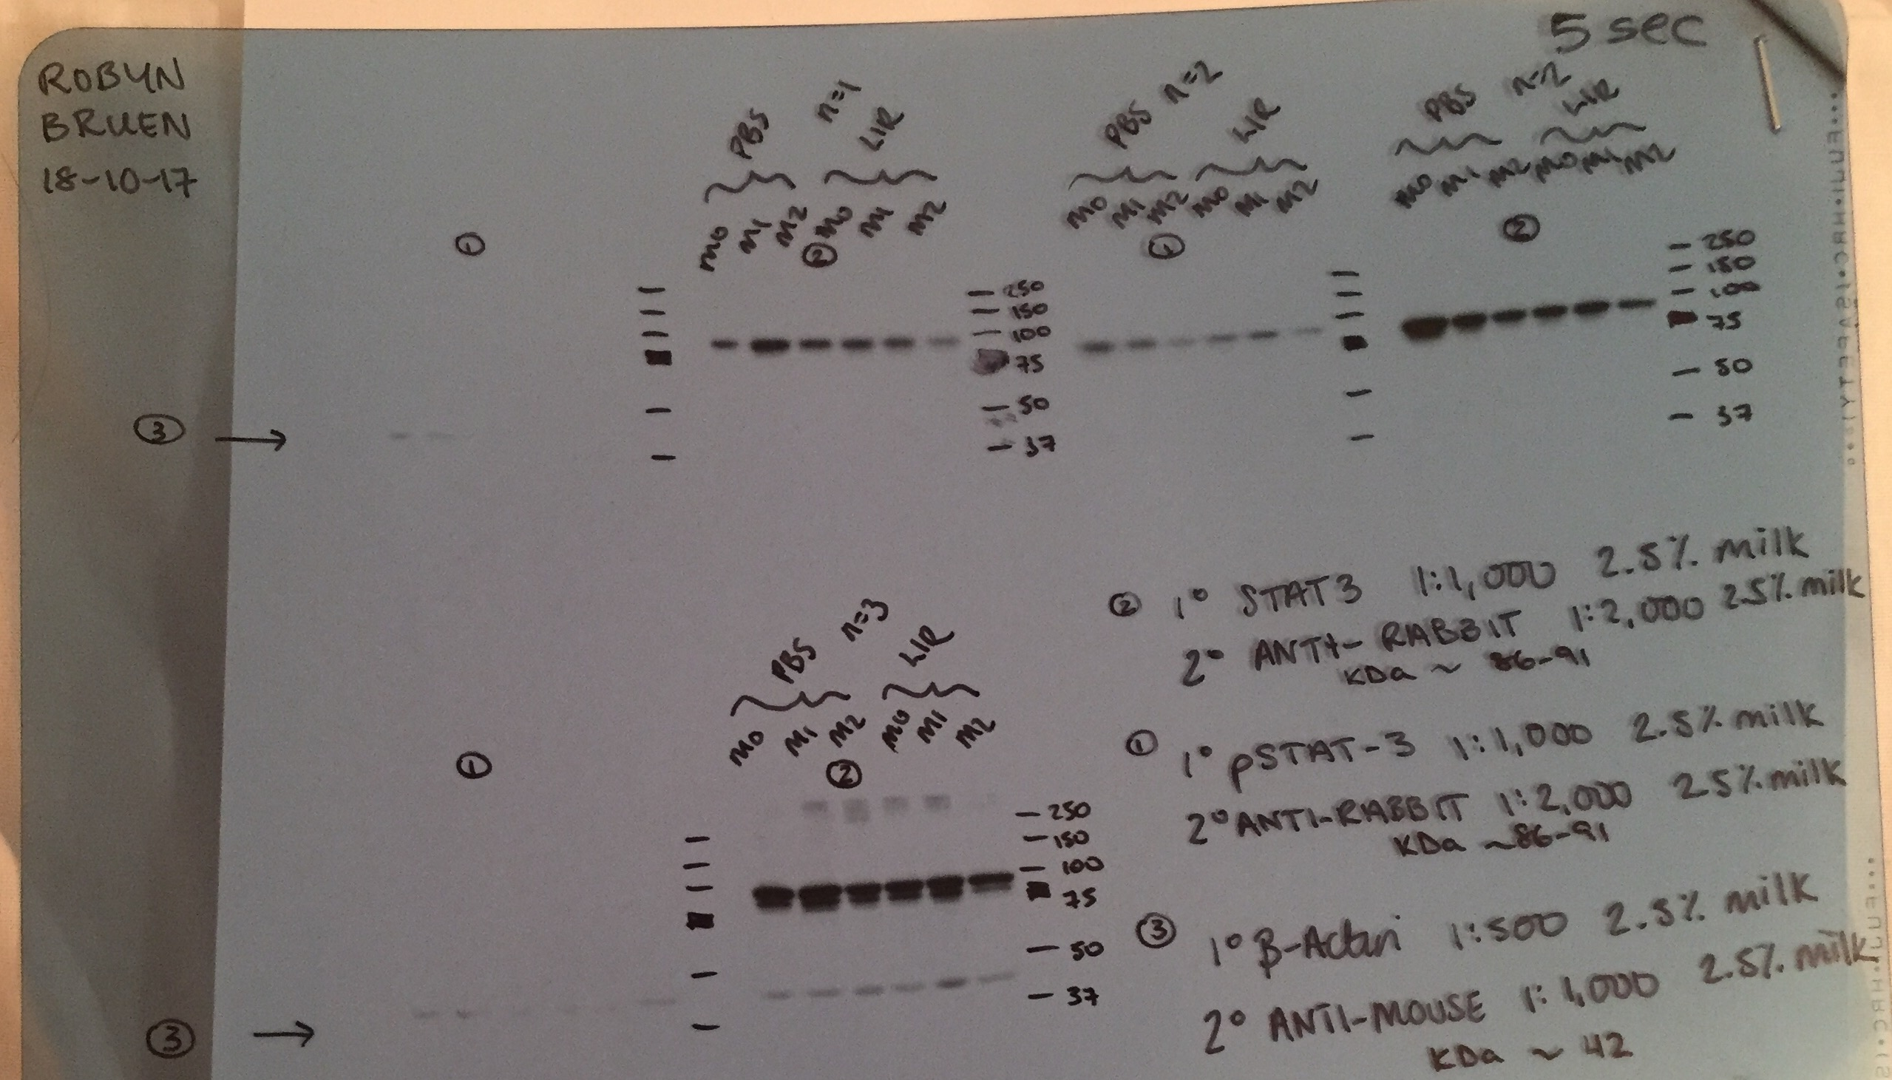
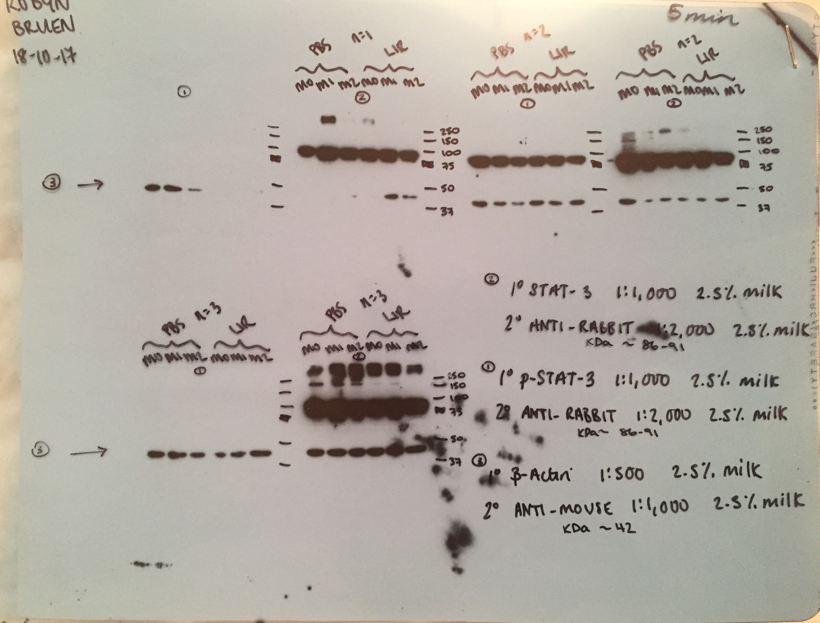
Lir
-
-
-
+
+
+
p-STAT1
86-91 kDa
STAT1
86-91 kDa
β-actin
42 kDa
STAT3
86-91 kDa
β-actin
42 kDa
M0
M1
M2
M0
M1
M2
Figure S1

