Slide 1
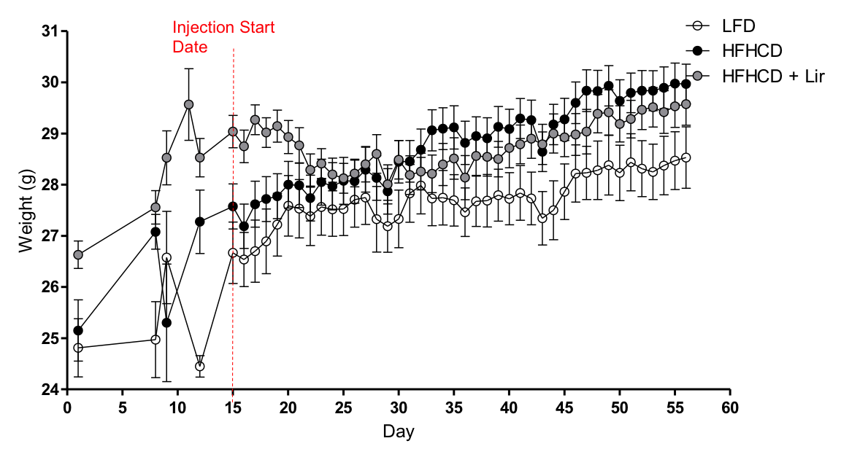
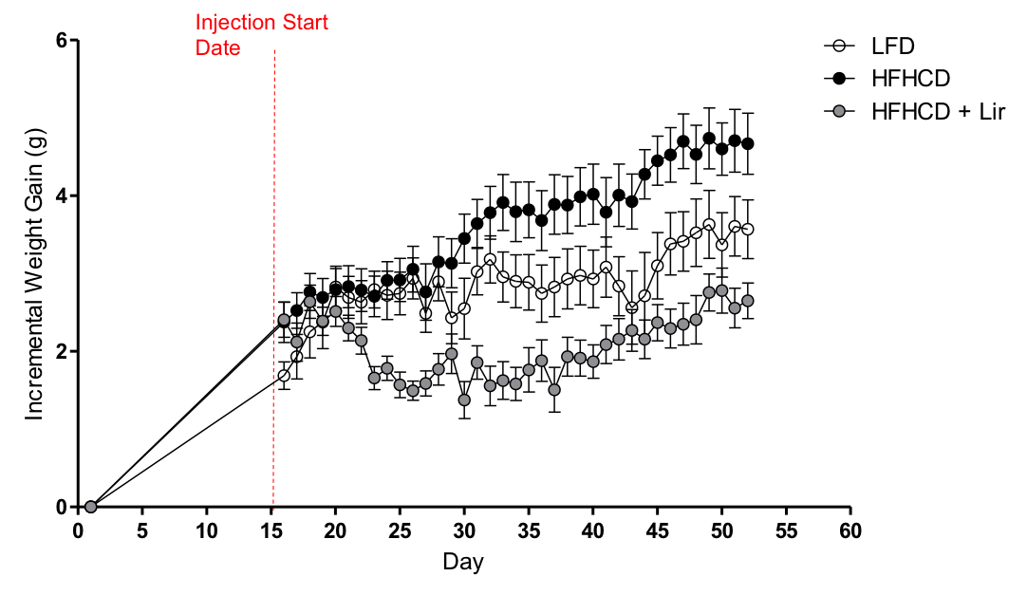
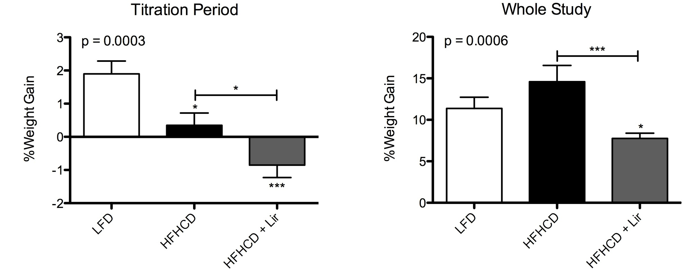
A
B
p = 0.0010
HFHCD vs. HFHCD+Lir ***
p = 0.1302
C
D
Figure S4

