Slide 1
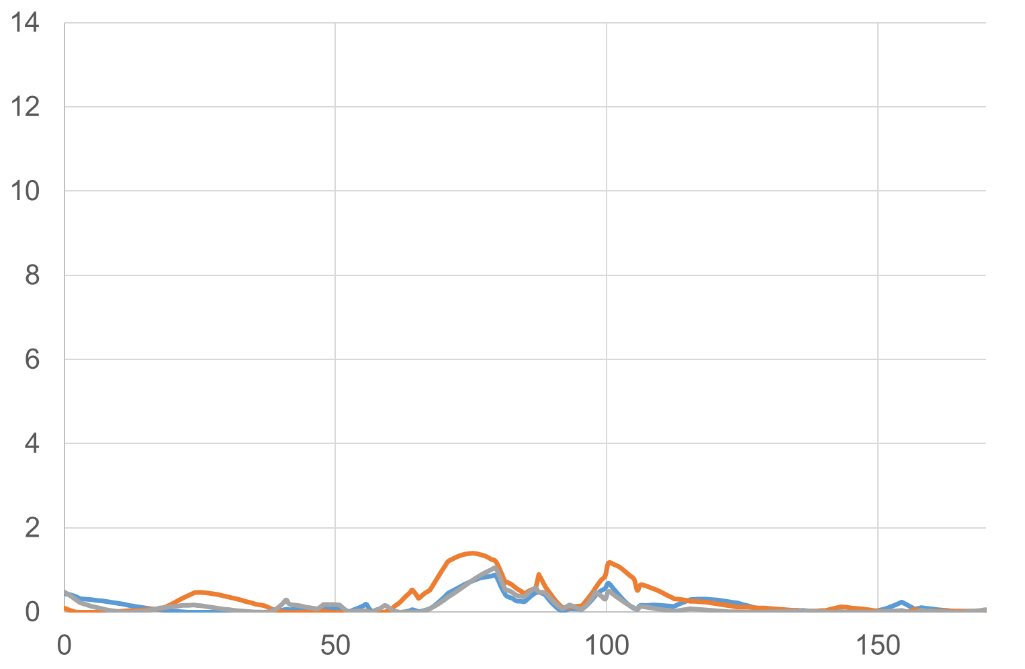
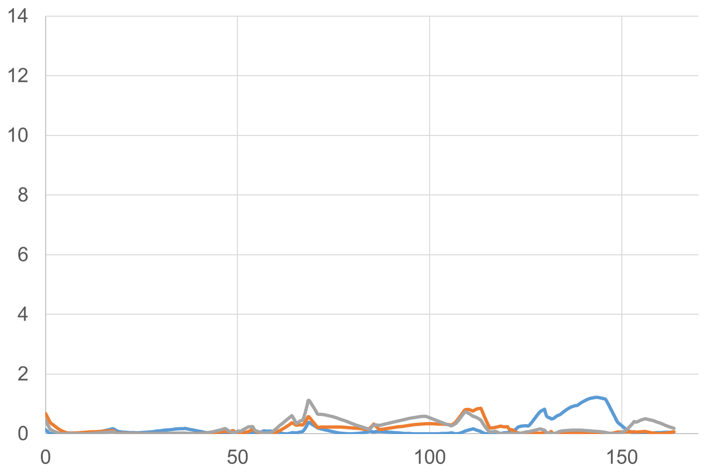
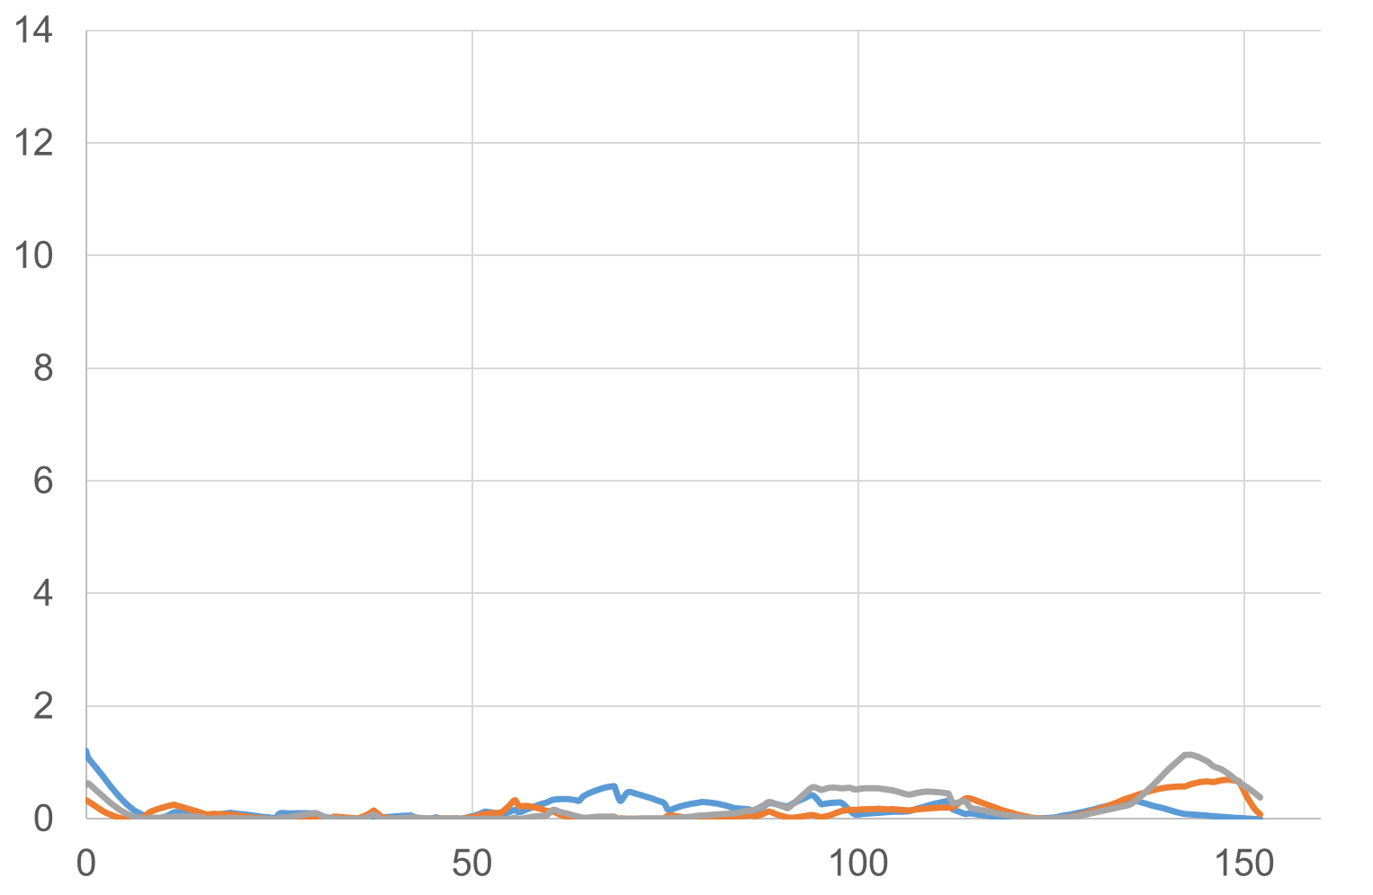
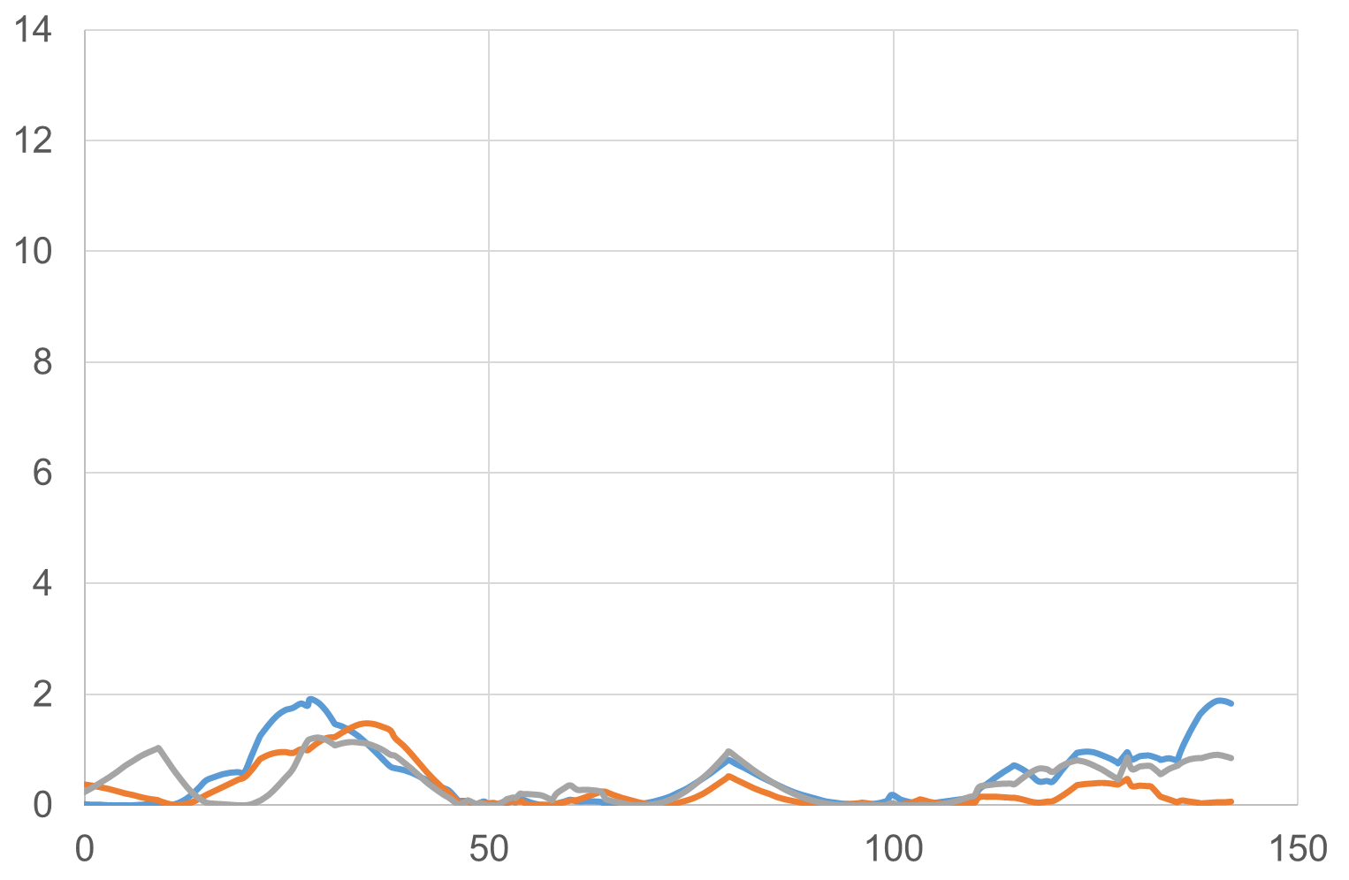
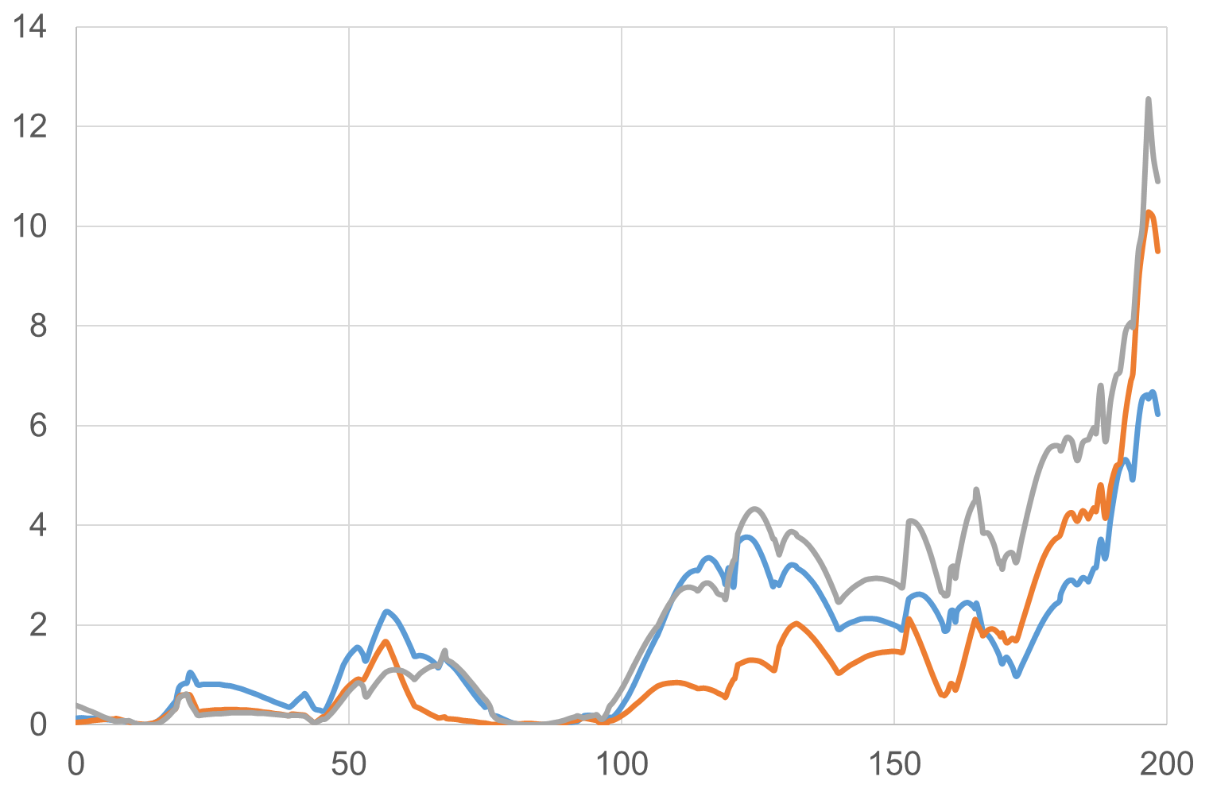
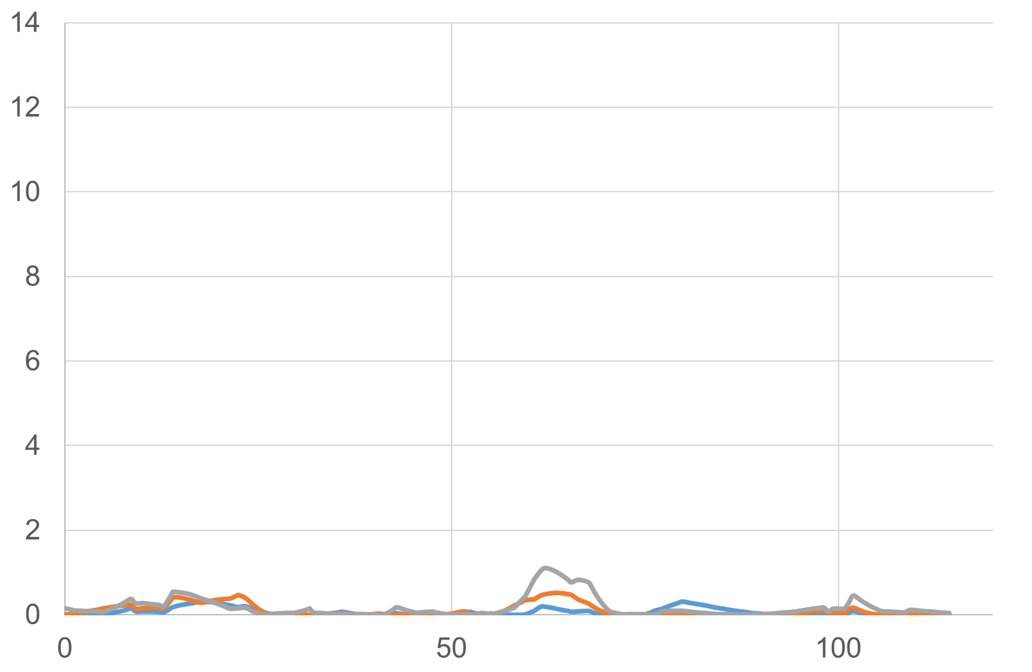
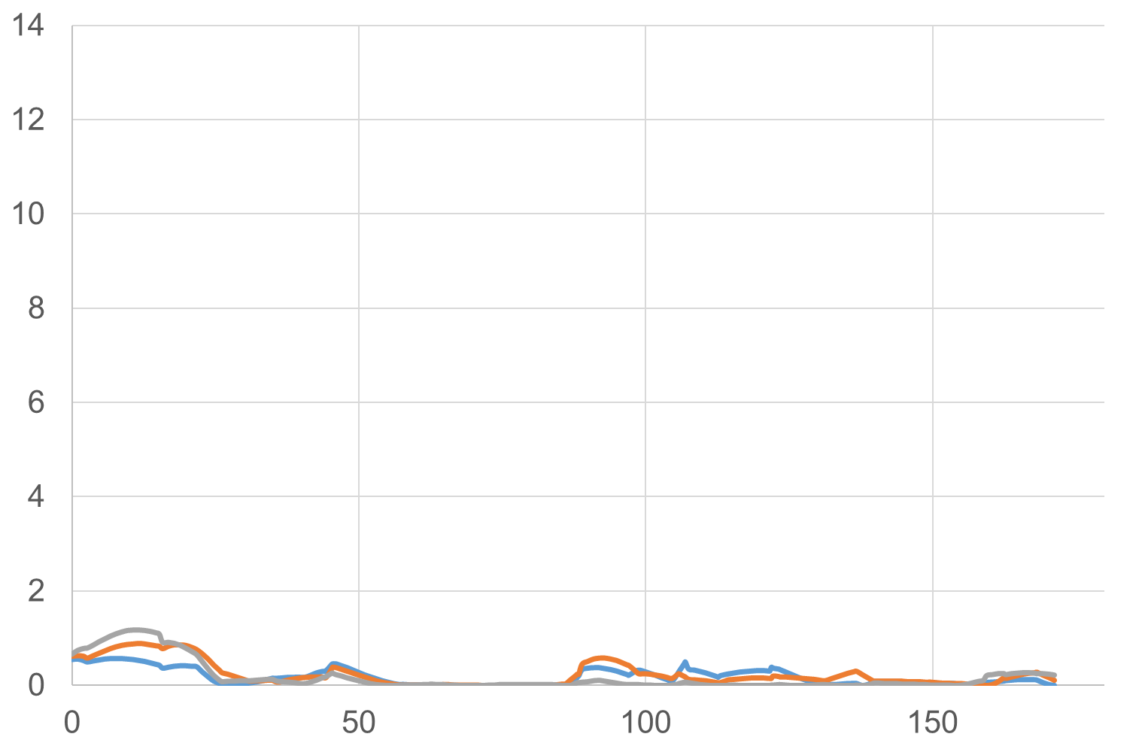
1H
2H
3H
LOD
LOD
LOD
cM
cM
Qsd2-OK
cM
4H
5H
6H
LOD
LOD
Qsdw-5H
LOD
Qsd1-OK
cM
cM
cM
7H
LOD
FIGURE S1| Grain dormancy QTL analysis of the RILs. The germination tests were performed using samples harvested in 2010, 2011, and 2013. Blue line, 2010; orange line, 2011; gray line, 2013. LOD: logarithm of odds. cM: centiMorgan. Blue arrows indicate the detected QTL positions.
cM

